Slide 1
Complete Partition Problem

Slide 2
What is complete partition problem?
The "partition problem", or number partitioning, is the task of deciding whether a given set S of positive integers can be partitioned into two subsets S1 and S2 such that the sum of the numbers in S1 equals the sum of the numbers in S2.
Example: A set S with 6 elements
3
1
1
2
2
1
1
1
2
3
Solution:
1st way:
2nd way:
1
2
3
1
1
2
2
1

Slide 3
Algorithms solving complete partition problem
01
02
03
BRUTE FORCE
TOP DOWN DYNAMIC
BOTTOM UP DYNAMIC
Problem: Given a set of integer numbers, return true if the set can be partitioned into two sets with equal sum, if not then return false

Slide 4
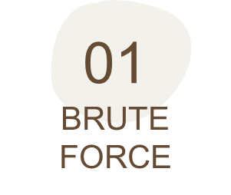
Try all combinations of partitioning the given numbers into two sets to see if any pair of sets has an equal sum.
->The problem is reduced to find a subset whose sum is S/2
for each x create
*a new set which INCLUDES x, if sum < S/2, recursively process the remaining numbers
*create a new set WITHOUT number x, and recursively process the remaining numbers
return true if any of the above sets has a sum equal to 'S/2', otherwise return false

Slide 5
Example
Without 3
Without 1
Without 1
Without 1
Without 1
Without 1
Without 1
The sum is 10, we need to find subset which sums up to 5
3
1
1
2
2
1
3
1
1
1
1
1
1
We got a subset with sum 5, so return True

Slide 6
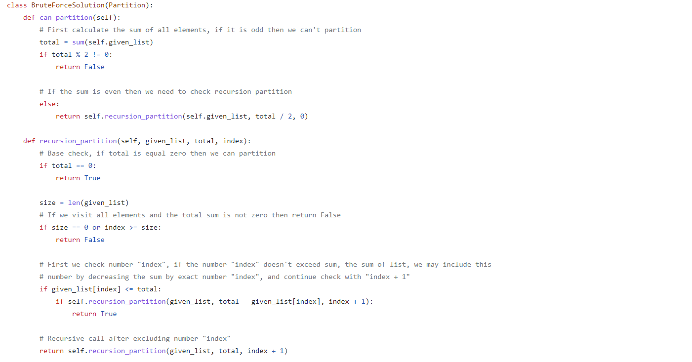
Code

Slide 7
Time Complexity:
The time complexity of the brute force is exponential O(2^{n}), where ‘n’ represents the total number.
The space complexity is O(n)

Slide 8
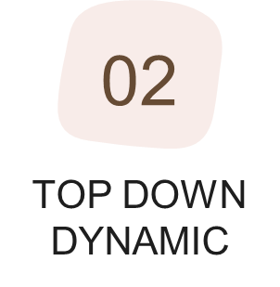
We can use memorization to reduce the overlapping sub-problems.
Since we need to store the results for every subset and for every possible sum, therefore we will be using a two-dimensional array to store the results of the solved sub-problems.
The first dimension of the array will represent different subsets and the second dimension will represent different ‘sums’ that we can calculate from each subset.
-> The approach is the same as brute force solution but we save the result of any sub process.

Slide 9
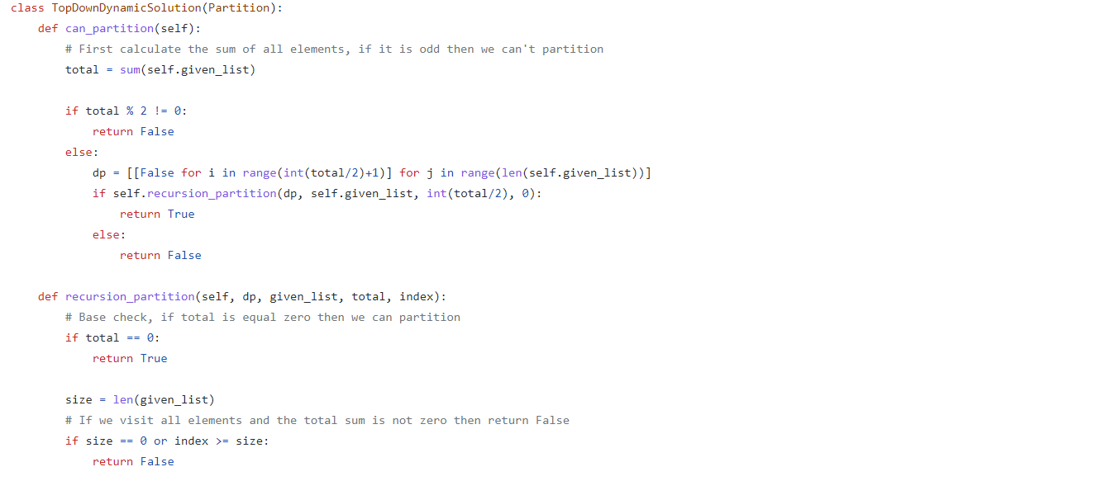
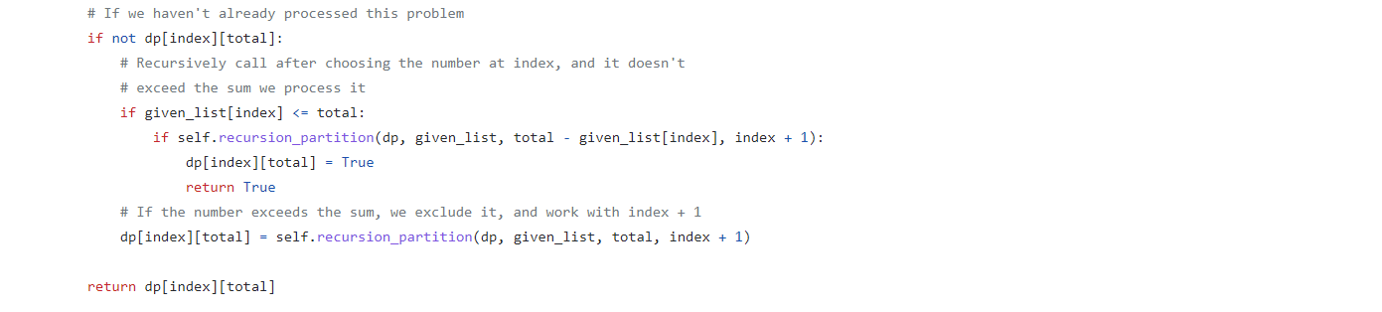
Code

Slide 10
Time Complexity:
The above algorithm has time and space complexity of O(N*S), where ‘N’ represents total numbers and ‘S’ is the total sum of all the numbers.

Slide 11
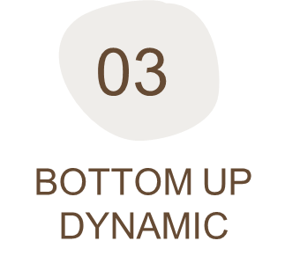
So, for each number at index i and sum s, we have two options:
Exclude the number. In this case, we will see if we can get ‘s’ from the subset excluding this number: dp[i-1][s]
Include the number if its value is not more than ‘s’. In this case, we will see if we can find a subset to get the remaining sum: dp[i-1][s-num[i]]
If either of the two above scenarios is true, we can find a subset of numbers with a sum equal to ‘s’.

Slide 12
Example
Sum
Number
The sum is 10, we need to find subset which sums up to 5
3
1
1
2
2
1
'0' sum can always be found through an empty set
This mean we can partition the set into two equal subsets
0 1 2 3 4 5
3
T
F
F
T
F
F
With only one number, we can form a subset only when the required sum is equal to its value
{3, 1}
T
T
F
T
T
F
sum: 1, index:1=> (dp[index-1][sum] || dp[index-1][sum-1])
we don’t add 1 we add 1
{3, 1, 1}
T
T
T
T
T
T
sum: 2, index:1=> (dp[index-1][sum] || dp[index-1][sum-1])
we don’t add 1 we add 1
{3, 1, 1, 2}
T
T
T
T
T
T
sum: 3, index:1=> (dp[index-1][sum] || dp[index-1][sum-1])
we don’t add 1 we add 1
{3, 1, 1, 2, 2}
T
T
T
T
T
T
sum: 4, index:1=> (dp[index-1][sum] || dp[index-1][sum-1])
we don’t add 1 we add 1
{3, 1, 1, 2, 2, 1}
T
T
T
T
T
T
sum: 5, index:1=> (dp[index-1][sum] || dp[index-1][sum-1])
we don’t add 1 we add 1
Note: If number[index] > sum then we will not add this number so dp[index][sum] = dp[index –1][sum]

Slide 13
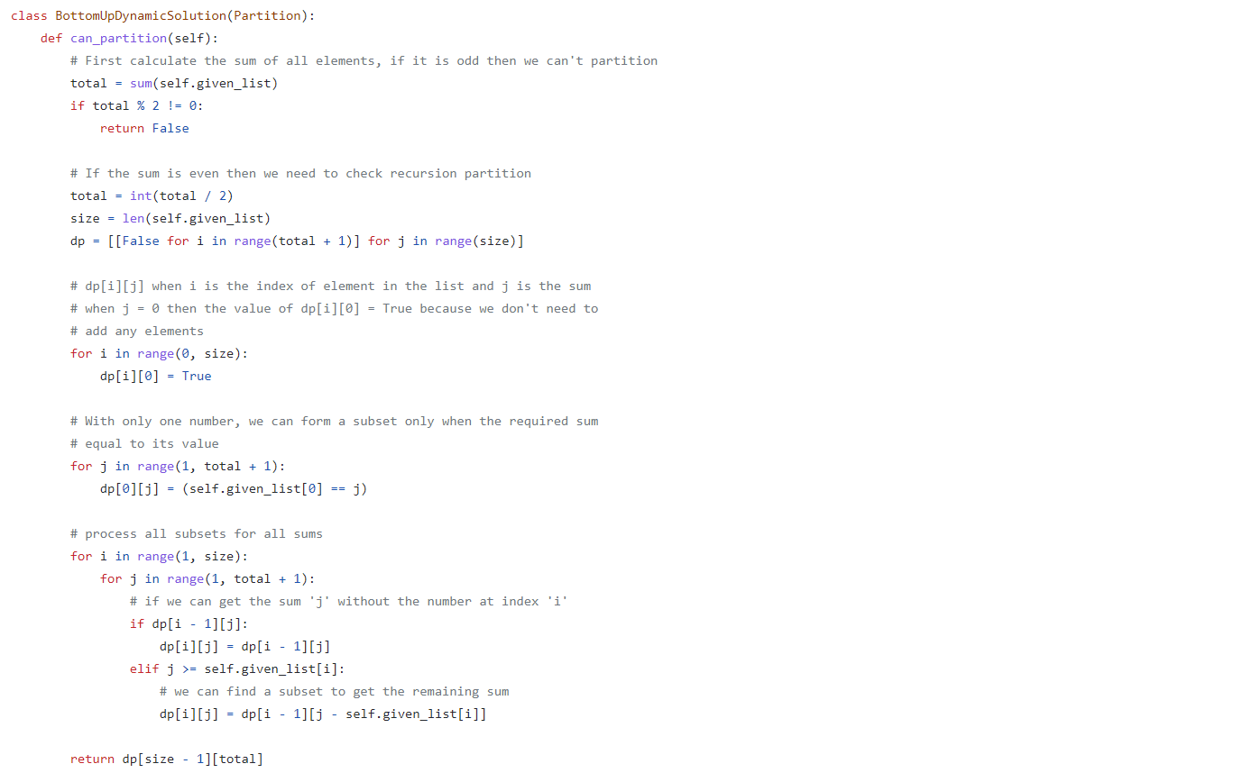
Code

Slide 14
Time Complexity:
The above algorithm has time and space complexity of O(N*S), where ‘N’ represents total numbers and ‘S’ is the total sum of all the numbers.

Slide 15
THANKS!
Does anyone have any questions?

