Slide 1
Benchmark different fully-connected NN architectures in predicting minor allele frequencies
tar -czvf archive.tar.gz /path/to/folder
Ha Vu’s sample code
05/26/2023

Slide 2
First: get the sample data to use this sample_code
Clone the sample repository: https://github.com/havu73/sample_code.git
cd into the sample_code folder
Run download_data.sh → data folder is created

Slide 3
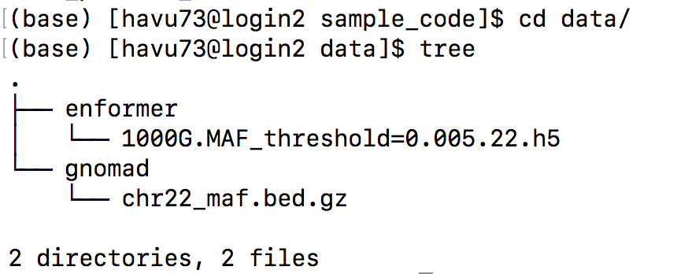
Background
Enformer is a transformer-based model that predicts ChiP-seq/DNAse-seq signals from long DNA sequences (~100kb).
Given data of Enformer (predictions of signals in 5313 ChiP-seq/DNAse-seq experiments at regions overlapping a genetic variant) → predict minor allele frequencies of the variants
Supervised prediction task
Example input data
(inside data folder of the shared Github):

Slide 4
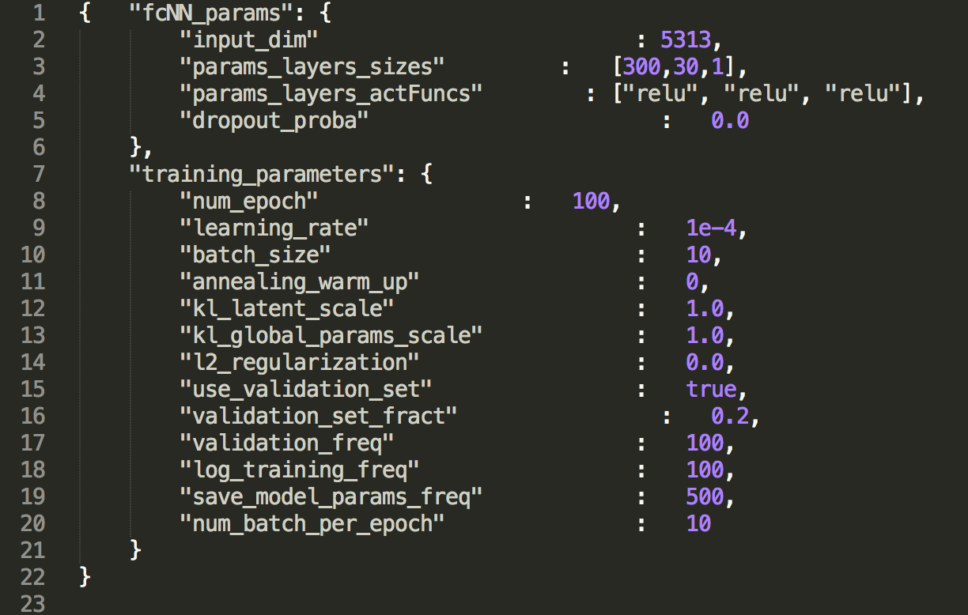
Goal
Given the prediction task (Enformer --> MAF), do a hyperparameters search for fully connected neural networks (FCNN).
Training parameters are specified in file model_config.json
Parameters we will vary in the sample code: params_layers_sizes and params_layers_actFuncs
In this example (→), FCNN has 3 layers, each is a linear transform, followed by relu:
Dimension based on this json file: input_dim (5313) → 300 → 30 → 1

Slide 5
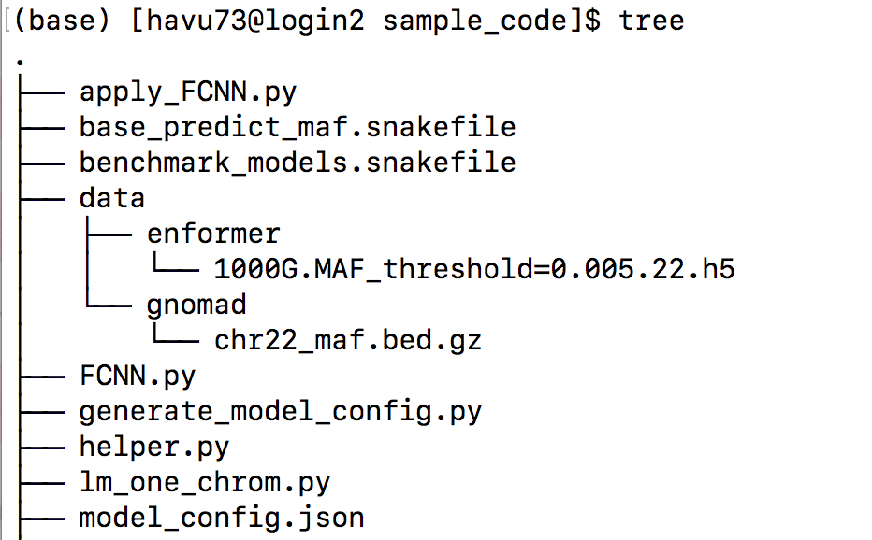
Code file structure
Code to run model training/ evaluation
Snakemake file to run linear model model
Snakemake file to run FCNN model hyperparams sweep
Folder containing sample input data
Where the FCNN and the Dataloader are defined
Code to generate the json files for different FCNN model architectures
Functions to manage files and read in data, used by both linear and FCNN
Linear regression model (we will not use this in the pipeline)
Default model parameters. Except for the params that we try to sweep for, all the other params are kept as default values.
Note: some lines of my code is very long, that’s because I use ‘wrap code’ view in Sublime text that allows me to see a line of code within the screen.

Slide 6
Set up and installation
I specified the needed packages in torch_env.yml
Snakemake is needed but I could not install it using conda, so I used pip install instead
If you do not want to set up → you can just see the screenshots of outputs in following slides

Slide 7
Evaluation pipeline: just 1 or 2 layers for toy example
For n (nLayers in FCNN) in [1,2]
Specify model architecture in json file (code: generate_model_config.py)
All of this is handled by snakemake (code: benchmark_models.snakefile)
1-layer model dimensions: 5313 → 1
2-layer model dimensions: 5313 → 2656 → 1
(each intermediate layer is half the size of the previous one’s dimension, except for the last one (which has dim = 1))
- This is just an example coded in the file benchmark_models.snakefile, we can specify any model architecture to test.
Learn model (code: apply_FCNN.py)
Eval model (code: apply_FCNN.py)
Using pearson correlation (Y_hat, Y_obs)

Slide 8
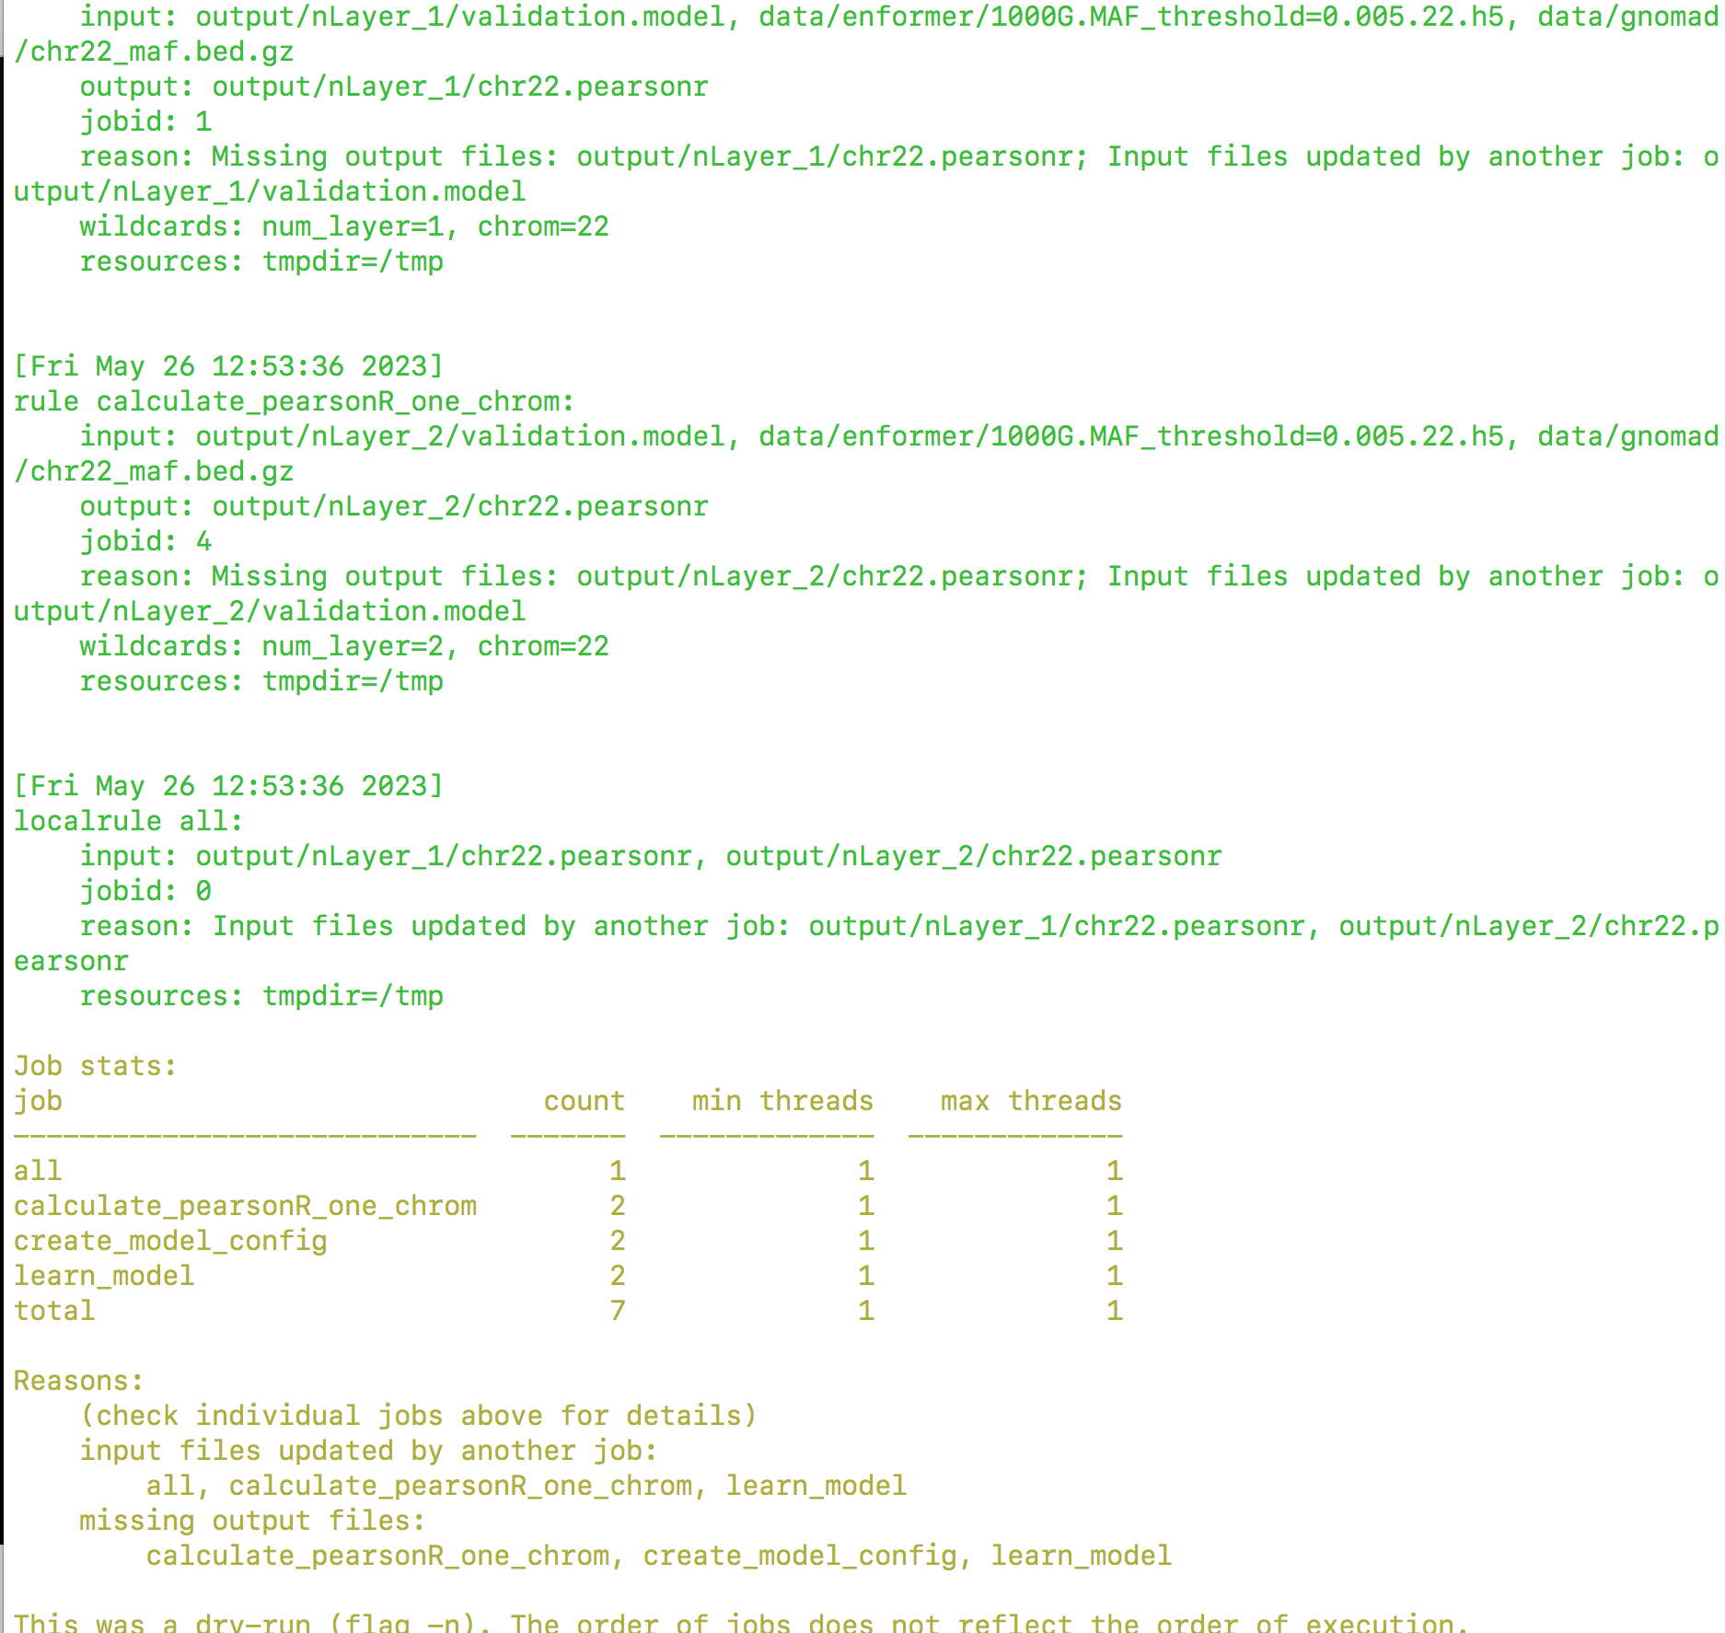
How to run
This is part of the screenshot output for command:
snakemake -n --snakefile benchmark_models.snakefile
This lists out the number times each rule (i.e. a step in the pipeline) is run. Since we are testing 2 model architectures (nLayers = 1 or 2), each step in the pipeline is run twice (once for each model).

Slide 9
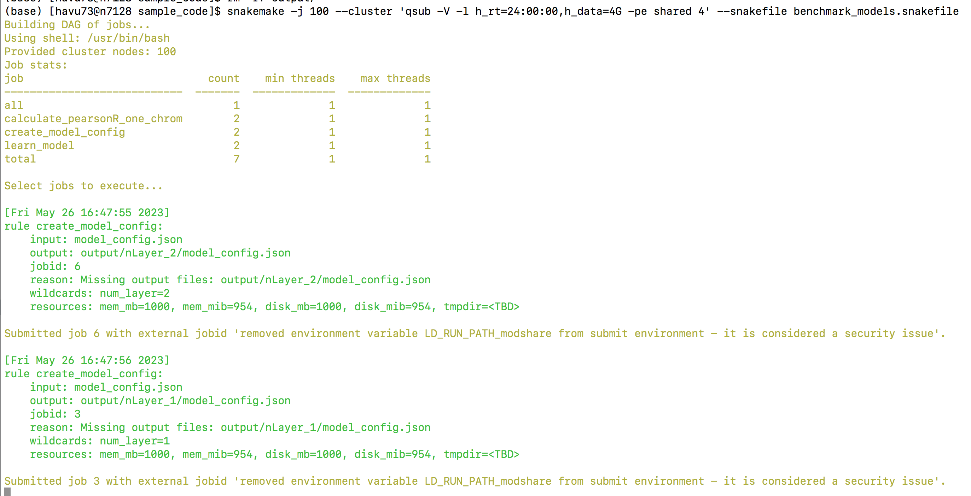
How to run
The command to use snakemake to submit jobs onto the computer cluster, and submit jobs in parallel whenever possible.
Snakemake will do the job sitting for me

Slide 10
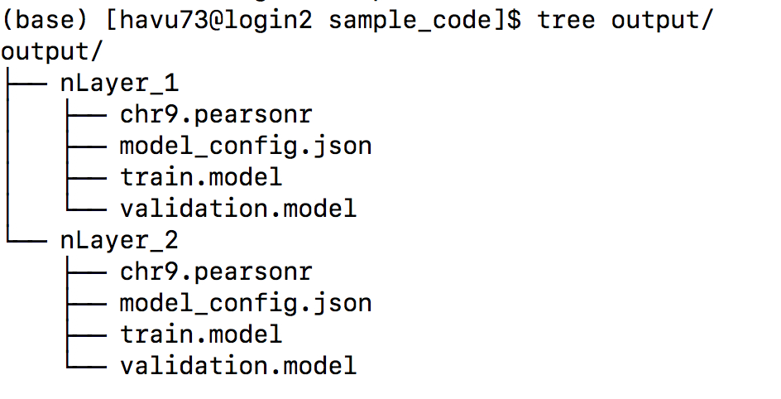
Sample output
Output folder is created within the current directory (that contains benchmark_models.snakefile)
This is the file structure of output folder after all snakemake jobs are finished
Output of pearson’s correlation (y_hat, y_obs) , where y means the variants’ minor allele frequencies. Code: apply_FCNN.py
File showing model’s architecture and other hyperparameters. Code: generate_model_config.py
Two model files showing model’s architecture and other hyperparameters. Code: apply_FCNN.py
Train.model: model saved in the training process
Validation.model: best-performing model on validation data.

Slide 11
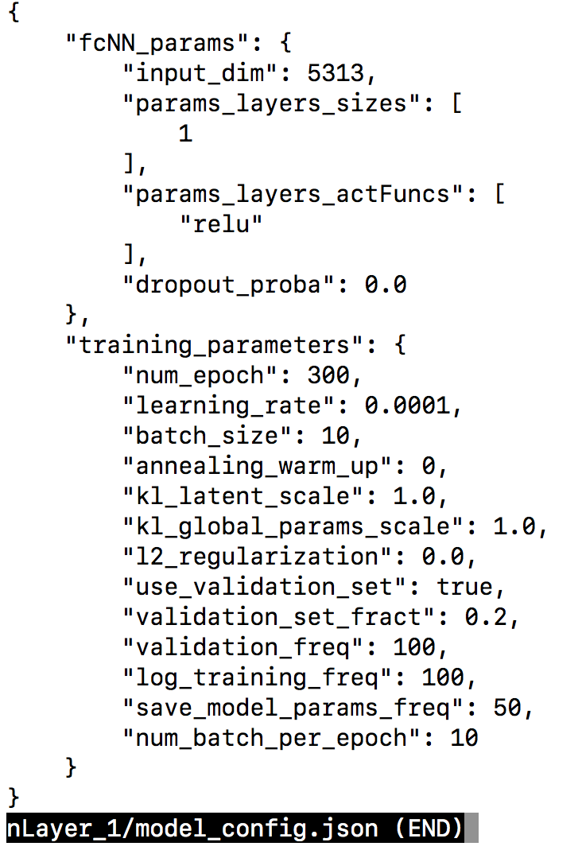
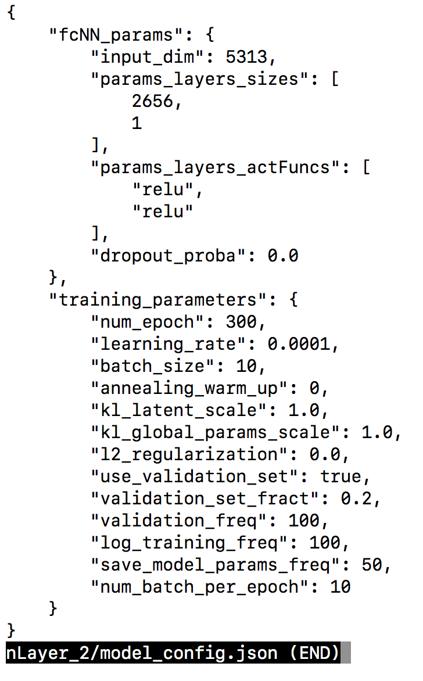
Sample output: model_config.json
The only difference between the two files are here
apply_FCNN.py

Slide 12
Appendix
The following slides are just screenshots of help-pages for different scripts.

Slide 13
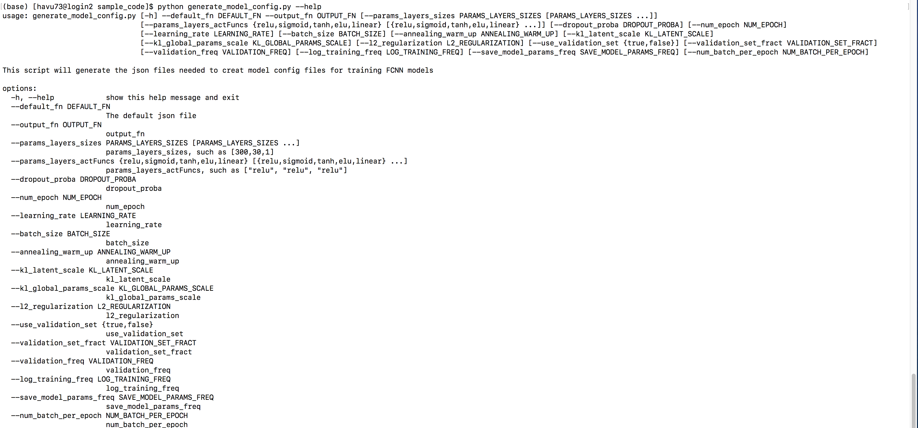
Generate_model_config.py

Slide 14
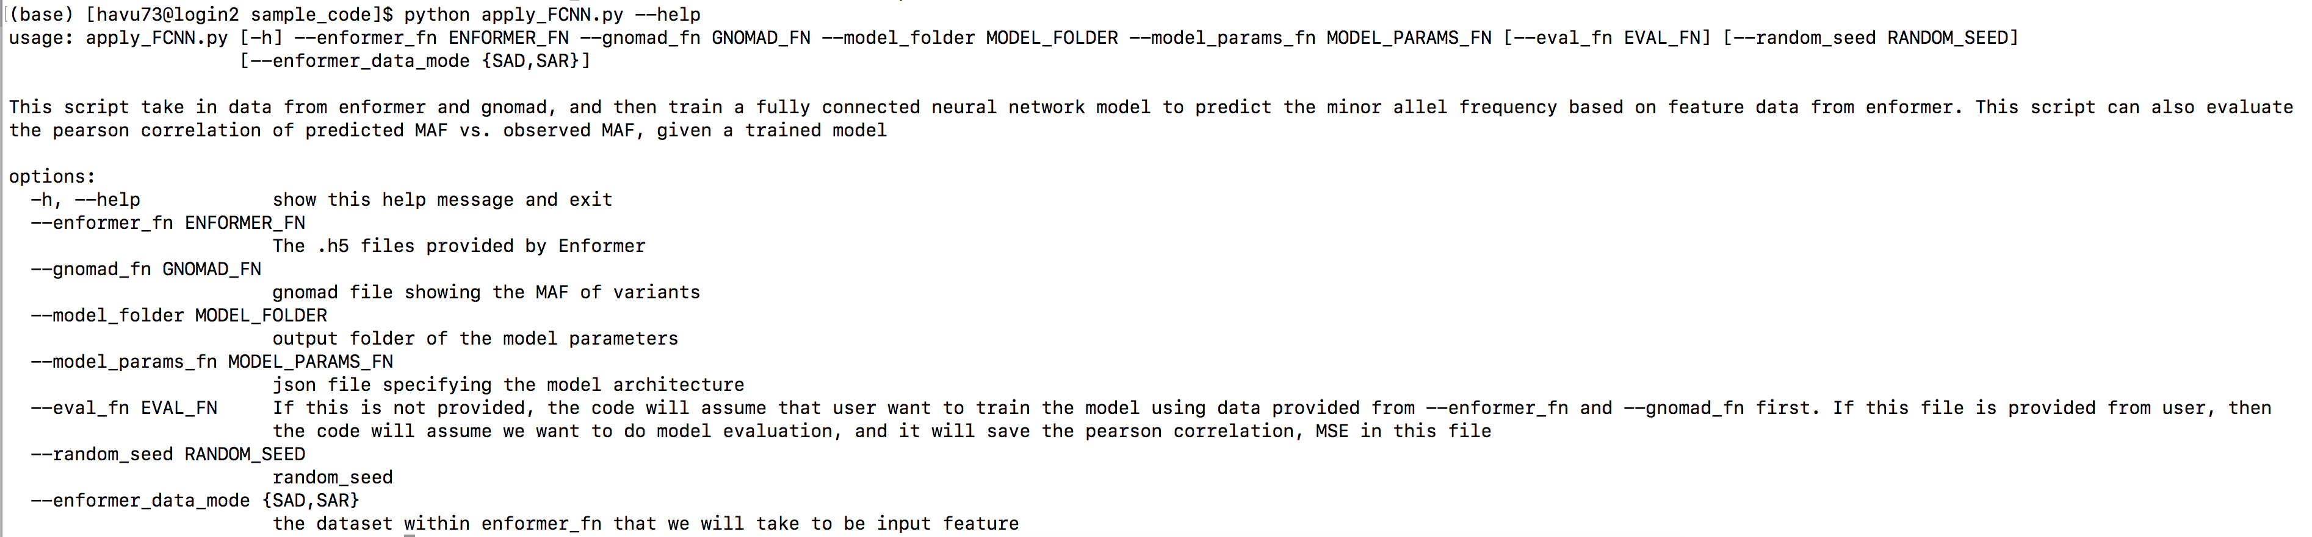
Apply_FCNN.py

