Slide 1
Blockchain Agent
Mock Demo Ready
WorldLand Knowledge Wiki Agent
Core idea
블록체인은 위키 저장소가 아니라 검증 통과 페이지의 인증서 레지스트리입니다.
출처 검증 기반 논문 지식 그래프와 Blockchain Certificate Registry
PASS → certificate FAIL → local-only / SKIP_CHAIN
Cheon Seungyeon · Final Project Presentation
WorldLand Knowledge Wiki Agent · Cheon Seungyeon
Current mode: MOCK_CHAIN / MOCK_PAYMENT
1

Slide 2
문제 정의: LLM Wiki는 유용하지만 위험합니다
Blockchain Agent · Mock Demo
LLM-generated knowledge bases need publication control.
Hallucination
Passive hash log
Need a gate
근거 없는 claim이 위키에 들어가면 노이즈/오정보가 됩니다.
단순 page hash 기록은 로컬 로그와 차별성이 약합니다.
검증된 page만 발행되어야 지식 품질과 보안이 함께 올라갑니다.
Design question: “WorldLand에 기록이 있다는 사실이 무엇을 증명하는가?”
답: 이 page hash는 EvalAgent의 source-grounded verification을 통과한 certificate이다.
WorldLand Knowledge Wiki Agent · Cheon Seungyeon
Current mode: MOCK_CHAIN / MOCK_PAYMENT
2
02

Slide 3
교수님 피드백 반영: Hash Logger → Certificate Registry
Blockchain Agent · Mock Demo
The blockchain role changed from recording to gating.
Before: Passive Hash Logger
After: Publication Certificate Registry
위키 page 생성 후 page_hash 기록
hash + timestamp + agent name
문제: 로컬 로그와 본질적 차이가 약함
EvalAgent가 claim groundedness 검증
score_bps ≥ threshold_bps일 때만 certify
FAIL은 SKIP_CHAIN, tx_hash=None
Local log와 비슷한 수준
온체인 기록 = 검증 통과 인증서
Professor feedback implemented
WorldLand Knowledge Wiki Agent · Cheon Seungyeon
Current mode: MOCK_CHAIN / MOCK_PAYMENT
3
03

Slide 4
전체 Agentic Workflow
Blockchain Agent · Mock Demo
Goal → Input → Tools → Check → Record → Human Review → Output
PDF/MD/TXT Sources
Chunker
WikiCurator Agent
EvalAgent Verification
Policy Gate score ≥ 7800
PASS
FAIL
certificate payload MockBlockchain / Registry
local-only SKIP_CHAIN
Read-only tools
Memory / Record
Action tools
Filesystem · Fetch · Git · source chunks
Obsidian wiki · certificates · USAGE_LOG
certifyPage · mock/real WLC payment
WorldLand Knowledge Wiki Agent · Cheon Seungyeon
Current mode: MOCK_CHAIN / MOCK_PAYMENT
4
04

Slide 5
Publication Gate: 온체인 기록의 의미
Blockchain Agent · Mock Demo
A certificate exists only if the page passes source-grounded verification.
if score_bps >= threshold_bps and not critical_unsupported: tx_hash = certifyPage(page_hash, cert_hash, score_bps) else: tx_hash = None log('SKIP_CHAIN')
PASS
FAIL
certificate JSON 생성
page_hash + cert_hash
Mock/real tx 생성
local evaluation log
SKIP_CHAIN
tx_hash=None
Key phrase: “The absence of a certificate is the rejection.”
실패한 page는 reject event조차 온체인에 남기지 않습니다.
🌐
WorldLand explorer / real tx screenshot (optional after WLC integration)
WorldLand Knowledge Wiki Agent · Cheon Seungyeon
Current mode: MOCK_CHAIN / MOCK_PAYMENT
5
05

Slide 6
EvalAgent Groundedness Scoring
Blockchain Agent · Mock Demo
Claim-level verification with basis points.
Scoring rule
Sample evaluation fixture at threshold_bps = 7800
SUPPORTED
1.0
근거 충분
sample
score
critical
decision
PARTIAL
0.5
부분 근거
strong
9200
False
PASS
UNSUPPORTED
0.0
근거 없음
good
8700
False
PASS
score_bps = average × 10000
borderline
8100
False
PASS
partial
7600
False
FAIL
weak
7200
False
FAIL
critical hallucination
0
True
FAIL
Gate behavior는 fixture로, large batch는 scalability evidence로 설명합니다.
WorldLand Knowledge Wiki Agent · Cheon Seungyeon
Current mode: MOCK_CHAIN / MOCK_PAYMENT
6
06

Slide 7
Cross-linking: 후보 생성과 최종 채택을 분리
Blockchain Agent · Mock Demo
Cosine similarity is candidate generation only.
TF-IDF / Cosine
EvalAgent
Obsidian Page
candidate links only
accept / reject with evidence
accepted links only
ACCEPT example
REJECT example
State Transition → Gas Reason: source evidence shows transaction execution consumes gas.
State Transition → Polymarket Reason: semantic similarity but no source-backed relation.
🕸️
Obsidian graph / generated wiki page screenshot
WorldLand Knowledge Wiki Agent · Cheon Seungyeon
Current mode: MOCK_CHAIN / MOCK_PAYMENT
7
07

Slide 8
Latest Demo Run Summary
Blockchain Agent · Mock Demo
Reproducible mock mode for presentation.
python demo/demo_pipeline.py --threshold-bps 7800 --llm-provider mock --mock-chain --mock-payment --append-usage-log
109
1328
110
source files
chunks
pages
109 / 1
109
545
PASS / FAIL
mock certs
mock payments
Important framing
Large batch는 scalability/practicality evidence입니다. Publication gate behavior는 sample fixture와 FAIL evidence로 설명합니다.
WorldLand Knowledge Wiki Agent · Cheon Seungyeon
Current mode: MOCK_CHAIN / MOCK_PAYMENT
8
08

Slide 9
PASS vs FAIL Evidence in Logs
Blockchain Agent · Mock Demo
The key professor-feedback evidence.
PASS → CERTIFIED
FAIL → LOCAL ONLY
CERTIFIED | 0xmock_cert_da5400... | 3D Diffuser Actor | score_bps=10000 threshold_bps=7800
SKIP_CHAIN | tx_hash=None | Hallucinated Failure Fixture | score_bps=0 threshold_bps=7800 critical=True FAIL_LOCAL_ONLY | ... | chain_action=SKIP_CHAIN
evaluation certificate exists
mock certificate tx exists
WorldLand interface can be swapped to real mode later
no blockchain call
no mock certificate event
absence of certificate = rejection
WorldLand Knowledge Wiki Agent · Cheon Seungyeon
Current mode: MOCK_CHAIN / MOCK_PAYMENT
9
09

Slide 10
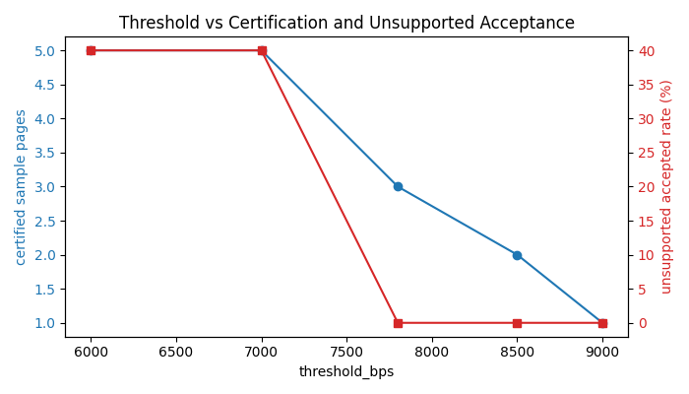
Threshold Trade-off: Quality Gate Sensitivity
Blockchain Agent · Mock Demo
Fixture-based sensitivity test.
Interpretation
threshold가 올라가면 certified sample pages가 감소
unsupported accepted rate가 40% → 0%로 감소
large batch는 mock evaluator 특성상 대부분 10000점
따라서 gate 민감도는 fixture로 설명
At threshold 7800: sample 3 PASS / 3 FAIL
WorldLand Knowledge Wiki Agent · Cheon Seungyeon
Current mode: MOCK_CHAIN / MOCK_PAYMENT
10
10

Slide 11
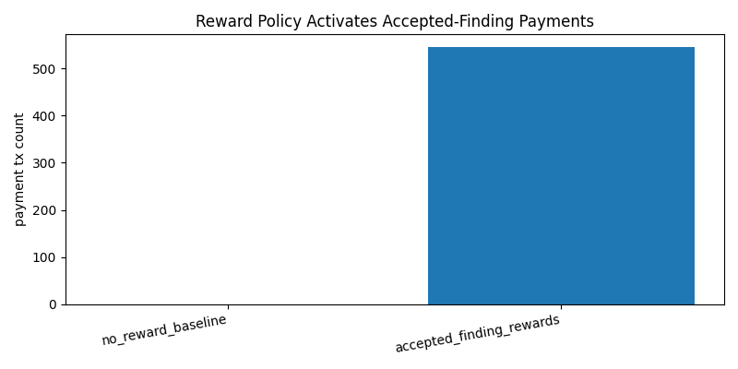
PayAgent: Accepted Finding Reward Flow
Blockchain Agent · Mock Demo
Reward is paid per accepted EvalAgent finding, not per passed page.
Reward policy
no_reward_baseline: 0 payments
accepted_finding_rewards: 545 mock payments
total mock WLC: 5.45
이 그래프는 quality improvement 증거가 아니라 payment flow 증거
0xmock_pay_... | finding=f_... | amount_wlc=0.01
실제 WLC payment는 아직 없습니다.
WorldLand Knowledge Wiki Agent · Cheon Seungyeon
Current mode: MOCK_CHAIN / MOCK_PAYMENT
11
11

Slide 12
WorldLand / WLC Integration Plan
Blockchain Agent · Mock Demo
Mock mode today; real tx can be added after WLC and wallet setup.
What goes on-chain?
WLC use cases
Current status
page_hash
cert_hash
score_bps / threshold_bps
page_id / evaluator / timestamp
No full paper text or private notes
contract deploy gas
certifyPage tx gas
accepted finding reward
retry / demo buffer
real WorldLand tx: none
real WLC payment: none
MOCK_CHAIN / MOCK_PAYMENT
mock prefixes: 0xmock_cert_, 0xmock_pay_
Recommended request: 50 WLC
Do not present mock tx as real tx
WorldLand Knowledge Wiki Agent · Cheon Seungyeon
Current mode: MOCK_CHAIN / MOCK_PAYMENT
12
12

Slide 13
Privacy & Security Design
Blockchain Agent · Mock Demo
Local content, minimal on-chain metadata, explicit approval for risky actions.
Privacy by default
Secret handling
Threat controls
PDFs and wiki content stay local
Only hashes/cert metadata on-chain
No private notes on WorldLand
No .env committed
Private keys only from env vars
Never print wallet key
FAIL → SKIP_CHAIN only
Mock tx prefixes separate reality
Real payment blocked without confirmation
Security takeaway: certificate registry proves a page version passed verification without exposing source content.
WorldLand Knowledge Wiki Agent · Cheon Seungyeon
Current mode: MOCK_CHAIN / MOCK_PAYMENT
13
13

Slide 14
사진 / 영상 삽입 위치
Blockchain Agent · Mock Demo
Blank placeholders for screenshots or demo video.
💻
Terminal demo output python demo/demo_pipeline.py ...
🗂️
Obsidian vault graph or generated wiki page
📄
Evaluation certificate JSON claim checks + score_bps
🧾
CERTIFICATE_LOG.md CERTIFIED + SKIP_CHAIN lines
💸
PAYMENT_LOG.md accepted finding mock reward
🎬
Demo video thumbnail ≤ 5 min screen capture
Tip
실제 WorldLand explorer screenshot은 WLC 수령 후 real tx가 생겼을 때만 추가합니다. 현재 발표에서는 “real tx 없음”을 명확히 표시합니다.
WorldLand Knowledge Wiki Agent · Cheon Seungyeon
Current mode: MOCK_CHAIN / MOCK_PAYMENT
14
14

Slide 15
Limitations & Final Takeaway
Blockchain Agent · Mock Demo
Honest boundaries and next steps.
Current limitations
Next steps
Mock evaluator: not full LLM claim verification
No real WorldLand tx yet
No real WLC payment yet
Reward graph shows payment flow, not proven quality improvement
Large batch scores are optimistic under mock mode
Add Ollama/OpenAI EvalAgent mode
Deploy PageCertificateRegistry on WorldLand
Use WLC for deploy + certifyPage + accepted finding rewards
Add block explorer proof and read-only tx receipt verification
Final takeaway: WorldLand is not a passive hash log. It is a publication certificate registry.
WorldLand Knowledge Wiki Agent · Cheon Seungyeon
Current mode: MOCK_CHAIN / MOCK_PAYMENT
15
15

