Slide 1
Credit Demand
in Afghan Firms
A Python Data Analysis Pipeline
Advanced Programming Techniques — OOP Project
Notes:
Good morning Professor. I present my OOP project analyzing credit demand among Afghan firms using the World Bank Enterprise Survey 2025. The pipeline is built in Python with modular OOP architecture and argparse CLI.

Slide 2
Dataset & Research Question
World Bank Enterprise Survey
Target: Credit Demand
Afghanistan, 2025 edition
426 firms across 4 regions
53 variables + 11 merged from full survey
Covers: finance, firm characteristics,
performance, innovation, workforce
No need (0): 219 firms
Demand (1): 179 firms
Excluded: 28 ambiguous cases
Question:
What firm characteristics predict whether a firm seeks credit?
Notes:
World Bank Enterprise Survey 2025, 426 Afghan firms. 11 additional financial access variables merged from the full dataset. Binary target: 219 no need, 179 demand, 28 excluded.

Slide 3





Pipeline Architecture
data_loader.py
utils.py
preprocessing.py
File discovery with
os & glob, CSV/JSON/
XLSX loading, merging
Sentinel codes, column
groupings, helper
functions
Sentinel recoding,
type conversion,
feature engineering
analysis.py
visualization.py
main.py
EDA (Analyzer class) +
XGBoost (ModelTrainer)
64-combo grid search
9 matplotlib/seaborn
plots saved to
outputs/
Pipeline orchestrator
with argparse CLI
for flexible runs
Notes:
6 Python modules. data_loader discovers files with os and glob. utils centralizes constants. preprocessing cleans in 4 steps. analysis has Analyzer and ModelTrainer classes. visualization produces 9 plots. main.py orchestrates everything with argparse CLI support.

Slide 4
Data Preprocessing
1
Sentinel Recoding
-9 and -7 → NaN across all numeric
-8 → NaN only in column k11
2
Type Conversion
30 categorical → category dtype
29 numeric → validated as numeric
3
Feature Engineering
firm_age, log transforms (d2, n3, a6c,
l4a1, l4a2, l4b), credit_demand target,
sector_broad_3 from ISIC codes
4
Missing Values
Drop columns with >20% missing (14 cols)
Median imputation for remaining numeric
'Missing' category for categorical
Notes:
4 preprocessing steps matching thesis methodology. Sentinel codes recoded to NaN. 14 columns dropped for >20% missingness. Log transforms for 6 skewed variables. credit_demand NaN preserved for excluded firms.

Slide 5
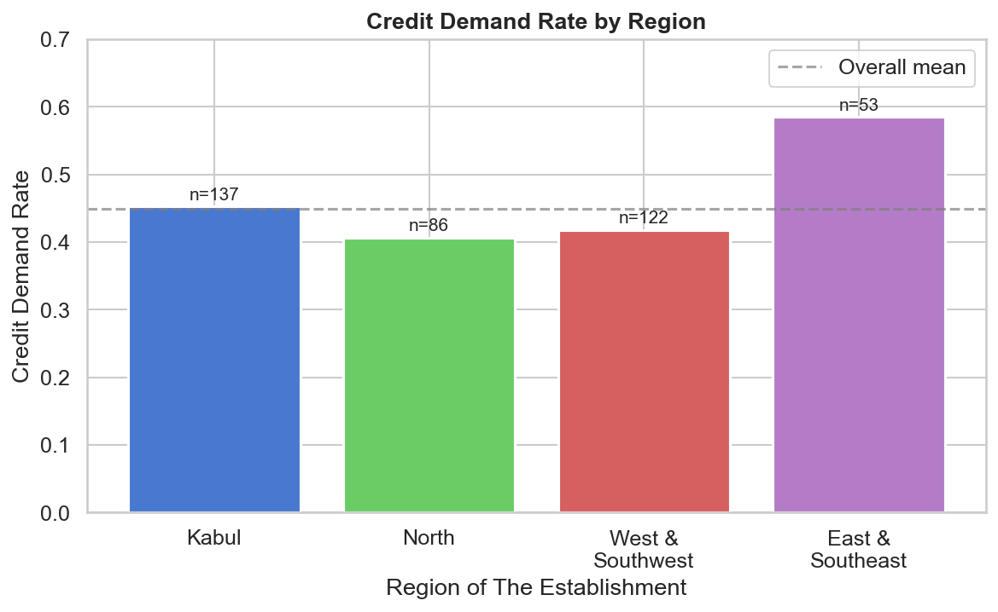
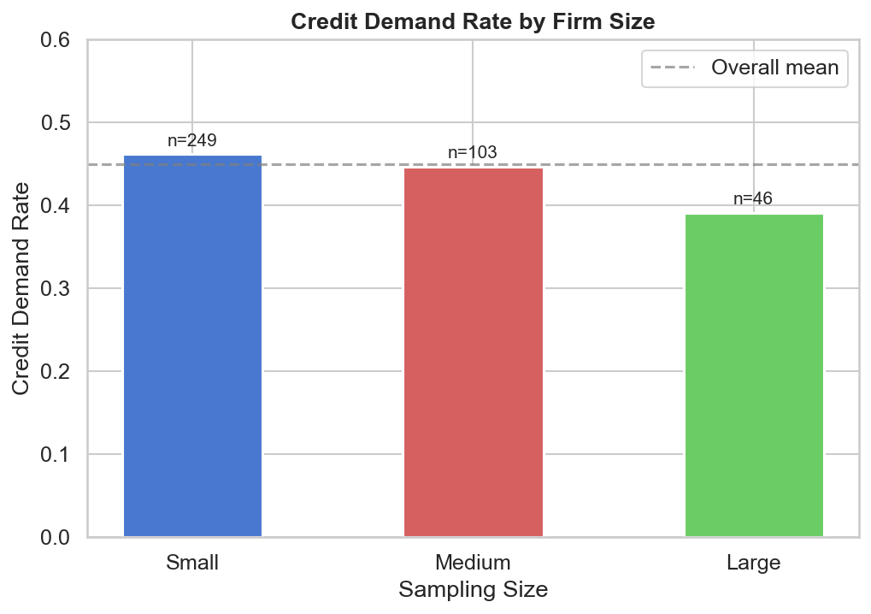
Who Demands Credit?
Credit demand is not random. East & Southeast has the highest demand rate (58.5%), North the lowest (40.7%). Small firms demand credit most (46.2%), large firms least (39.1%). Industry sector shows 50% demand vs ~30% for Services and Trade.
Notes:
Credit demand is concentrated. East and Southeast at 58.5%, North at 40.7%. Small firms at 46.2%, large at 39.1%. Industry sector at 50% versus Services and Trade at about 30%. So demand varies by region, firm size, and sector.

Slide 6
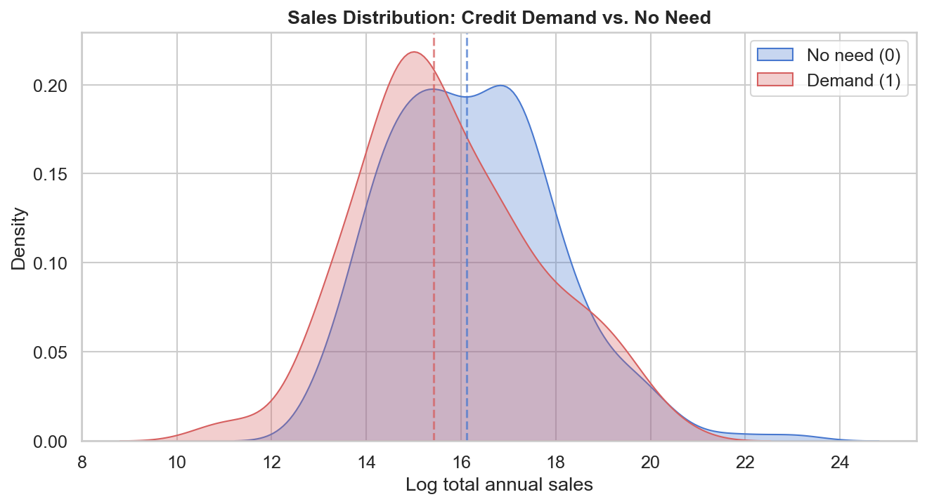
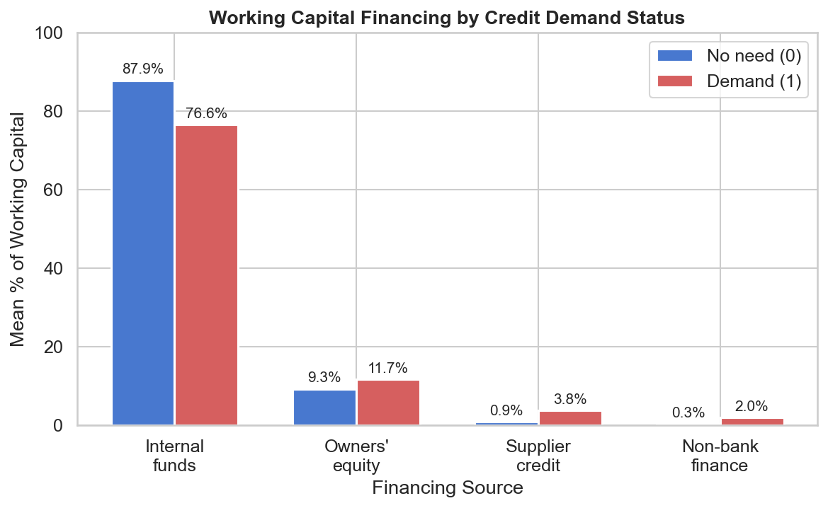
What Makes Demand Firms Different?
Demand firms look financially weaker. They have lower median log sales (15.4 vs 16.1). They rely less on internal funds (76.6% vs 87.9%) and more on external sources like supplier credit and non-bank finance. k3a and k3i are negatively correlated (r = -0.81) — firms substitute between them.
Notes:
Sales KDE shows demand firms peak lower. Financing chart shows no-need firms use 87.9% internal funds versus 76.6% for demand firms. Demand firms compensate with more equity, supplier credit, and non-bank finance. This connects directly to the model — k3a, k3f, k3i, k3e are all top features.

Slide 7
Firm Size Patterns
Small (n=249)
Medium (n=103)
Large (n=46)
Internal funds gap: 87.4% → 76.6%
Supplier credit: 0.7% → 3.3%
Median sales gap: 15.89 → 15.07
Internal funds gap: 90.5% → 75.6%
Supplier credit: 1.8% → 6.3%
Median sales gap: 16.81 → 16.49
Internal funds gap: 84.6% → 79.4%
Supplier credit: 0.4% → 1.1%
Median sales gap: 16.71 → 15.56
Largest sales gap
Largest financing gap
Smaller differences
Pattern holds across all sizes: demand firms consistently rely less on internal funds and more on external financing. Medium firms show the largest financing gap (15 percentage points in internal funds). No need → Demand shown as arrows above.
Notes:
Cross-tabulating financing sources by firm size and demand status. The pattern is consistent: demand firms always rely less on internal funds. Medium firms show the biggest gap — 90.5% to 75.6%. Supplier credit jumps most for medium demand firms: 1.8% to 6.3%. Small firms show the biggest sales gap.

Slide 8
Two Faces of Credit Demand
Constrained Demand
Expansion Demand?
Kabul, North, West & Southwest
East & Southeast (n=53)
Demand firms have lower sales
North: median 14.73 vs 16.12
Demand firms rely less on internal funds
West: 90.3% → 70.3% (20-point drop)
Higher use of supplier credit & non-bank
Demand likely driven by financial weakness
Demand firms have slightly higher sales
Median: 15.42 vs 15.12
Internal funds similar or slightly higher
72.4% vs 69.7%
Highest demand rate overall: 58.5%
May reflect business activity, not weakness
Caution: East & Southeast findings are based on only 53 firms. The differences are small and may reflect noise. A larger sample would be needed to confirm whether this represents a genuinely different type of demand.
Notes:
This is the most interesting analytical finding. In three regions, demand firms look financially weaker — lower sales, less internal funds. But in East and Southeast, the pattern reverses: demand firms have slightly higher sales and similar internal funds. This could suggest expansion-driven demand rather than constraint-driven. However, East and Southeast has only 53 firms, so this should be interpreted cautiously. If the professor asks, I would say a larger sample or SHAP analysis would be needed to confirm.

Slide 9
Why XGBoost?
Nonlinear Interactions
Captures complex patterns — e.g. region × financing × sector interactions that linear models miss
Built-in Regularization
gamma, max_depth, min_child_weight prevent overfitting on small samples (n=398)
Early Stopping
Training halts when validation AUC stops improving (early_stopping_rounds=30)
Thesis Consistency
Same model used in my thesis (R), enabling direct comparison of results
Notes:
XGBoost for four reasons: nonlinear interactions, regularization for small sample, early stopping, and thesis consistency for R vs Python comparison.

Slide 10
Model Results
0.724
Grid Search
64 combinations × 5 folds = 320 fits
6 hyperparameters tuned:
eta, max_depth, min_child_weight,
subsample, colsample_bytree, gamma
Best parameters:
eta=0.01, depth=3, mcw=1
sub=0.7, col=0.7, gamma=0.1
Baseline: 0.550
CV AUC (5-fold stratified)
Thesis (R): CV AUC = 0.710 | Python: CV AUC = 0.724
Notes:
CV AUC 0.724 beats baseline 0.550. 64 hyperparameter combos, 5-fold stratified CV, early stopping. Best params: eta 0.01, depth 3, mcw 1. Consistent with thesis R result of 0.710.

Slide 11
Top Predictors of Credit Demand
k3a — Internal funds (%)
0.083
k3f — Supplier credit (%)
0.073
k3i — Owners / equity (%)
0.063
h8 — Spent on R&D: Yes
0.063
log_n3 — Log past sales
0.058
k3e — Non-bank finance (%)
0.054
Sector — Industry
0.053
a3a — East & Southeast
0.049
4 of top 6 features are financing-source variables — confirming the EDA finding that how firms finance working capital is the strongest signal.
Notes:
k3a is the top predictor. 4 of top 6 are financing source variables. This confirms the EDA: financing structure is the strongest signal. Industry and East Southeast also appear, matching EDA patterns. Feature importance shows which variables the model used most, not the direction.

Slide 12
Summary
Modular OOP pipeline with 6 Python modules + argparse CLI
World Bank Enterprise Survey 2025, 426 Afghan firms
4-step preprocessing: sentinel recoding, log transforms, >20% threshold, imputation
EDA narrative: demand is concentrated, linked to financing structure
Cross-tabs reveal firm size patterns and two types of demand (constrained vs expansion)
XGBoost with 64-combo grid search + early stopping → CV AUC 0.724
Top predictors: financing source variables (k3a, k3f, k3i, k3e)
Consistent with thesis (R: AUC 0.710 vs Python: 0.724)
Thank you
Notes:
Modular Python pipeline, real-world data, 4-step preprocessing, EDA with narrative, cross-tab analysis, XGBoost AUC 0.724, financing structure as main predictor. Thank you, happy to answer questions or show code live.

