Slide 1
Properties of Adjacency Matrix of The Directed Cyclic Friendship Graph
Nanda Anzana¹, S. Aminah¹, S. Utama¹
¹Department of Mathematics, Faculty of Mathematics and Natural Sciences, Universitas Indonesia

Slide 2
Title and Content Layout with List
Introduction
Definitions and Theorems
Main Result and Proof
Conclusion
References

Slide 3
Introduction

Slide 4
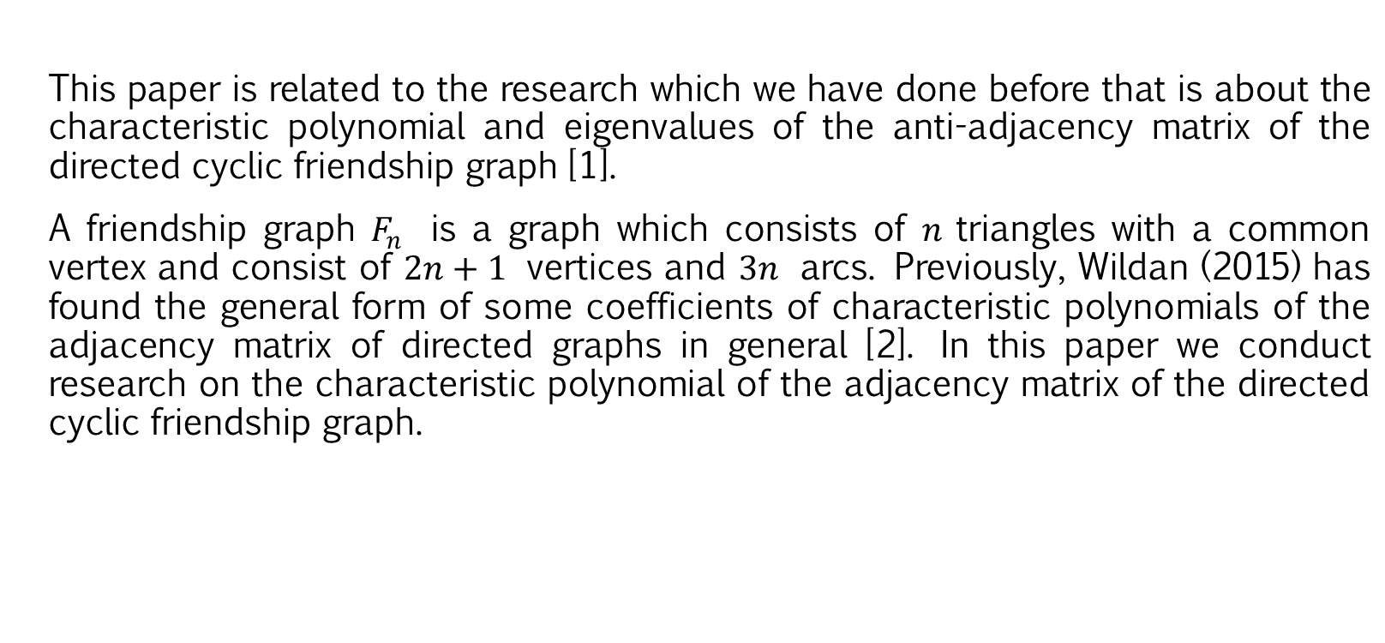
Introduction
This paper is related to the research which we have done before that is about the characteristic polynomial and eigenvalues ​​of the anti-adjacency matrix of the directed cyclic friendship graph [1].
A friendship graph $F_{n}$ is a graph which consists of $n$triangles with a common vertex and consist of $2n+1$ vertices and $3n$ arcs. Previously, Wildan (2015) has found the general form of some coefficients of characteristic polynomials of the adjacency matrix of directed graphs in general [2]. In this paper we conduct research on the characteristic polynomial of the adjacency matrix of the directed cyclic friendship graph.

Slide 5
Definitions and Theorems

Slide 6
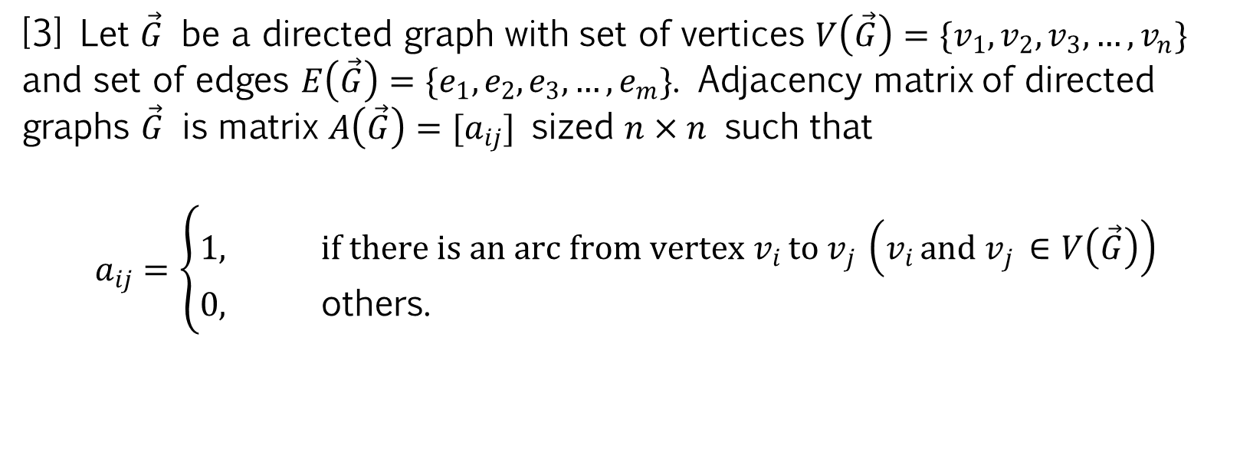
Definitions
Definition 1.
[3] Let $\vec{G}$ be a directed graph with set of vertices $V\left(\vec{G}\right)=\{v_{1},v_{2}, v_{3},…,v_{n}\}$ and set of edges $E\left(\vec{G}\right)=\{e_{1},e_{2},e_{3},…,e_{m}\}$. Adjacency matrix of directed graphs $\vec{G}$ is matrix $A\left(\vec{G}\right)=[a_{ij}]$ sized $n×n$ such that
$$a_{ij}=\left\{\begin{aligned}1, &if there is an arc from vertex v_{i }to v_{j }\left(v_{i }and v_{j }∈V\left(\vec{G}\right)\right) \\ 0, &\text{others}\text{.}\end{aligned}\right.$$

Slide 7

Definitions
Definition 2.
[4] Let $G$ be graph with set of vertices $V\left(G\right)=\{v_{1},v_{2},v_{3},…,v_{n}\}$ and set of edges $E\left(G\right)=\{e_{1},e_{2},e_{3},…,e_{m}\}$. If $V′(G^{′})⊆V(G)$ and $E′(G^{′})⊆E(G)$, then $G^{′}$ is a subgraph of $G$ (and $G$ is a supergraph of $G′$), written as $G′⊆G$.

Slide 8

Definitions
Definition 3.
[4] Let $G$ be graph with set of vertices $V\left(G\right)=\{v_{1},v_{2},v_{3},…,v_{n}\}$ and set of edges $E\left(G\right)=\{e_{1},e_{2},e_{3},…,e_{m}\}$. If $G′⊆G$ and $G′$ contains all the edges $v_{i}v_{j}∈E(G)$ with $v_{i},v_{j}∈V′(G′)$, then $G′$ is an induced subgraph of $G$.

Slide 9

Definitions
Definition 4.
[5] For an integer $n≥3$, the cycle $C_{n}$ is a graph of order $n$ and size $n$ whose vertices can be labelled by $v_{1},v_{2},v_{3},…,v_{n}$ and whose edges are $v_{n}v_{1}$ and $v_{i}v_{i+1}$ for $i=1,2,…,n−1$. The cycle $C_{n}$ is also referred to as an $n$-cycle and the 3-cycle is also called a triangle.

Slide 10
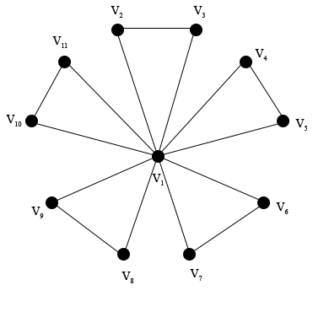
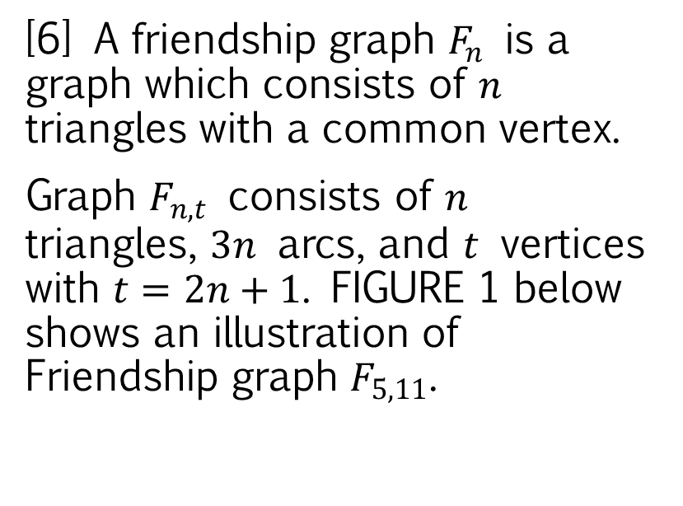
Definitions
Definition 5.
Figure 1. The friendship graph $F_{5,11}$
[6] A friendship graph $F_{n}$ is a graph which consists of $n$ triangles with a common vertex.
Graph $F_{n,t}$ consists of $n$ triangles, $3n$ arcs, and $t$ vertices with $t=2n+1$. FIGURE 1 below shows an illustration of Friendship graph $F_{5,11}$.

Slide 11
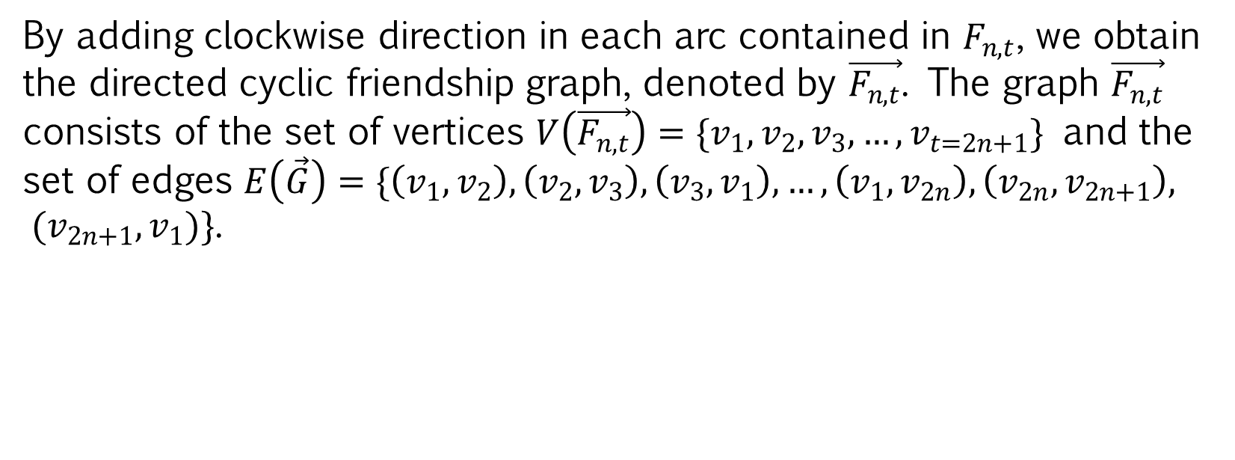
Definitions
By adding clockwise direction in each arc contained in $F_{n,t}$, we obtain the directed cyclic friendship graph, denoted by $\vec{F_{n,t}}$. The graph $\vec{F_{n,t}}$ consists of the set of vertices $V\left(\vec{F_{n,t}}\right)=\{v_{1},v_{2},v_{3},…,v_{t=2n+1}\}$ and the set of edges $E\left(\vec{G}\right)=\{\left(v_{1},v_{2}\right), \left(v_{2},v_{3}\right),\left(v_{3},v_{1}\right),…,\left(v_{1},v_{2n}\right), \left(v_{2n},v_{2n+1}\right), (v_{2n+1},v_{1})\}$.

Slide 12
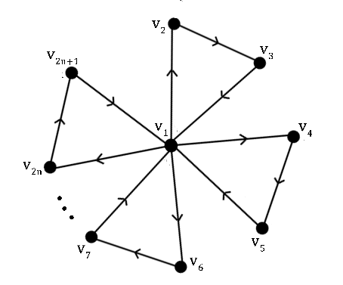
Definitions
Figure 2. The directed cyclic friendship graph $\vec{F_{n,t}}$

Slide 13

Definitions
By using the Definition 1, the adjacency matrix of the directed cyclic friendship graph $\vec{F_{n,t}}$ which has $t×t=(2n+1)×(2n+1)$ entries is shown in figure 3.

Slide 14
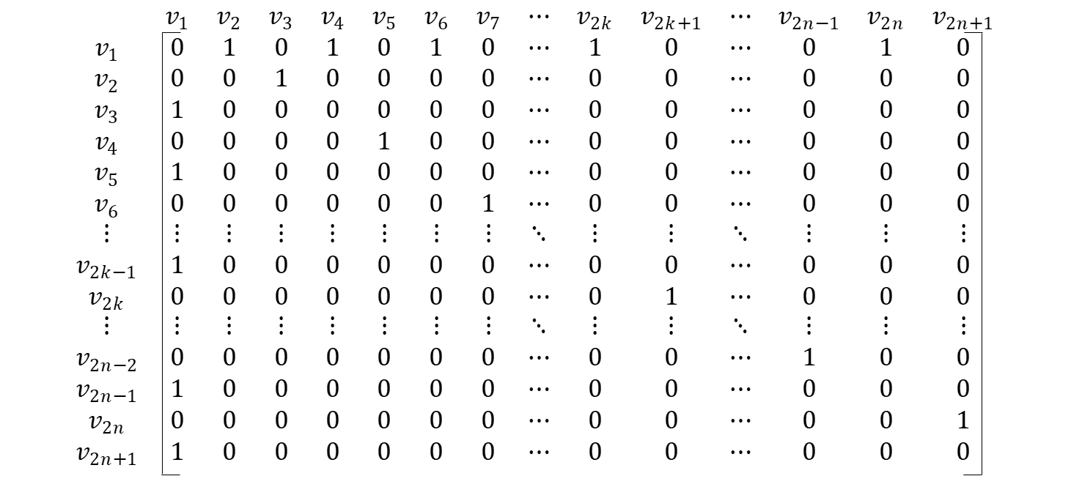
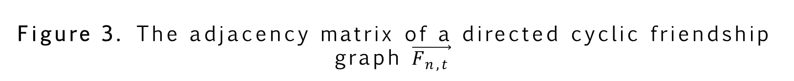
Definitions
Figure 3. The adjacency matrix of a directed cyclic friendship graph $\vec{F_{n,t}}$

Slide 15
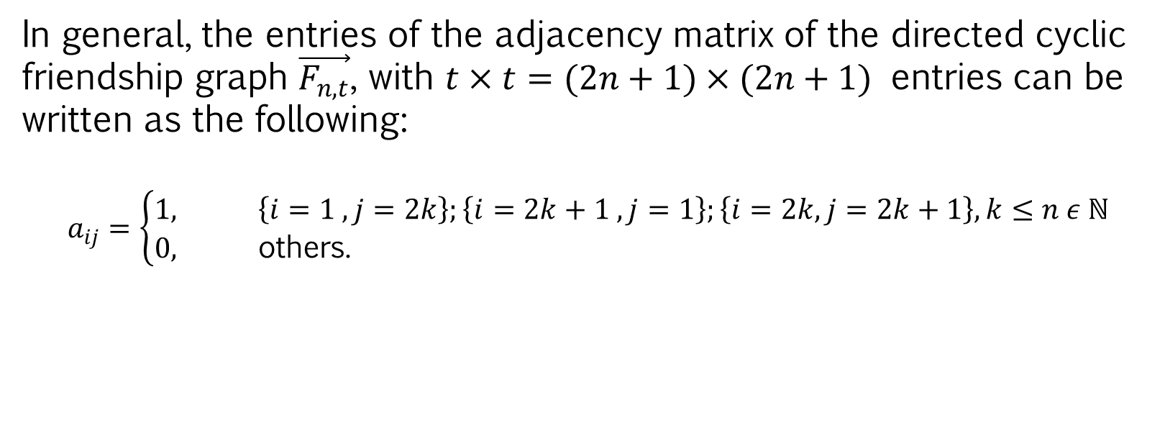
Definitions
In general, the entries of the adjacency matrix of the directed cyclic friendship graph $\vec{F_{n,t}}$, with $t×t=(2n+1)×(2n+1)$ entries can be written as the following:
$$a_{ij}=\left\{\begin{aligned}1, &\left\{i=1 , j=2k\right\};\left\{i=2k+1 , j=1\right\};\left\{i=2k, j=2k+1\right\}, k≤n ε ℕ \\ 0, &\text{others}\text{.}\end{aligned}\right.$$

Slide 16
Theorems
Theorem 1.
[7] Let $A$ be a square matrix. If $A$ has a row or a column of zeros, then $\det\left(A\right)=0$.

Slide 17
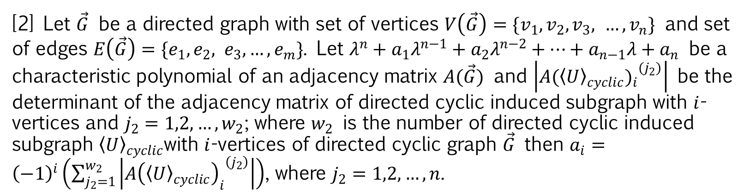
Theorems
Theorem 2.
[2] Let $\vec{G}$ be a directed graph with set of vertices $V\left(\vec{G}\right)=\{v_{1},v_{2},v_{3}, …,v_{n}\}$ and set of edges $E\left(\vec{G}\right)=\{e_{1},e_{2}, e_{3},…,e_{m}\}$. Let $λ^{n}+a_{1}λ^{n−1}+a_{2}λ^{n−2}+…+a_{n−1}λ+a_{n}$ be a characteristic polynomial of an adjacency matrix $A(\vec{G})$ and $\left|{A{({〈U〉}_{cyclic})}_{i}}^{(j_{2})}\right|$ be the determinant of the adjacency matrix of directed cyclic induced subgraph with $i$-vertices and $j_{2}=1,2,…,w_{2}$; where $w_{2}$ is the number of directed cyclic induced subgraph ${〈U〉}_{cyclic}$with $i$-vertices of directed cyclic graph $\vec{G}$ then $a_{i}={\left(−1\right)}^{i}\left(\sum_{j_{2}=1}^{w_{2}}{\left|{A{\left({〈U〉}_{cyclic}\right)}_{i}}^{\left(j_{2}\right)}\right|}\right)$, where $j_{2}=1,2,…,n$.

Slide 18
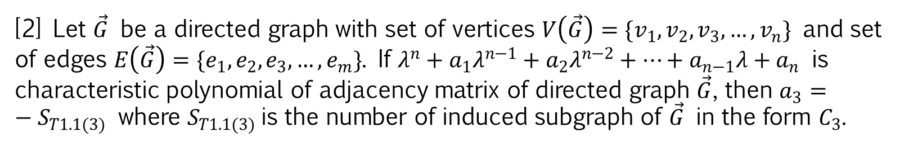
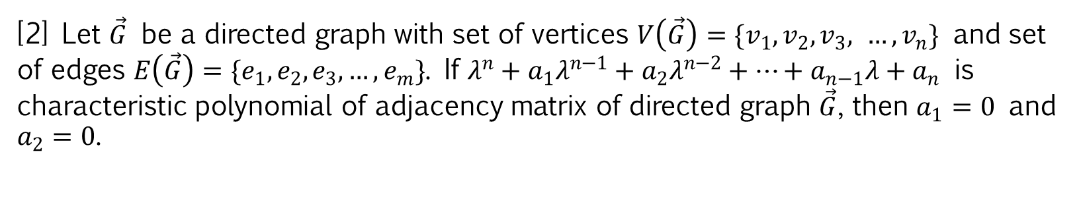
Theorems
Theorem 3.
[2] Let $\vec{G}$ be a directed graph with set of vertices $V\left(\vec{G}\right)=\{v_{1},v_{2},v_{3}, …,v_{n}\}$ and set of edges $E\left(\vec{G}\right)=\{e_{1},e_{2},e_{3},…,e_{m}\}$. If $λ^{n}+a_{1}λ^{n−1}+a_{2}λ^{n−2}+…+a_{n−1}λ+a_{n}$ is characteristic polynomial of adjacency matrix of directed graph $\vec{G}$, then $a_{1}=0$ and $a_{2}=0$.
Theorem 4.
[2] Let $\vec{G}$ be a directed graph with set of vertices $V\left(\vec{G}\right)=\{v_{1},v_{2},v_{3},…,v_{n}\}$ and set of edges $E\left(\vec{G}\right)=\{e_{1},e_{2},e_{3},…,e_{m}\}$. If $λ^{n}+a_{1}λ^{n−1}+a_{2}λ^{n−2}+…+a_{n−1}λ+a_{n}$ is characteristic polynomial of adjacency matrix of directed graph $\vec{G}$, then $a_{3}=−S_{T1.1(3)}$ where $S_{T1.1(3)}$is the number of induced subgraph of $\vec{G}$ in the form $C_{3}$.

Slide 19
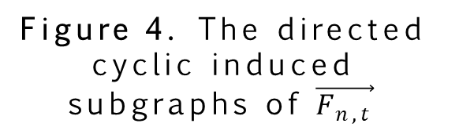
Figure 4. The directed cyclic induced subgraphs of $\vec{F_{n,t}}$

Slide 20
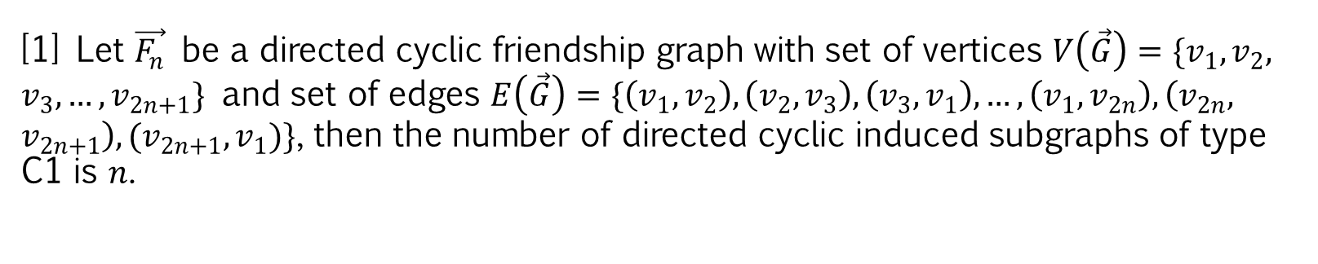
Theorems
Theorem 5.
[1] Let $\vec{F_{n}}$ be a directed cyclic friendship graph with set of vertices $V\left(\vec{G}\right)=\{v_{1},v_{2}, v_{3},…,v_{2n+1}\}$ and set of edges $E\left(\vec{G}\right)=\{\left(v_{1},v_{2}\right),\left(v_{2},v_{3}\right),\left(v_{3},v_{1}\right),…,\left(v_{1},v_{2n}\right), \left(v_{2n}, v_{2n+1}\right), (v_{2n+1},v_{1})\}$, then the number of directed cyclic induced subgraphs of type C1 is $n$.

Slide 21
Main Result and Proof

Slide 22
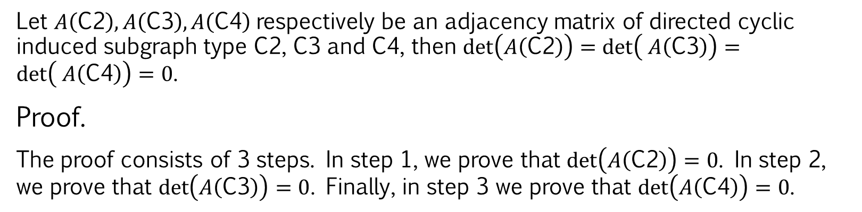
Lemmas
Lemma 1.
Let $A\left(\text{C}\text{2}\right), A\left(\text{C}\text{3}\right), A\left(\text{C}\text{4}\right)$respectively be an adjacency matrix of directed cyclic induced subgraph type C2, C3 and C4, then $\det\left(A\left(\text{C}\text{2}\right)\right)=\det\left( A\left(\text{C}\text{3}\right)\right)=\det\left( A\left(\text{C}\text{4}\right)\right)=0$.
Proof.
The proof consists of 3 steps. In step 1, we prove that $\det\left(A\left(\text{C}\text{2}\right)\right)=0$. In step 2, we prove that $\det\left(A\left(\text{C}\text{3}\right)\right)=0$. Finally, in step 3 we prove that $\det\left(A\left(\text{C}\text{4}\right)\right)=0$.

Slide 23
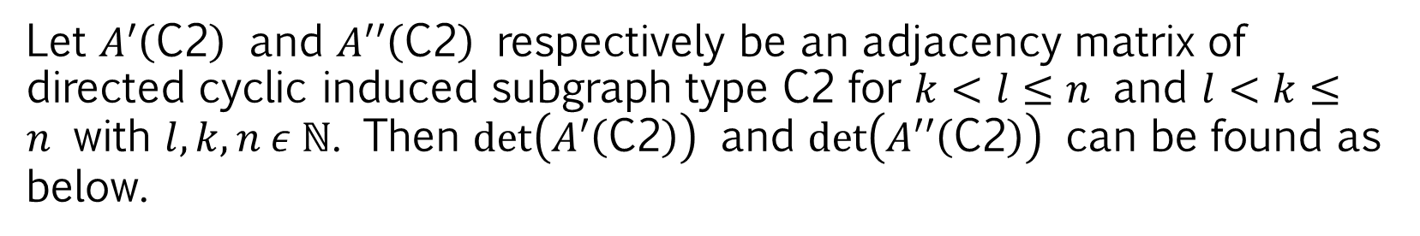
Lemmas
Step 1.
Let $A′\left(\text{C}\text{2}\right)$ and $A′′\left(\text{C}\text{2}\right)$ respectively be an adjacency matrix of directed cyclic induced subgraph type C2 for $k<l≤n$ and $l<k≤n$ with $l,k,n ε ℕ$. Then $\det\left(A′\left(\text{C}\text{2}\right)\right)$ and $\det\left(A′′\left(\text{C}\text{2}\right)\right)$ can be found as below.
Figure 5. The determinant of the adjacency matrix of the directed cyclic induced subgraph type C2

Slide 24
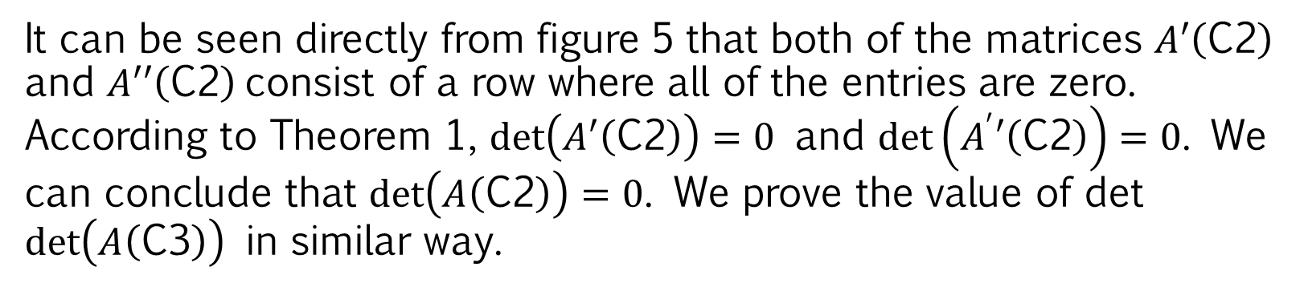
Lemmas
It can be seen directly from figure 5 that both of the matrices $A′\left(\text{C}\text{2}\right)$ and $A′′\left(\text{C}\text{2}\right)$consist of a row where all of the entries are zero. According to Theorem 1, $\det\left(A′\left(\text{C}\text{2}\right)\right)=0$ and $\det\left(A^{′}′\left(\text{C}\text{2}\right)\right)=0$. We can conclude that $\det\left(A\left(\text{C}\text{2}\right)\right)=0$. We prove the value of det $\det\left(A\left(\text{C}\text{3}\right)\right)$ in similar way.

Slide 25
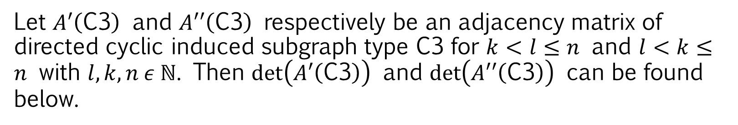
Lemmas
Step 2.
Let $A′\left(\text{C}\text{3}\right)$ and $A′′\left(\text{C}\text{3}\right)$ respectively be an adjacency matrix of directed cyclic induced subgraph type C3 for $k<l≤n$ and $l<k≤n$ with $l,k,n ε ℕ$. Then $\det\left(A′\left(\text{C}\text{3}\right)\right)$ and $\det\left(A′′\left(\text{C}\text{3}\right)\right)$ can be found below.
Figure 6. The determinant of the adjacency matrix of the directed cyclic induced subgraph type C3

Slide 26
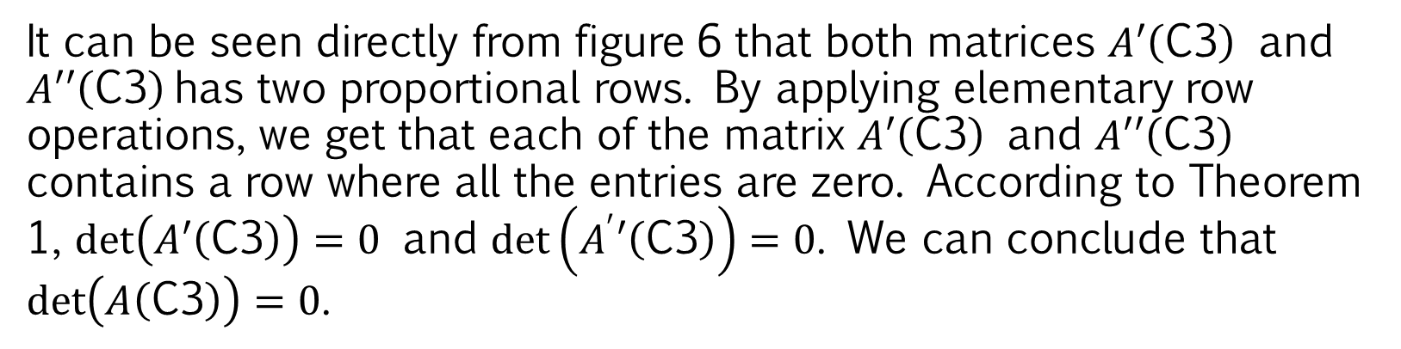
Lemmas
It can be seen directly from figure 6 that both matrices $A′\left(\text{C}\text{3}\right)$ and $A′′\left(\text{C}\text{3}\right)$has two proportional rows. By applying elementary row operations, we get that each of the matrix $A′\left(\text{C}\text{3}\right)$ and $A′′\left(\text{C}\text{3}\right)$ contains a row where all the entries are zero. According to Theorem 1, $\det\left(A′\left(\text{C}\text{3}\right)\right)=0$ and $\det\left(A^{′}′\left(\text{C}\text{3}\right)\right)=0$. We can conclude that $\det\left(A\left(\text{C}\text{3}\right)\right)=0$.

Slide 27
Lemmas
Step 3.
The directed cyclic induced subgraph type C4 contains the main circle. The main circle in a C4 is defined as a circle chosen randomly from all the circles contained in C4. The directed cyclic induced subgraph type C4 can be grouped into 2 groups. The first group is a subgraph of type C4 where there is a vertex outside the main circle with odd index. The second group is a subgraph of type C4 where all vertices outside the main circle are even indexed. FIGURE 7 is an example of the main circle in subgraph C4.

Slide 28
Lemmas
Figure 7. Examples of main circles

Slide 29
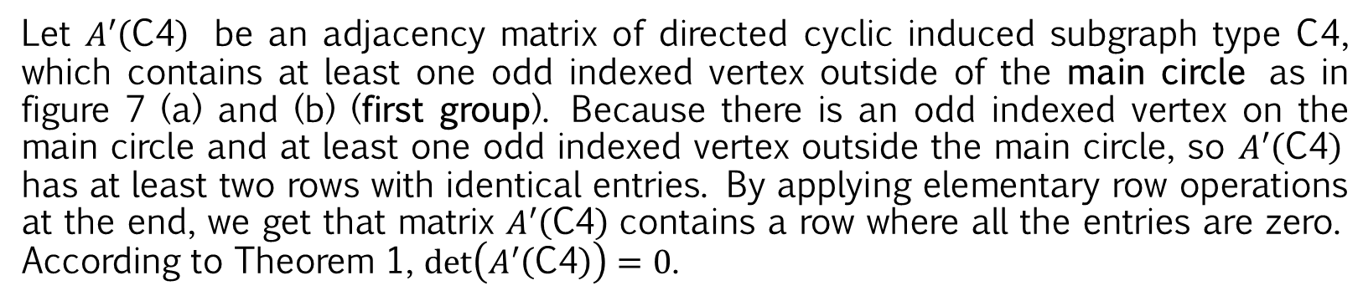
Lemmas
Let $A′\left(\text{C}\text{4}\right)$ be an adjacency matrix of directed cyclic induced subgraph type C4, which contains at least one odd indexed vertex outside of the main circle as in figure 7 (a) and (b) (first group). Because there is an odd indexed vertex on the main circle and at least one odd indexed vertex outside the main circle, so $A′\left(\text{C}\text{4}\right)$ has at least two rows with identical entries. By applying elementary row operations at the end, we get that matrix $A′\left(\text{C}\text{4}\right)$contains a row where all the entries are zero. According to Theorem 1, $\det\left(A′\left(\text{C}\text{4}\right)\right)=0$.

Slide 30
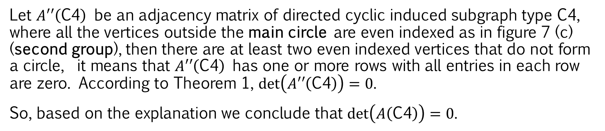
Lemmas
Let $A′′\left(\text{C}\text{4}\right)$ be an adjacency matrix of directed cyclic induced subgraph type C4, where all the vertices outside the main circle are even indexed as in figure 7 (c) (second group), then there are at least two even indexed vertices that do not form a circle, it means that $A′′\left(\text{C}\text{4}\right)$ has one or more rows with all entries in each row are zero. According to Theorem 1, $\det\left(A′′\left(\text{C}\text{4}\right)\right)=0$.
So, based on the explanation we conclude that $\det\left(A\left(\text{C}\text{4}\right)\right)=0$.

Slide 31
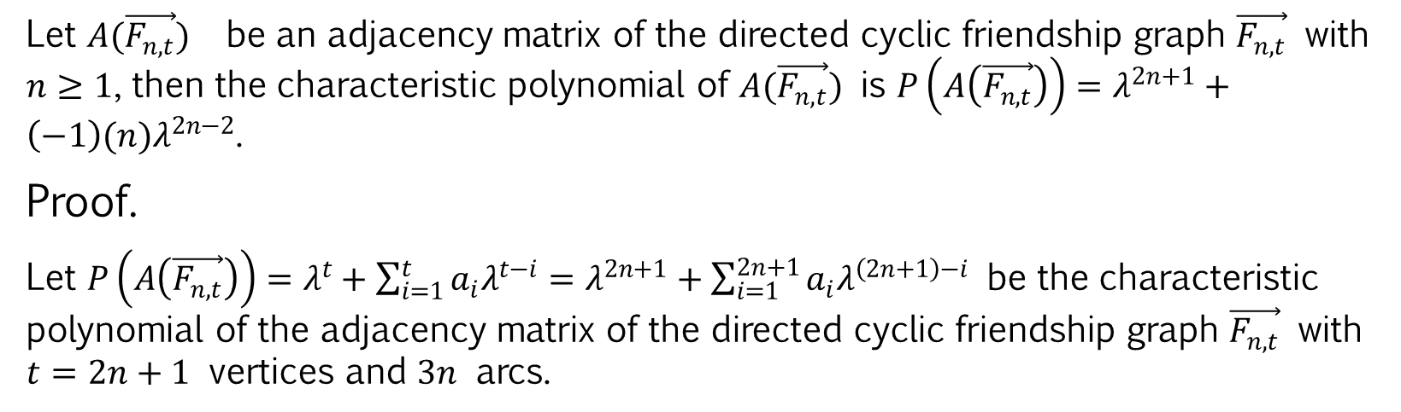
Theorems
Theorem 6.
Let $A(\vec{F_{n,t}})$ be an adjacency matrix of the directed cyclic friendship graph $\vec{F_{n,t}}$ with $n≥1$, then the characteristic polynomial of $A(\vec{F_{n,t}})$ is $P\left(A\left(\vec{F_{n,t}}\right)\right)=λ^{2n+1}+\left(−1\right)(n)λ^{2n−2}$.
Proof.
Let $P\left(A\left(\vec{F_{n,t}}\right)\right)=λ^{t}+\sum_{i=1}^{t}{a_{i}λ^{t−i}}=λ^{2n+1}+\sum_{i=1}^{2n+1}{a_{i}λ^{\left(2n+1\right)−i}}$ be the characteristic polynomial of the adjacency matrix of the directed cyclic friendship graph $\vec{F_{n,t}}$ with $t=2n+1$ vertices and $3n$ arcs.

Slide 32
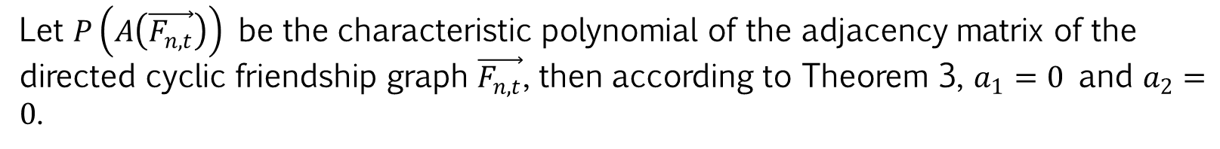
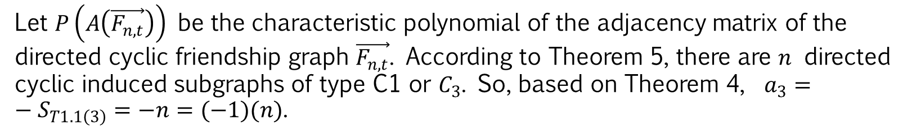
Theorems
For $a_{i}$, $1≤i≤2$
Let $P\left(A\left(\vec{F_{n,t}}\right)\right)$ be the characteristic polynomial of the adjacency matrix of the directed cyclic friendship graph $\vec{F_{n,t}}$, then according to Theorem 3, $a_{1}=0$ and $a_{2}=0$.
For $a_{3}$
Let $P\left(A\left(\vec{F_{n,t}}\right)\right)$ be the characteristic polynomial of the adjacency matrix of the directed cyclic friendship graph $\vec{F_{n,t}}$. According to Theorem 5, there are $n$ directed cyclic induced subgraphs of type C1 or $C_{3}$. So, based on Theorem 4, $a_{3}=−S_{T1.1\left(3\right)}=−n=(−1)(n)$.

Slide 33
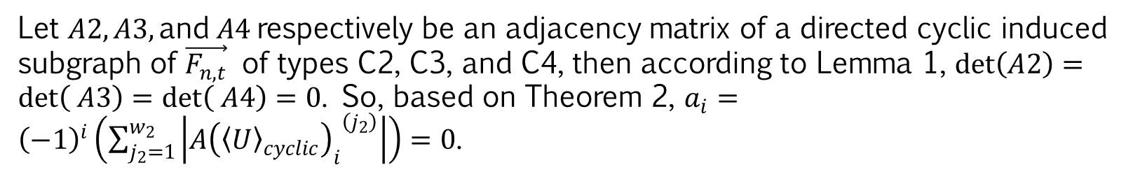
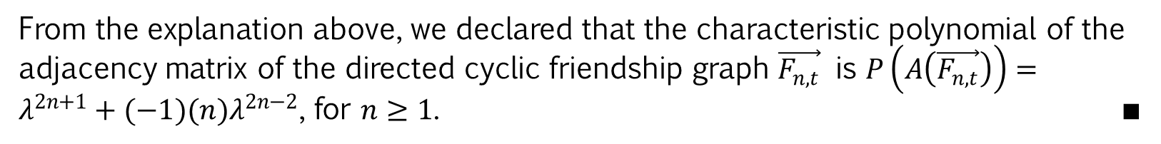
Theorems
For $a_{i}$, $4≤i≤t=2n+1$
Let $A2, A3, \text{and} A4$respectively be an adjacency matrix of a directed cyclic induced subgraph of $\vec{F_{n,t}}$ of types C2, C3, and C4, then according to Lemma 1, $\det\left(A2\right)=\det\left( A3\right)=\det\left( A4\right)=0$. So, based on Theorem 2, $a_{i}={\left(−1\right)}^{i}\left(\sum_{j_{2}=1}^{w_{2}}{\left|{A{\left({〈U〉}_{cyclic}\right)}_{i}}^{\left(j_{2}\right)}\right|}\right)=0$.
From the explanation above, we declared that the characteristic polynomial of the adjacency matrix of the directed cyclic friendship graph $\vec{F_{n,t}}$ is $P\left(A\left(\vec{F_{n,t}}\right)\right)=λ^{2n+1}+(−1)(n)λ^{2n−2}$, for $n≥1$. ∎

Slide 34
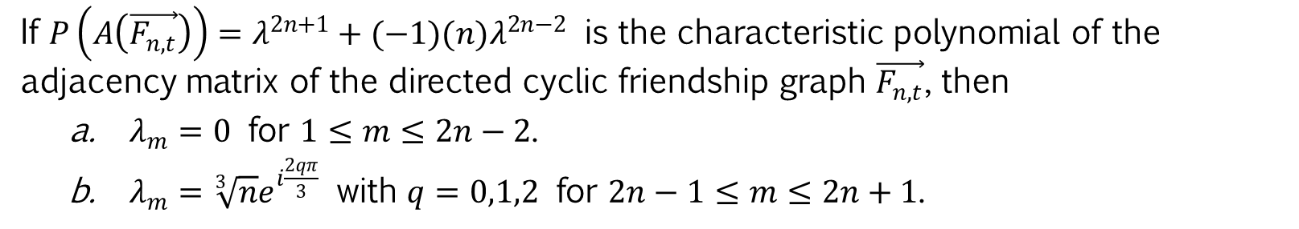
Theorems
Theorem 7.
If $P\left(A\left(\vec{F_{n,t}}\right)\right)=λ^{2n+1}+(−1)(n)λ^{2n−2}$ is the characteristic polynomial of the adjacency matrix of the directed cyclic friendship graph $\vec{F_{n,t}}$, then
$λ_{m}=0$ for $1≤m≤2n−2$.
$λ_{m}=\sqrt[3]{n}e^{i\frac{2qπ}{3}}$ with $q=0,1,2$ for $2n−1≤m≤2n+1$.

Slide 35
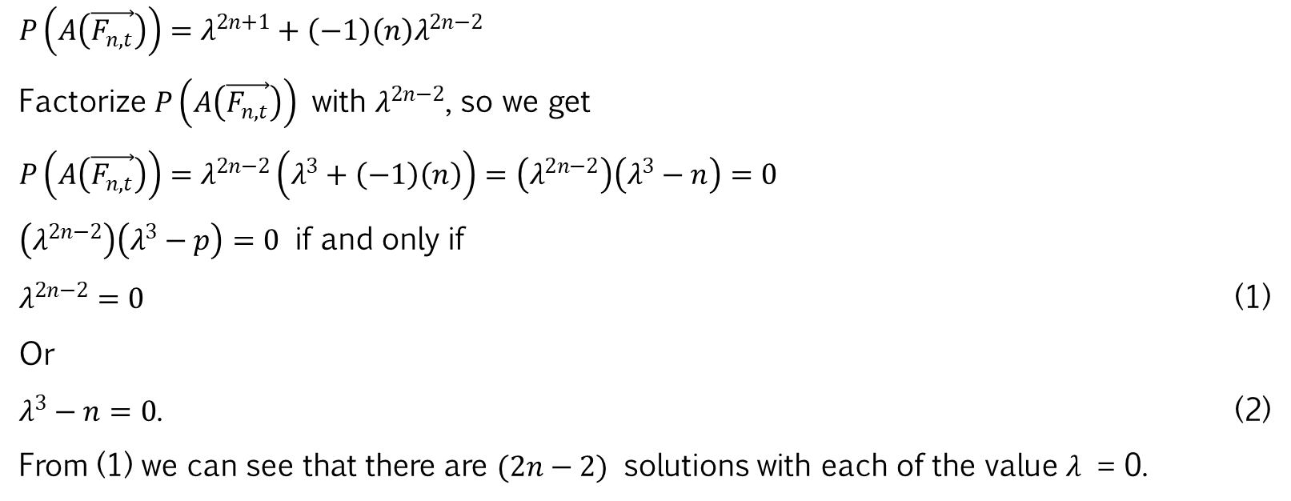
Theorems
Proof part (a)
$P\left(A\left(\vec{F_{n,t}}\right)\right)=λ^{2n+1}+\left(−1\right)\left(n\right)λ^{2n−2}$
Factorize $P\left(A\left(\vec{F_{n,t}}\right)\right)$ with $λ^{2n−2}$, so we get
$P\left(A\left(\vec{F_{n,t}}\right)\right)=λ^{2n−2}\left(λ^{3}+\left(−1\right)\left(n\right)\right)=\left(λ^{2n−2}\right)\left(λ^{3}−n\right)=0$
$\left(λ^{2n−2}\right)\left(λ^{3}−p\right)=0$ if and only if
$λ^{2n−2}=0$ (1)
Or
$λ^{3}−n=0$. (2)
From (1) we can see that there are $(2n−2)$ solutions with each of the value 𝜆 = 0.

Slide 36
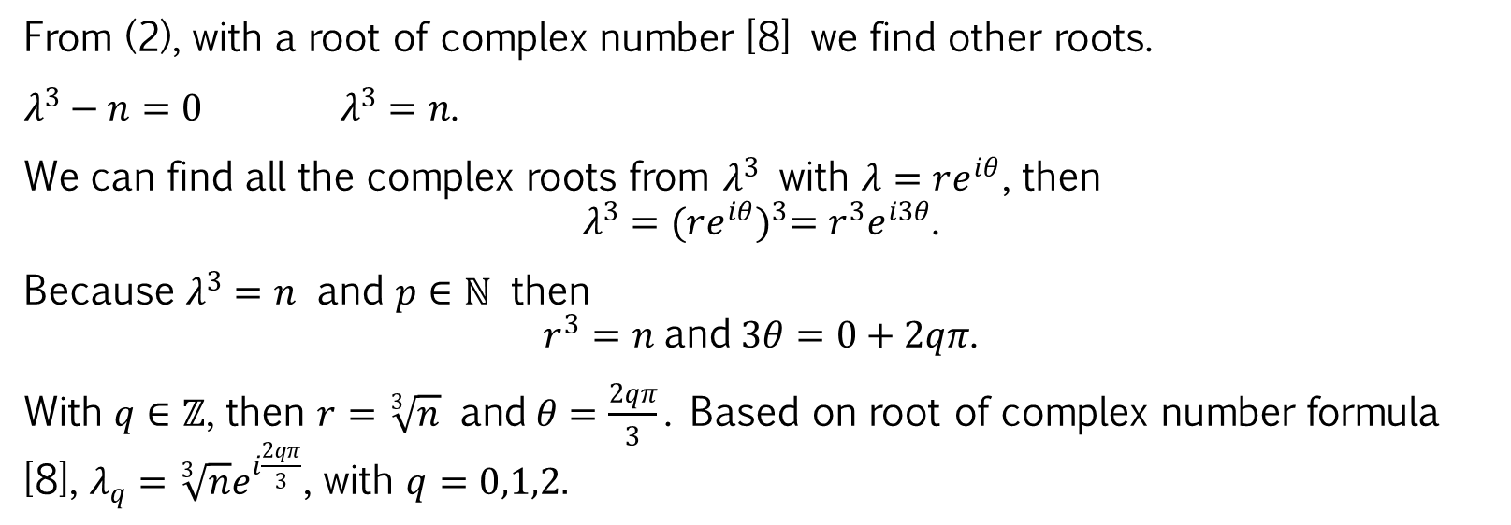
Theorems
Proof part (b)
From (2), with a root of complex number [8] we find other roots.
$λ^{3}−n=0$ $λ^{3}=n\text{.}$
We can find all the complex roots from $λ^{3}$ with $λ=re^{iθ}$, then
$$λ^{3}={(re^{iθ})}^{3}=r^{3}e^{i3θ}\text{.}$$
Because $λ^{3}=n$ and $p∈ℕ$ then
$$r^{3}=n \text{and} 3θ=0+2qπ\text{.}$$
With $q∈ℤ$, then $r=\sqrt[3]{n} \text{and} θ=\frac{2qπ}{3}\text{.}$ Based on root of complex number formula [8], $λ_{q}=\sqrt[3]{n}e^{i\frac{2qπ}{3}}$, with $q=0,1,2.$

Slide 37
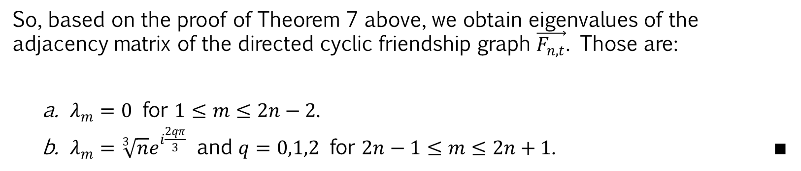
Theorems
So, based on the proof of Theorem 7 above, we obtain eigenvalues of the adjacency matrix of the directed cyclic friendship graph $\vec{F_{n,t}}$. Those are:
$λ_{m}=0$ for $1≤m≤2n−2$.
$λ_{m}=\sqrt[3]{n}e^{i\frac{2qπ}{3}}$ and $q=0,1,2$ for $2n−1≤m≤2n+1$. ∎

Slide 38
Conclusions

Slide 39
Conclusion
So, the characteristic polynomial of the adjacency matrix of the directed cyclic friendship graph $\vec{F_{n,t}}$ is $P\left(A\left(\vec{F_{n,t}}\right)\right)=λ^{2n+1}+(−1)(n)λ^{2n−2}$, for $n≥1$.

Slide 40
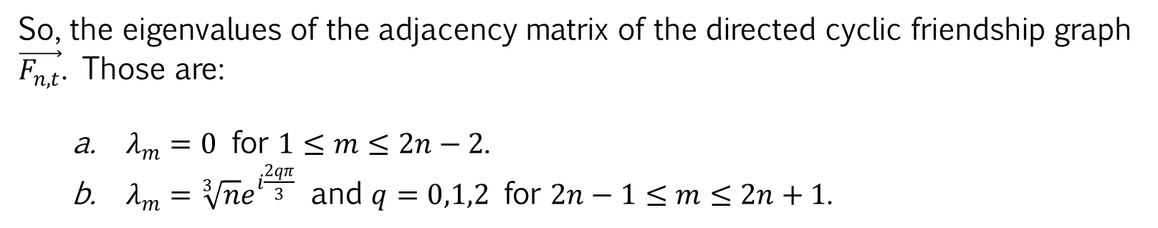
Conclusion
So, the eigenvalues of the adjacency matrix of the directed cyclic friendship graph $\vec{F_{n,t}}$. Those are:
$λ_{m}=0$ for $1≤m≤2n−2$.
$λ_{m}=\sqrt[3]{n}e^{i\frac{2qπ}{3}}$ and $q=0,1,2$ for $2n−1≤m≤2n+1$.

Slide 41
References

Slide 42
Conclusion
N. Anzana, S. Aminah, S. Utama, and D.R. Silaban, Journal of Physics: Conference Series 1538, 012007 (2020).
Wildan, M.Sc. thesis. Universitas Indonesia, Depok, 2015.
R.B. Bapat, Graphs and Matrices, 2nd ed. (Springer, London, 2014).
R. Diestel, Graph Theory, 3rd ed. (Springer-Verlag Heidelberg, New York, 2005)
G. Chartrand, L. Lesniak and P. Zhang, Graphs & Digraphs, 11th ed. (CRC Press, Florida, 2011)
D. Tanna, International Journal of Advanced Engineering Research and Studies 2, 46-48 (2013).
H. Anton and C. Rorres, Elementary Linear Algebra: Applications Version, 11th ed. (John Wiley & Sons, 2014).
J.W. Brown and R.V. Churchill, Complex Variables and Applications (McGraw-Hill, New York, 1990).

