Slide 1
Modeling Pipes Using Pipes' Center Curves of Quadratic and Cubic Spline Interpolation
Kusno, University of Jember

Slide 2
List of Presentation
Introduction
Quadratic and Cubic Curves of Spline Interpolation
Pipes Formulation & Simulation
Conclusions

Slide 3
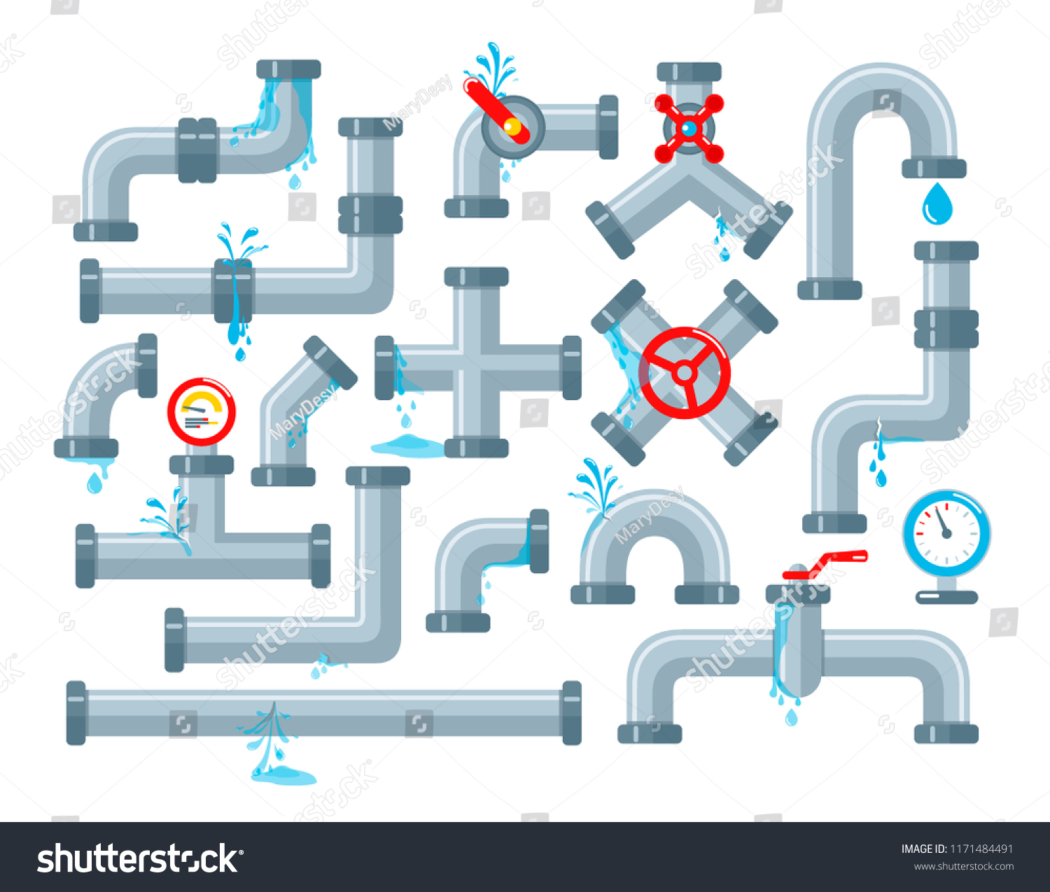
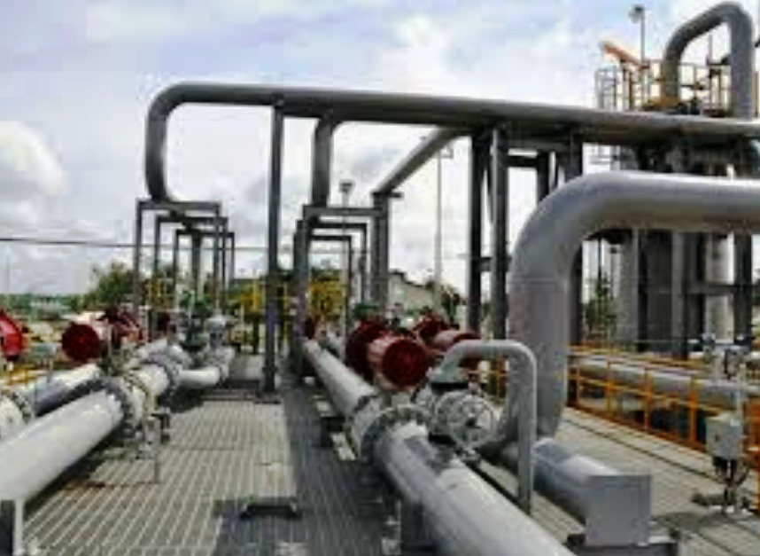
Introduction
Year: 2013 -2019 → ± 7 Researchs → Pipes Construction
Limitations:
Focus on → short measure models
Two Pipes Connection → C¹
Presented Paper:
To model the long pipes + connection C²

Slide 4
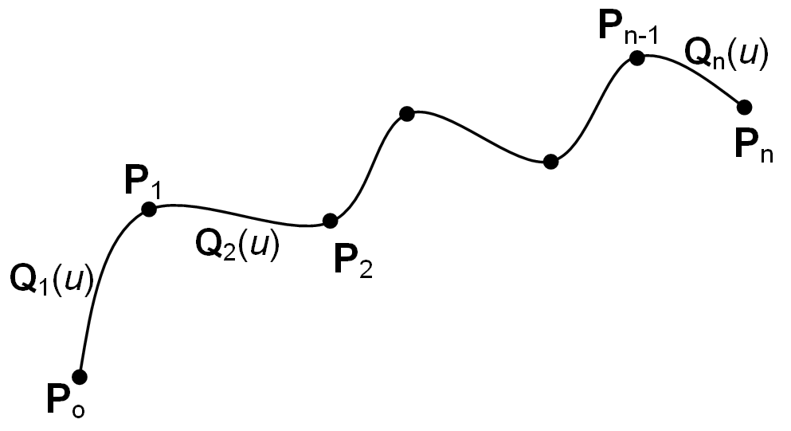
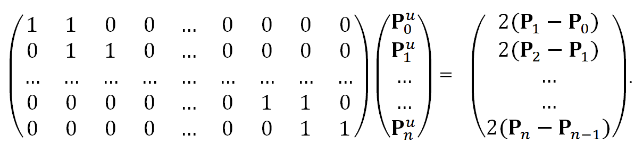
Quadratic and Cubic Curves of Spline Interpolation^{(Review)}
Quadratic Spline Curve
Curve : Q(u) = a.u² + b.u + c → Q(0) = P₀, Q(1) = P₁, and Q^{u}(0) = P₀^{u}.
Curve in [P₀,P₁]: Q(u) = a.u² + b.u + c = (P₁ - P₀ - P₀^{u}).u² + P₀^{u}.u + P₀ with 0 ≤ u ≤ 1.
Data Control Points: P₀, P₁, P₂, …,P_{n}.
Pb. Segment Curves in: [P₀,P₁], [P₁,P₂], [P₂,P₃], …, [P_{n-1},P_{n}].
Conditions of Spline: Q_{i}(1) = Q_{i+1}(0) and Q_{i}^{u}(1) = Q_{i+1}^{u}(0); for i = 1, 2, 3, .., n-1.
Solution:
n → Equations
N+1 → Unknown Tangent Vectors → Fixed One Value

Slide 5
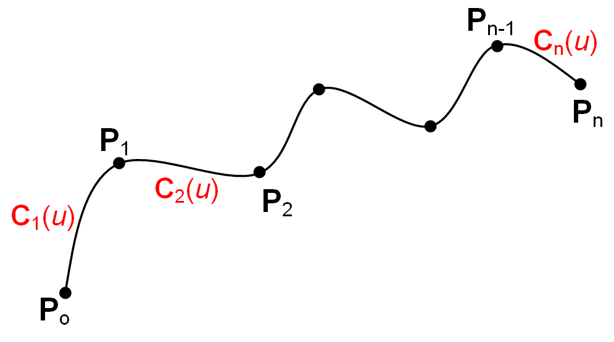
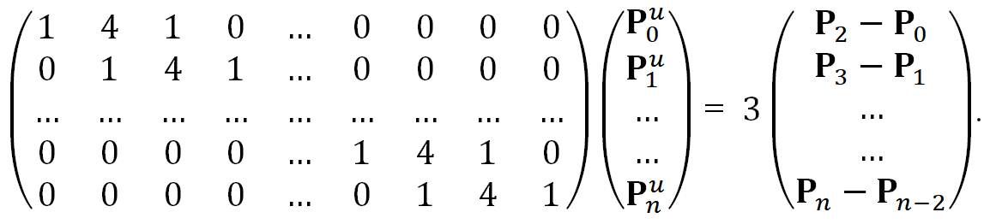
Cubic Spline Curve
Curve : Q(u) = a.u² + b.u + c → Q(0) = P₀, Q(1) = P₁, Q^{u}(0) = P₀^{u}, and Q^{u}(1) = P₁^{u}.
Curve in [P₀,P₁]: Q(u) = [2(P₁–P₀)-P₀^{u}+P₁^{u}].u³ + [3 (P₁ – P₀)-2P₀^{u}+P₁^{u}].u² + P₀^{u}.u+P₀; 0 ≤ u ≤ 1.
Data Control Points: P₀, P₁, P₂, …,P_{n}.
Pb. Segment Curves in: [P₀,P₁], [P₁,P₂], [P₂,P₃], …, [P_{n-1},P_{n}].
Conditions of Spline:
Q_{i}(1) = Q_{i+1}(0); Q_{i}^{u}(1) = Q_{i+1}^{u}(0); Q_{i}^{uu}(1) = Q_{i+1}^{uu}(0); for i = 1, 2, 3, .., n-1.
Solution:
n -1 → Equations
n+1 → Unknown Tangent Vectors → Fixed Two Values

Slide 6
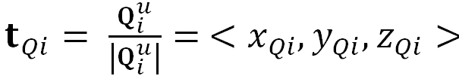

Pipes Formulation & Simulation
Formulation
t
V₂
p(uo)
Γ(u)
r(v)
V₁
ρ(u)
Pipe Construction → Data P₀, P₁, P₂, …,P_{n},
Determine ϒ(u,v) = r(v) ρ(u)
Calculate the Spline Q_{i}(u) and C_{i}(u) → Center Curves
Compute unity tangent vectors [t_{Qi}, (v₁)_{Qi} ,(v₂)_{Qi}] and [t_{Ci}, (v₁)_{Ci} ,(v₂)_{Ci}]

Slide 7
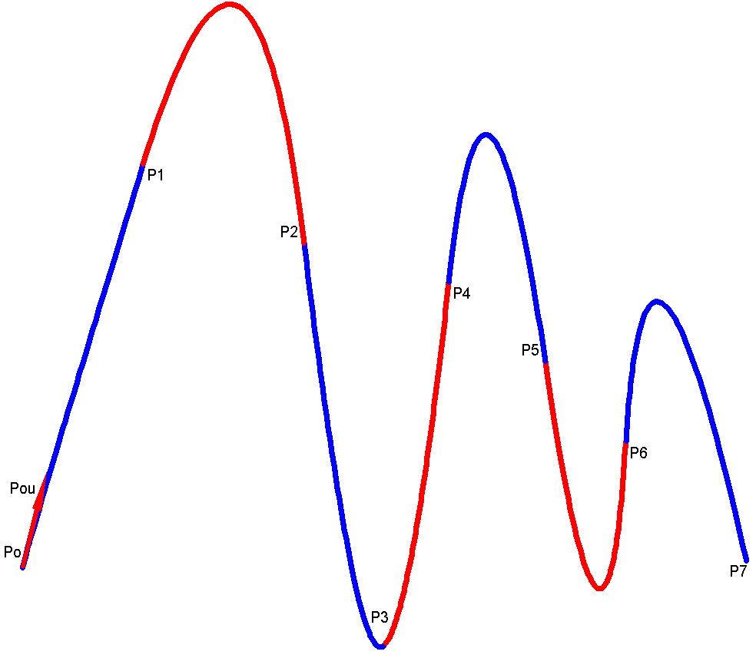
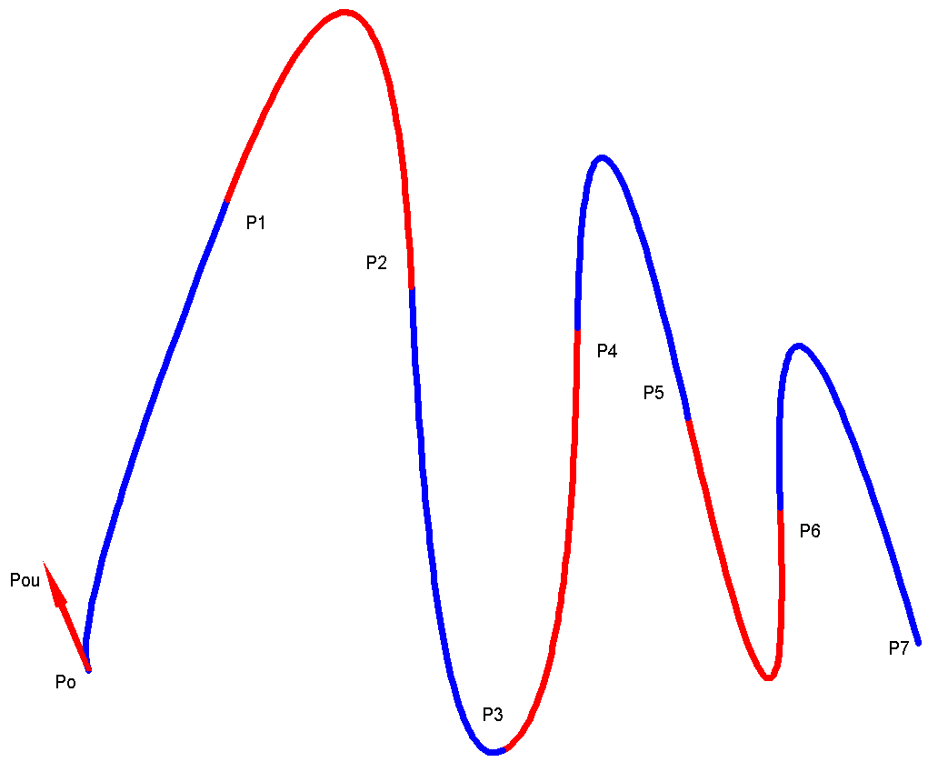
Simulation
Quadratic Spline Curves
Data:
P₀ = <-45,0,-25>,
P₁ = <-30,025>,
P₂ = <-10,0,15>,
P₃= <0,0,-35>,
P₄ = <8,0,10>,
P₅ = <20,0,0>,
P₆= <30,0,-10>,
P₇ = <45,0,-25>,
P₀ ^{u} = <3,0,12>.
Solution:
P₁ ^{u} = <27,0,88>,
P₂ ^{u} = <13,0,-108>,
P₃ ^{u} = <7,0,8>,
P₄^{u} = <9,0,82>,
P₅ ^{u} = <15,0,-102>,
P₆ ^{u} = <5,0,82>,
P₇ ^{u} = <25,0,-112>.

Slide 8
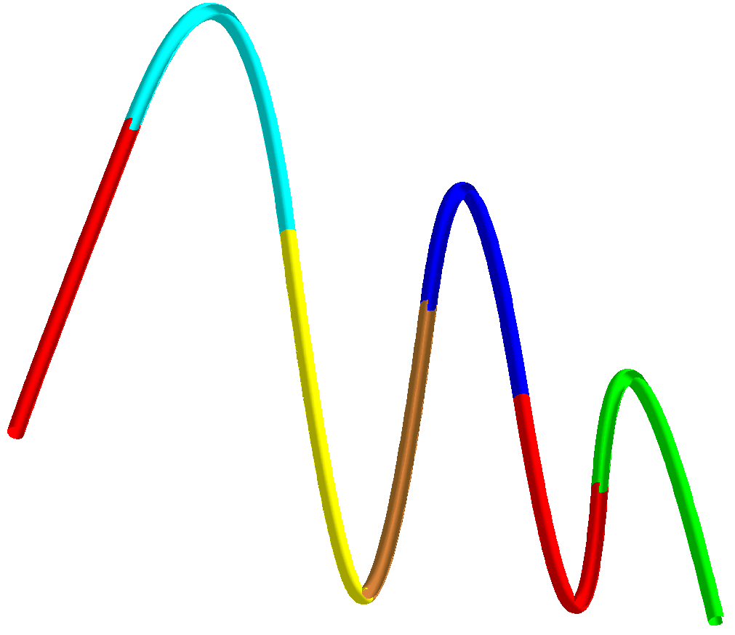
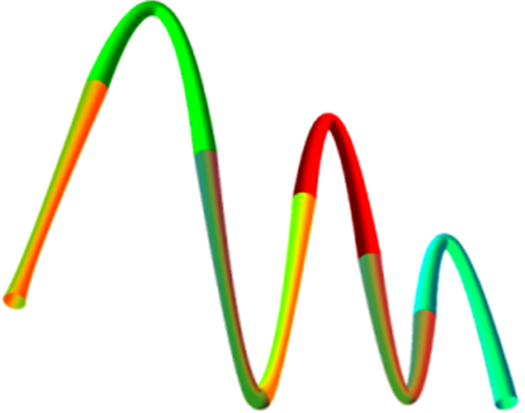
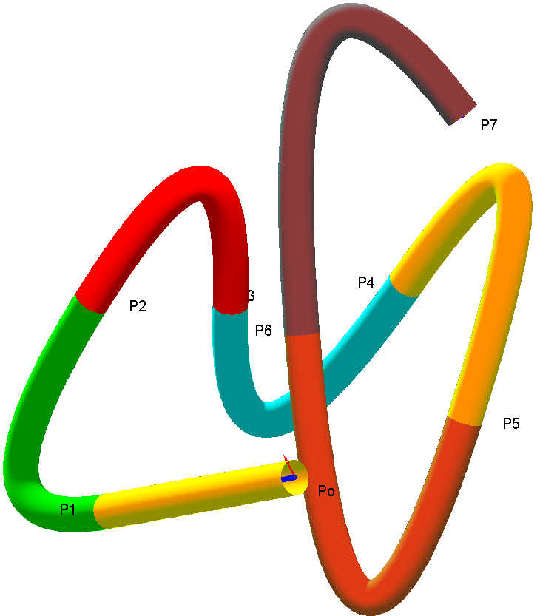
Simulation
Quadratic Spline Curves
Data:
P₀ = <-45,0,-25>,
P₁ = <-30,025>,
P₂ = <-10,0,15>,
P₃= <0,0,-35>,
P₄ = <8,0,10>,
P₅ = <20,0,0>,
P₆= <30,0,-10>,
P₇ = <45,0,-25>,
P₀ ^{u} = <3,0,12>.
Solution:
P₁ ^{u} = <27,0,88>,
P₂ ^{u} = <13,0,-108>,
P₃ ^{u} = <7,0,8>,
P₄^{u} = <9,0,82>,
P₅ ^{u} = <15,0,-102>,
P₆ ^{u} = <5,0,82>,
P₇ ^{u} = <25,0,-112>.
r(v) =ρ(u) =1
ρ(u) = 2.(1-u)³+ 3.(1-u)².u+ 3.(1-u).u² + 2.u³
P₀ = <45,-45,-45>, P₁ = <-38,-40,-50>
P₂ = <-50,-35,10>, P₃= <-30,0,10>
P₄ = <10,30,15>, P₅ = <40,25,-25>
P₆ = <5,-5,0>, P₇ = <50,15,60>
P₀ ^{u} = <-1.75,1.25,-1.25>.

Slide 9
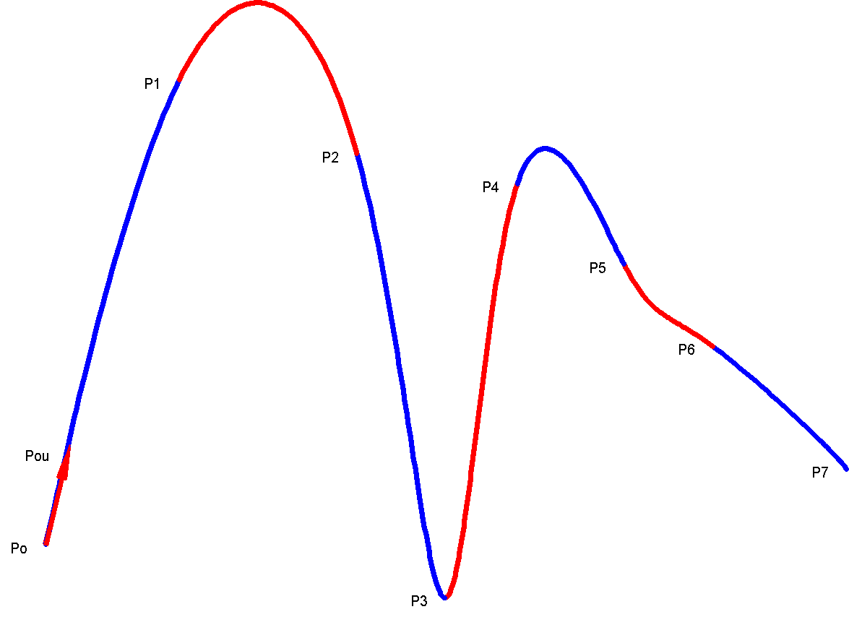
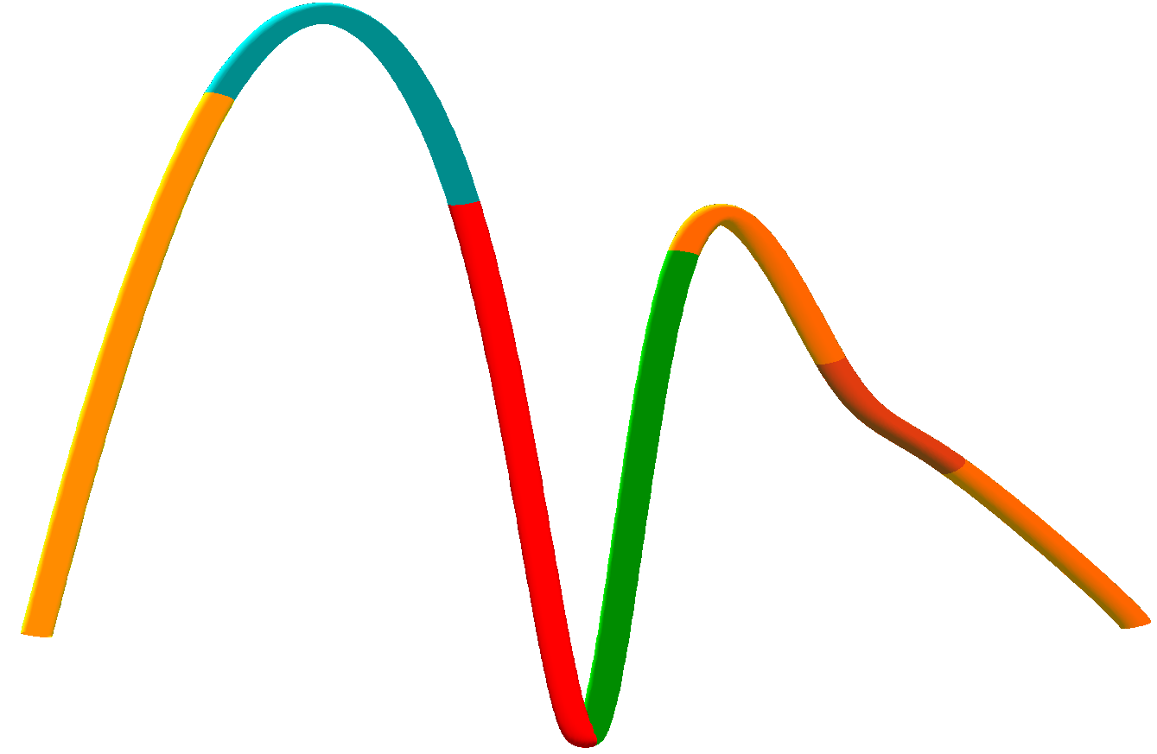
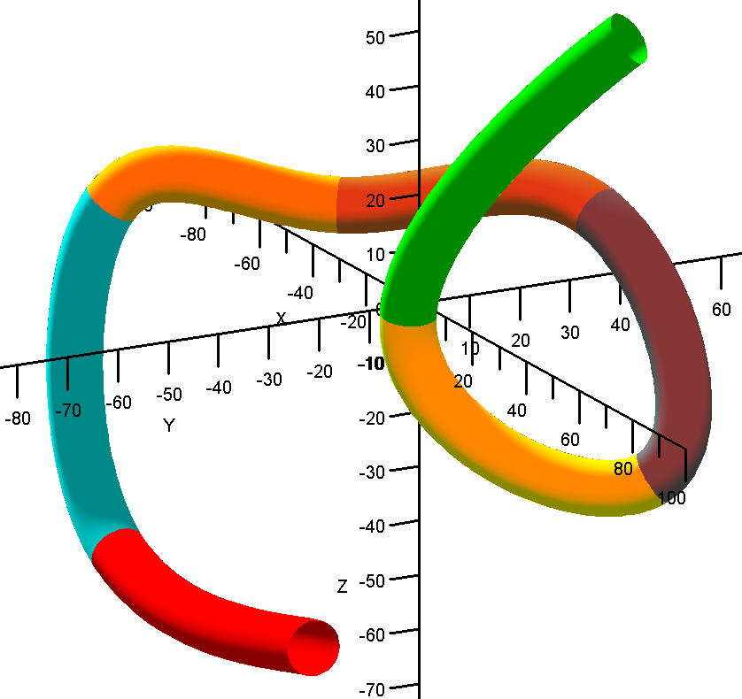
Simulation
Cubic Spline
Cubic Spline Curves
Data:
P₀ = <-45,0,-25>,
P₁ = <-30,025>,
P₂ = <-10,0,15>,
P₃= <0,0,-35>,
P₄ = <8,0,10>,
P₅ = <20,0,0>,
P₆= <30,0,-10>,
P₇ = <45,0,-25>,
P₀ ^{u} = <3,0,12>.
P₇ ^{u} = <1,0,-3>.
Solution:
P₁ ^{u} = <21.7,0,50>,
P₂ ^{u} = <15.3,0,-55.9>,
P₃ ^{u} = <7,0,2.6>,
P₄^{u} = <10.8,0,30.4>,
P₅ ^{u} = <9.8,0,-19.3>,
P₆ ^{u} = <16.1,0,-13.2>.
r(v) =ρ(u) =1
P₀ = <45,-45,-45>, P₁ = <-38,-40,-50>,
P₂ = <-50,-35,10>, P₃= <-30,0,10>,
P₄ = <10,30,15>, P₅ = <40,25,-25>,
P₆ = <5,-5,0>, P₇ = <50,15,60>
P₀ ^{u} = <-20.75,1.25,-1.25>
P₇ ^{u} = <5,5,5>,.

Slide 10
CONCLUSION
Computations→ Handy + Straightforward → Pipe shapes
Easy to construct → Many curvatures and multiple tracks.
Quadratic spline → Fewer oscillations
Cubic Spline → Curves tighter C²

