Slide 1
Comparison of Characteristic of Furrow Irrigation Infiltration in Various Types of Soils Using Dual Reciprocity Boundary Element Method

Slide 2
Point to Discuss
INTRODUCTION
METHODS
RESULTS AND DISCUSSIONS
CONCLUSION

Slide 3
INTRODUCTION
The amount of water on earth is very restricted
It is only 3% is fresh water.
Less than 1% is on the surface.

Slide 4
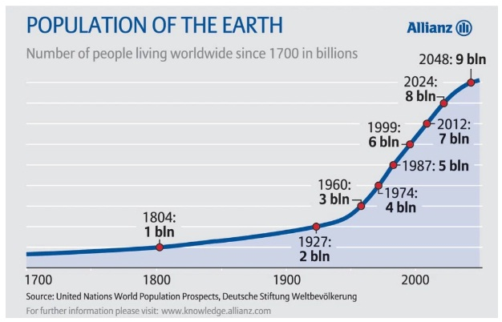
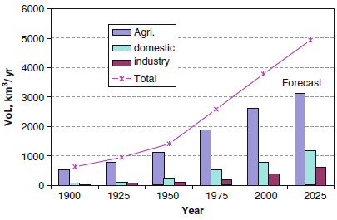
Year by year number of human population is increasing.
Follwed by the number of water consumption
The biggest area which consumes water is agriculture
That's why the sistem of irrigation in agriculture sector is very important

Slide 5
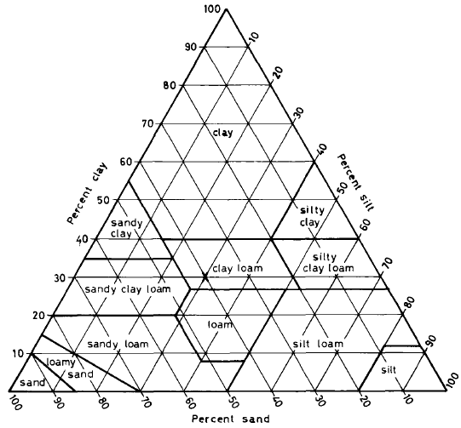
Clasification of Soil
The main factor that influences the process of water infiltration in irrigation channel is soil type.
Every soil has different constituent substances implying different infiltration processes.
The elements in the soils are generally sand, silt, and clay with different grains of soil.

Slide 6
Clasification of Soil
One approach to find and explain solutions to problems that occur in the real world is by mathematical modeling.
After the mathematical model is obtained it can be solved mathematically, and can be applied in real problems.
Mathematical model for water infiltration in a channel irrigation is a modified Helmhotz equation in the form of a partial differential equation (PDE) with boundary conditions or in mathematics, it is called Boundary Value Problem (BVP)

Slide 7
Boundary Element Method
A method that is used to get the solution is by using numerical method called Dual Reciprocity Boundary Element Method (DRBEM) numerical method. DRBEM is part of the Boundary Element Method (BEM)
BEM is a numerical method used to solve partial differential equations found in mathematical physics and engineering.
The reasons of choosing DRBEM
(1)Discretization is only done at the domain boundary, thus making numerical modeling with BEM simpler and reducing the number of collocation points needed;
(2) BEM is proven effective in calculating derivatives from field functions such as flux;
(3) Using a set of collocation points located at the domain boundaries can be used to find solutions at all points in the domain;

Slide 8
Focus of The Research
According to description stated above, DRBEM is more effective in solving mathematical models of furrow irrigation infiltration.
Therefore, the focus of the research is Furrow Irrigation Infiltration in Various Types of Soils with different type of soils and will be analyzed in terms of suction potential and water content.
Soil types studied in this research are Sand (Regosol order sandy soil type), Gila Fine Sandy Loam (Podsolik order sandy clay type), Latene Clay Loam (Alluvial order clay loam type), dan Yolo Clay (Latosol order sandy soil type).

Slide 9
METHODS Solution of Helmholtz Equation with DRBEM
This Helmhotz equation has R domain, a closed and bounded region by a simple curve C.
with the boundary conditions
and

Slide 10
The following describes the procedure for solving with DBREM :
1.Reciprocal relation
2. Boundary Integral Equations
with

Slide 11
3.Domain Integral Approach
4.Boundary Integral Equations in the Form of Lines Integral
2. Boundary Integral Equations
with

Slide 12
5.Completion of Boundary Integral Equations
6.Complete the system of linear equations. Next, by substituting the system of linear equations solution into the boundary integral equation, an equation can be obtained that can be used to evaluate the partial differential equation solution at all points in the domain.
with

Slide 13
RESULTS AND DISCUSSIONS
This study uses DRBEM to solve water infiltration problems in various channel irrigation channels.

Slide 14
Mathematical Models of Infiltration in Furrow Irrigation
The channel irrigation channel uses the trapezoidal, so the assumptions used are as follows:
1.Trapezoidal irrigation channel with a channel surface length of 2L.
2.The distance between the midpoints of two adjacent channels is 2 (L + D).
3.The channel is always full of water.
4.The influence of other irrigation channels is ignored.
5.The infiltration rate of water / large incoming fluxes on the surface of the irrigation channel is constant, that is equal to
6.There is no incoming water flow except from the channel.

Slide 15
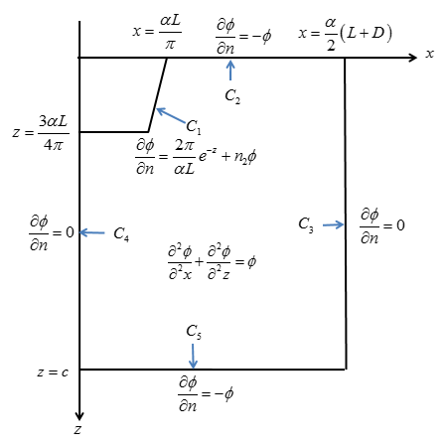
Mathematical model of water infiltration in furrow irrigation channel

Slide 16
DRBEM implementation using Matlab, after Matlab program implementation is complete then it is used to solve the infiltration problem in four homogeneous soil types.
Furthermore, each soil type will be evaluated with ψ and θ at several points along the line X = 10 cm , X = 30 cm, X = 50 cm, X = 70 cm, and X = 90 cm, for 0≤Z≤160 cm.

Slide 17
Based on Figure 2b and 3b the water content in shallow soil is greater than deep soil under the channel assuming water is entering from the channel that seeps deeper into the soil under the channel. The value of θ plotted for each type of soil in these figures show that for shallow soil, the largest water content is sandy soil, i.e. Sand and Gila Fine Sandy Loam. For deep soil, large water content is found in clay soil, i.e. Latene Clay Loam and Yolo Clay.

Slide 19
Based on Figure 4b, 5b, and 6b, it can be seen that for soils that are outside of the bottom of the channel, the clay soil types, i.e. Yolo Clay and lateen Clay Foam, contain more water than sandy soils (Sand Gila Fine Sandy Loam. The explanation from this conclusion is that the clay soils holds more water or does not easily absorb water, thus the water in the channel does not run out but it can seep into the side of the channel. In contrast to sandy soils which have high water absorption so the water in the channel immediately seeps down without having the time to seep to the side of the channel.

Slide 20
Based on Figure 7b - 10b, all of these soil types have the greatest water content located under the channel, while the smallest one at the surface of the soil on outside of the channel which is the furthest from the center of the channel. Based on Figure 7b - 10b the upper soil layer, the farther the distance from the channel, the smaller the water content, different in the lower soil layer, the water content tends to be the same and does not depend on the distance from the channel.

Slide 21
CONCLUSION
DRBEM can mathematically solve for water infiltration in a channel surface irrigation channel system in homogeneous soil in the form of MSB with modified Helmholtz equation as the governing equation and the boundary condition is a mixed boundary condition.
The largest water content value is located at the bottom of the channel and the smallest water content at ground level outside the channel which is the furthest from the center of the channel. For the topsoil water content, the farther the distance from the channel the smaller the water content, while in the lower soil layer the water content tends to be the same and does not depend on the distance from the channel.
The value of absorption is directly proportional to the water content. However, the relationship pattern for each soil type is different, so that the absorption affects the soil type texture or α value and can be ordered based on the soil type texture. The most containing water respectively are Sand (Regosol Order of sandy soil type), Gila Fine Sandy Loam (Podsolik Order of sandy clay), Latene Clay Loam (Alluvial Order of clay loam type), and Yolo Clay (Order of Latosol clay soil type).

Slide 22
References
1.M. G. Bos, R.A.L. Kselik, R. Allen, and D. Molden, Water Requirements for Irrigation and the Environment, (Springer, New York, 2009).
2.E Bresler, "Analysis of Trickle Irrigation with Application to Design Problems," Irrigation Science, 1, 3-17 (1978).
3.M Manaqib, "Mathematical Model for MERS-COV Disease Transmission with Medical Mask Usage and Vaction ," Inprime: Indonesian Journal of Pure and Applied Mathematics, 1, 97-109 (2019).
4.C. Pozrikidis, A Practical Guide to Boundary Element Methods with The Software Library BEMLIB, (CHAPMAN & HALL/CRC, Florida, 2002).
5.J. T. Katsikadelis, Boundary Element: Teory and Applications. (Elsevier Science, Oxford, 2002).
6.V. Batu , "Steady Infiltration from Single and Periodic Strip Source," Soil Sci. Soc. Am, 42, 544-549 (1978).
7.Imam Solekhudin and K.C. Ang, "Suction Potential and Water Absorption from Periodic Channels in Different Types of Homogeneous Soils," Electronic Jurnal of Boundary Element, 10, 42-55 (2012).
8.NurhasanahA., ManaqibM., and FauziahI, “Analysis Infiltration Waters in Various Forms of Irrigation Channels by Using Dual Reciprocity Boundary Element Method,” Jurnal Matematika MANTIK, 6, 52-65 (2020).
9.M Manaqib, "Dual Reciprocity Boundary Element Method untuk Menyelesaikan Masalah Infiltrasi Air pada Saluran Irigasi Alur," in proceeddings of Seminar Matematika dan Pendidikan Matematika UNY, Yogyakarta, (2017).
10.D. Subardja, S. Ritung, M. Anda, Sukarman, E. Suryani, and R. E. Subandiono, Petunjuk Teknis Klasifikasi Tanah Nasional. (Balai Besar Litbang Sumberdaya Lahan Pertanian Badan Penelitian dan Pengembangan Pertanian, Bogor, 2014).
11.A. A. Fard, A. W. Warrick, and D. O. Lomen, “Design Nomographs for Trickle Irrigation System,” J. Irrig. Drain. Eng., 110, 107 (1982).
12.H. A. Basha, “Multidimensional Linearized Nonsteady Infiltration with Prescribed Boundary Conditions at The Soil Surface,” Water Resour. Res., 35, 75–83 (1999).
13.M. Lobo, D.L. Clements and N. Widana , "Infiltration from Irrigation Channels in a Soil with Impermeable Inclusions," ANZIAM, 46, 1055-1068 (2005).
14.M Manaqib, "Pemodelan Matematika Infiltrasi Air pada Saluran Irigasi Alur," MANTIK, 3, 25-31 (2017).
15.D. L. Clements, M. Lobo, and N. Widana, "A Hypersingular Boundary Integral Equation for a Class of a Problems Concerning Infiltration from Periodic Channels," Electronic Journal of Boundary Element, 5, 1-16 (2007).
16.I. Solekhudin and K.C. Ang, "A Dual Reciprocity Boundary Element Method for Steady Infiltration Problems," ANZIAM, 54, 171-180 (2013).

