Slide 1
Stochastic Fractal Search Algorithm in Permutation Flowshop Schedulling Problem
Ayomi Sasmito and Asri Bekti Pratiwi

Slide 2
Table of Contents
Introduction
Permutation Flowshop Schedulling Problem
Stochastic Fractal Search Algorithm
Flowchart
Results and Conclusion

Slide 3


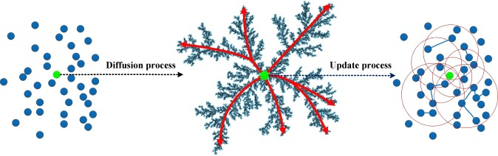
Introduction
The problem of industrial
Schedulling
Permutation Flowshop Schedulling Problem (PFSP)
Stochastic Fractal Search (SFS) Algorithm
Problem Case
Tools

Slide 4
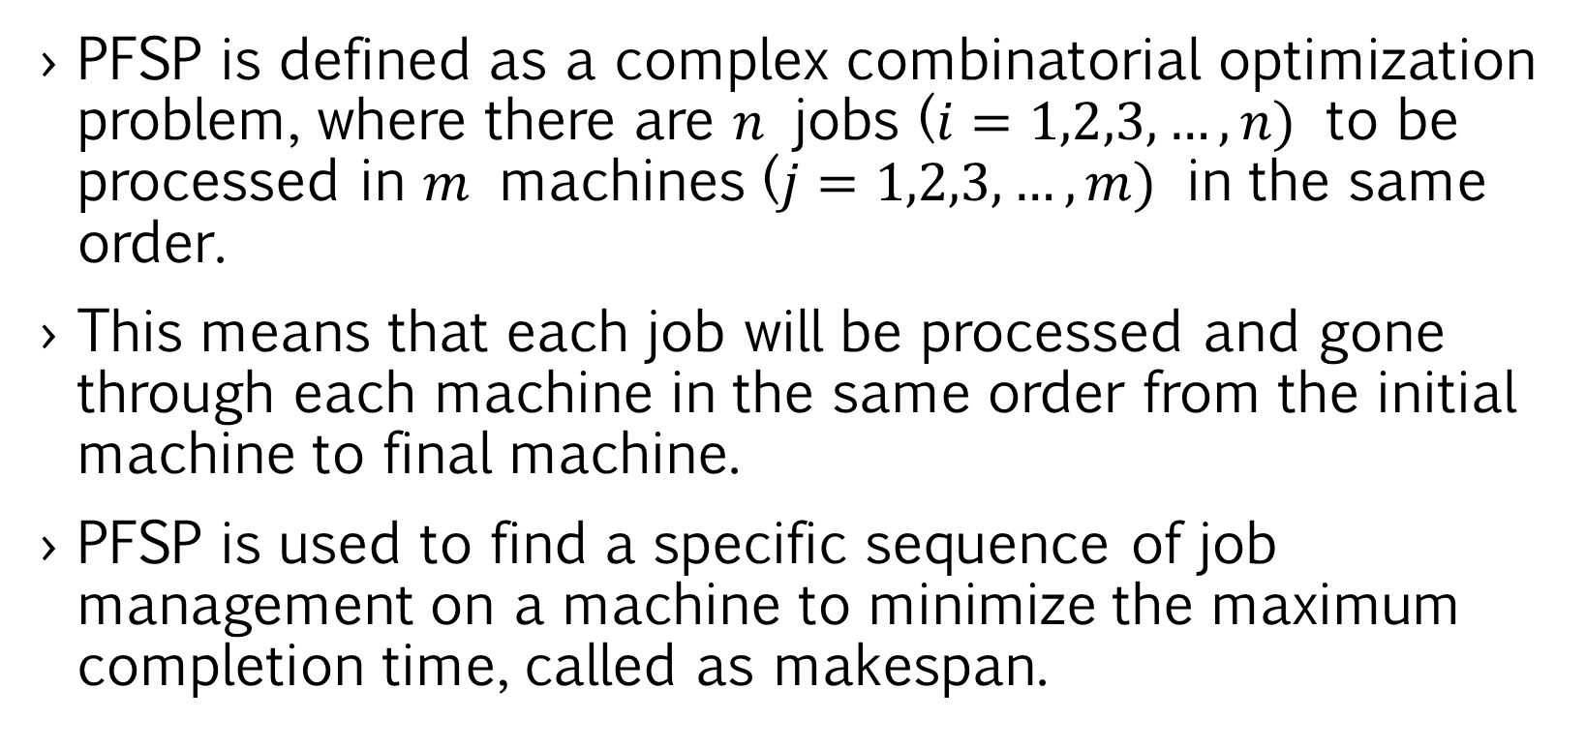
Permutation Flowshop Schedulling Problem (PFSP)
PFSP is defined as a complex combinatorial optimization problem, where there are $n$ jobs ($i=1,2,3,…,n)$ to be processed in $m$ machines ($j=1,2,3,…,m)$ in the same order.
This means that each job will be processed and gone through each machine in the same order from the initial machine to final machine.
PFSP is used to find a specific sequence of job management on a machine to minimize the maximum completion time, called as makespan.

Slide 5
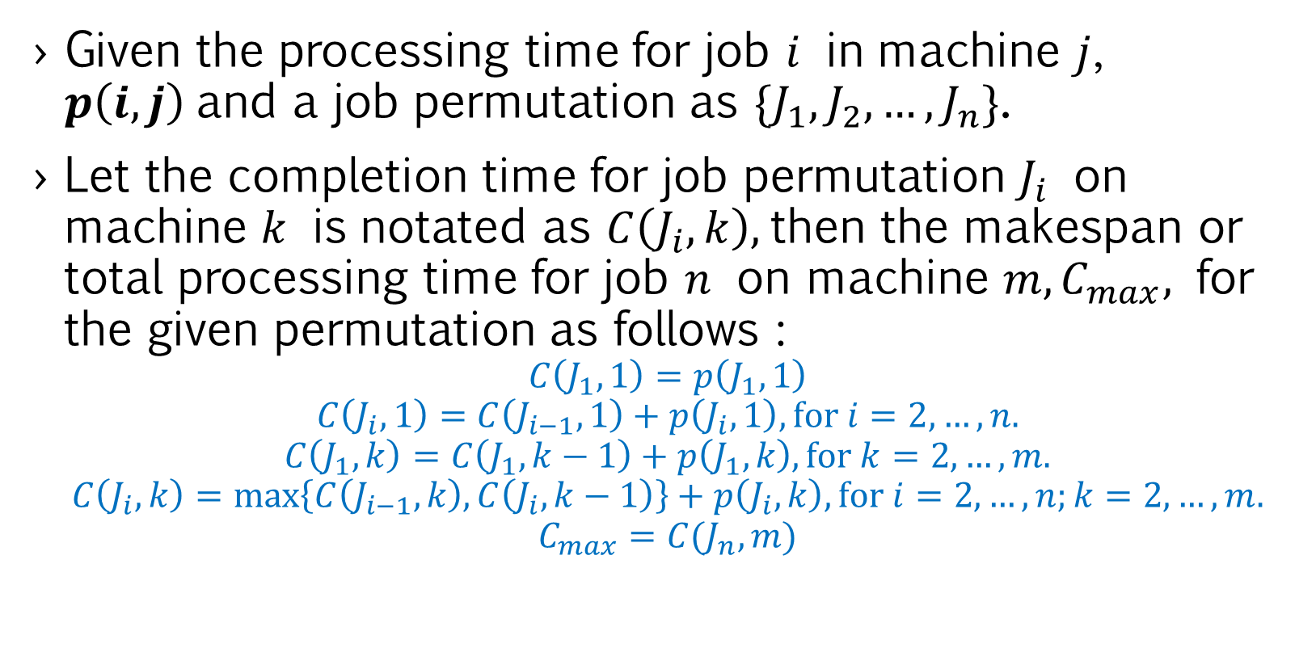
PFSP models
Given the processing time for job $i$ in machine $j$, $p\left(i,j\right)$and a job permutation as $\{J_{1},J_{2},…,J_{n}\}$.
Let the completion time for job permutation $J_{i}$ on machine $k$ is notated as $C\left(J_{i},k\right),$then the makespan or total processing time for job $n$ on machine $m, C_{max},$ for the given permutation as follows :
$$C\left(J_{1},1\right)=p\left(J_{1},1\right)$$
$$C\left(J_{i},1\right)=C\left(J_{i−1},1\right)+p\left(J_{i},1\right), for i=2,…,n.$$
$$C\left(J_{1},k\right)=C\left(J_{1},k−1\right)+p\left(J_{1},k\right), for k=2,…,m.$$
$$C\left(J_{i},k\right)=\max\left\{C\left(J_{i−1},k\right),C\left(J_{i},k−1\right)\right\}+p\left(J_{i},k\right), for i=2,…,n;k=2,…,m.$$
$$C_{max}=C(J_{n},m)$$

Slide 6
Stochastic Fractal Search (SFS) Algorithm
The stochastic fractal search (SFS) algorithm is an improved procedure of fractal search algorithm inspired by growth natural phenomenon.
To obtain the optimal solution of an optimization problem, SFS algorithm uses characteristic of fractal leading to growth of random fractal by having good performance in accuracy and time consumption.
SFS procedure begins with process of diffusion and follows with updating process, which are described below.

Slide 7
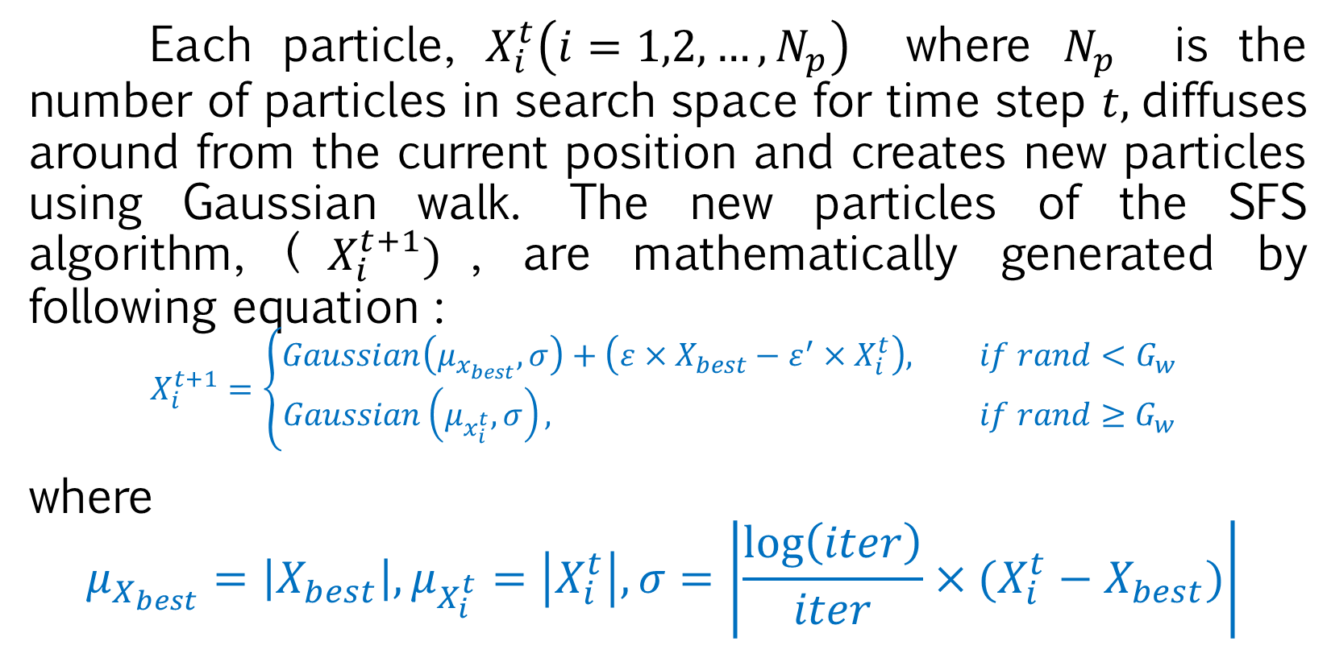
Diffusion Process
Each particle, $X_{i}^{t}\left(i=1,2,…,N_{p}\right)$ where $N_{p}$ is the number of particles in search space for time step $t,$diffuses around from the current position and creates new particles using Gaussian walk. The new particles of the SFS algorithm, ($X_{i}^{t+1})$, are mathematically generated by following equation :
$$X_{i}^{t+1}=\left\{\begin{aligned}Gaussian\left(μ_{x_{best}},σ\right)+\left(ε×X_{best}−ε^{′}×X_{i}^{t}\right), if rand<G_{w} \\ Gaussian\left(μ_{x_{i}^{t}},σ\right), if rand≥G_{w}\end{aligned}\right.$$
where
$$μ_{X_{best}}=\left|X_{best}\right|,μ_{X_{i}^{t}}=\left|X_{i}^{t}\right|, σ=\left|\frac{\log\left(iter\right)}{iter}×(X_{i}^{t}−X_{best})\right|$$

Slide 8
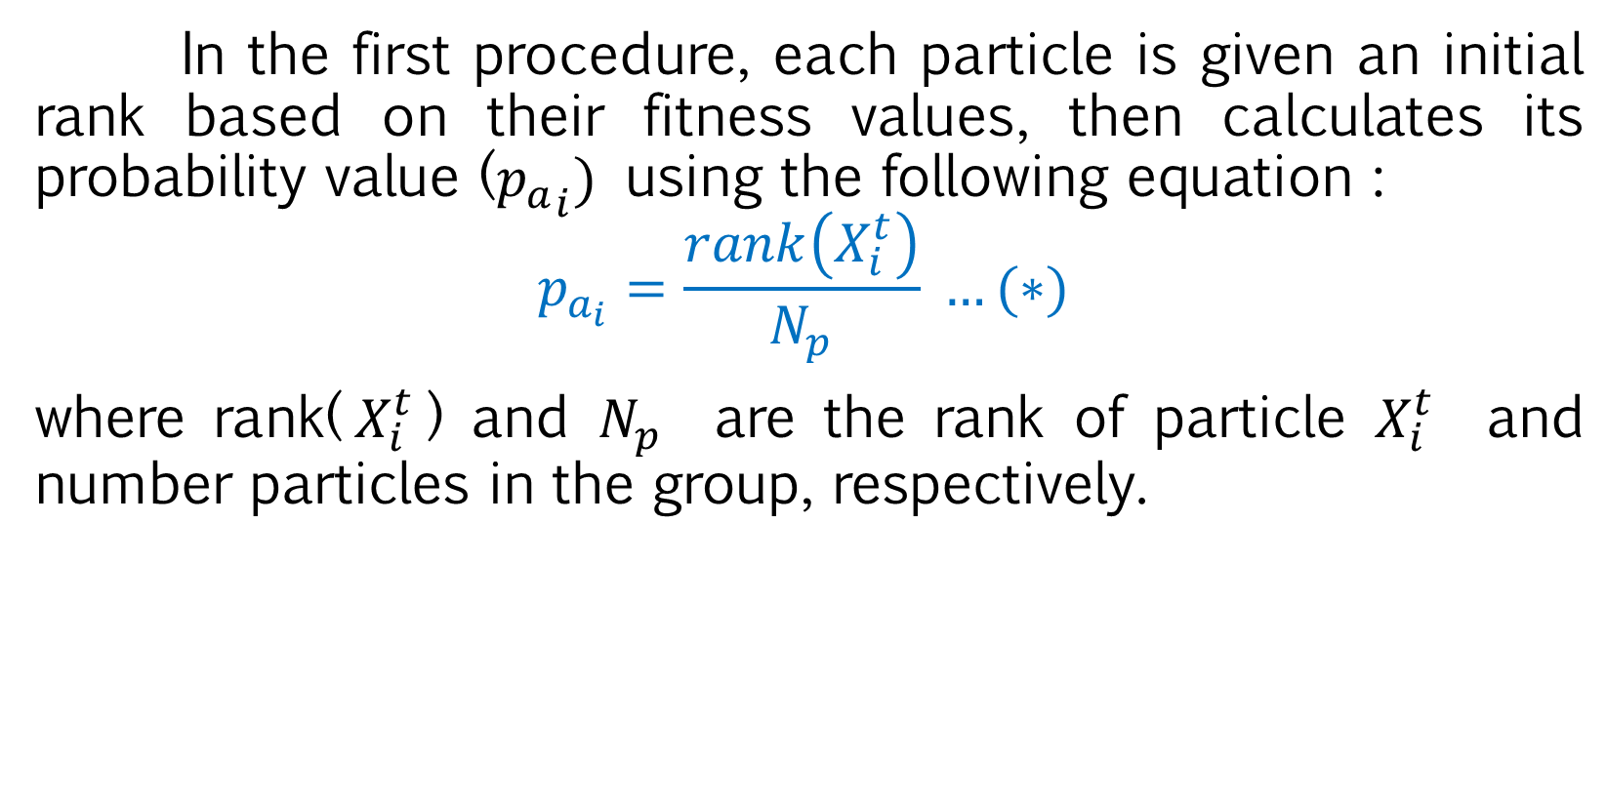
Updating Process
In the first procedure, each particle is given an initial rank based on their fitness values, then calculates its probability value (${p_{a}}_{i})$ using the following equation :
$$p_{a_{i}}=\frac{rank\left(X_{i}^{t}\right)}{N_{p}} …(∗)$$
where rank($X_{i}^{t}$) and $N_{p}$ are the rank of particle $X_{i}^{t}$ and number particles in the group, respectively.

Slide 9
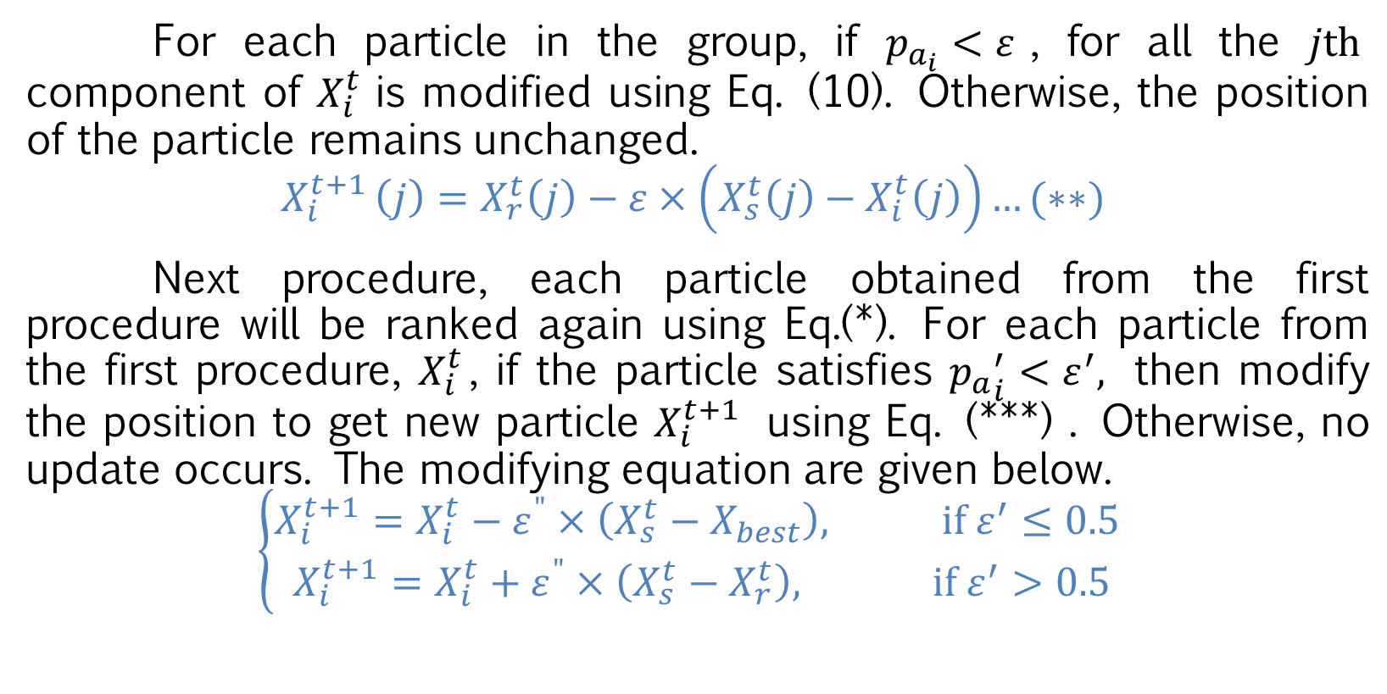
Updating Process
For each particle in the group, if $p_{a_{i}}<ε$, for all the $jth$ component of $X_{i}^{t}$is modified using Eq. (10). Otherwise, the position of the particle remains unchanged.
$$X_{i}^{t+1 }\left(j\right)=X_{r}^{t}\left(j\right)−ε×\left(X_{s}^{t}\left(j\right)−X_{i}^{t}\left(j\right)\right)…(∗∗)$$
Next procedure, each particle obtained from the first procedure will be ranked again using Eq.(*). For each particle from the first procedure, $X_{i}^{t}$, if the particle satisfies ${p_{a}}_{i}^{′}<ε^{′},$ then modify the position to get new particle $X_{i}^{t+1}$ using Eq. (***) . Otherwise, no update occurs. The modifying equation are given below.
$$\left\{\begin{aligned}X_{i}^{t+1}=X_{i}^{t}−ε^{"}×\left(X_{s}^{t}−X_{best}\right), if ε^{′}≤0.5 \\ X_{i}^{t+1}=X_{i}^{t}+ε^{"}×\left(X_{s}^{t}−X_{r}^{t}\right), if ε^{′}>0.5\end{aligned}\right.$$

Slide 10



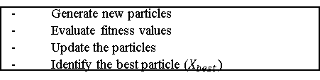

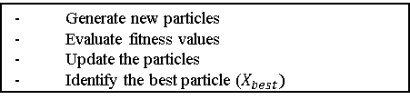
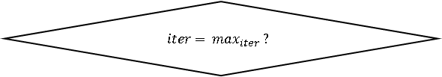



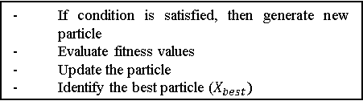
Start
Initialization parameters ($N_{p}, MDN, max_{iter}, Gw)$
Generate initial population randomly
Evaluate fitness function
Identify the best particle ($X_{best})$
$$iter=1$$
$$Diff=1$$
Diffusion Process
Generate new particles
Evaluate fitness values
Update the particles
Identify the best particle ($X_{best})$
$$Diff=Diff+1$$
$$Diff=MDN?$$
No
Yes
$$iter=iter+1$$
First Updating Process
If condition is satisfied, then generate new particle
Evaluate fitness values
Update the particle
Identify the best particle ($X_{best})$
Generate new particles
Evaluate fitness values
Update the particles
Identify the best particle ($X_{best})$
Second Updating Process
$$iter= max_{iter} ?$$
No
Yes
Stop

Slide 11
RESULTS
The optimal job sequence of this problem leads to a minimum total production time called makespan. In this computational simulation, PFSP was solved using the SFS algorithm while in order to evaluate the performance of the SFS algorithm, it was simulated using 12 datasets derived from the Taillard benchmark. The results of the simulation were then compared with other metaheuristic algorithms: CS, FPA, and TLBO algorithms.

Slide 12
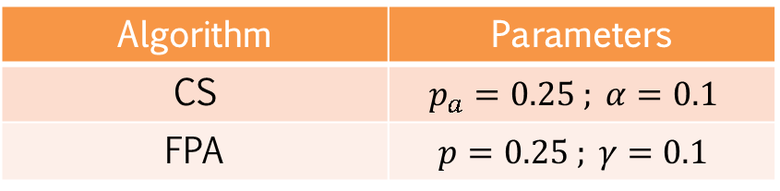
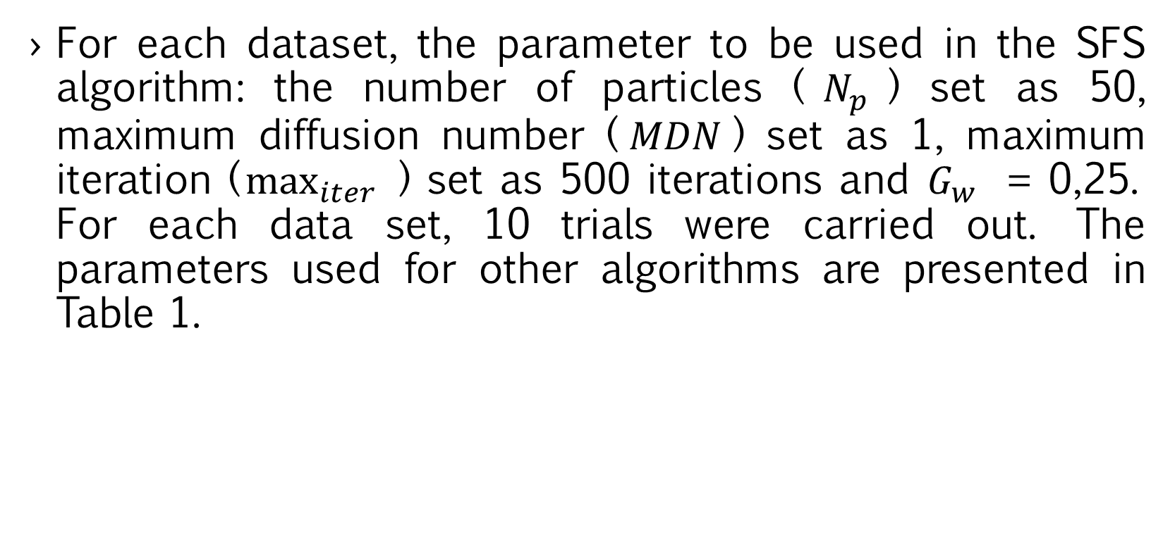
RESULTS
For each dataset, the parameter to be used in the SFS algorithm: the number of particles ($N_{p}$) set as 50, maximum diffusion number ($MDN$) set as 1, maximum iteration ($\max_{iter}{ }$) set as 500 iterations and $G_{w}$ = 0,25. For each data set, 10 trials were carried out. The parameters used for other algorithms are presented in Table 1.
Algorithm | Parameters
CS | $$p_{a}=0.25 ; α=0.1$$
FPA | $$p=0.25 ; γ=0.1$$
Table 1. Parameters of algorithm

Slide 13
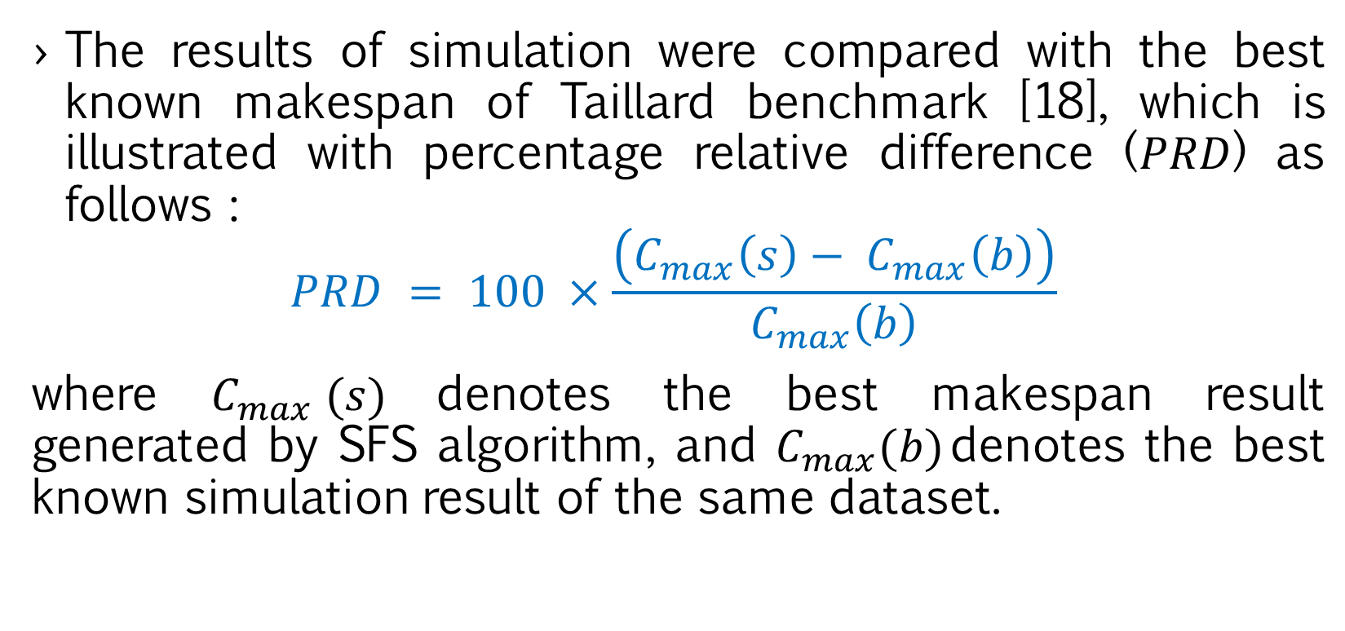
RESULTS
The results of simulation were compared with the best known makespan of Taillard benchmark [18], which is illustrated with percentage relative difference (𝑃𝑅𝐷) as follows :
$$PRD = 100 ×\frac{\left(C_{max}\left(s\right)− C_{max}\left(b\right)\right)}{C_{max}\left(b\right)}$$
where $C_{max} (s)$denotes the best makespan result generated by SFS algorithm, and $C_{max}(b)$denotes the best known simulation result of the same dataset.

Slide 14
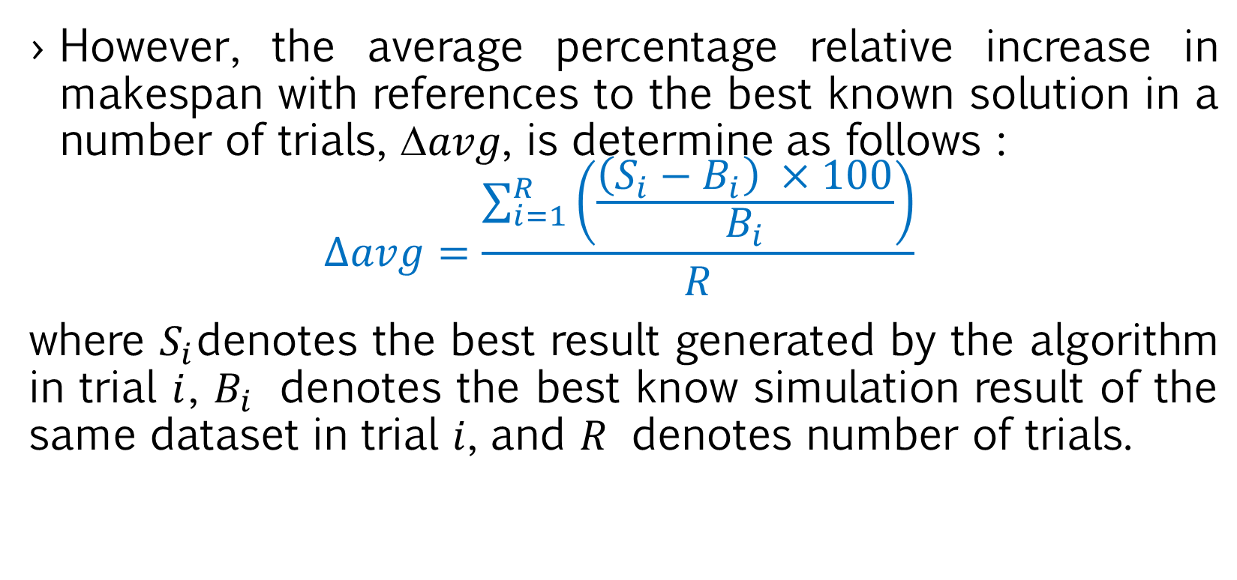
RESULTS
However, the average percentage relative increase in makespan with references to the best known solution in a number of trials, ∆𝑎𝑣𝑔, is determine as follows :
$$∆avg=\frac{\sum_{i=1}^{R}{\left(\frac{\left(S_{i}−B_{i}\right) ×100}{B_{i}}\right)}}{R}$$
where $S_{i}$denotes the best result generated by the algorithm in trial $i$, $B_{i}$ denotes the best know simulation result of the same dataset in trial $i$, and $R$ denotes number of trials.

Slide 15
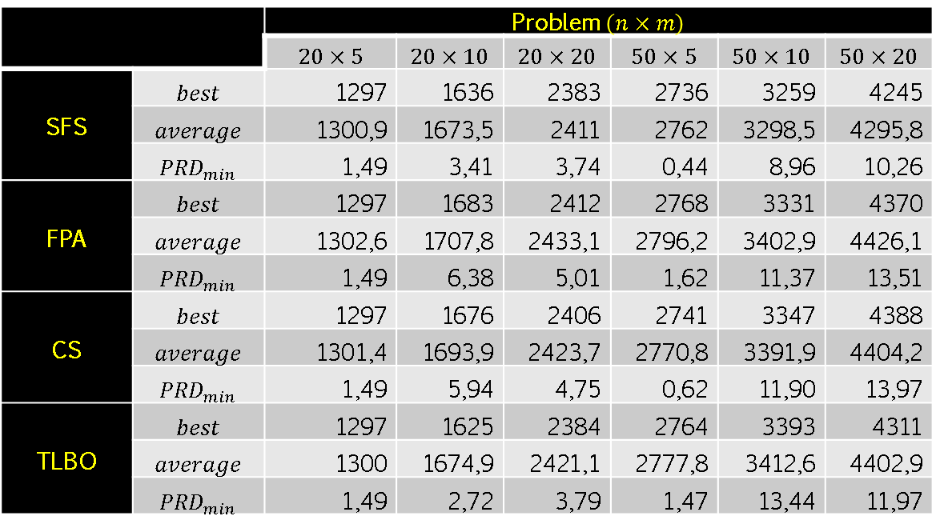
RESULTS
 |  | Problem $\left(n×m\right)$
 |  | $$20×5$$ | $$20×10$$ | $$20×20$$ | $$50×5$$ | $$50×10$$ | $$50×20$$
SFS | $$best$$ | 1297 | 1636 | 2383 | 2736 | 3259 | 4245
 | $$average$$ | 1300,9 | 1673,5 | 2411 | 2762 | 3298,5 | 4295,8
 | $${PRD}_{min}$$ | 1,49 | 3,41 | 3,74 | 0,44 | 8,96 | 10,26
FPA | $$best$$ | 1297 | 1683 | 2412 | 2768 | 3331 | 4370
 | $$average$$ | 1302,6 | 1707,8 | 2433,1 | 2796,2 | 3402,9 | 4426,1
 | $${PRD}_{min}$$ | 1,49 | 6,38 | 5,01 | 1,62 | 11,37 | 13,51
CS | $$best$$ | 1297 | 1676 | 2406 | 2741 | 3347 | 4388
 | $$average$$ | 1301,4 | 1693,9 | 2423,7 | 2770,8 | 3391,9 | 4404,2
 | $${PRD}_{min}$$ | 1,49 | 5,94 | 4,75 | 0,62 | 11,90 | 13,97
TLBO | $$best$$ | 1297 | 1625 | 2384 | 2764 | 3393 | 4311
 | $$average$$ | 1300 | 1674,9 | 2421,1 | 2777,8 | 3412,6 | 4402,9
 | $${PRD}_{min}$$ | 1,49 | 2,72 | 3,79 | 1,47 | 13,44 | 11,97
Table 2. Experiment Results

Slide 16
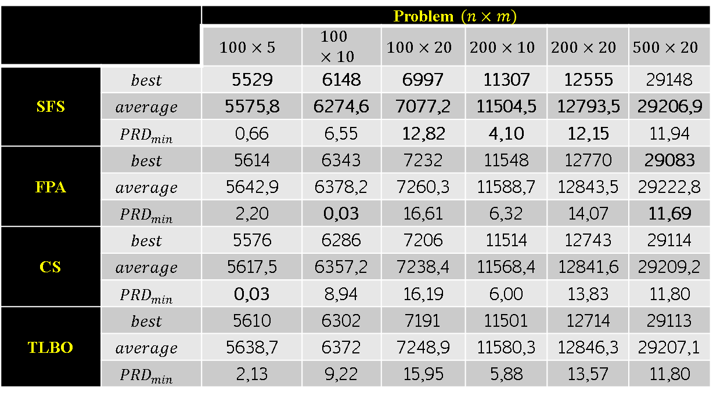
RESULTS
 |  | Problem $\left(n×m\right)$
 |  | $$100×5$$ | $$100×10$$ | $$100×20$$ | $$200×10$$ | $$200×20$$ | $$500×20$$
SFS | $$best$$ | 5529 | 6148 | 6997 | 11307 | 12555 | 29148
 | $$average$$ | 5575,8 | 6274,6 | 7077,2 | 11504,5 | 12793,5 | 29206,9
 | $${PRD}_{min}$$ | 0,66 | 6,55 | 12,82 | 4,10 | 12,15 | 11,94
FPA | $$best$$ | 5614 | 6343 | 7232 | 11548 | 12770 | 29083
 | $$average$$ | 5642,9 | 6378,2 | 7260,3 | 11588,7 | 12843,5 | 29222,8
 | $${PRD}_{min}$$ | 2,20 | 0,03 | 16,61 | 6,32 | 14,07 | 11,69
CS | $$best$$ | 5576 | 6286 | 7206 | 11514 | 12743 | 29114
 | $$average$$ | 5617,5 | 6357,2 | 7238,4 | 11568,4 | 12841,6 | 29209,2
 | $${PRD}_{min}$$ | 0,03 | 8,94 | 16,19 | 6,00 | 13,83 | 11,80
TLBO | $$best$$ | 5610 | 6302 | 7191 | 11501 | 12714 | 29113
 | $$average$$ | 5638,7 | 6372 | 7248,9 | 11580,3 | 12846,3 | 29207,1
 | $${PRD}_{min}$$ | 2,13 | 9,22 | 15,95 | 5,88 | 13,57 | 11,80
Table 2. Experiment Results

Slide 17
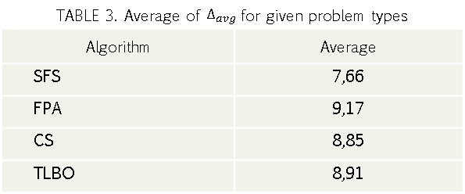
RESULTS
TABLE 3. Average of $∆_{avg}$ for given problem types
Algorithm | Average
SFS | 7,66
FPA | 9,17
CS | 8,85
TLBO | 8,91

Slide 18
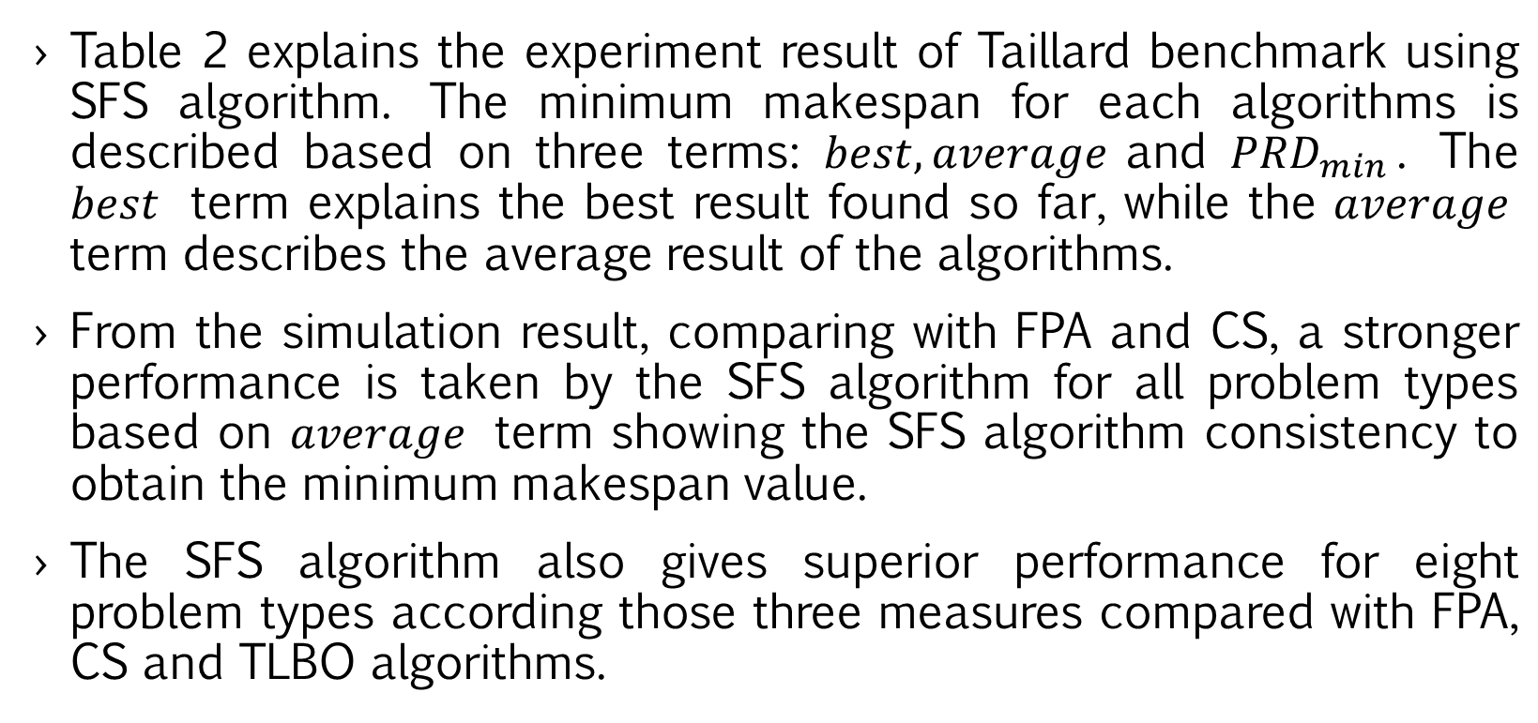
RESULTS
Table 2 explains the experiment result of Taillard benchmark using SFS algorithm. The minimum makespan for each algorithms is described based on three terms: $best, average$and ${PRD}_{min}$. The $best$ term explains the best result found so far, while the $average$ term describes the average result of the algorithms.
From the simulation result, comparing with FPA and CS, a stronger performance is taken by the SFS algorithm for all problem types based on $average$ term showing the SFS algorithm consistency to obtain the minimum makespan value.
The SFS algorithm also gives superior performance for eight problem types according those three measures compared with FPA, CS and TLBO algorithms.

Slide 19
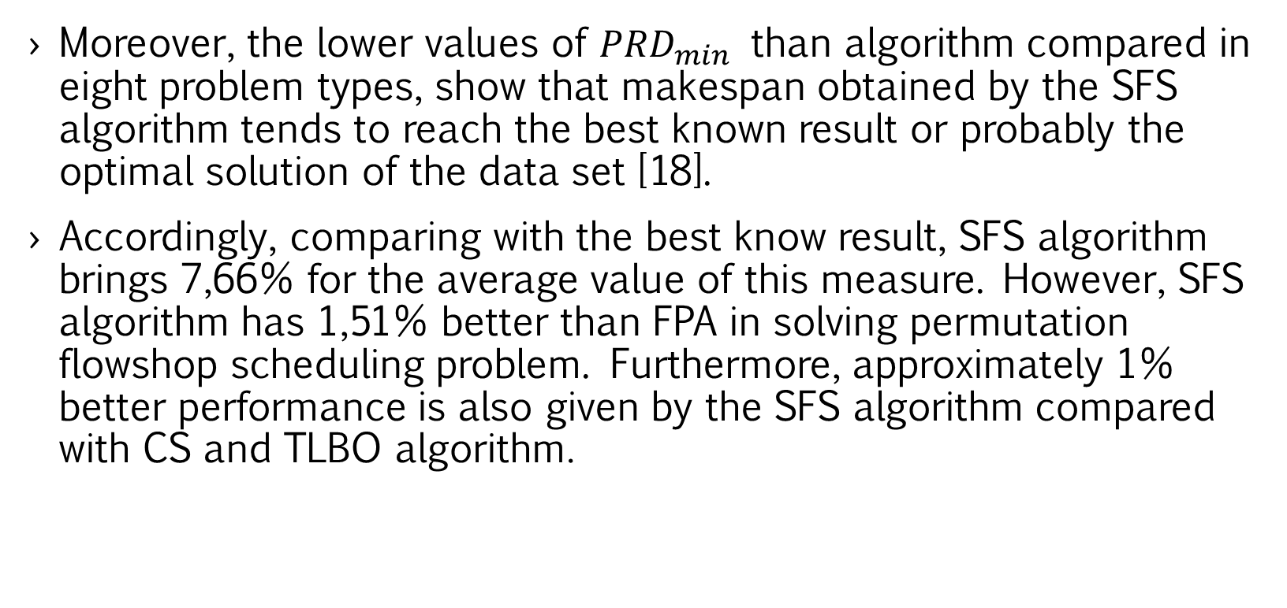
RESULTS
Moreover, the lower values of ${PRD}_{min}$ than algorithm compared in eight problem types, show that makespan obtained by the SFS algorithm tends to reach the best known result or probably the optimal solution of the data set [18].
Accordingly, comparing with the best know result, SFS algorithm brings 7,66% for the average value of this measure. However, SFS algorithm has 1,51% better than FPA in solving permutation flowshop scheduling problem. Furthermore, approximately 1% better performance is also given by the SFS algorithm compared with CS and TLBO algorithm.

Slide 20
CONCLUSION
Based on the experiment result using Taillard benchmark in 12 problem types, SFS algorithm gives best performance compared with FPA and CS in solving permutation flowshop scheduling problem. As well, better average performance is obtained compared with the best know result which provides 1% and 1,5% better than other algorithms, CS also TLBO, and FPA respectively. SFS algorithm has successfully found a solution which is closed to the best known simulation results, therefore for future study, this work would be extended to apply improved stochastic fractal search algorithm to solve another optimization problems.

Slide 21
THANK YOU FOR YOUR ATTENTION !!

