Slide 1
Global Analysis of a Dengue Hemorrhagic Fever (DHF) Transmission Model with Logistics Growth in Human Population
Anita T. Kurniawati, Fatmawati, Windarto

Slide 2
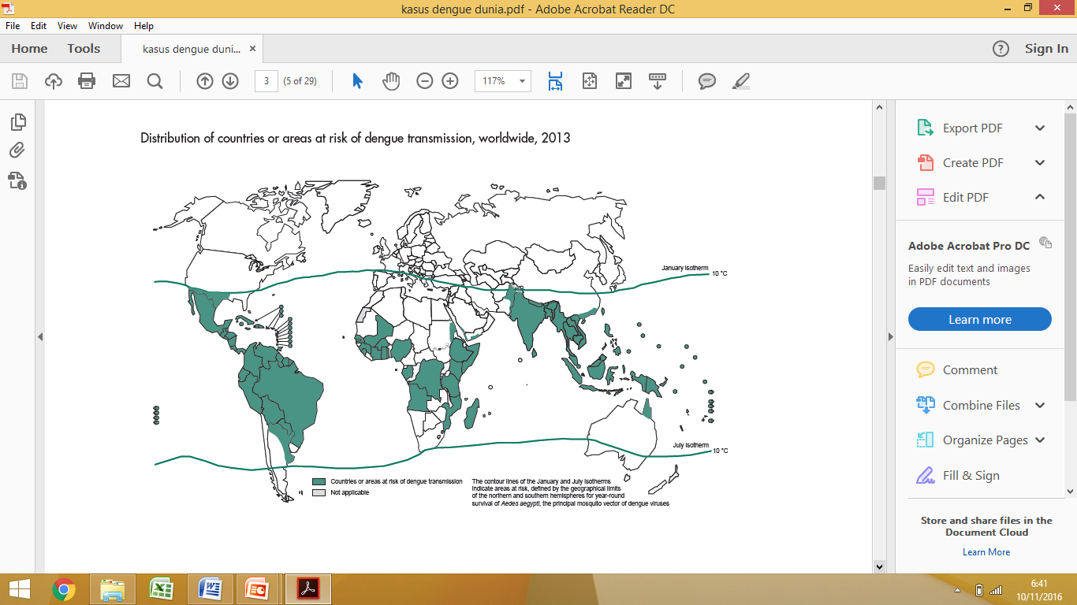
INTRODUCTION
The incidence of DHF has reached 30 times over the past 50 years
Up to 50-100 million infections are now estimated to occur each year in more than 100 endemic countries
DHF is an infectious disease caused by the dengue virus and transmitted by Aedes aegypti or Aedes albopictus mosquitoes.
we extend the DFH model in (Soewono & Supriatna, 2001) by propose a recruitment rate in the human population using a logistic growth model. Aim: Analysis Global of DHF transmission model with Lyapunov Function.

Slide 3
MODEL FORMULATION
Assumption:
Both of these populations are not affected by migration.
Population is homogeneous
The mosquito population is assumed to be constant.
Not considering the serotype type
The incubation period is neglected
Humans who have been infected will be immune to DHF

Slide 4
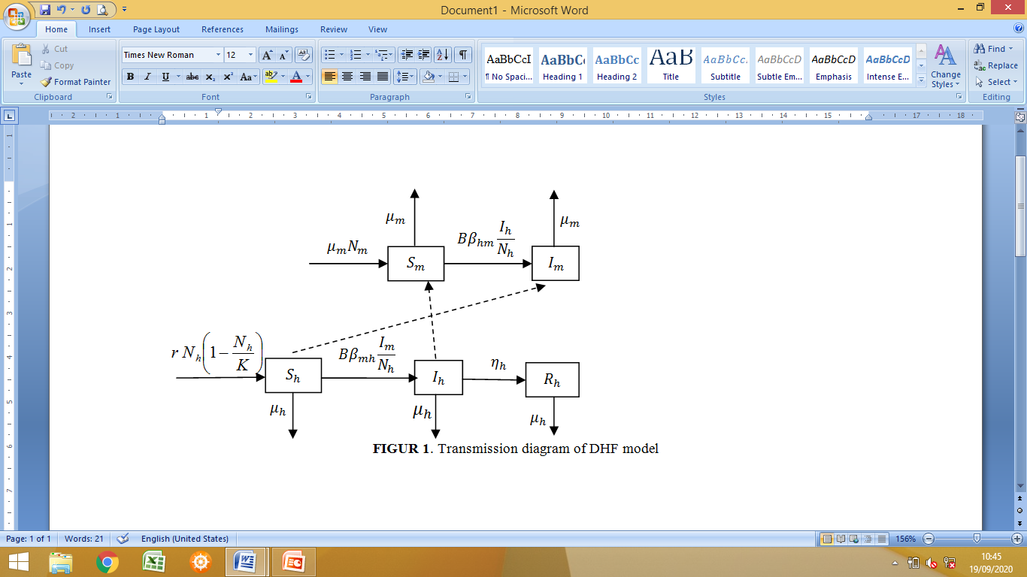

Slide 5
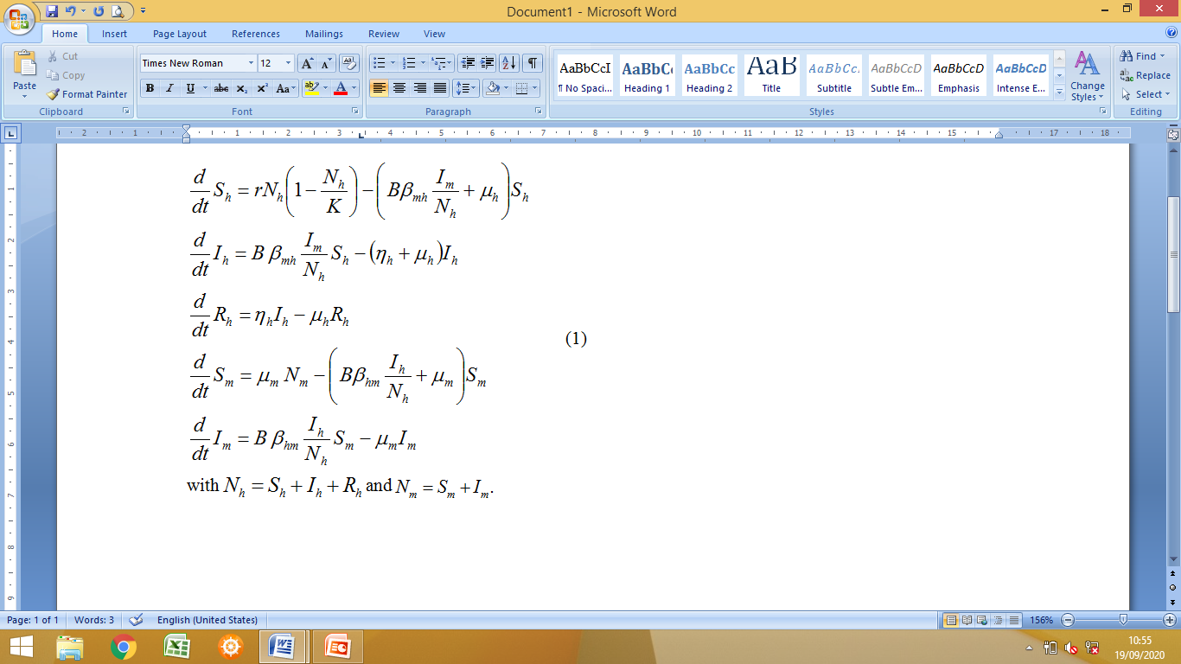
The model of DHF transmission

Slide 6
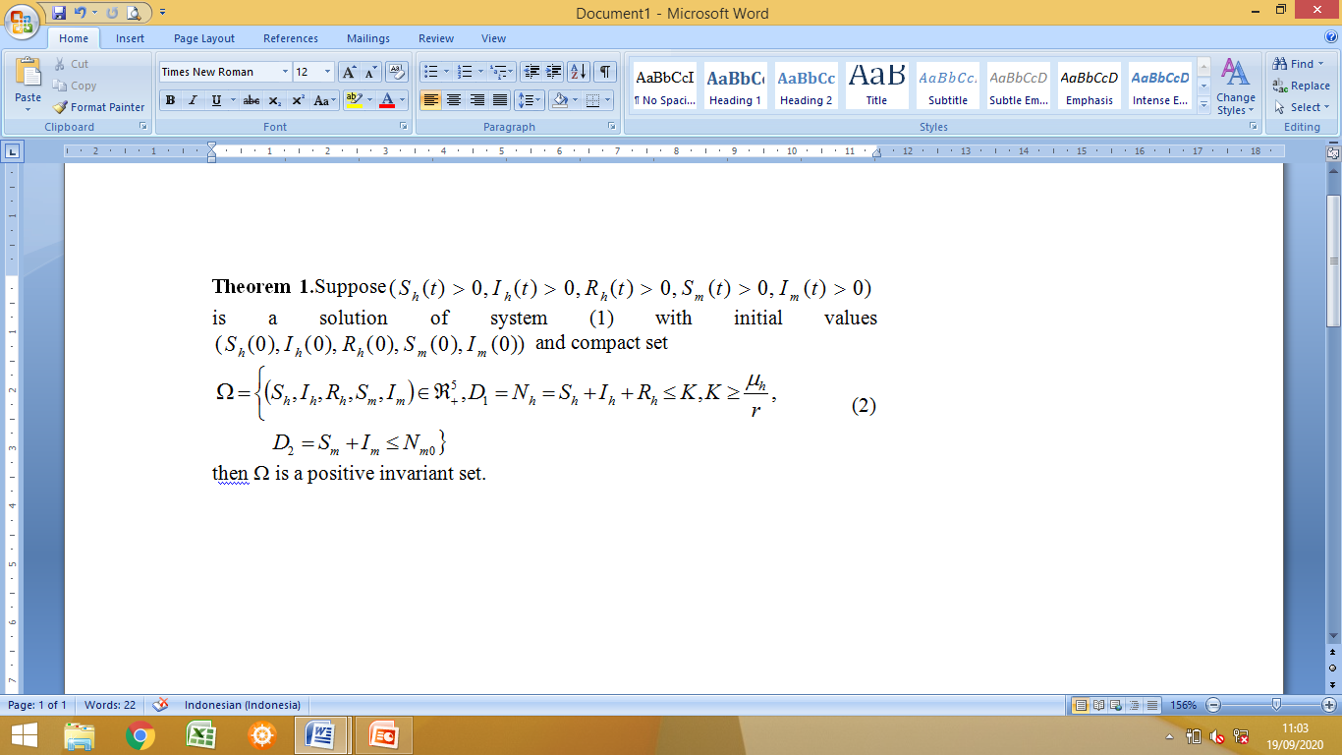
MODEL ANALYSIS
Positivity and boundedness of the solutions model

Slide 7
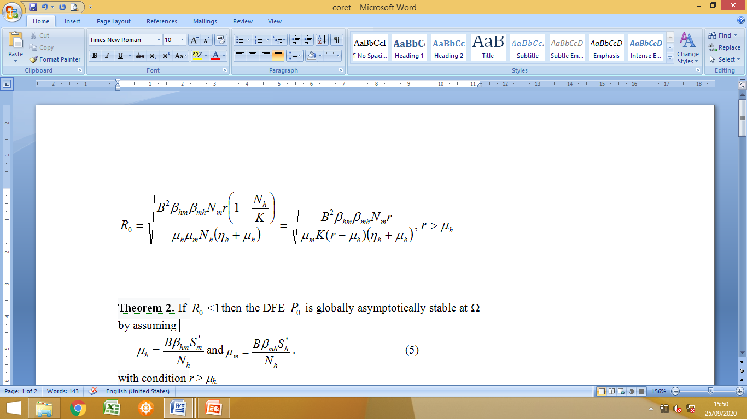
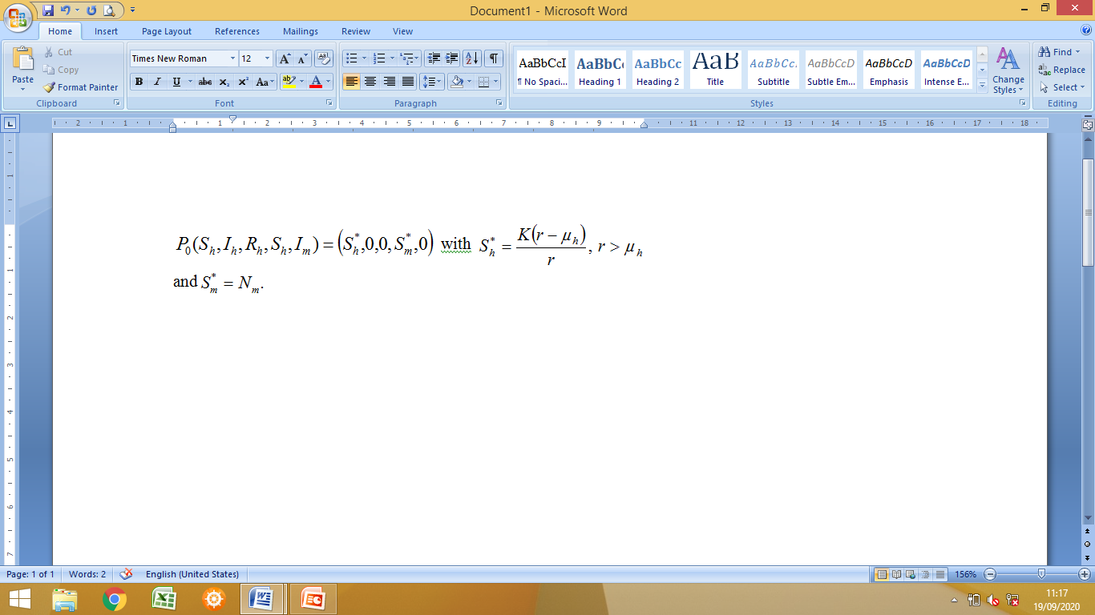
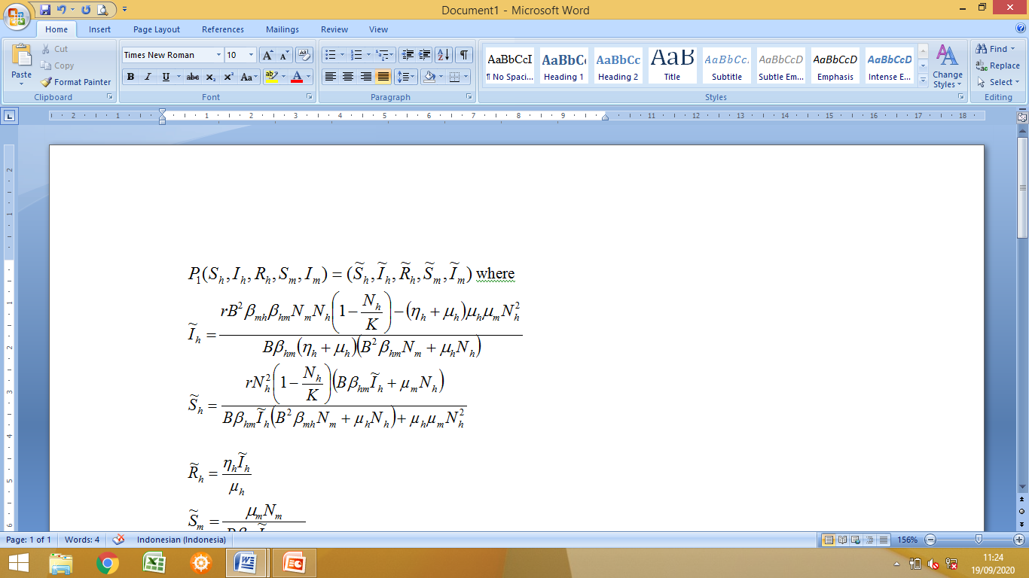
The Equilibrium of the Model
The basic reproduction number
Disease-free equilibrium (DFE):
(3)
The endemic equilibrium:
where
(3)

Slide 8
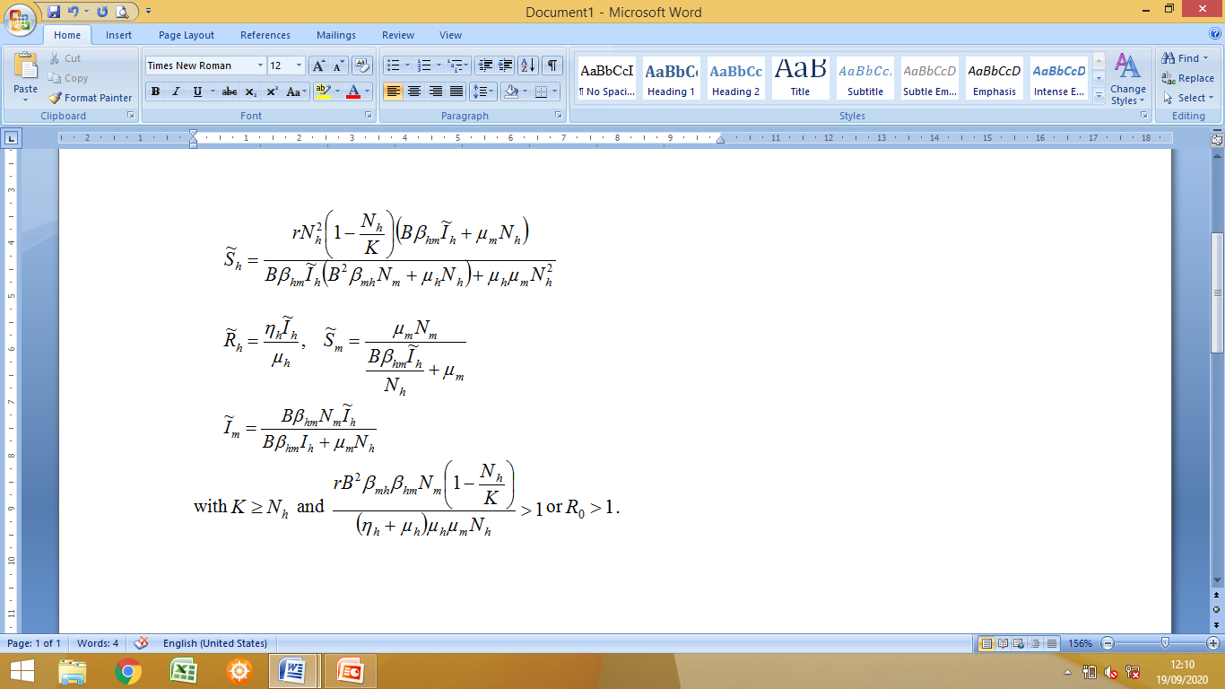
(4)

Slide 9
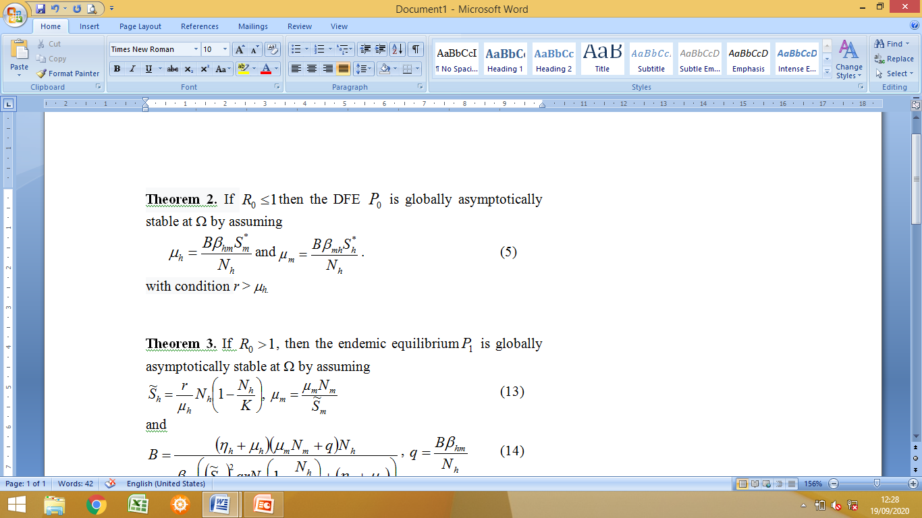
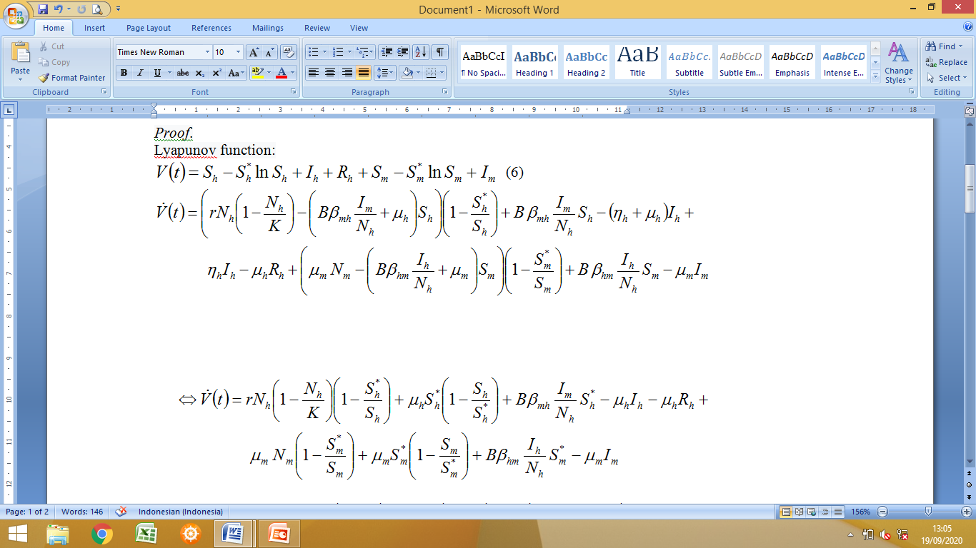
Global Stability Analysis

Slide 10
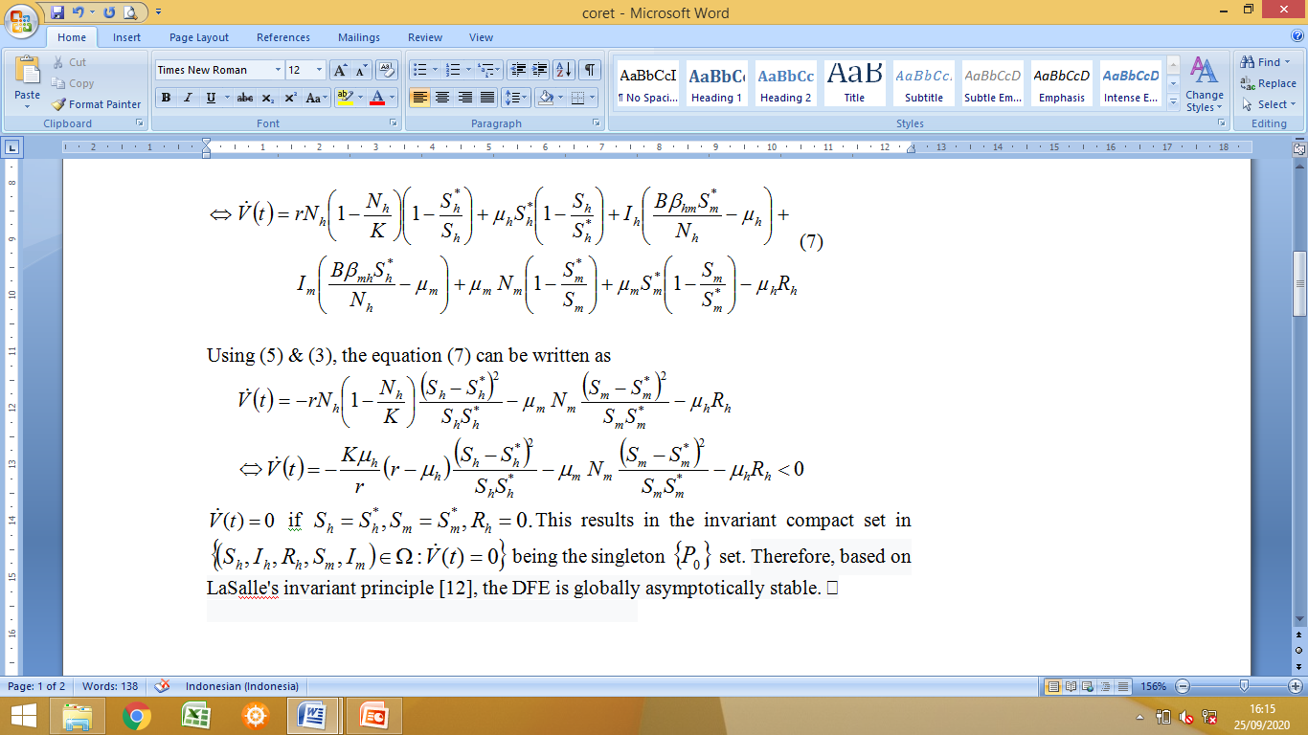

Slide 11
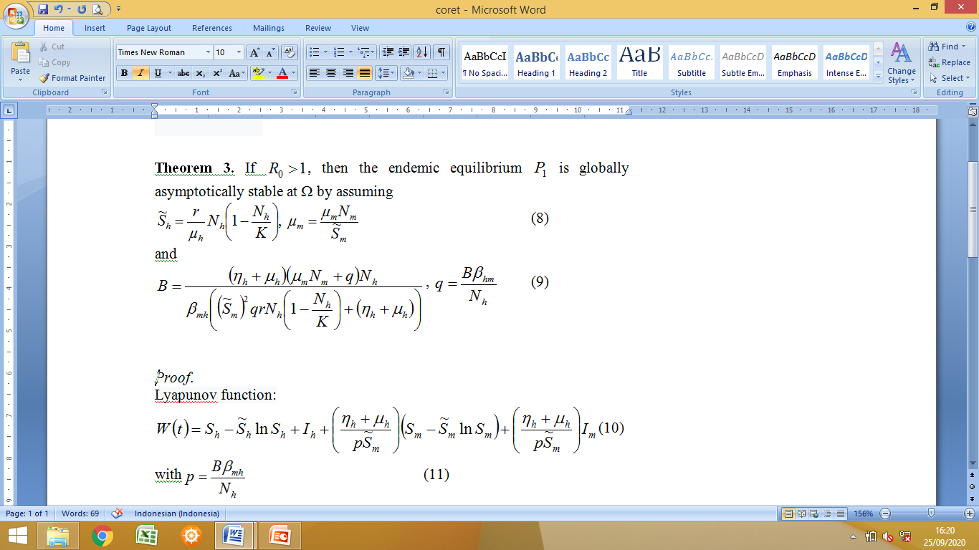
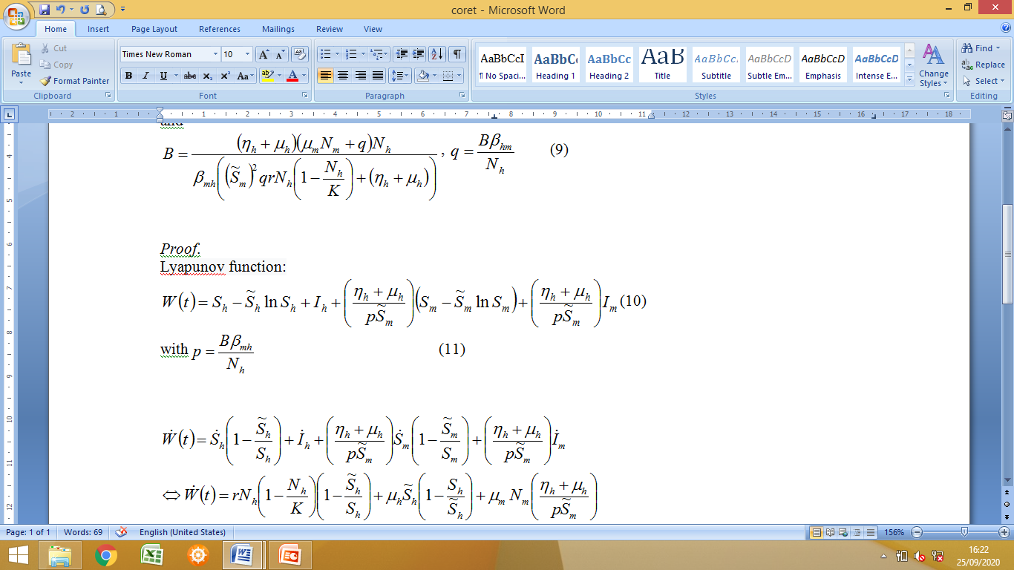

Slide 12
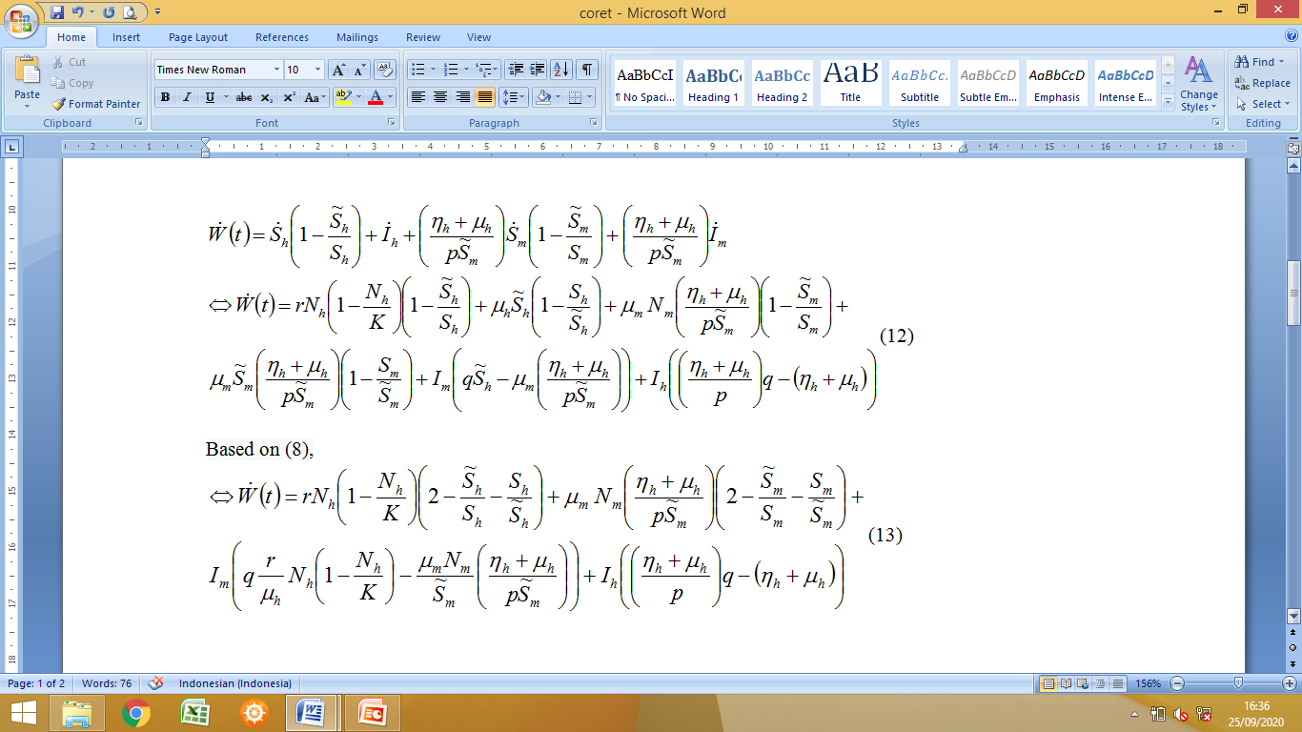

Slide 13
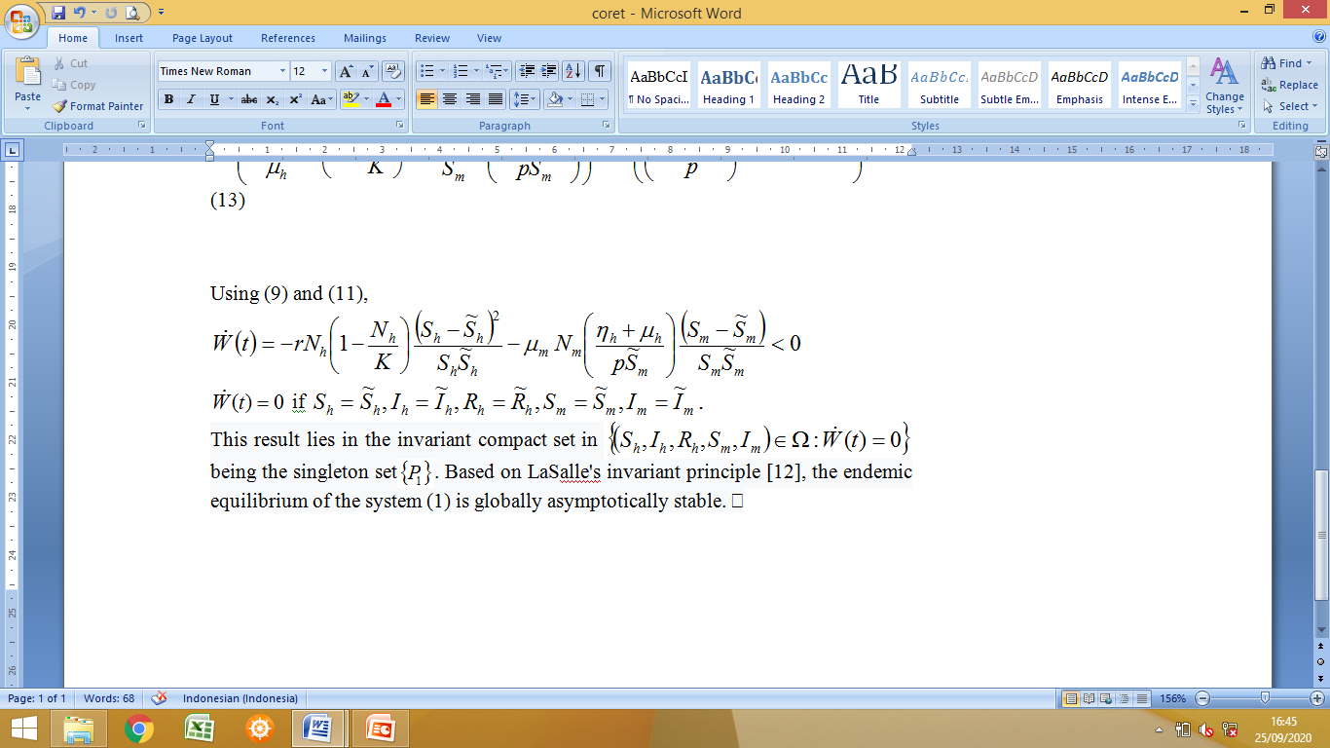
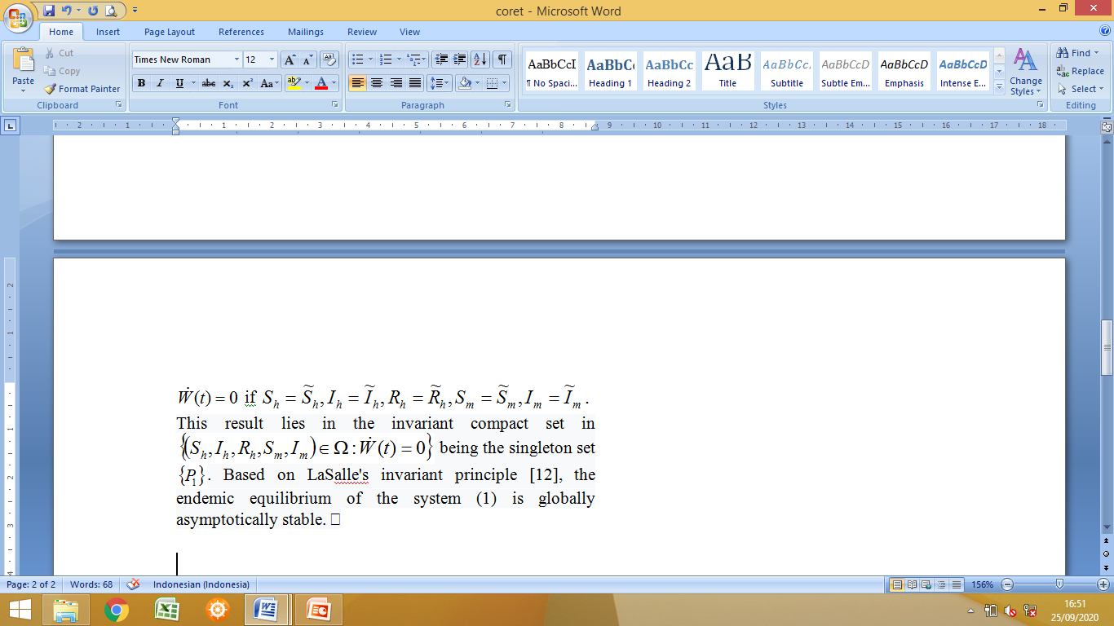

Slide 14
CONCLUSION
The disease-free equilibrium P₀ is globally asymptotically stable whenever r > μ_{h.} and the basic reproduction number less than one.
The endemic equilibrium P₁ is globally asymptotically stable whenever the basic reproduction number more than one

Slide 15
REFERENCE
World Health Organization, Dengue and Severe Dengue, http://www.who.int/DengueandSevereDengue (2019).
World Health Organization, Dengue and Severe Dengue, http://www.who.int/news-room/fact-sheets/detail/dengue-and-severe-dengue (2020).
L. Esteva and C. Vargas, Math. Biosci. 150, 131-151 (1998).
L. Esteva and C. Vargas, J. Math. Biol. 38, 220-240 (1999)
E. Soewono and A. K. Supriatna, B. Malays. Math. Sci. So. 24, 49-57 (2001).
J. J. Tewa, J. L. Dimi and S .Bowong, Chaos Solitons Fractals 39, 936-941 (2009).
N. Anggriani, H. Tasman, M. Z. Ndii, A. K. Supriatna, E. Soewono and E. Siregar, Appl. Math. Comput. 349:62-80 (2019).
Kasbawati, S. Ningsih, A.Ribal and Fatmawati, J. Phys. Conf. Ser. 1245(1),012043 (2019).
Windarto, M. A. Khan and Fatmawati, AIMS Math.5(3), 2758-2779 (2020).
O. Diekmann and J.A.P.Heesterbeek, Mathematical Epidemiology of Infectious Disease: Model Building, Analysis and Interpretation, (John Wiley & Son, Chichester, 2000).
P. van den Driessche and J. Watmough, Math. Biosci. 180, 29–48 (2002).
J. LaSalle, The Stability of Dynamical Systems,(SIAM, Philadelphia, 1976).

Slide 16
Thank you

