Slide 1



Modeling of Global Warming Effect on the Melting of Polar Ice Caps with Optimal Control Analysis
E. Andry Dwi Kurniawan, Fatmawati, Miswanto
Departement of Mathematics, Faculty of Science and Technology
Universitas Airlangga

Slide 2

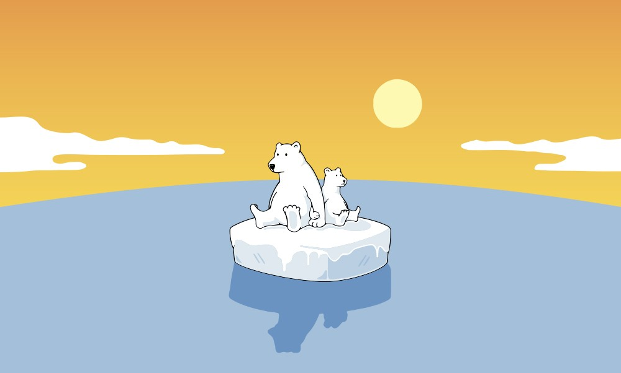
Global Warming

Slide 3
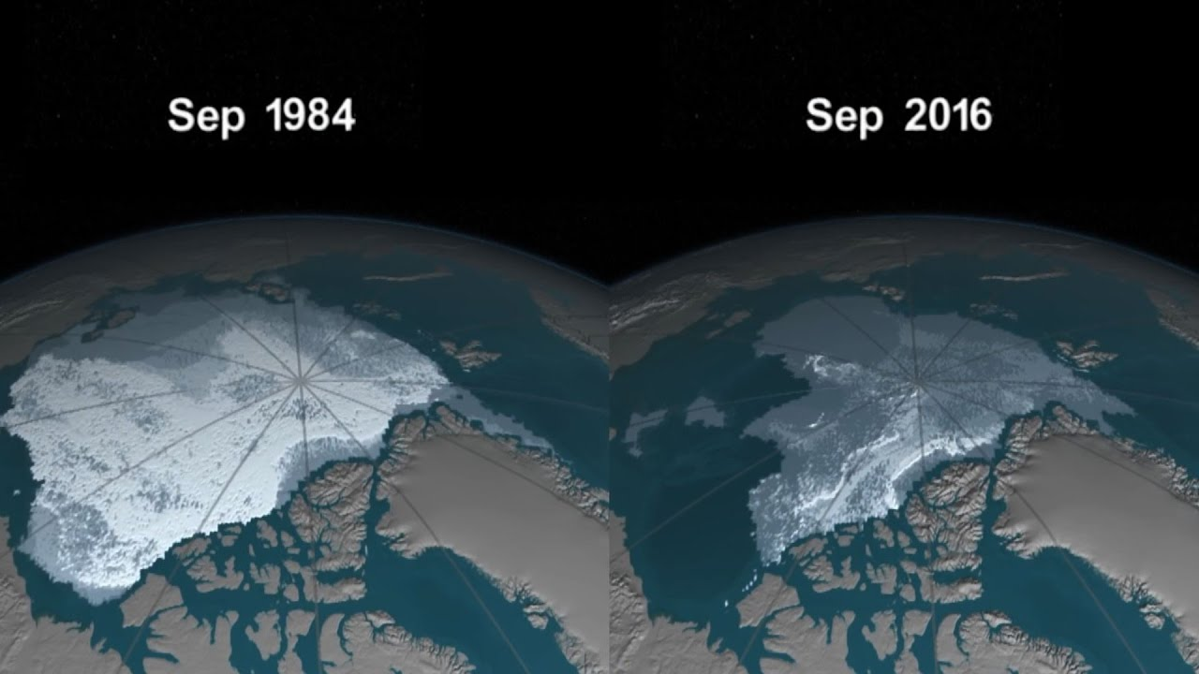
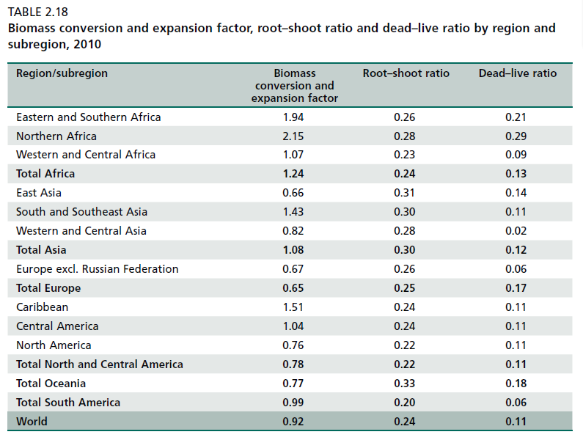
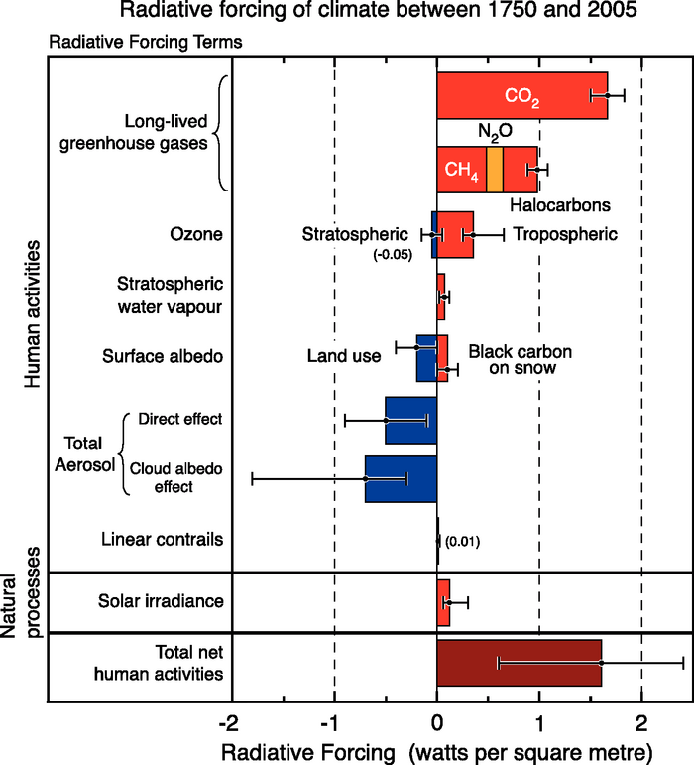
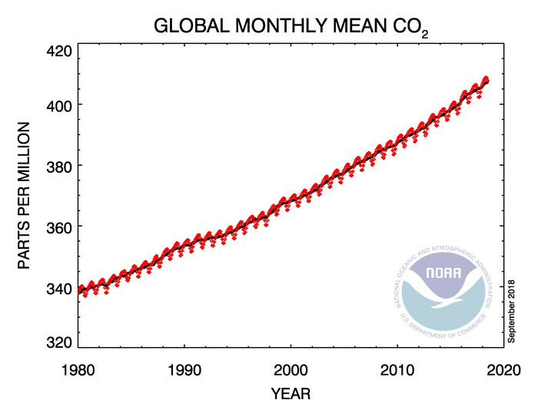
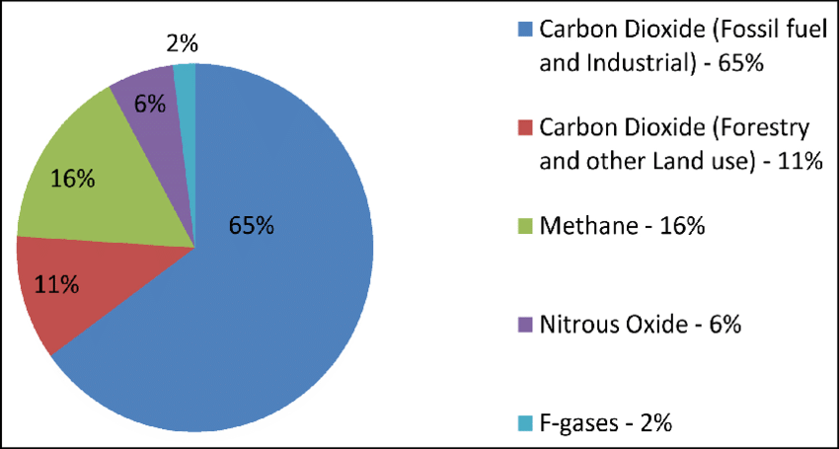

Slide 4
The Assumptions
Carbon dioxide (CO₂) gas is one of greenhouse gas emissions that causes the increase of global warming in the atmosphere due to human activity.
Carbon dioxide gas is absorbed by plant, and with the existence of sunshine, it will be decomposed to form plant tissue in photosynthesis process.
Increasing of carbon dioxide as global warming effect caused polar ice caps melt faster.
The melting of polar ice caps causes the increasing of sea level that can degrade forest and land ecosystem especially coastal area.
Polar ice caps will melt and froze periodically every season.

Slide 5
Definition of Variables
$$X(t)$$
𝑋(𝑡)
Concentration of carbon dioxide in the atmosphere at any time t (ppm).
$$N(t)$$
𝑁(𝑡)
Human population at any time t (million people).
$$F(t)$$
𝐹(𝑡)
Forest biomass at any time t (ton).
$$I_{c}\left(t\right)$$
𝐼_𝑐 (𝑡)
Volume of polar ice caps at any time t (km³).

Slide 6
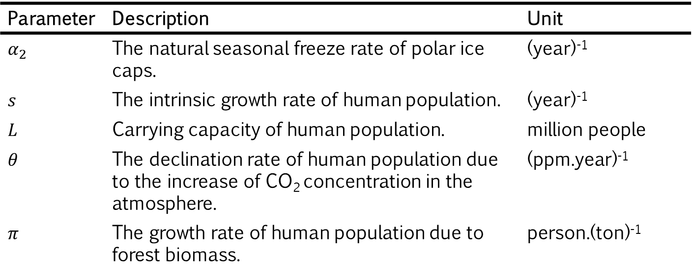
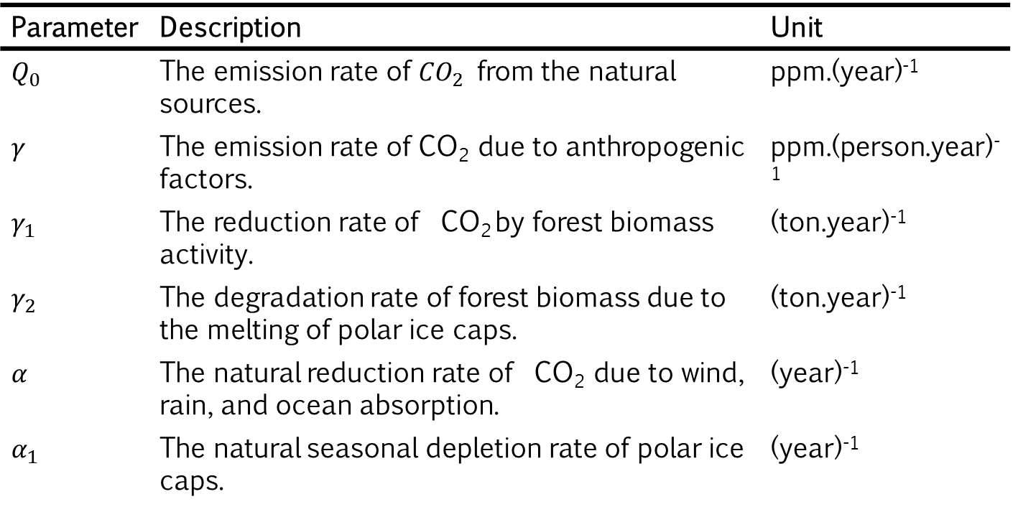
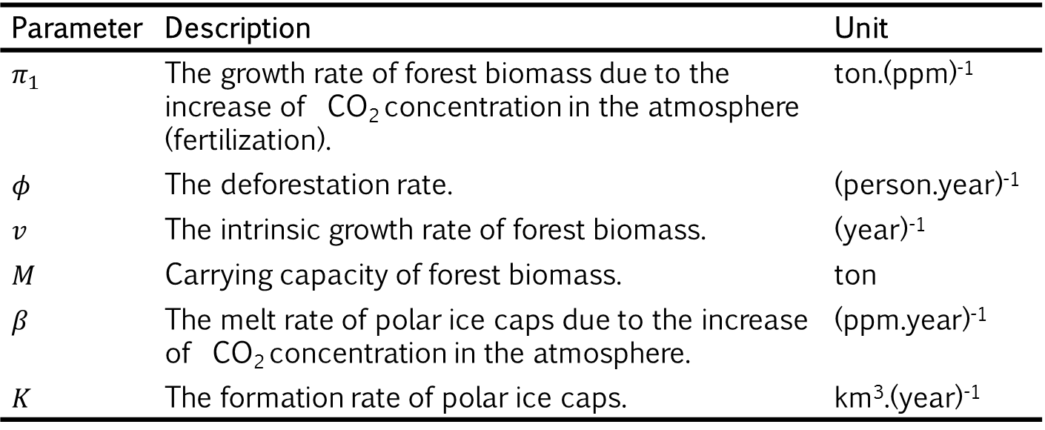
Definition of Parameters
Parameter | Description | Unit
$$α_{2}$$ | The natural seasonal freeze rate of polar ice caps. | (year)⁻¹
$$s$$ | The intrinsic growth rate of human population. | (year)⁻¹
$$L$$ | Carrying capacity of human population. | million people
$$θ$$ | The declination rate of human population due to the increase of CO₂ concentration in the atmosphere. | (ppm.year)⁻¹
$$π$$ | The growth rate of human population due to forest biomass. | person.(ton)⁻¹
Parameter | Description | Unit
$$π_{1}$$ | The growth rate of forest biomass due to the increase of CO₂ concentration in the atmosphere (fertilization). | ton.(ppm)⁻¹
$$φ$$ | The deforestation rate. | (person.year)⁻¹
$$v$$ | The intrinsic growth rate of forest biomass. | (year)⁻¹
$$M$$ | Carrying capacity of forest biomass. | ton
$$β$$ | The melt rate of polar ice caps due to the increase of CO₂ concentration in the atmosphere. | (ppm.year)⁻¹
$$K$$ | The formation rate of polar ice caps. | km³.(year)⁻¹
Parameter | Description | Unit
$$Q_{0}$$ | The emission rate of ${CO}_{2}$ from the natural sources. | ppm.(year)⁻¹
$$γ$$ | The emission rate of CO₂ due to anthropogenic factors. | ppm.(person.year)⁻¹
$$γ_{1}$$ | The reduction rate of CO₂ by forest biomass activity. | (ton.year)⁻¹
$$γ_{2}$$ | The degradation rate of forest biomass due to the melting of polar ice caps. | (ton.year)⁻¹
$$α$$ | The natural reduction rate of CO₂ due to wind, rain, and ocean absorption. | (year)⁻¹
$$α_{1}$$ | The natural seasonal depletion rate of polar ice caps. | (year)⁻¹

Slide 7
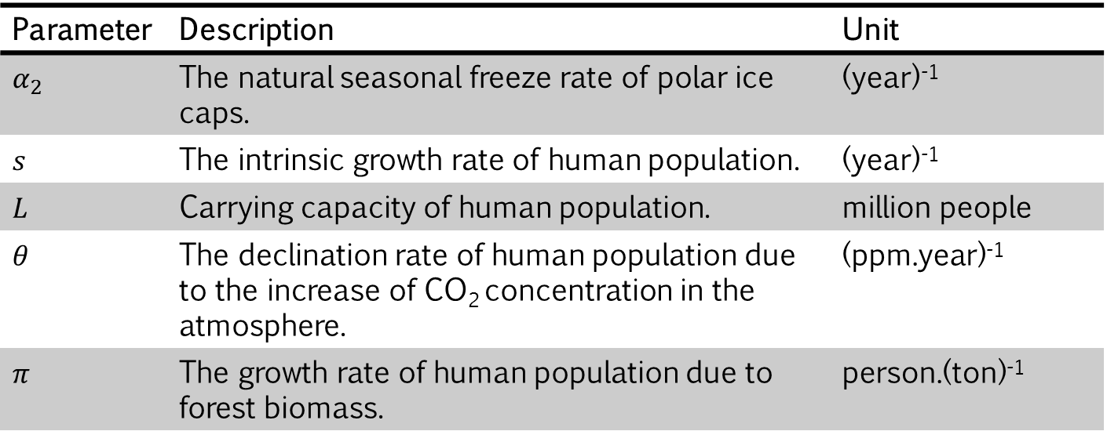
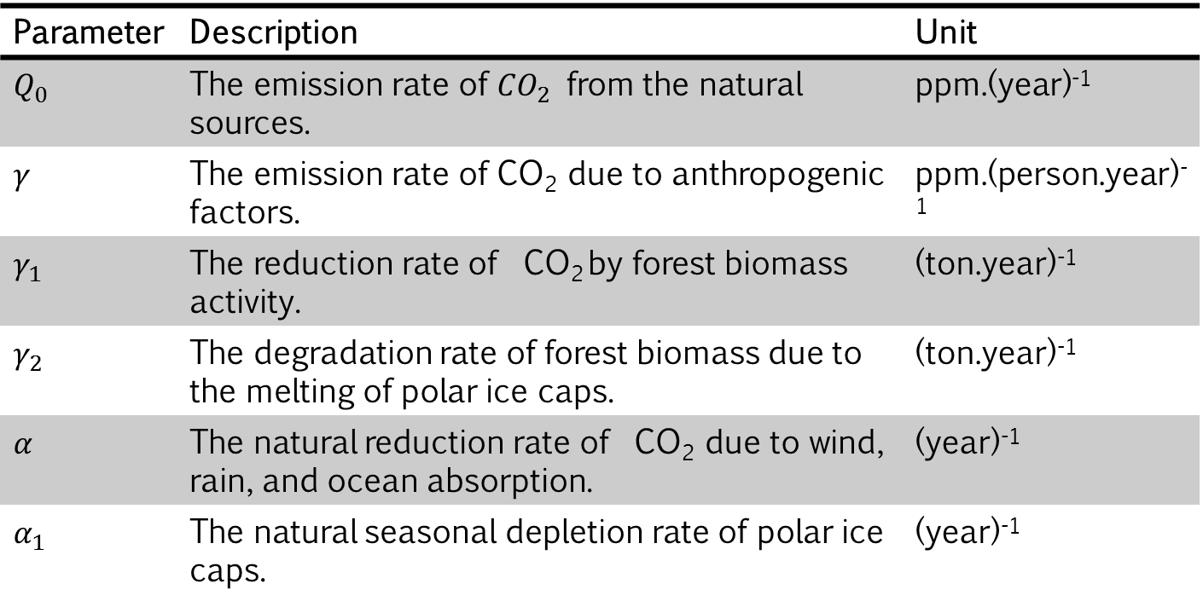

Definition of Parameters
Parameter | Description | Unit
$$π_{1}$$ | The growth rate of forest biomass due to the increase of CO₂ concentration in the atmosphere (fertilization). | ton.(ppm)⁻¹
$$φ$$ | The deforestation rate. | (person.year)⁻¹
$$v$$ | The intrinsic growth rate of forest biomass. | (year)⁻¹
$$M$$ | Carrying capacity of forest biomass. | ton
$$β$$ | The melt rate of polar ice caps due to the increase of CO₂ concentration in the atmosphere. | (ppm.year)⁻¹
$$K$$ | The formation rate of polar ice caps. | km³.(year)⁻¹
Parameter | Description | Unit
$$α_{2}$$ | The natural seasonal freeze rate of polar ice caps. | (year)⁻¹
$$s$$ | The intrinsic growth rate of human population. | (year)⁻¹
$$L$$ | Carrying capacity of human population. | million people
$$θ$$ | The declination rate of human population due to the increase of CO₂ concentration in the atmosphere. | (ppm.year)⁻¹
$$π$$ | The growth rate of human population due to forest biomass. | person.(ton)⁻¹
Parameter | Description | Unit
$$Q_{0}$$ | The emission rate of ${CO}_{2}$ from the natural sources. | ppm.(year)⁻¹
$$γ$$ | The emission rate of CO₂ due to anthropogenic factors. | ppm.(person.year)⁻¹
$$γ_{1}$$ | The reduction rate of CO₂ by forest biomass activity. | (ton.year)⁻¹
$$γ_{2}$$ | The degradation rate of forest biomass due to the melting of polar ice caps. | (ton.year)⁻¹
$$α$$ | The natural reduction rate of CO₂ due to wind, rain, and ocean absorption. | (year)⁻¹
$$α_{1}$$ | The natural seasonal depletion rate of polar ice caps. | (year)⁻¹

Slide 8

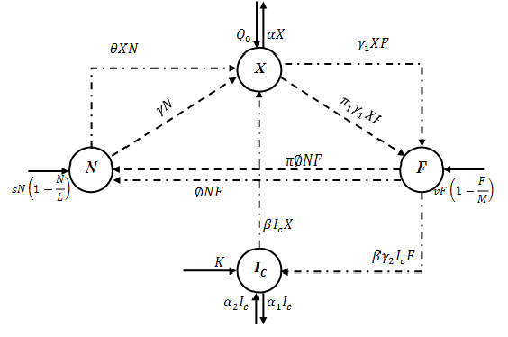
Transmission Diagram
: Reducing the population of origin and increasing the population of goals
: Expanding the population of goals without reducing the population of origin.
: Reducing the population of origin without expanding the population ofgoals.

Slide 9
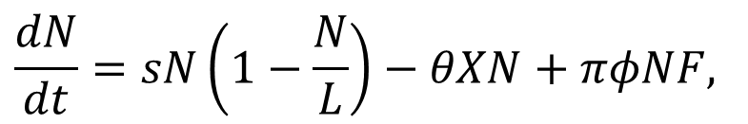
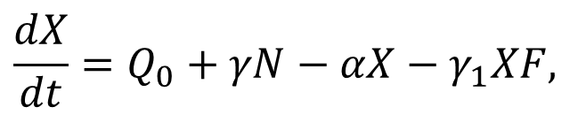
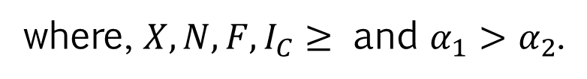
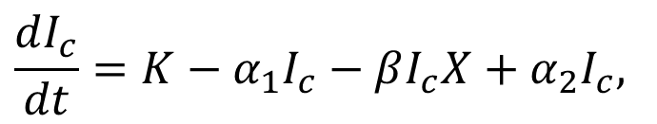
Mathematical Model
$$\frac{dX}{dt}=Q_{0}+γN−αX−γ_{1}XF,$$
$$\frac{dN}{dt}=sN\left(1−\frac{N}{L}\right)−θXN+πφNF,$$
$$\frac{dF}{dt}=vF\left(1−\frac{F}{M}\right)−φNF+π_{1}γ_{1}XF−βγ_{2}I_{c}F,$$
$$\frac{dI_{c}}{dt}=K−α_{1}I_{c}−βI_{c}X+α_{2}I_{c},$$
where, ${X,N,F,I}_{C}≥$ and ${α_{1}>α}_{2}$.

Slide 10
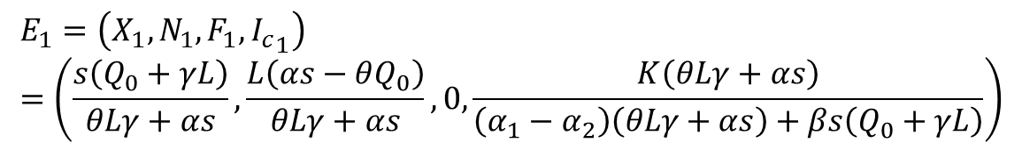
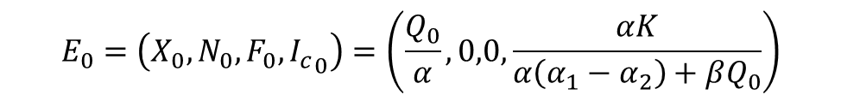

The Equilibrium
The model above has three equilibria,
Human and Forest Absence
$$E_{0}=\left(X_{0},N_{0},F_{0},{I_{c}}_{0}\right)=\left(\frac{Q_{0}}{α},0,0,\frac{αK}{α\left(α_{1}−α_{2}\right)+βQ_{0}}\right)$$
Forest Absence
$$E_{1}=\left(X_{1},N_{1},F_{1},{I_{c}}_{1}\right)=\left(\frac{s\left(Q_{0}+γL\right)}{θLγ+αs},\frac{L\left(αs−θQ_{0}\right)}{θLγ+αs},0,\frac{K\left(θLγ+αs\right)}{\left(α_{1}−α_{2}\right)\left(θLγ+αs\right)+βs\left(Q_{0}+γL\right)}\right)$$
$E_{1}$ will exist if : $s>\frac{θQ_{0}}{α}.$

Slide 11
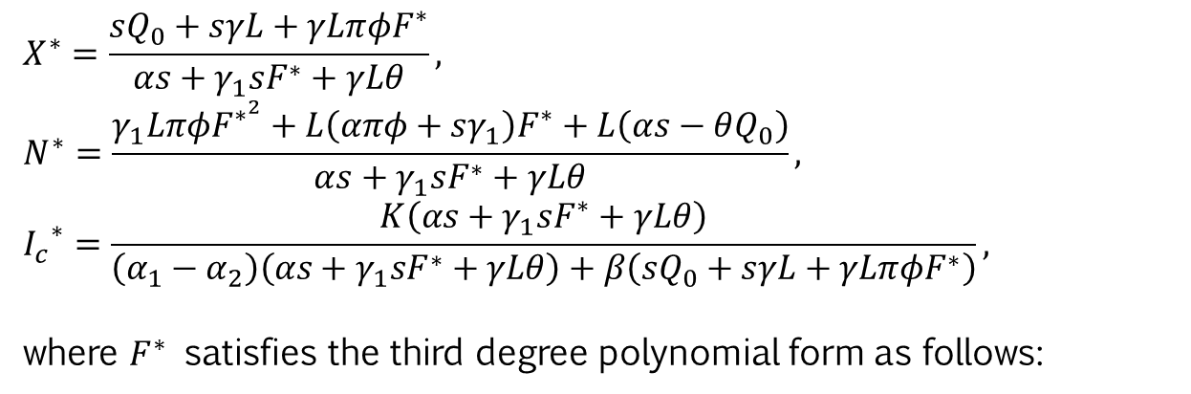


The Equilibrium
Co-existence
$$E_{2}=\left(X^{∗},N^{∗},F^{∗},I_{c}^{∗}\right)$$
with,
$$X^{∗}=\frac{sQ_{0}+sγL+γLπφF^{∗}}{αs+γ_{1}sF^{∗}+γLθ},$$
$$N^{∗}=\frac{γ_{1}LπφF^{∗^{2}}+L\left(απφ+sγ_{1}\right)F^{∗}+L\left(αs−θQ_{0}\right)}{αs+γ_{1}sF^{∗}+γLθ},$$
$${I_{c}}^{∗}=\frac{K\left(αs+γ_{1}sF^{∗}+γLθ\right)}{\left(α_{1}−α_{2}\right)\left(αs+γ_{1}sF^{∗}+γLθ\right)+β\left(sQ_{0}+sγL+γLπφF^{∗}\right)},$$
where $F^{∗}$ satisfies the third degree polynomial form as follows:
$$A{F^{∗}}^{3}+B{F^{∗}}^{2}+PF^{∗}+R=0$$
where,
NEXT

Slide 12
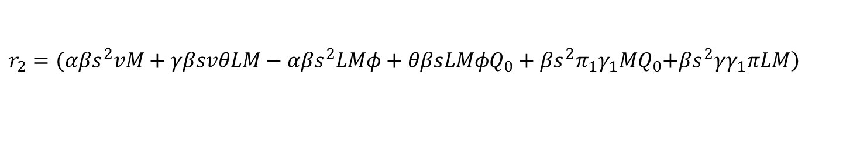



The Equilibrium
Existence condition:
If $A>0$ and $R<0$
if $A<0$ and $R>0$
with,
$$A=\left(α_{1}{−α}_{2}\right)\left({γ_{1}}^{2}sLMπφ\right)+\left(γ_{1}+α\right)\left(βγL^{2}Mπ^{2}φ^{3}\right)$$
$$R=r_{1}+\left(Q_{0}+γL\right)r_{2}+\left(α_{1}{−α}_{2}\right)r_{3}$$
where,
$$r_{1}=α^{2}γ_{2}βKs^{2}M+2αγγ_{2}βKsLMθ+γ^{2}γ_{2}{βKL}^{2}Mθ^{2}$$
$$r_{2}=(αβs^{2}vM+γβsvθLM−αβs^{2}LMφ+θβsLMφQ_{0}+βs^{2}π_{1}γ_{1}MQ_{0}\left.+βs^{2}γγ_{1}πLM\right)$$
$$r_{3}=(α^{2}s^{2}LMφ−α^{2}s^{2}vM−αθsLMφQ_{0}−αγγ_{1}πs^{2}LM−γ^{2}θ^{2}vL^{2}M+αγθsL^{2}Mφ$$
$$−γθ^{2}L^{2}MφQ_{0}−γγ_{1}θsL{MQ}_{0}−γ^{2}γ_{1}πθsL^{2}M−2αγθsvLM−αs^{2}π_{1}γ_{1}Q_{0}M)$$

Slide 13

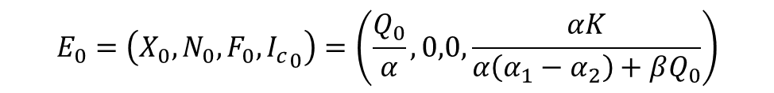
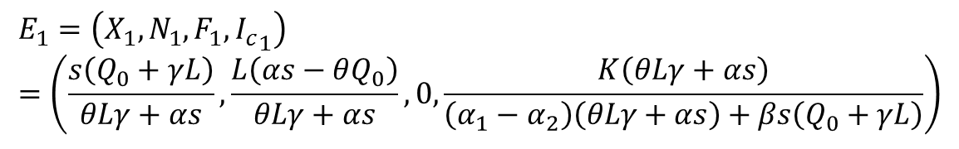
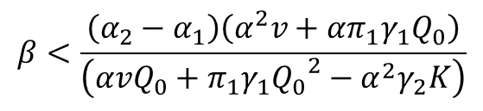

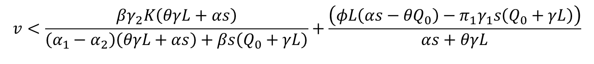
Stability of The Equilibrium
The Equilibrium of Human and Forest Absence
$$E_{0}=\left(X_{0},N_{0},F_{0},{I_{c}}_{0}\right)=\left(\frac{Q_{0}}{α},0,0,\frac{αK}{α\left(α_{1}−α_{2}\right)+βQ_{0}}\right)$$
The equilibrium $E_{0}$ is locally asymptotically stable if,
$$s<\frac{θQ_{0}}{α}$$
$$β<\frac{\left(α_{2}−α_{1}\right)\left(α^{2}v+απ_{1}γ_{1}Q_{0}\right)}{\left(α{vQ}_{0}+π_{1}γ_{1}{Q_{0}}^{2}−α^{2}γ_{2}K\right)}$$
dan
The Equilibrium of Forest Absence
$$E_{1}=\left(X_{1},N_{1},F_{1},{I_{c}}_{1}\right)=\left(\frac{s\left(Q_{0}+γL\right)}{θLγ+αs},\frac{L\left(αs−θQ_{0}\right)}{θLγ+αs},0,\frac{K\left(θLγ+αs\right)}{\left(α_{1}−α_{2}\right)\left(θLγ+αs\right)+βs\left(Q_{0}+γL\right)}\right)$$
The equilibrium $E_{1}$ is locally asymptotically stable if,
$$s>\frac{θQ_{0}}{α}$$
and
$$v<\frac{βγ_{2}K\left(θγL+αs\right)}{\left(α_{1}−α_{2}\right)\left(θγL+αs\right)+βs\left(Q_{0}+γL\right)}+\frac{\left(φL\left({αs−θQ}_{0}\right)−π_{1}γ_{1}s\left(Q_{0}+γL\right)\right)}{αs+θγL}$$

Slide 14
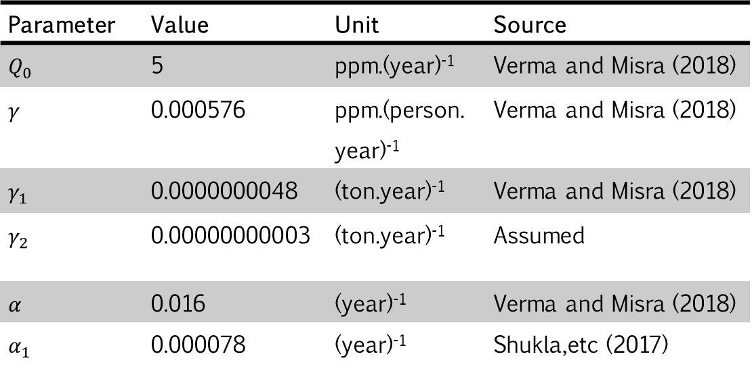
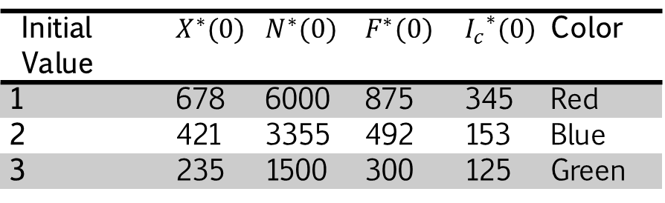
Stability of The Equilibrium
The Equilibrium of Co-existence
Numerical
Phase potrait
Initial Value | $$X^{∗}(0)$$ | $$N^{∗}(0)$$ | $$F^{∗}(0)$$ | $${I_{c}}^{∗}(0)$$ | Color
1 | 678 | 6000 | 875 | 345 | Red
2 | 421 | 3355 | 492 | 153 | Blue
3 | 235 | 1500 | 300 | 125 | Green
Parameter | Value | Unit | Source
$$Q_{0}$$ | 5 | ppm.(year)⁻¹ | Verma and Misra (2018)
$$γ$$ | 0.000576 | ppm.(person.year)⁻¹ | Verma and Misra (2018)
$$γ_{1}$$ | 0.0000000048 | (ton.year)⁻¹ | Verma and Misra (2018)
$$γ_{2}$$ | 0.00000000003 | (ton.year)⁻¹ | Assumed
$$α$$ | 0.016 | (year)⁻¹ | Verma and Misra (2018)
$$α_{1}$$ | 0.000078 | (year)⁻¹ | Shukla,etc (2017)
Next

Slide 15
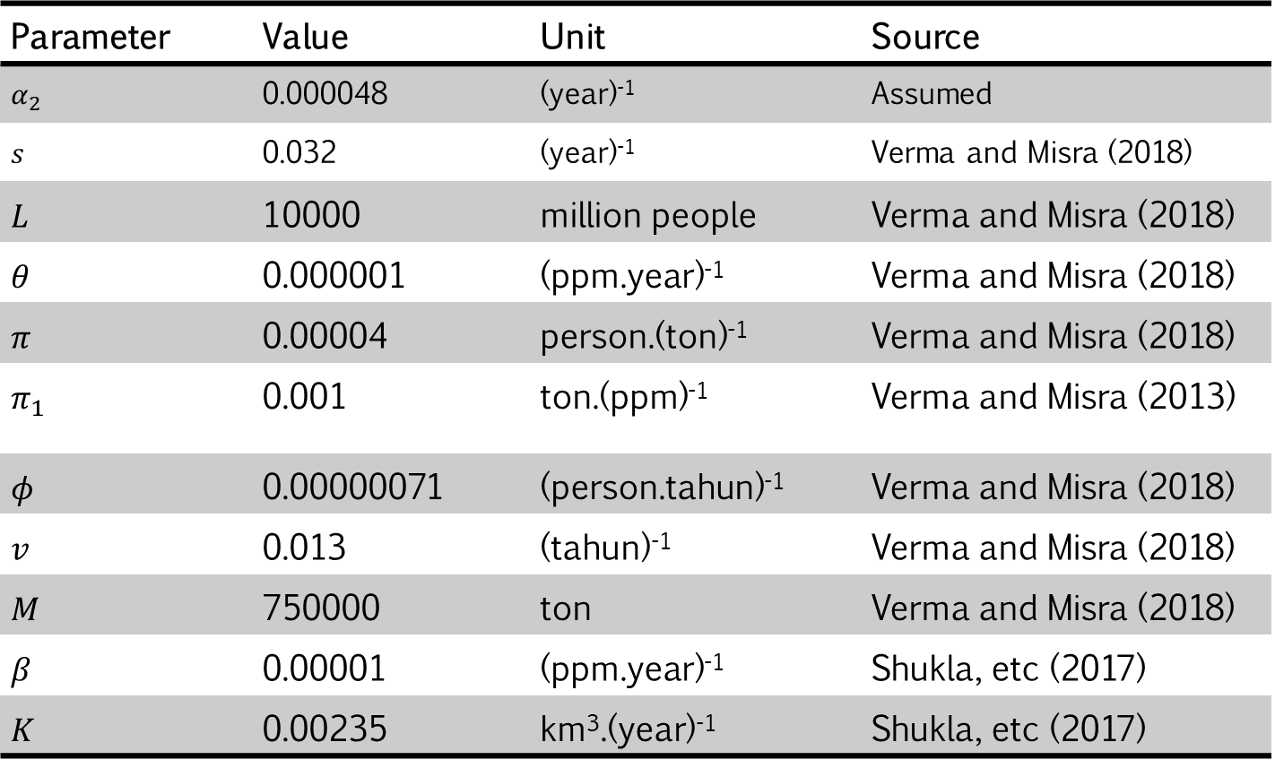
Stability of The Equilibrium
The Equilibrium of Co-existence
Numerical
Phase potrait
Parameter | Value | Unit | Source
$$α_{2}$$ | 0.000048 | (year)⁻¹ | Assumed
$$s$$ | 0.032 | (year)⁻¹ | Verma and Misra (2018)
$$L$$ | 10000 | million people | Verma and Misra (2018)
$$θ$$ | 0.000001 | (ppm.year)⁻¹ | Verma and Misra (2018)
$$π$$ | 0.00004 | person.(ton)⁻¹ | Verma and Misra (2018)
$$π_{1}$$ | 0.001 | ton.(ppm)⁻¹ | Verma and Misra (2013)
$$φ$$ | 0.00000071 | (person.tahun)⁻¹ | Verma and Misra (2018)
$$v$$ | 0.013 | (tahun)⁻¹ | Verma and Misra (2018)
$$M$$ | 750000 | ton | Verma and Misra (2018)
$$β$$ | 0.00001 | (ppm.year)⁻¹ | Shukla, etc (2017)
$$K$$ | 0.00235 | km³.(year)⁻¹ | Shukla, etc (2017)

Slide 16
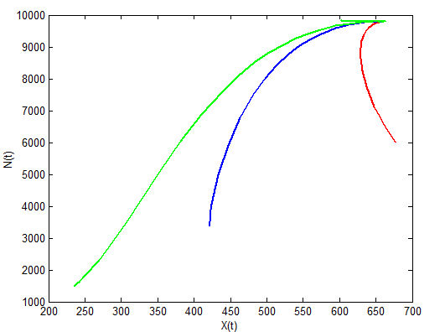
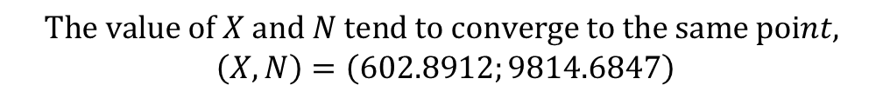
Stability of The Equilibrium
Nonlinear stability of model in X-N space
$$The value of X and N tend to converge to the same point,$$
$$\left(X,N\right)=\left(602.8912;9814.6847\right)$$

Slide 17

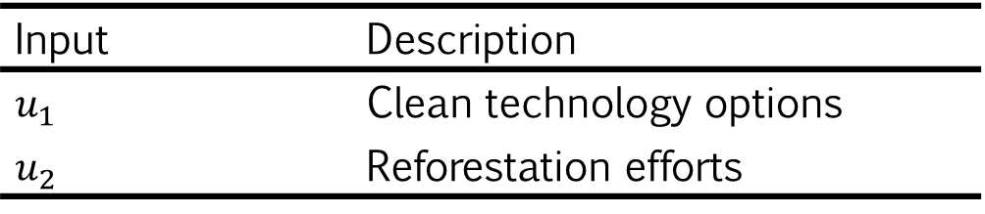



Optimal Control Problem
Input | Description
$$u_{1}$$ | Clean technology options
$$u_{2}$$ | Reforestation efforts
$$\frac{dX}{dt}=Q_{0}+(1−u_{1})γN−αX−γ_{1}XF,$$
$$\frac{dN}{dt}=sN\left(1−\frac{N}{L}\right)−θXN+πφNF,$$
$$\frac{dF}{dt}=vF\left(1−\frac{F}{M}\right)−φNF+π_{1}γ_{1}XF−βγ_{2}I_{c}F+u_{2}δF,$$
$$\frac{dI_{c}}{dt}=K−α_{1}I_{c}−βI_{c}X+α_{2}I_{c},$$
with, $α_{1}>α_{2}$
$δ$ : the rate of growth of forest biomass due to reforestation efforts.

Slide 18
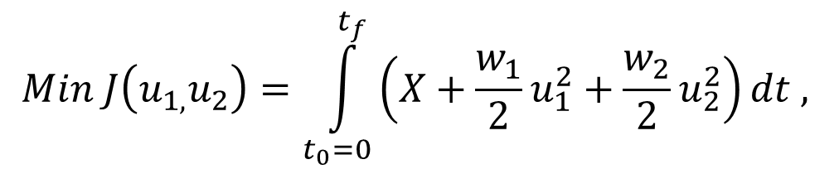
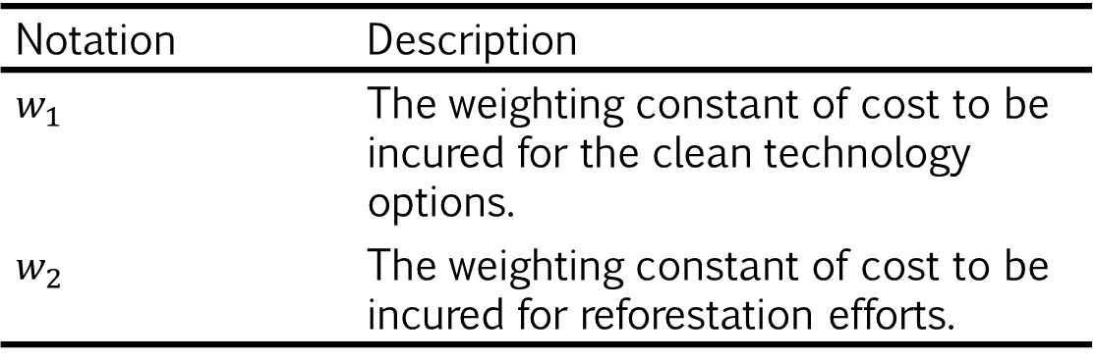

The Objective Functional
$$Min J\left(u_{1,}u_{2}\right)=\int_{t_{0}=0}^{t_{f}}{\left(X+\frac{w_{1}}{2}u_{1}^{2}+\frac{w_{2}}{2}u_{2}^{2}\right)}dt ,$$
$$0≤u_{1}\left(t\right)≤1,0≤u_{2}\left(t\right)≤1, 0≤t≤t_{f}$$
Notation | Description
$$w_{1}$$ | The weighting constant of cost to be incured for the clean technology options.
$$w_{2}$$ | The weighting constant of cost to be incured for reforestation efforts.

Slide 19

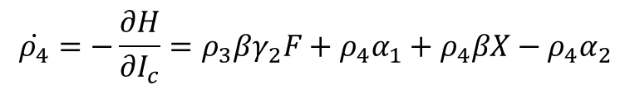

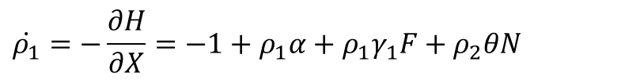



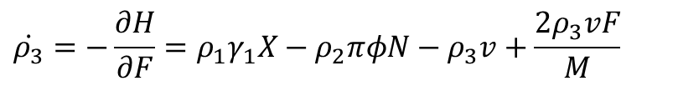



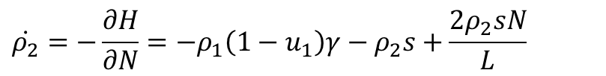
The Pontryagin Maximum Principle
Hamiltonian Function
Co-state Equation
$$H=X+\frac{w_{1}}{2}u_{1}^{2}+\frac{w_{2}}{2}u_{2}^{2}+\sum_{i=1}^{4}{ρ_{i}f_{i}}$$
$$\dot{ρ_{1}}=−\frac{∂H}{∂X}=−1+ρ_{1}α+ρ_{1}γ_{1}F+ρ_{2}θN$$
$$−ρ_{3}π_{1}γ_{1}F+ρ_{4}βI_{c}$$
Stationary Condition
$$\dot{ρ_{2}}=−\frac{∂H}{∂N}=−ρ_{1}\left(1−u_{1}\right)γ−ρ_{2}s+\frac{2ρ_{2}sN}{L}$$
$$\frac{∂H}{∂u}=0⇔\frac{∂H}{∂u_{1}}=0$$
$$\frac{∂H}{∂u_{2}}=0$$
and
$$+ρ_{2}θX−ρ_{2}πφF+ρ_{3}φF$$
Optimal Control
$$\dot{ρ_{3}}=−\frac{∂H}{∂F}=ρ_{1}γ_{1}X−ρ_{2}πφN−ρ_{3}v+\frac{2ρ_{3}vF}{M}$$
${u_{1}}^{∗}=$ min $\left(1, max\left(0, \frac{ρ_{1}γN}{w_{1}}\right)\right)$
$$+ρ_{3}φN−ρ_{3}π_{1}γ_{1}X+ρ_{3}u_{2}δ+ρ_{3}βγ_{2}I_{c}$$
${u_{2}}^{∗}=$ min $\left(1, max\left(0, −\frac{ρ_{3}δF}{w_{2}}\right)\right)$
$$\dot{ρ_{4}}=−\frac{∂H}{∂I_{c}}=ρ_{3}βγ_{2}F+ρ_{4}α_{1}+ρ_{4}βX−ρ_{4}α_{2}$$

Slide 20
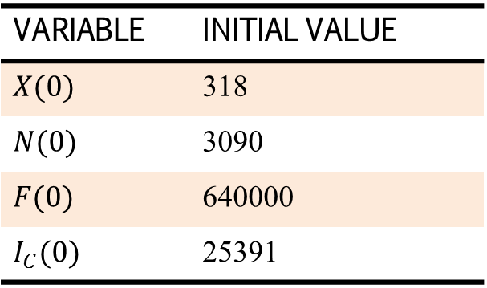
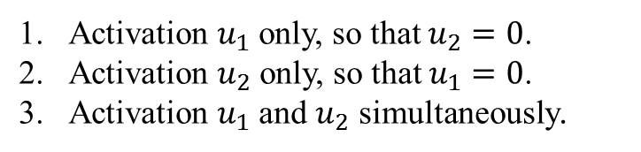

Numerical Simulation
Initial Value
Scenarios used are as follows:
VARIABLE | INITIAL VALUE
$$X(0)$$ | 318
$$N(0)$$ | 3090
$$F(0)$$ | 640000
$$I_{C}(0)$$ | 25391
Activation $u_{1}$ only, so that $u_{2}=0$.
Activation $u_{2}$ only, so that $u_{1}=0$.
Activation $u_{1}$ and $u_{2}$ simultaneously.
$$δ=0.0026$$
$$w_{1}=1 \left(×{10}^{9}\right)$$
$$w_{1}=3.5 \left(×{10}^{9}\right)$$

Slide 21
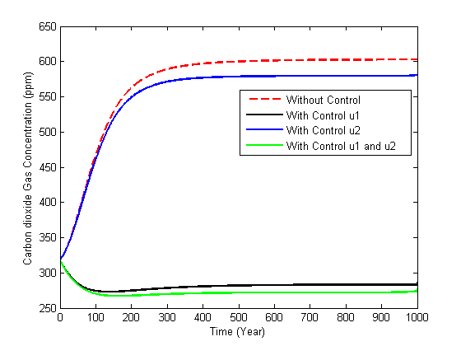
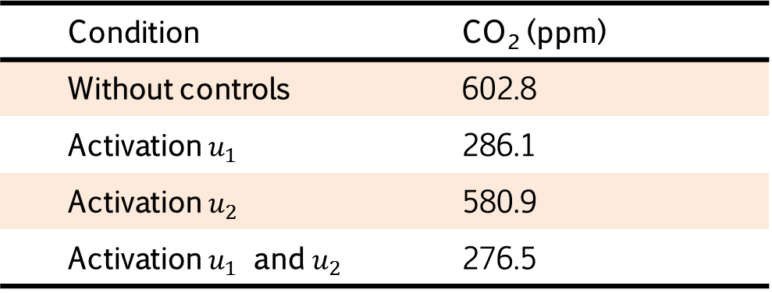
Numerical Simulation
Comparison of CO2 concentrations in the atmosphere
Simulation of CO2 concentrations in the atmosphere
Condition | CO₂ (ppm)
Without controls | 602.8
Activation $u_{1}$ | 286.1
Activation $u_{2}$ | 580.9
Activation $u_{1}$ and $u_{2}$ | 276.5

Slide 22
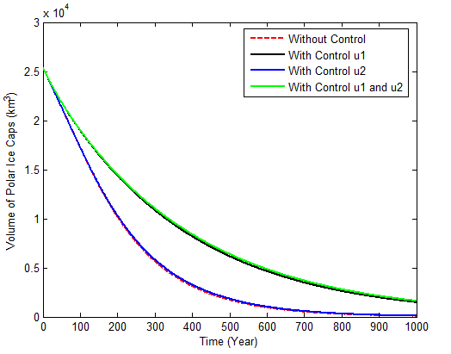
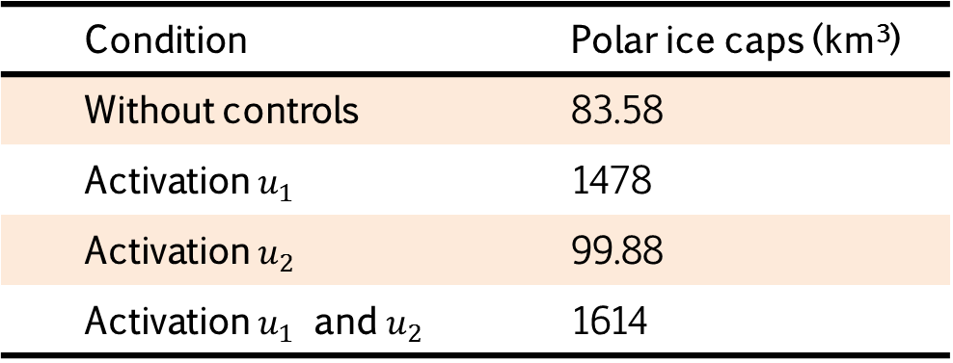
Numerical Simulation
Comparison of polarice caps volume
Simulation of polar ice caps volume
Condition | Polar ice caps (km³)
Without controls | 83.58
Activation $u_{1}$ | 1478
Activation $u_{2}$ | 99.88
Activation $u_{1}$ and $u_{2}$ | 1614

Slide 23
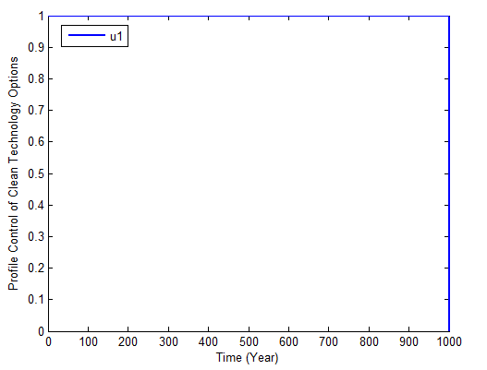
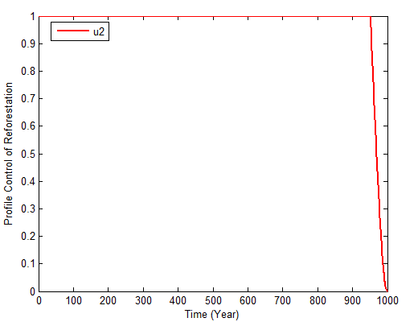
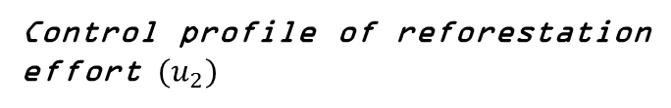
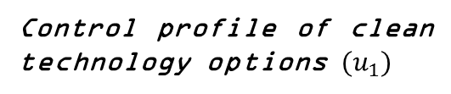
Numerical Simulation
Control profile of clean technology options ${(u}_{1})$
Control profile of reforestation effort ${(u}_{2})$
The objective functional (Billion US$)
J = 281870
The objective functional (Billion US$)
J = 552670

Slide 24
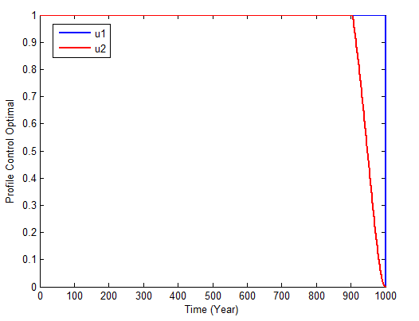
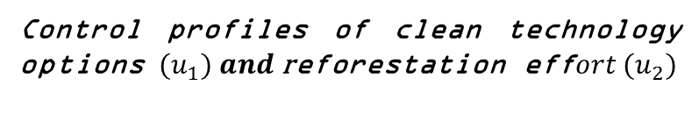
Numerical Simulation
Control profiles of clean technology options ${(u}_{1}) and \text{r}\text{eforestation} \text{eff}ort {(u}_{2})$
The objective functional (Billion US$)
J = 274700

Slide 25

CONCLUSION
The mathematical model of global warming effect on the melting of polar ice caps has three equilibria namely, the human and forest absence, the forest absence, and the co-existence. All of the equilibria are conditionally local asymptotically stable.
The application of control in the form of clean technology options and reforestation effort simultaneously is the most effective way to reduce the concentration of ${CO}_{2}$ gas in the atmosphere and the melting of polar ice caps.

Slide 26
Thank You

