Slide 1
Transformation Method for Solving Interval Linear Programming Problem
Herry Suprajitno and Ismail bin Mohd

Slide 2
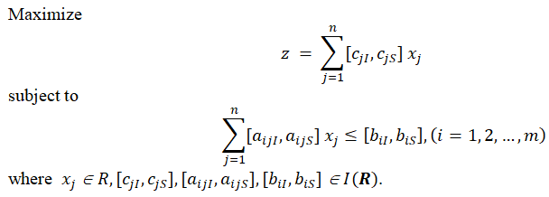
Interval Linear Programming (ILP)
LP with interval coefficients is a development of LP. This development is necessary to anticipate when data value is not known exactly, the smallest upper bound and the largest lower bound.
The problem could be formulated as follows.

Slide 3
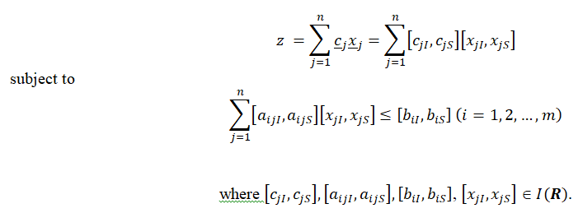
Interval Linear Programming (ILP)
ILP is a further development of the linear programming, where coefficients and variables are intervals.
ILP problem could be formulated as follows. Maximize

Slide 4
Transformation Method
START
Determine Largest & Smallest feasible region
Theorem 1 and 2
Determine Upper & Lower bound of objective function
Theorem 3 and 4
Construct 2 LP models
Determine Optimal Solution
N
bounded
solution ?
Y
Has 2 solutions ?
Add the constraint
N
Y
N
unbounded solution ?
Y
Construct interval solution
Has added constraint ?
N
Y
STOP

Slide 5
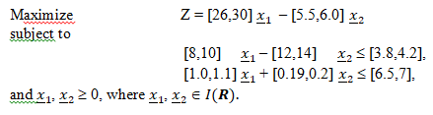


Implementation & discussion
Zhou et al. (2009)

Slide 6
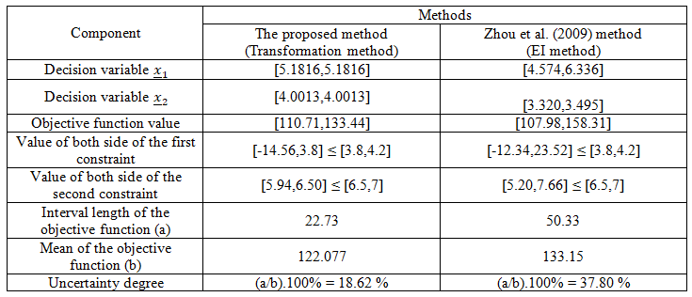
Criteria that can be used to determine the best solution, Zhou et al. (2009)
1. The solution satisfy all constraints,
2. Interval length of the objective function is minimum,
3. Uncertainty degree of the objective function value is small.
Table . Comparison of solution

Slide 7
From the Table
Criteria
1, I did not compare constraints feasibility because Zhou's and mine meet Zhou's definition of comparison between intervals.
2, interval length of decision variables and objective function obtained from my method are smaller than the result from Zhou et al.
3, uncertainty degree of the objective function from my method is smaller than the result from Zhou et al.
Hence, my method (transformation method) could be said to be better than the EI method from Zhou et al.

Slide 8
Conclusions
The transformation method proposed in this paper could be used to solve interval linear programming problem. Results from the proposed model is better than the EI method.

