Slide 1
Solving Bi-Objective Quadratic Assignment Problem with Squirrel Search Algorithm
Sri Wahyuni Ningtiyas, Asri Bekti Pratiwi, Auli Damayanti
Surabaya, Universitas Airlangga

Slide 2
Content
Introduction
Bi-objective Quadratic Assignment Problem
Squirrel Search Algorithm (SSA)
Experiment Result
Conclusion

Slide 3
INTRODUCTION

Slide 4
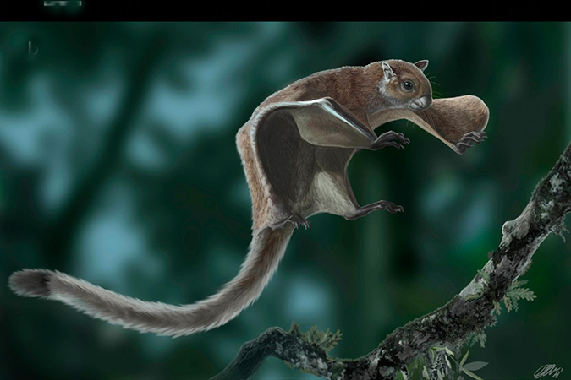
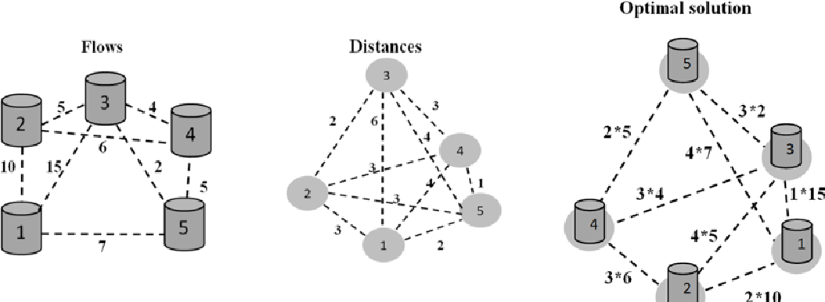
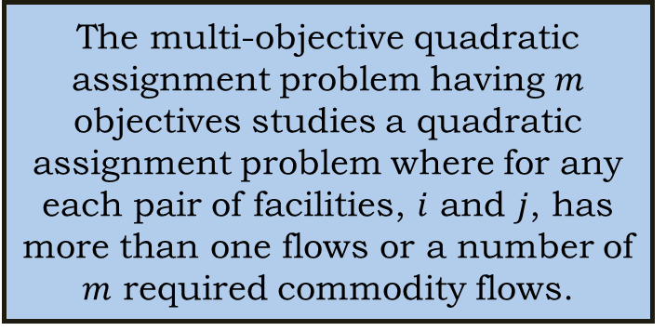
INTRODUCTION
The multi-objective quadratic assignment problem having $m$ objectives studies a quadratic assignment problem where for any each pair of facilities, $i$ and $j$, has more than one flows or a number of $m$ required commodity flows.
Squirrel Search Algorithm (SSA) is inspired by the behavior of southern flying squirrels in intelligent dynamic foraging strategy and gliding mechanism. It provides remarkable convergence behavior in finding the global optimum solutions which is found more accurate and consistent comparing with other algorithms.
Curiosity to apply Squirrel Search Algorithm in solving bi-quadratic optimization problem

Slide 5
bi-objective quadratic assignment problem

Slide 6
Bi-Objective Quadratic Assignment Problem
quadratic assignment problem discusses allocation of n known facilities to n known locations in order to minimize the total assignment costs between facilities and locations. Simplest model of multi-objectives assignment problem which have two objectives describes quadratic assignment problem in which there are two flows between any pairs of facilities.
subject to
where

Slide 7
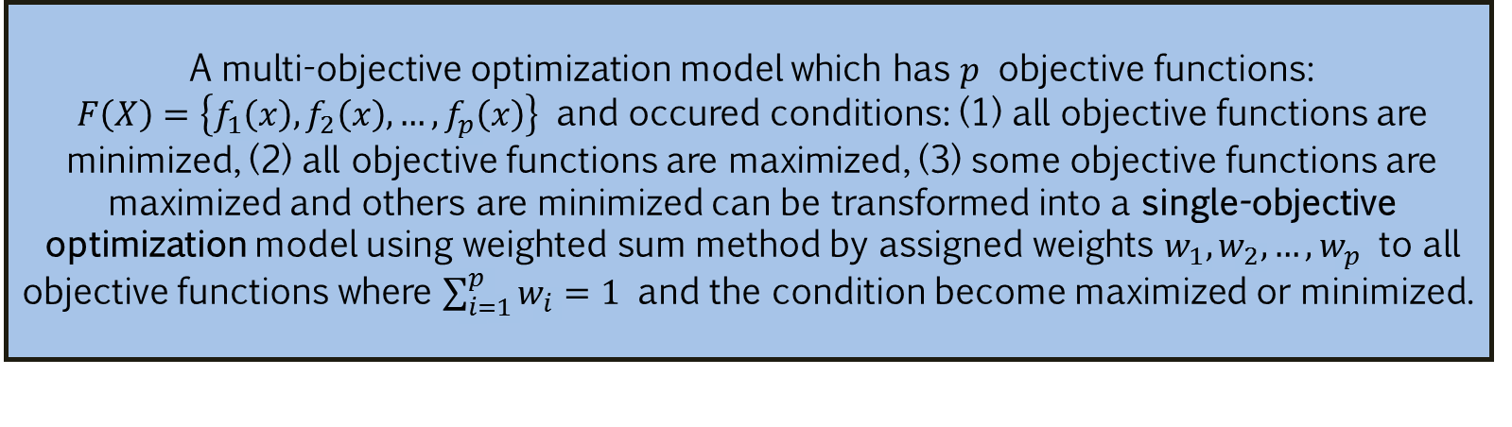

A multi-objective optimization model which has $p$ objective functions: $F\left(X\right)=\left\{f_{1}\left(x\right),f_{2}\left(x\right),…,f_{p}\left(x\right)\right\}$ and occured conditions: (1) all objective functions are minimized, (2) all objective functions are maximized, (3) some objective functions are maximized and others are minimized can be transformed into a single-objective optimization model using weighted sum method by assigned weights $w_{1},w_{2},…,w_{p}$ to all objective functions where $\sum_{i=1}^{p}{w_{i}}=1$ and the condition become maximized or minimized.
where $w_{1}+w_{2}=1$.

Slide 8
SQUIRREL SEARCH ALGORITHM (SSA)

Slide 9
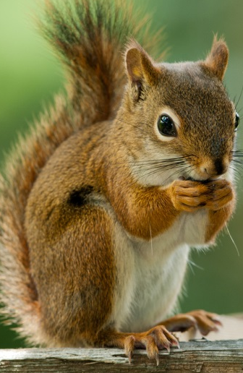
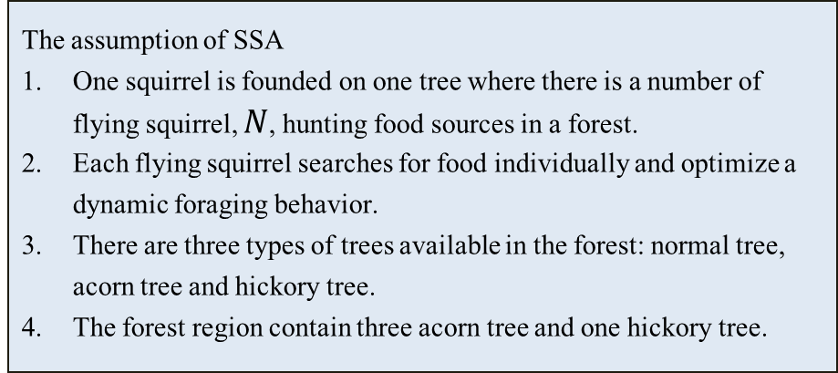
SQUIRREL SEARCH ALGORITHM (SSA)
The assumption of SSA
One squirrel is founded on one tree where there is a number of flying squirrel, $N$, hunting food sources in a forest.
Each flying squirrel searches for food individually and optimize a dynamic foraging behavior.
There are three types of trees available in the forest: normal tree, acorn tree and hickory tree.
The forest region contain three acorn tree and one hickory tree.
SSA is inspired by the behavior of southern flying squirrels in intelligent dynamic foraging strategy and gliding mechanism.
Survived flying squirrel → hickory tree
Other three survival flying squirrel → acorn tree → glide to hickory tree
Other squirrel → normal tree → randomly glide to hickory tree or acorn tree
Warm weather
Before winter
Winter
End of winter season

Slide 10



Parameters initialization and data input
$S_{c}<S_{min}$ ?
No
Generate locations for flying squirrels randomly (Eq 1)
Yes
Evaluate the fitness
Relocate flying squirrels
(Eq 7,8,9,10)
Sort the fitness and declare for each flying squirrels
Stopping condition is satisfied ?
No
Modification
(Eq 2,3,4)
Determine $S_{c}$
(Eq 5)
Yes
Best solution
Calculate $S_{min}$
(Eq 6)

Slide 11
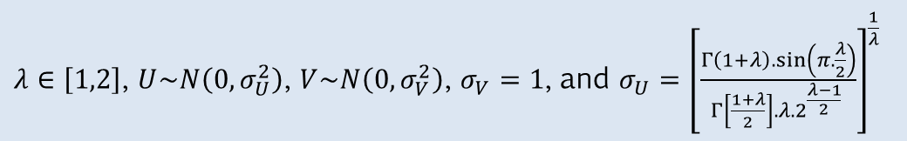
(5)
(1)
(2)
(6)
(3)
(7)
(4)
(8)
(9)
(10)
$λ∈\left[1,2\right]$, $U\sim N\left(0,σ_{U}^{2}\right)$, $V\sim N\left(0,σ_{V}^{2}\right)$, $σ_{V}=1$, and $σ_{U}={\left[\frac{Γ\left(1+λ\right).\sin\left(π.\frac{λ}{2}\right)}{Γ\left[\frac{1+λ}{2}\right].λ.2^{\frac{λ−1}{2}} }\right]}^{\frac{1}{λ}}$

Slide 12
EXPERIMENT RESULT

Slide 13
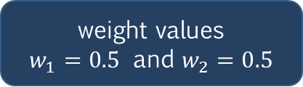
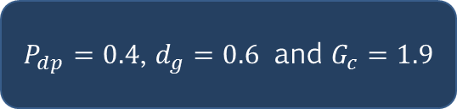
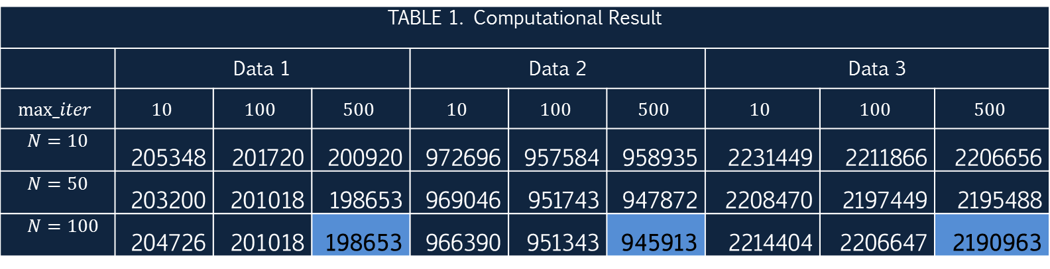
EXPERIMENT RESULT
Bi-objective quadratic assignment problems were taken from: https://github.com/apupiales/cuda_mqap/tree/master/mqap_instance_files
Data 1 : 10 facilities and 10 locations
Data 2 : 20 facilities and 20 locations
Data 3 : 30 facilities and 30 locations
Parameter
weight values
$w_{1}=0.5$ and $w_{2}=0.5$
$P_{dp}=0.4$, $d_{g}=0.6$ and $G_{c}=1.9$
TABLE 1. Computational Result
 | Data 1 |  |  | Data 2 |  |  | Data 3
$$max_iter$$ | $$10$$ | $$100$$ | $$500$$ | $$10$$ | $$100$$ | $$500$$ | $$10$$ | $$100$$ | $$500$$
$$N=10$$ | 205348 | 201720 | 200920 | 972696 | 957584 | 958935 | 2231449 | 2211866 | 2206656
$$N=50$$ | 203200 | 201018 | 198653 | 969046 | 951743 | 947872 | 2208470 | 2197449 | 2195488
$$N=100$$ | 204726 | 201018 | 198653 | 966390 | 951343 | 945913 | 2214404 | 2206647 | 2190963

Slide 14
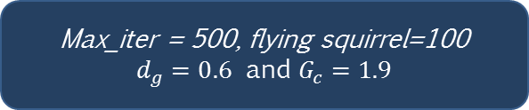
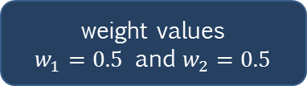
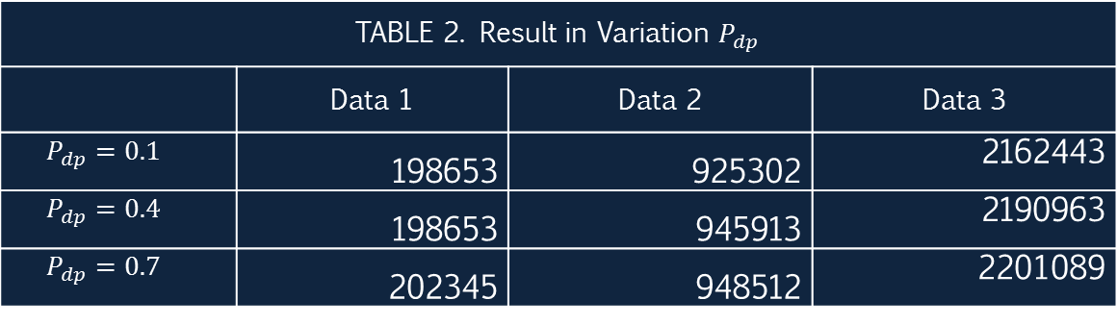
Bi-objective quadratic assignment problems were taken from: https://github.com/apupiales/cuda_mqap/tree/master/mqap_instance_files
Parameter
Data 1 : 10 facilities and 10 locations
Data 2 : 20 facilities and 20 locations
Data 3 : 30 facilities and 30 locations
weight values
$w_{1}=0.5$ and $w_{2}=0.5$
Max_iter = 500, flying squirrel=100
$d_{g}=0.6$ and $G_{c}=1.9$
TABLE 2. Result in Variation $P_{dp}$
 | Data 1 | Data 2 | Data 3
$$P_{dp}=0.1$$ | 198653 | 925302 | 2162443
$$P_{dp}=0.4$$ | 198653 | 945913 | 2190963
$$P_{dp}=0.7$$ | 202345 | 948512 | 2201089

Slide 15
CONCLUSION

Slide 16
CONCLUSION
The simplest model of multi-objective quadratic assignment problems is bi-objective quadratic assignment problem and solved by squirrel search algorithm.
From experiment result that the larger value in number of iteration and flying squirrels can lead to better performance.
Probability of predator presence has an effect to the performance of the algorithm in solving this problem. Small value of this probability can turn out a better performance of the algorithm to find the best solution.

Slide 17
THANK YOU

