Slide 1
Evaluating the Quality of a Help-Desk Complaint Management Service using Six-Sigma and COBIT 5 Framework
Presented By :
Army Justitia, S.Kom., M.Kom

Slide 2
Introduction
A help-desk system is crucial when it deals with the maintenance of customer satisfaction
Help-desk services in the IS/IT department in a public university under the current study receives too many complaints than what they can handle.
Research by Fitrani found that the process capability model of this university was at level 1 (as-is) from level 4 (to-be) in the DSS02 Manage Service Requests and Incidents domain.
The university is currently planning to implement IT to handle entry complaints and adopts COBIT 5 framework for IT governance.
Before the adoption, it is necessary to analyze the root of the problem to get a global overview.
Furthermore, the help-desk team wants to find out what complaints are the most frequent so that they can find preventive solutions, while making note of the process capability level they already know through research.
This study aims to evaluate and improve the service quality of a help-desk in the IS/IT department using a combination of Six-Sigma and COBIT 5 framework.
The results of this study can inform the organization in order to improve the service quality of its help-desk.

Slide 3
Research Methodology

Slide 4
Definition PHASE
SIPOC DIAGRAM
Data was collect through interview, documents review, and observation
In-depth open interviews were conducted with 2 staff from help-desk, either by face to face, telephone, or other media (ex. WhatsApp, email, short message).
The interview covers the following questions:
- The media used to channel user complaints
- The handling if there is a complaint that not related to IS/IT issues
- The follow-up after complaints are received and recorded
- The complaints classification and coordination with the technical team
- The monitoring of complaint handling
- The mechanism after complaints are resolved
User complaints are divided into :
Network
SIAD
Data Security
Informatics Branding

Slide 5
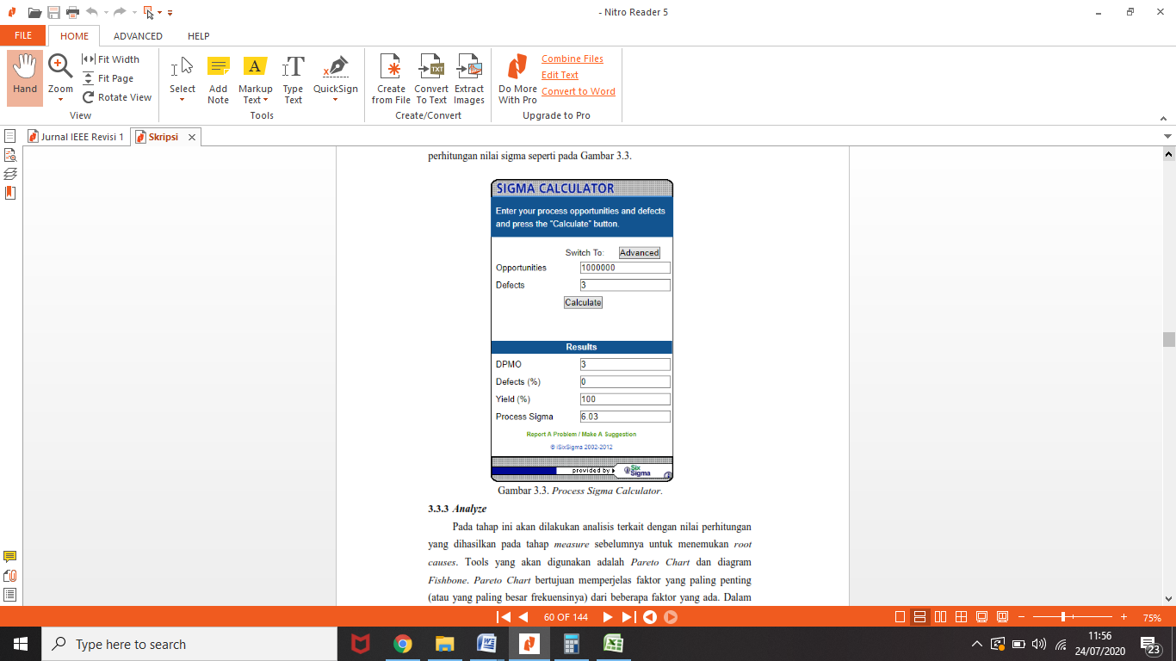

Measurement Phase
No. | Problem Categories | 2016 |  |  | 2017
 |  | ∑ Entry Complaints (Opportunities) | ∑ complete complaints | ∑ Unresolved complaints (Defects) | ∑ Entry Complaints (Opportunities) | ∑ complete complaints | ∑ Unresolved complaints (Defects)
1 | Network | 238 | 206 | 32 | 224 | 180 | 44
2 | System Integration and Application Development (SIAD) | 728 | 655 | 73 | 643 | 551 | 92
3 | Data security | 314 | 295 | 19 | 245 | 219 | 26
4 | Informatics branding | 3.164 | 3.154 | 10 | 1.196 | 1.173 | 23
 | Total | 4.444 |  | 134 | 2.308 |  | 185
 | DPMO | 30.153,015 |  |  | 80.155,979
 | Sigma Level | 3,37855 |  |  | 2,904023
Data source : complaint reports from 2016 to 2017

Slide 6
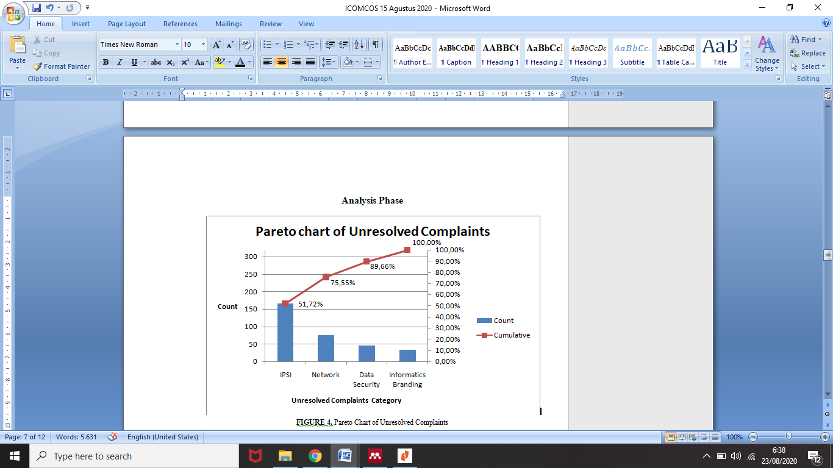
Pareto Chart
Based on the 80/20 Pareto principle[32], as many as 80% of the help-desk problems came from the SIAD and network categories (shown by line diagram), resulting in low quality of help-desk services.

Slide 7
Fishbone Diagram

Slide 8
Measurement Phase
The procedure factor is analyzed using the COBIT5 reference because the IT/IS department will install a new system in the future.
It caused a re-adjustment of the standard operational procedure in the Public Relations Information Support, Help-desk Information Management, and Help-desk Services.
Adjustments are made by comparing activities in the DSS02 Manage Service Requests and Incident and DSS03 Manage Problem in COBIT 5.
Here are some activities that do not yet have a standard operational procedure:
Sub Domain DSS02.07: Compile reports periodically, provide online data control, and perform obligations analysis of incidents that occur to develop a plan for service improvement.
Sub Domain DSS03.02: Identify the problem based on recorded incidents in the database.
Sub Domain DSS03.03: Record known root causes of incidents into the database.
Sub Domain DSS03.04: Monitor the effect of problems on the service, and review the problem-solving approach.

Slide 9
Improvement Phase
Service improvement are formulated based on the Pareto chart and the Fishbone diagrams
While for the technology itself, a new system is currently being developed.
The COBIT 5 framework is used as a reference for compiling new suggested standard operational procedure, especially DSS02 Manage Service Requests and Incidents and DSS03 Manage Problems.
No. | Actor role based on COBIT 5 | Organizational structure | RACI DSS02
 |  |  | 01 | 02 | 03 | 04 | 05 | 06 | 07
1. | Business Process Owners | Director | C | I | R | R | I | I | I
2. | Head of Development | KaSubditPengembangan SI | R |  | R | C | R | I | I
3. | Head of IT Operations | KaSubdit Operational SI | R | A | R | R | R | A | A
4. | Service Manager | Head of Informatics Branding | R | R | A | A | A | I | R
5. | Information Security Manager | Head of Keamanan Data | C |  |  | C | R | R | I
TABLE 3. Mapping the actors from COBIT 5 onto the organizational structure for DSS02 Manage Service Requests and Incidents

Slide 10
Improvement Phase
TABLE 4. Mapping the actors from COBIT 5 onto the organizational structure for DSS03 Manage Problems
No. | Actor role based on COBIT 5 | Organizational structure | RACI DSS02
 |  |  | 01 | 02 | 03 | 04 | 05
1. | Chief Information Officer | Director | R |  |  | I
2. | Head of Development | KaSubditPengembangan SI | R | C |  | C | C
3. | Head of IT Operations | KaSubdit Operational SI | R | A | A | R | R
4. | Service Manager | Head of Informatics Branding | A | R | R | A | A
5. | Information Security Manager | Head of Keamanan Data | C | R | R

Slide 11
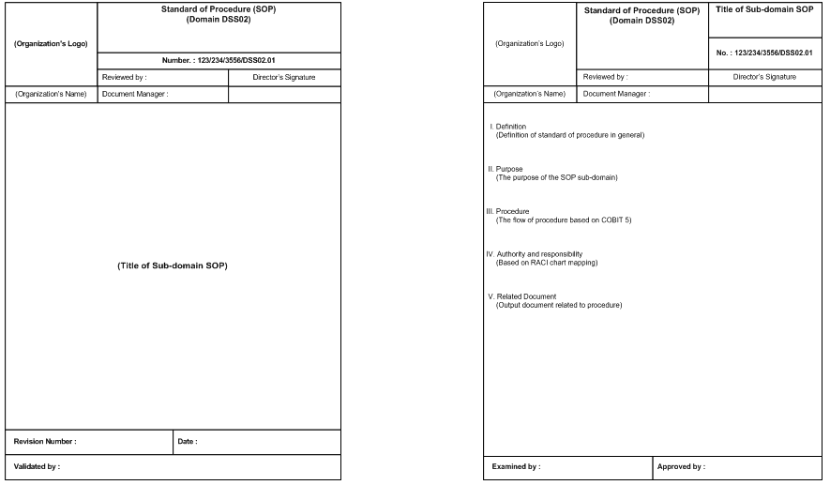
FIGURE 6. Template for Standard Operation Procedure, (a) Cover Page, (b) Main Page

Slide 12
Control Phase
TABLE 5. Control Plan
TABLE 5. Control Plan
Root Cause | Control Plans | Responsibility
Procedure | Writing down the name of the procedure and the impact/constraint it causes, both positive and negative Creating improvement plans for procedures that have a negative impact | Head of Informatics Branding
People | Calculating the proportion of the help-desk/technical staff team with the number of complaints received Mapping the technical staff skills with the type of complaint received | Head of Informatics Branding
Policy | Similar to the procedure, the policy must also be monitored and evaluated Establish KPIs as a form of control procedure | Head of Informatics Branding
Plant / technology | Calculating the increase in the performance of help-desk services before and after implementing any technology Ensuring the IT technology used is able to provide integrated solutions to assist communication between divisions | Head of Informatics Branding

Slide 13
Discussion
Fitrani’s research examines the same object as our research.
Fitriani used the combination of the COBIT 5 framework, especially the DSS02 Manage Service Requests and Incidents domain, as well as ITIL V3 to examine and improve the help-desk services’ quality.
Fitrani used the process assessment model in COBIT 5 to calculate the process maturity model, while we used the DPMO and the sigma level to determine the effectiveness of complaint handling.
In our study, COBIT 5 is used to formulate standard operational procedures.
It is noteworthy that the university could also adopt the steps in ITIL to be implemented in the new system, from the identification of complaint to the evaluation of complaints handling.

Slide 14
Discussion
We used SIPOC diagram to deliver the results in the definition phase.
Li et all produced project charter (contains project description, project goal, project scope, process indicator, financial indicator and calculation steps, team members, and their roles and responsibilities).
Prashar’s research mentioned the critical to quality (CTQ) factors and SIPOC diagram in the screening process.
Tello’s research improved the domain of DSS02 Manage Services Requests and Incidents using process mining go generate the details of the incident handling process.
The detailed process produced by [27] refers to the ITIL V3 framework for handling incidents.

Slide 15
Conclussion
The high number of entry complaints and unresolved complaints prompts the evaluation of the help-desk service in a public university.
Using Six-Sigma methodology, the service of help-desk is at 3σ of 6σ.
We decided to discover the root cause of the low sigma level value by using the Pareto charts and the Fishbone diagrams.
According to the Pareto principle, SIAD and network category of complaints contributed to the largest value at around 76%.
Further analysis revealed that four solutions could overcome these problems, namely Policy, Procedure, Plant/Technology, and People factors.

Slide 16
Conclussion
Improvement phase in DMAIC sub-methodology adopts COBIT 5 framework in the domain of DSS02 Manage Service Requests and Incidents and DSS03 Manage Problems.
This study produced 12 recommendations procedure for the policy and procedure solutions.
For further research, analysis needs to be done to find the root causes for Plant/Technology and People factors.
For these two root causes, it is necessary to explore other appropriate methods to evaluate them.
Other recommendations are to evaluate help-desk services related to working time, waiting time, and processing time of complaint handling.

