Slide 1
The Semiparametric Regression Curve Estimation by Using Mixed Truncated Spline and Fourier Series Model
(Case Study: Human Development Index in East Java)
Helida Nurcahayani, I Nyoman Budiantara and Ismaini Zain
Department of Statistics, Faculty of Science and Data Analytics
Sepuluh Nopember Institute of Technology

Slide 2
Content Layout
Semiparametric Regression Curve Estimation by Using Mixed Truncated Spline and Fourier Series Model
Introduction
Semiparametric Regression Model
Semiparametric Regression Curve Estimation by Using Mixed Truncated Spline and Fourier Series Model
Application of Data

Slide 3
Introduction (1)
Semiparametric regression is a model that combines parametric and nonparametric models. The use of two different components in semiparametric regression practically makes this model broader and developed rapidly in theoretical respect
The objective of this research is to obtain an estimator of multivariable semiparametric regression curve using mixed truncated spline and fourier series model
and applying the data of the 2018 Human Development Index (HDI) in East Java.
› Truncated spline -- data changing patterns at certain sub-intervals
› Fourier series -- data are smooth & follow the pattern repeated at certain intervals.
› In multivariable nonparametric regression - possible to use different estimators for each predictor → mixed or combined truncated spline and fourier series estimators

Slide 4
Introduction (2)
› Measure important aspects related to the degree in basic 3 dimensions of human dev.
› Determining component of the General Allocation Fund (DAU) of regencies/cities
# Human Development Index (HDI)?
› One of the largest provinces & population (>39.5 million)
› Annual index of East Java’s HDI: the lowest achievement in Java island ; lower than Indonesia’s HDI
# East Java’s HDI?
Further studies on East Java’s HDI becomes important as the basis of government evaluation in formulating policies to improve the quality of human resources

Slide 5
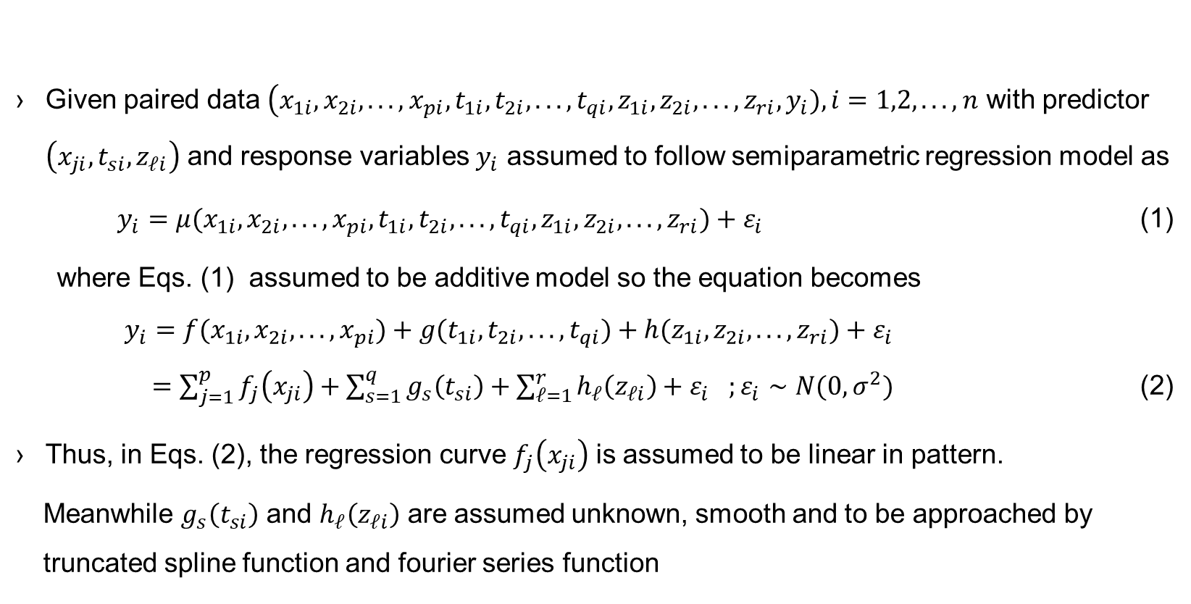
Semiparametric Regression Model (1)
Given paired data $\left(x_{1i},x_{2i},...,x_{pi},t_{1i},t_{2i},...,t_{qi},z_{1i},z_{2i},...,z_{ri},y_{i}),i=1,2,...,n\right.$ with predictor $\left(x_{ji},t_{si},z_{𝓁i}\right)$ and response variables $y_{i}$ assumed to follow semiparametric regression model as
$y_{i}=μ(x_{1i},x_{2i},...,x_{pi},t_{1i},t_{2i},...,t_{qi},z_{1i},z_{2i},...,z_{ri})+ε_{i}$ (1)
where Eqs. (1) assumed to be additive model so the equation becomes
$$y_{i}=f(x_{1i},x_{2i},...,x_{pi})+g(t_{1i},t_{2i},...,t_{qi})+h(z_{1i},z_{2i},...,z_{ri})+ε_{i}$$
$=\sum_{j=1}^{p}{f_{j}\left(x_{ji}\right)}+\sum_{s=1}^{q}{g_{s}\left(t_{si}\right)}+\sum_{𝓁=1}^{r}{h_{𝓁}\left(z_{𝓁i}\right)}+ε_{i} ;ε_{i}∼N(0,σ^{2})$ (2)
Thus, in Eqs. (2), the regression curve $f_{j}\left(x_{ji}\right)$ is assumed to be linear in pattern.
Meanwhile $g_{s}\left(t_{si}\right)$ and $h_{𝓁}\left(z_{𝓁i}\right)$ are assumed unknown, smooth and to be approached by truncated spline function and fourier series function

Slide 6
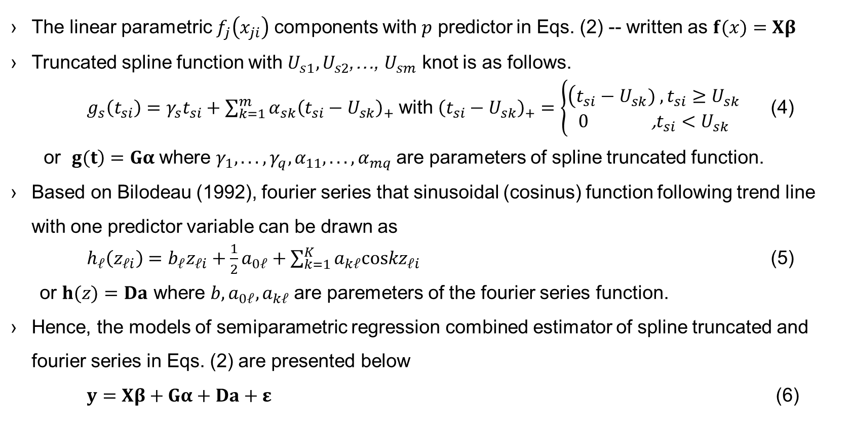
Semiparametric Regression Model (2)
The linear parametric $f_{j}\left(x_{ji}\right)$ components with $p$ predictor in Eqs. (2) -- written as $f(x)=Xβ$
Truncated spline function with $U_{s1},U_{s2}$,…, $U_{sm}$ knot is as follows.
$g_{s}\left(t_{si}\right)=γ_{s}t_{si}+\sum_{k=1}^{m}{α_{sk}{\left(t_{si}−U_{sk}\right)}_{+}}$ with ${\left(t_{si}−U_{sk}\right)}_{+}=\left\{\begin{matrix}\left(t_{si}−U_{sk}) ,t_{si}≥U_{sk}\right. \\ 0\text{ ,}t_{si}<U_{sk}\end{matrix}\right.$ (4)
or $\left.g(t\right)=Gα$ where $γ_{1},...,γ_{q},α_{11},...,α_{mq}$ are parameters of spline truncated function.
Based on Bilodeau (1992), fourier series that sinusoidal (cosinus) function following trend line with one predictor variable can be drawn as
$h_{𝓁}\left(z_{𝓁i}\right)=b_{𝓁}z_{𝓁i}+\frac{1}{2}a_{0𝓁}+\sum_{k=1}^{K}{a_{k𝓁}coskz_{𝓁i}}$ (5)
or $h(z)=Da$ where $b,a_{0𝓁},a_{k𝓁}$ are paremeters of the fourier series function.
Hence, the models of semiparametric regression combined estimator of spline truncated and fourier series in Eqs. (2) are presented below
$y=Xβ+Gα+Da+ε$ (6)

Slide 7
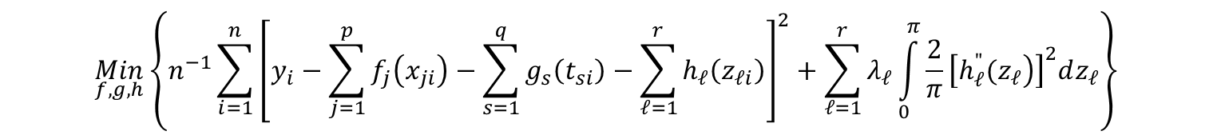
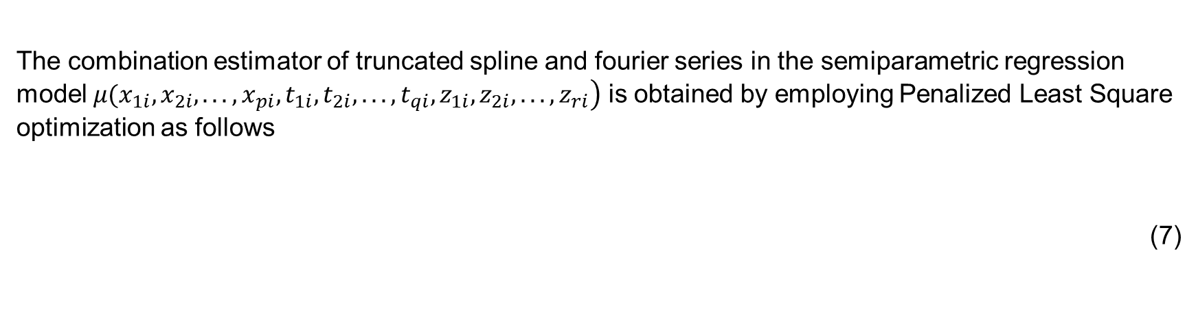
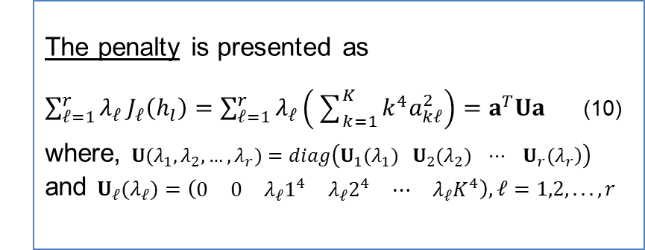
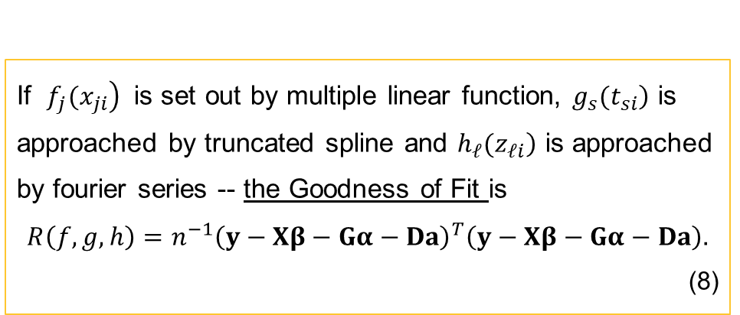
Semiparametric Regression Curve Estimation by Using Mixed Truncated Spline and Fourier Series Model (1)
The combination estimator of truncated spline and fourier series in the semiparametric regression model $\left.μ(x_{1i},x_{2i},...,x_{pi},t_{1i},t_{2i},...,t_{qi},z_{1i},z_{2i},...,z_{ri}\right)$ is obtained by employing Penalized Least Square optimization as follows
(7)
$$\underset{f,g,h}{Min}\left\{n^{−1}\sum_{i=1}^{n}{{\left[y_{i}−\sum_{j=1}^{p}{f_{j}\left(x_{ji}\right)}−\sum_{s=1}^{q}{g_{s}\left(t_{si}\right)}−\sum_{𝓁=1}^{r}{h_{𝓁}\left(z_{𝓁i}\right)}\right]}^{2}}+\sum_{𝓁=1}^{r}{λ_{𝓁}}\int_{0}^{π}{\frac{2}{π}{\left[\left.h_{𝓁}^{"}(z_{𝓁}\right)\right]}^{2}dz_{𝓁}}\right\}$$
If $\left.f_{j}(x_{ji}\right)$ is set out by multiple linear function, $\left.g_{s}(t_{si}\right)$ is approached by truncated spline and $\left.h_{𝓁}(z_{𝓁i}\right)$ is approached by fourier series -- the Goodness of Fit is
$$R\left(f,g,h\right)=n^{−1}{\left(y−Xβ−Gα−Da\right)}^{T}\left(y−Xβ−Gα−Da\right).$$
(8)
The penalty is presented as
$\sum_{𝓁=1}^{r}{λ_{𝓁}}J_{𝓁}\left(h_{l}\right)=\sum_{𝓁=1}^{r}{λ_{𝓁}}\left(\sum_{k=1}^{K}{k^{4}a_{k𝓁}^{2}}\right)=a^{T}Ua$ (10)
where, $U(λ_{1},λ_{2},…,λ_{r})=diag\left(\left.U_{1}(λ_{1}) U_{2}(λ_{2}) ⋯ U_{r}(λ_{r}\right)\right)$ and $U_{𝓁}(λ_{𝓁})=\left(\begin{matrix}0 & 0 & λ_{𝓁}1^{4} & λ_{𝓁}2^{4} & ⋯ & λ_{𝓁}K^{4}\end{matrix}\right),𝓁=1,2,...,r$

Slide 8
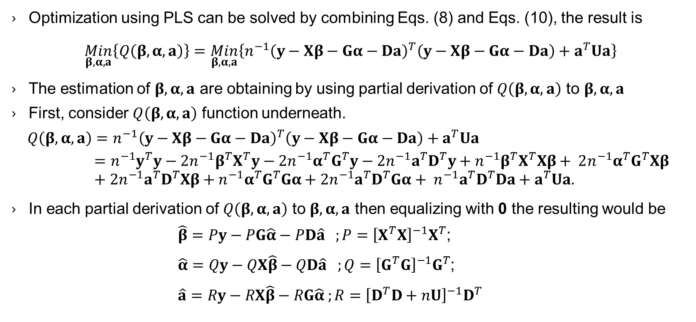
Semiparametric Regression Curve Estimation by Using Mixed Truncated Spline and Fourier Series Model (2)
Optimization using PLS can be solved by combining Eqs. (8) and Eqs. (10), the result is
$$\underset{β,α,a}{Min}\left\{Q\left(β,α,a\right)\right\}=\underset{β,α,a}{Min}\left\{n^{−1}{\left(y−Xβ−Gα−Da\right)}^{T}\left(y−Xβ−Gα−Da\right)+a^{T}Ua\right\}$$
The estimation of $β,α,a$ are obtaining by using partial derivation of $Q\left(β,α,a\right)$ to $β,α,a$
First, consider $Q\left(β,α,a\right)$ function underneath.
$$Q\left(β,α,a\right)=n^{−1}{\left(y−Xβ−Gα−Da\right)}^{T}\left(y−Xβ−Gα−Da\right)+a^{T}Ua$$
$$=n^{−1}y^{T}y−2n^{−1}β^{T}X^{T}y−2n^{−1}α^{T}G^{T}y−2n^{−1}a^{T}D^{T}y+n^{−1}β^{T}X^{T}Xβ+ 2n^{−1}α^{T}G^{T}Xβ+2n^{−1}a^{T}D^{T}Xβ+n^{−1}α^{T}G^{T}Gα+2n^{−1}a^{T}D^{T}Gα+ n^{−1}a^{T}D^{T}Da+a^{T}Ua.$$
In each partial derivation of $Q\left(β,α,a\right)$ to $β,α,a$ then equalizing with 0 the resulting would be
$\hat{β}=Py−PG\hat{α}−PD\hat{a} ;P={\left[X^{T}X\right]}^{−1}X^{T}$;
$\hat{α}=Qy−QX\hat{β}−QD\hat{a} ;Q={\left[G^{T}G\right]}^{−1}G^{T}$;
$$\hat{a}=Ry−RX\hat{β}−RG\hat{α} ;R={\left[D^{T}D+nU\right]}^{−1}D^{T}$$

Slide 9
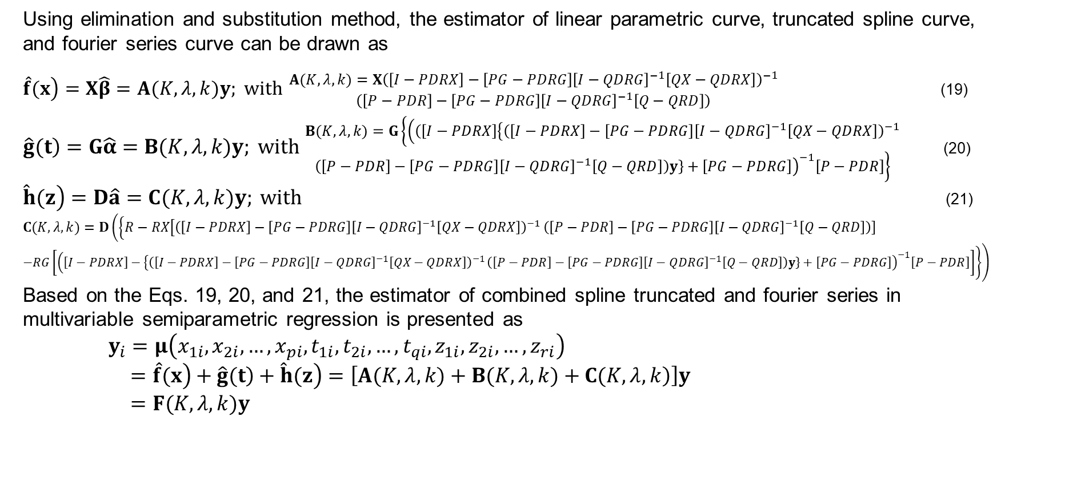
Semiparametric Regression Curve Estimation by Using Mixed Truncated Spline and Fourier Series Model (3)
Using elimination and substitution method, the estimator of linear parametric curve, truncated spline curve, and fourier series curve can be drawn as
$\left.\hat{f}(x\right)=X\hat{β}=A(K,λ,k)y; \text{with}$ $\begin{matrix}A(K,λ,k)=X{\left(\left[I−PDRX\right]−\left[PG−PDRG\right]{\left[I−QDRG\right]}^{−1}\left[QX−QDRX\right]\right)}^{−1} \\ \left(\left[P−PDR\right]−\left[PG−PDRG\right]{\left[I−QDRG\right]}^{−1}\left[Q−QRD\right]\right)\end{matrix}$ (19)
$\left.\hat{g}(t\right)=G\hat{α}=B(K,λ,k)y; \text{with}$ $\begin{matrix}B(K,λ,k)=G\left\{\left(\left(\left[I−PDRX\right]\right.\left\{{\left(\left[I−PDRX\right]−\left[PG−PDRG\right]{\left[I−QDRG\right]}^{−1}\left[QX−QDRX\right]\right)}^{−1}\right.\right.\right. \\ \left.{\left.\left.\left(\left[P−PDR\right]−\left[PG−PDRG\right]{\left[I−QDRG\right]}^{−1}\left[Q−QRD\right]\right)y\right\}+\left[PG−PDRG\right]\right)}^{−1}\left[P−PDR\right]\right\}\end{matrix}$ (20)
$\left.\hat{h}(z\right)=D\hat{a}=C(K,λ,k)y; \text{with}$ (21)
$$C(K,λ,k)=D\left(\left\{R−RX\left[{\left(\left[I−PDRX\right]−\left[PG−PDRG\right]{\left[I−QDRG\right]}^{−1}\left[QX−QDRX\right]\right)}^{−1}\right.\right.\right.\left.\left(\left[P−PDR\right]−\left[PG−PDRG\right]{\left[I−QDRG\right]}^{−1}\left[Q−QRD\right]\right)\right]$$
$$−RG\left[\left(\left[I−PDRX\right]−\left\{{\left(\left[I−PDRX\right]−\left[PG−PDRG\right]{\left[I−QDRG\right]}^{−1}\left[QX−QDRX\right]\right)}^{−1}\right.\right.\right.\left.\left.\left.{\left.\left.\left(\left[P−PDR\right]−\left[PG−PDRG\right]{\left[I−QDRG\right]}^{−1}\left[Q−QRD\right]\right)y\right\}+\left[PG−PDRG\right]\right)}^{−1}\left[P−PDR\right]\right]\right\}\right)$$
Based on the Eqs. 19, 20, and 21, the estimator of combined spline truncated and fourier series in multivariable semiparametric regression is presented as
$$y_{i}=μ\left(x_{1i},x_{2i},…,x_{pi},t_{1i},t_{2i},…,t_{qi},z_{1i},z_{2i},…,z_{ri}\right)$$
$$=\left.\hat{f}(x\right)+\left.\hat{g}(t\right)+\left.\hat{h}(z\right)=\left[\left.A(K,λ,k)+B(K,λ,k)+C(K,λ,k\right)\right]y$$
$$=F(K,λ,k)y$$

Slide 10
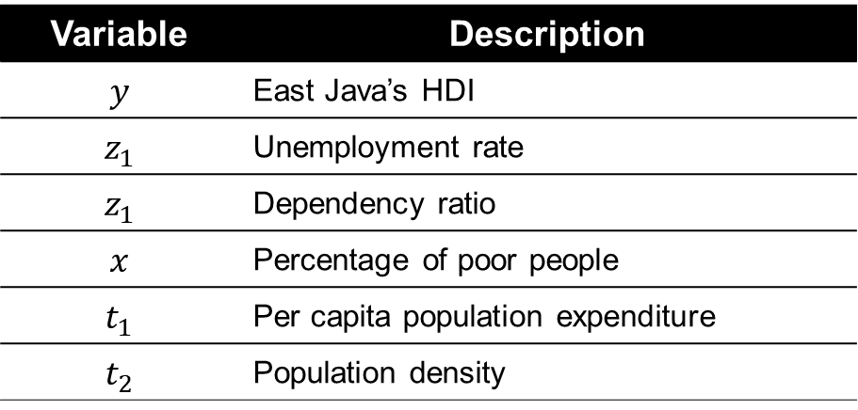
APPLICATION DATA (1)
The proposed model is applied to HDI data in 37 regencies/cities
across East Java in 2018
The steps used in this study
Determining the relationship between response and each predictor variable by linear, truncated spline, and fourier series function.
Modelling East Java’s HDI using semiparametric regression by mixed truncated spline and fourier series.
The best model is obtained based on the optimum smoothing parameter - the method of selecting: minimum Generalized Cross Validation (GCV) criteria.
From the best model, the coefficient determination (R²) is obtained and conclusion is drawn
Variable | Description
$$y$$ | East Java’s HDI
$$z_{1}$$ | Unemployment rate
$$z_{1}$$ | Dependency ratio
$$x$$ | Percentage of poor people
$$t_{1}$$ | Per capita population expenditure
$$t_{2}$$ | Population density

Slide 11
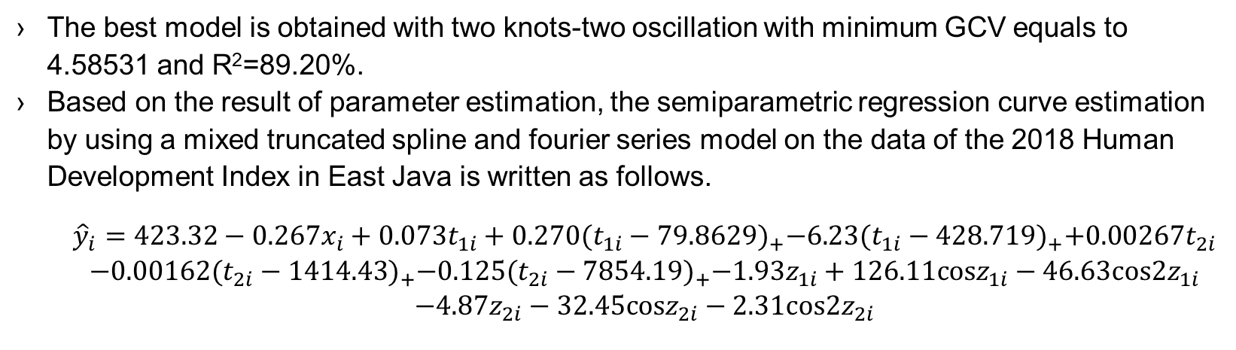
Application Data (2)
The best model is obtained with two knots-two oscillation with minimum GCV equals to 4.58531 and R²=89.20%.
Based on the result of parameter estimation, the semiparametric regression curve estimation by using a mixed truncated spline and fourier series model on the data of the 2018 Human Development Index in East Java is written as follows.
$$\begin{matrix}\begin{aligned}{\hat{y}}_{i}=423.32−0.267x_{i}+0.073t_{1i}+0.270{(t_{1i}−79.8629)}_{+}−6.23{(t_{1i}−428.719)}_{+}+0.00267t_{2i} \\ −0.00162{(t_{2i}−1414.43)}_{+}−0.125{(t_{2i}−7854.19)}_{+}−1.93z_{1i}+126.11cosz_{1i}−46.63cos2z_{1i}\end{aligned} \\ −4.87z_{2i}−32.45cosz_{2i}−2.31cos2z_{2i}\end{matrix}$$
Figure 2. Comparison of Actual versus Estimated Data

Slide 12
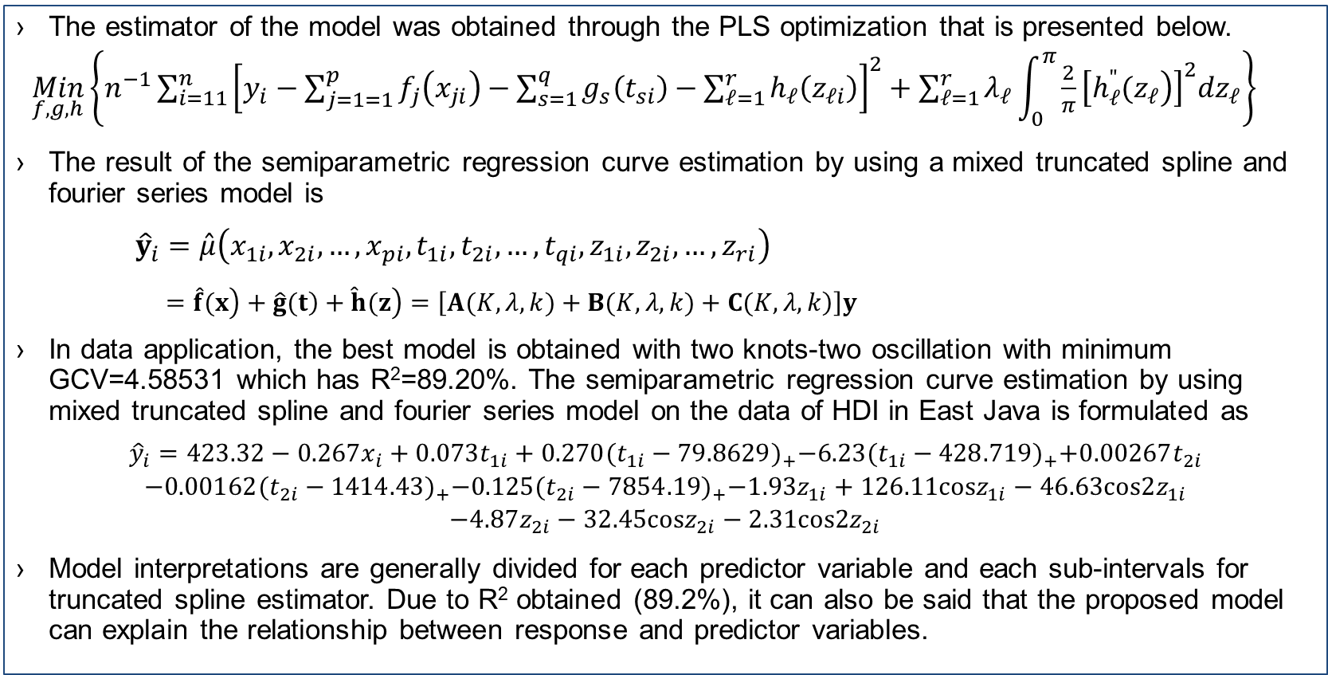
Conclusions
The estimator of the model was obtained through the PLS optimization that is presented below.
$\underset{f,g,h}{Min}\left\{n^{−1}{\sum_{i=11}^{n}{\left[y_{i}−\sum_{j=1=1}^{p}{f_{j}\left(x_{ji}\right)}−\sum_{s=1}^{q}{g_{s}\left(t_{si}\right)}−\sum_{𝓁=1}^{r}{h_{𝓁}\left(z_{𝓁i}\right)}\right]}}^{2}+\sum_{𝓁=1}^{r}{λ_{𝓁}}\int_{0}^{π}{\frac{2}{π}{\left[\left.h_{𝓁}^{"}(z_{𝓁}\right)\right]}^{2}dz_{𝓁}}\right\}$
The result of the semiparametric regression curve estimation by using a mixed truncated spline and fourier series model is
$${\hat{y}}_{i}=\hat{μ}\left(x_{1i},x_{2i},…,x_{pi},t_{1i},t_{2i},…,t_{qi},z_{1i},z_{2i},…,z_{ri}\right)$$
$$=\left.\hat{f}(x\right)+\left.\hat{g}(t\right)+\left.\hat{h}(z\right)=\left[\left.A(K,λ,k)+B(K,λ,k)+C(K,λ,k\right)\right]y$$
In data application, the best model is obtained with two knots-two oscillation with minimum GCV=4.58531 which has R²=89.20%. The semiparametric regression curve estimation by using mixed truncated spline and fourier series model on the data of HDI in East Java is formulated as
$$\begin{matrix}\begin{aligned}{\hat{y}}_{i}=423.32−0.267x_{i}+0.073t_{1i}+0.270{(t_{1i}−79.8629)}_{+}−6.23{(t_{1i}−428.719)}_{+}+0.00267t_{2i} \\ −0.00162{(t_{2i}−1414.43)}_{+}−0.125{(t_{2i}−7854.19)}_{+}−1.93z_{1i}+126.11cosz_{1i}−46.63cos2z_{1i}\end{aligned} \\ −4.87z_{2i}−32.45cosz_{2i}−2.31cos2z_{2i}\end{matrix}$$
Model interpretations are generally divided for each predictor variable and each sub-intervals for truncated spline estimator. Due to R² obtained (89.2%), it can also be said that the proposed model can explain the relationship between response and predictor variables.

Slide 13

