Slide 1
Robust Mean-Variance Portfolio Selection with Time Series Clustering
La Gubu
Dedi Rosadi
Abdurakhman
Department of Mathematic
Gadjah Mada University-Indonesia

Slide 2
1. Introduction
The strategy in utilizing statistical measures from historical data return, namely the mean, variance and covariance, has become a basic principle in the formation of the classic mean-variance (MV) portfolio model by Markowitz (1952).
Markowitz proposes a portfolio model that uses the mean and variance of asset returns to express the trade-off between portfolio returns and risks.
Various studies have been carried out to solve and develop the Markowitz portfolio model. All of that is done to adapt the existing model to the conditions of financial market factors and the demands of capital market practitioners
One of the focuses of research in portfolio selection is the efficiency of optimum portfolio selection time. This is understandable because the greater the number of securities involved in portfolio selection, the more likely the portfolio can be formed.
The large number of securities involved in portfolio selection can be tackled by grouping stock data using cluster analysis.

Slide 3
In the past few years, a lot of research on the portfolios selection has used cluster analysis.
Guan and Jiang (2007), Tola et al. (2008), Chen and Huang (2009) , Nanda et al. (2010) , Long et al. (2014)
Even though clustering can increase the efficiency of a model, this method is not much more effective than MV model. The main problem of MV portfolio model is that the mean vectors and variance-covariance matrix must be estimated from the data which can be highly volatile.
As a very important input in the formation of MV portfolio models, estimation errors of mean vectors and variance-covariance matrix will significantly affect the results of optimal portfolio formation.
Several studies related to estimation errors and their relationship with optimal portfolio formation have been carried out by Best and Grauer (1991), Broadie (1993), Chopra and Ziemba (1993), and Ceria and Stubbs (2006).
These studies conclude that although the MV model is supported by strong theory and is relatively easy in computing, the MV model shows some weaknesses, including the optimal portfolio produced by this model is not well diversified. In addition, MV model is also highly sensitive to changes in input parameters, which are the mean vector and the variance-covariance matrix.

Slide 4
Some researchers have therefore built up a robust portfolio, a portfolio that can reduce the effects of outliers on the estimated vector mean, and the variance-covariance matrix in the MV portfolio models.
One of the standard approaches in forming an optimal robust portfolio is through a robust estimation approach.
Several studies on the formation of optimal portfolios using robust estimation have been carried out by Lauprete (2001), Vaz-de Melo and Camara (2003), Zhou (2006), Welsh and Zhou (2007), DeMiguel and Nogales (2008), Kusch (2012), Supandi (2017). The difference between these studies lies in the use of robust estimates. All of the results presented in the papers stated that the performance of the portfolio with robust estimation is better than the classical portfolio in the presence of the outliers.
However, none of the above literature had considered a combination of cluster analysis and robust estimation methods in the formation of an optimum portfolio.

Slide 5
Based on those previous studies, we observed that, to increase the efficiency of portfolio building process we need to group the stocks into clusters, select a representative from each cluster and determined the weight of each representatives. In this study, for grouping stocks in clusters, we use Partitioning Around Medoids (PAM) time series clustering, Sharpe ratio we use to select representative from each cluster. To increase the effectivity of the model, we also Fast Minimum Covariance Determinant (FCMD) and S estimation for the mean and covariance of the data.

Slide 6
2. Methodology
First, stocks are grouped into several clusters using Partitioning Around Medoids (PAM) time series clustering.
From the calculation of return and risk each stock in each cluster, it can be determined the performance of each stock in each cluster using Sharpe ratio.
The next step is to choose stocks that will represent each cluster to form the optimum portfolio. The stock chosen as representations of a cluster is stock with the highest Sharpe ratio.
After the stocks that build the optimum portfolio have been selected, the next step is to determine the weight of each stock that builds the portfolio using robust FMCD estimation method and robust S estimation method.
To see the advantages of these two methods, the performance of portfolios that formed then compared with portfolio performance formed using the classic mean variance (MV) method.

Slide 7
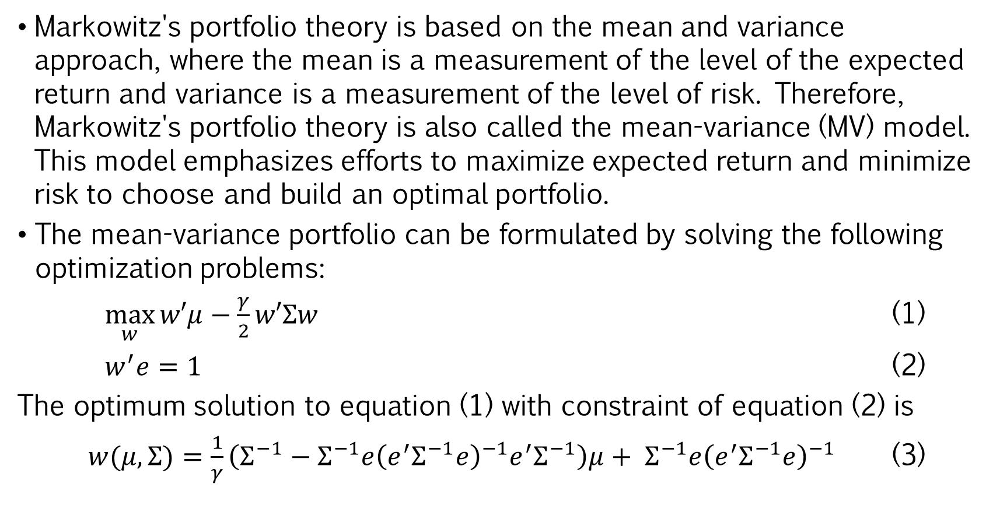
2.1 Mean Variance Portfolio
Markowitz's portfolio theory is based on the mean and variance approach, where the mean is a measurement of the level of the expected return and variance is a measurement of the level of risk. Therefore, Markowitz's portfolio theory is also called the mean-variance (MV) model. This model emphasizes efforts to maximize expected return and minimize risk to choose and build an optimal portfolio.
The mean-variance portfolio can be formulated by solving the following optimization problems:
$\max_{w}{w′μ}−\frac{γ}{2}w′Σw$ (1)
$w^{′}e=1$ (2)
The optimum solution to equation (1) with constraint of equation (2) is
$w(μ,Σ)=\frac{1}{γ}\left(Σ^{−1}−Σ^{−1}e{\left(e^{′}Σ^{−1}e\right)}^{−1}e^{′}Σ^{−1}\right)μ+ Σ^{−1}e{\left(e^{′}Σ^{−1}e\right)}^{−1}$ (3)

Slide 8
2.2 Clustering Stocks
Because the number of stocks available in the capital market is quite large, it is very difficult to determine the proportion of investment for each stock.
Therefore, it is necessary to use data mining techniques to deal with this. One of the data mining techniques that can be used is cluster analysis. Cluster analysis is a statistical analysis that aims to separate objects into several groups that have the same/different characteristics from one group to another group.
In this analysis each group is homogeneous between members in groups or variations of objects in groups that are formed as small as possible. Objects in a cluster will have a closer relationship compared to objects in other clusters.
In this study, the clustering using Partitioning Around Medoids (PAM) time series clustering will be applied.

Slide 9
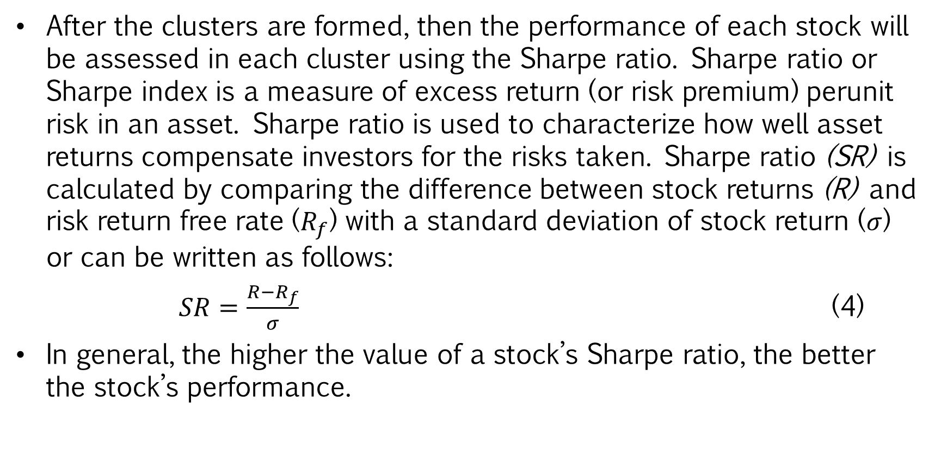
2.3 Sharpe ratio
After the clusters are formed, then the performance of each stock will be assessed in each cluster using the Sharpe ratio. Sharpe ratio or Sharpe index is a measure of excess return (or risk premium) perunit risk in an asset. Sharpe ratio is used to characterize how well asset returns compensate investors for the risks taken. Sharpe ratio (SR) is calculated by comparing the difference between stock returns (R) and risk return free rate ($R_{f}$) with a standard deviation of stock return ($σ$) or can be written as follows:
$SR=\frac{R−R_{f}}{σ}$ (4)
In general, the higher the value of a stock’s Sharpe ratio, the better the stock’s performance.

Slide 10
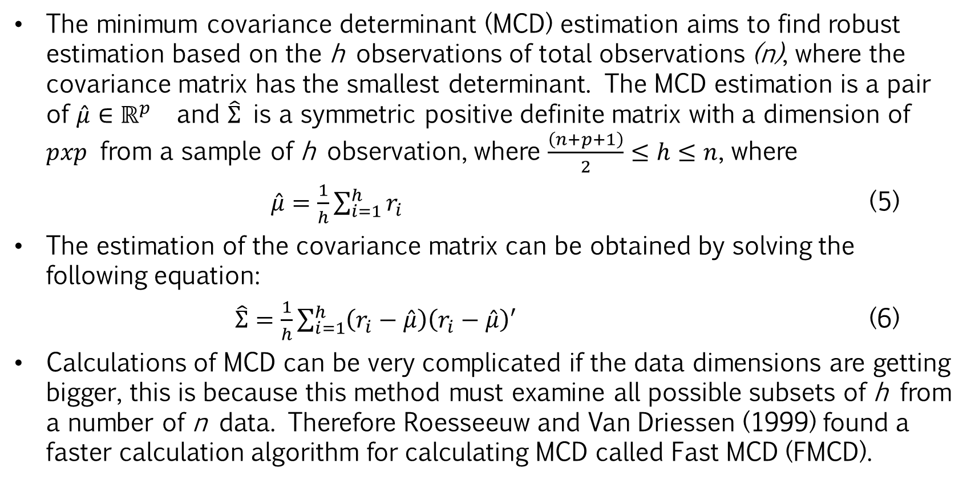
2.4 Portfolio selection using robust FMCD estimation
The minimum covariance determinant (MCD) estimation aims to find robust estimation based on the h observations of total observations (n), where the covariance matrix has the smallest determinant. The MCD estimation is a pair of $\hat{μ}∈ℝ^{p}$ and $\hat{Σ}$ is a symmetric positive definite matrix with a dimension of $pxp$ from a sample of h observation, where $\frac{\left(n+p+1\right)}{2}≤h≤n$, where
$\hat{μ}=\frac{1}{h}\sum_{i=1}^{h}{r_{i}}$ (5)
The estimation of the covariance matrix can be obtained by solving the following equation:
$\hat{Σ}=\frac{1}{h}\sum_{i=1}^{h}{\left(r_{i}−\hat{μ}\right)\left(r_{i}−\hat{μ}\right)′}$ (6)
Calculations of MCD can be very complicated if the data dimensions are getting bigger, this is because this method must examine all possible subsets of h from a number of n data. Therefore Roesseeuw and Van Driessen (1999) found a faster calculation algorithm for calculating MCD called Fast MCD (FMCD).

Slide 11
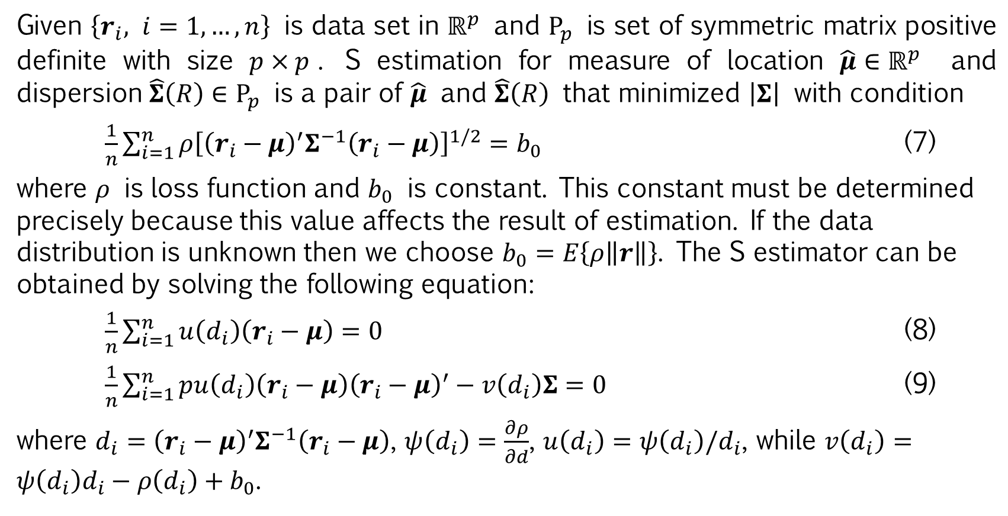
2.5 Portfolio selection using robust S estimation
Given $\left\{r_{i}, i=1,…,n\right\}$ is data set in $ℝ^{p}$ and $P_{p}$ is set of symmetric matrix positive definite with size $p×p$. S estimation for measure of location $\hat{μ}∈ℝ^{p}$ and dispersion $\hat{Σ}\left(R\right)∈P_{p}$ is a pair of $\hat{μ}$ and $\hat{Σ}\left(R\right)$ that minimized $\left|Σ\right|$ with condition
$\frac{1}{n}\sum_{i=1}^{n}{ρ{\left[{\left(r_{i}−μ\right)}^{′}Σ^{−1}\left(r_{i}−μ\right)\right]}^{1/2}}=b_{0}$ (7)
where $ρ$ is loss function and $b_{0}$ is constant. This constant must be determined precisely because this value affects the result of estimation. If the data distribution is unknown then we choose $b_{0}=E\left\{ρ\left\|r\right\|\right\}$. The S estimator can be obtained by solving the following equation:
$\frac{1}{n}\sum_{i=1}^{n}{u\left(d_{i}\right)\left(r_{i}−μ\right)}=0$ (8)
$\frac{1}{n}\sum_{i=1}^{n}{pu\left(d_{i}\right)\left(r_{i}−μ\right){\left(r_{i}−μ\right)}^{′}−v\left(d_{i}\right)Σ}=0$ (9)
where $d_{i}={\left(r_{i}−μ\right)}^{′}Σ^{−1}\left(r_{i}−μ\right)$, $ψ\left(d_{i}\right)=\frac{∂ρ}{∂d}$, $u\left(d_{i}\right)=ψ\left(d_{i}\right)/d_{i}$, while $v\left(d_{i}\right)=ψ\left(d_{i}\right)d_{i}−ρ\left(d_{i}\right)+b_{0}$.

Slide 12
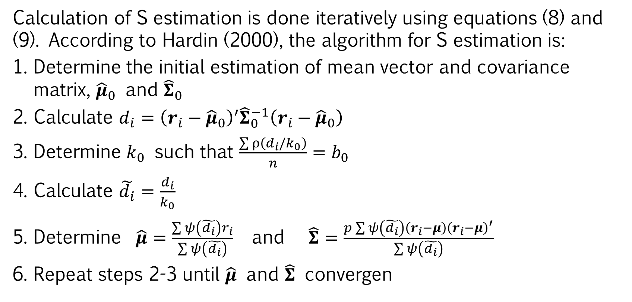
Calculation of S estimation is done iteratively using equations (8) and (9). According to Hardin (2000), the algorithm for S estimation is:
Determine the initial estimation of mean vector and covariance matrix, ${\hat{μ}}_{0}$ and ${\hat{Σ}}_{0}$
Calculate $d_{i}={\left(r_{i}−{\hat{μ}}_{0}\right)}^{′}{\hat{Σ}}_{0}^{−1}\left(r_{i}−{\hat{μ}}_{0}\right)$
Determine $k_{0}$ such that $\frac{\sum{ρ\left(d_{i}/k_{0}\right)}}{n}=b_{0}$
Calculate $\tilde{d_{i}}=\frac{d_{i}}{k_{0}}$
Determine $\hat{μ}=\frac{\sum{ψ\left(\tilde{d_{i}}\right)r_{i}}}{\sum{ψ\left(\tilde{d_{i}}\right)}}$ and $\hat{Σ}=\frac{p\sum{ψ\left(\tilde{d_{i}}\right)\left(r_{i}−μ\right){\left(r_{i}−μ\right)}^{′}}}{\sum{ψ\left(\tilde{d_{i}}\right)}}$
Repeat steps 2-3 until $\hat{μ}$ and $\hat{Σ}$ convergen

Slide 13
3. Result and Discussions
3.1 Stocks Clustering
In this study, we used the daily stock prices of all stocks which are included in the LQ-45 index, listed on the Indonesia Stock Exchange, see https://finance. yahoo.com. The cluster analysis used is PAM time series clustering using Autocorrelation Function (ACF) dissimilarity. By using TSclust function in R package, we found that using clustering PAM time series clustering base on ACF dissimilarty, LQ-45 stocks indexed can be grouped into 6 clusters. In Table 1 the members of each cluster are presented.
Table 1. The Cluster of Stocks
Cluster | Stocks
1 | AALI | BBTN | GGRM | HMSP | INTP | LSIP | PWON | SCMA | SMGR | SRIL
 | UNVR
2 | ADHI | BUMI | ICBP | SMRA | UNTR
3 | ADRO | BMTR | BRPT | INCO | LPPF | MNCN | MYRX | PGAS | WSKT
4 | AKRA | EXCL | JSMR | LPKR
5 | ANTM | ASII | BBCA | BBNI | BBRI | BJBR | BMRI | INDF | KLBF | PPRO
 | PTBA | SSMS | TLKM
6 | BSDE | PTPP | WIKA

Slide 14
3.2 Stocks Representation of Clusters
After the formation of clusters, the next step is to determine the Sharpe ratio of every stock in each cluster. The risk return free rate used in Sharpe ratio calculations is the latest Bank Indonesia rate, which is 5.25 percent per year. Based on the calculation of each stock's Sharpe ratio in each cluster we obtained stocks that represent each cluster to form the optimum portfolio as shown in Table 2.
Table 2. Stocks Representation of Clusters
Cluster | Representation | Return | Risk | Sharpe Ratio
1 | HMSP | 0.000664 | 0.021462 | 0.024240
2 | UNTR | 0.000804 | 0.022302 | 0.029621
3 | INCO | 0.002580 | 0.026730 | 0.091156
4 | EXCL | -0.000452 | 0.030176 | -0.019735
5 | PTBA | 0.002328 | 0.026015 | 0.083946
6 | PTPP | -0.001055 | 0.027845 | -0.043046

Slide 15
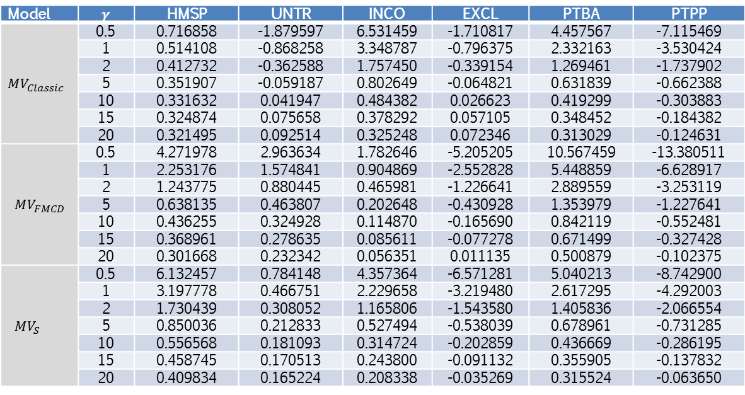
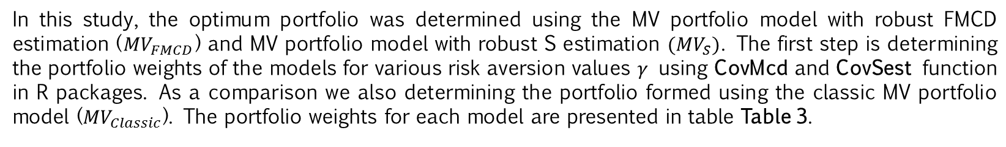
3.3 Portfolios Weight and Comparison of Portfolios Performance
In this study, the optimum portfolio was determined using the MV portfolio model with robust FMCD estimation (${MV}_{FMCD}$) and MV portfolio model with robust S estimation ${(MV}_{S})$. The first step is determining the portfolio weights of the models for various risk aversion values $γ$ using CovMcd and CovSest function in R packages. As a comparison we also determining the portfolio formed using the classic MV portfolio model (${MV}_{Classic}$). The portfolio weights for each model are presented in table Table 3.
Table 3. Portfolio Weight of Classic MV model and Robust MV model
Model | $$γ$$ | HMSP | UNTR | INCO | EXCL | PTBA | PTPP
${MV}_{Classic}$ | 0.5 | 0.716858 | -1.879597 | 6.531459 | -1.710817 | 4.457567 | -7.115469
 | 1 | 0.514108 | -0.868258 | 3.348787 | -0.796375 | 2.332163 | -3.530424
 | 2 | 0.412732 | -0.362588 | 1.757450 | -0.339154 | 1.269461 | -1.737902
 | 5 | 0.351907 | -0.059187 | 0.802649 | -0.064821 | 0.631839 | -0.662388
 | 10 | 0.331632 | 0.041947 | 0.484382 | 0.026623 | 0.419299 | -0.303883
 | 15 | 0.324874 | 0.075658 | 0.378292 | 0.057105 | 0.348452 | -0.184382
 | 20 | 0.321495 | 0.092514 | 0.325248 | 0.072346 | 0.313029 | -0.124631
${MV}_{FMCD}$ | 0.5 | 4.271978 | 2.963634 | 1.782646 | -5.205205 | 10.567459 | -13.380511
 | 1 | 2.253176 | 1.574841 | 0.904869 | -2.552828 | 5.448859 | -6.628917
 | 2 | 1.243775 | 0.880445 | 0.465981 | -1.226641 | 2.889559 | -3.253119
 | 5 | 0.638135 | 0.463807 | 0.202648 | -0.430928 | 1.353979 | -1.227641
 | 10 | 0.436255 | 0.324928 | 0.114870 | -0.165690 | 0.842119 | -0.552481
 | 15 | 0.368961 | 0.278635 | 0.085611 | -0.077278 | 0.671499 | -0.327428
 | 20 | 0.301668 | 0.232342 | 0.056351 | 0.011135 | 0.500879 | -0.102375
${MV}_{S}$ | 0.5 | 6.132457 | 0.784148 | 4.357364 | -6.571281 | 5.040213 | -8.742900
 | 1 | 3.197778 | 0.466751 | 2.229658 | -3.219480 | 2.617295 | -4.292003
 | 2 | 1.730439 | 0.308052 | 1.165806 | -1.543580 | 1.405836 | -2.066554
 | 5 | 0.850036 | 0.212833 | 0.527494 | -0.538039 | 0.678961 | -0.731285
 | 10 | 0.556568 | 0.181093 | 0.314724 | -0.202859 | 0.436669 | -0.286195
 | 15 | 0.458745 | 0.170513 | 0.243800 | -0.091132 | 0.355905 | -0.137832
 | 20 | 0.409834 | 0.165224 | 0.208338 | -0.035269 | 0.315524 | -0.063650

Slide 16
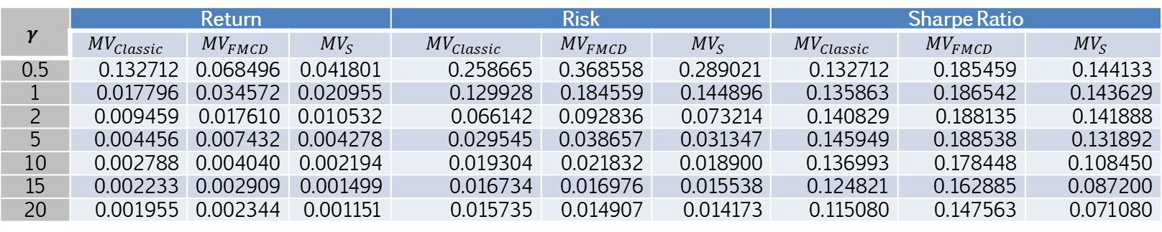
Based on portfolio weights, mean vectors and covariance matrix, we can then determine the Sharpe ratio of the three portfolio models as presented in Table 4.
Table 4. Returns, Risks and Sharpe Ratio of Robust Portfolios and Classic MV Portfolio
$$γ$$ | Return |  |  | Risk |  |  | Sharpe Ratio
 | $${MV}_{Classic}$$ | $${MV}_{FMCD}$$ | $${MV}_{S}$$ | $${MV}_{Classic}$$ | $${MV}_{FMCD}$$ | $${MV}_{S}$$ | $${MV}_{Classic}$$ | $${MV}_{FMCD}$$ | $${MV}_{S}$$
0.5 | 0.132712 | 0.068496 | 0.041801 | 0.258665 | 0.368558 | 0.289021 | 0.132712 | 0.185459 | 0.144133
1 | 0.017796 | 0.034572 | 0.020955 | 0.129928 | 0.184559 | 0.144896 | 0.135863 | 0.186542 | 0.143629
2 | 0.009459 | 0.017610 | 0.010532 | 0.066142 | 0.092836 | 0.073214 | 0.140829 | 0.188135 | 0.141888
5 | 0.004456 | 0.007432 | 0.004278 | 0.029545 | 0.038657 | 0.031347 | 0.145949 | 0.188538 | 0.131892
10 | 0.002788 | 0.004040 | 0.002194 | 0.019304 | 0.021832 | 0.018900 | 0.136993 | 0.178448 | 0.108450
15 | 0.002233 | 0.002909 | 0.001499 | 0.016734 | 0.016976 | 0.015538 | 0.124821 | 0.162885 | 0.087200
20 | 0.001955 | 0.002344 | 0.001151 | 0.015735 | 0.014907 | 0.014173 | 0.115080 | 0.147563 | 0.071080

Slide 17
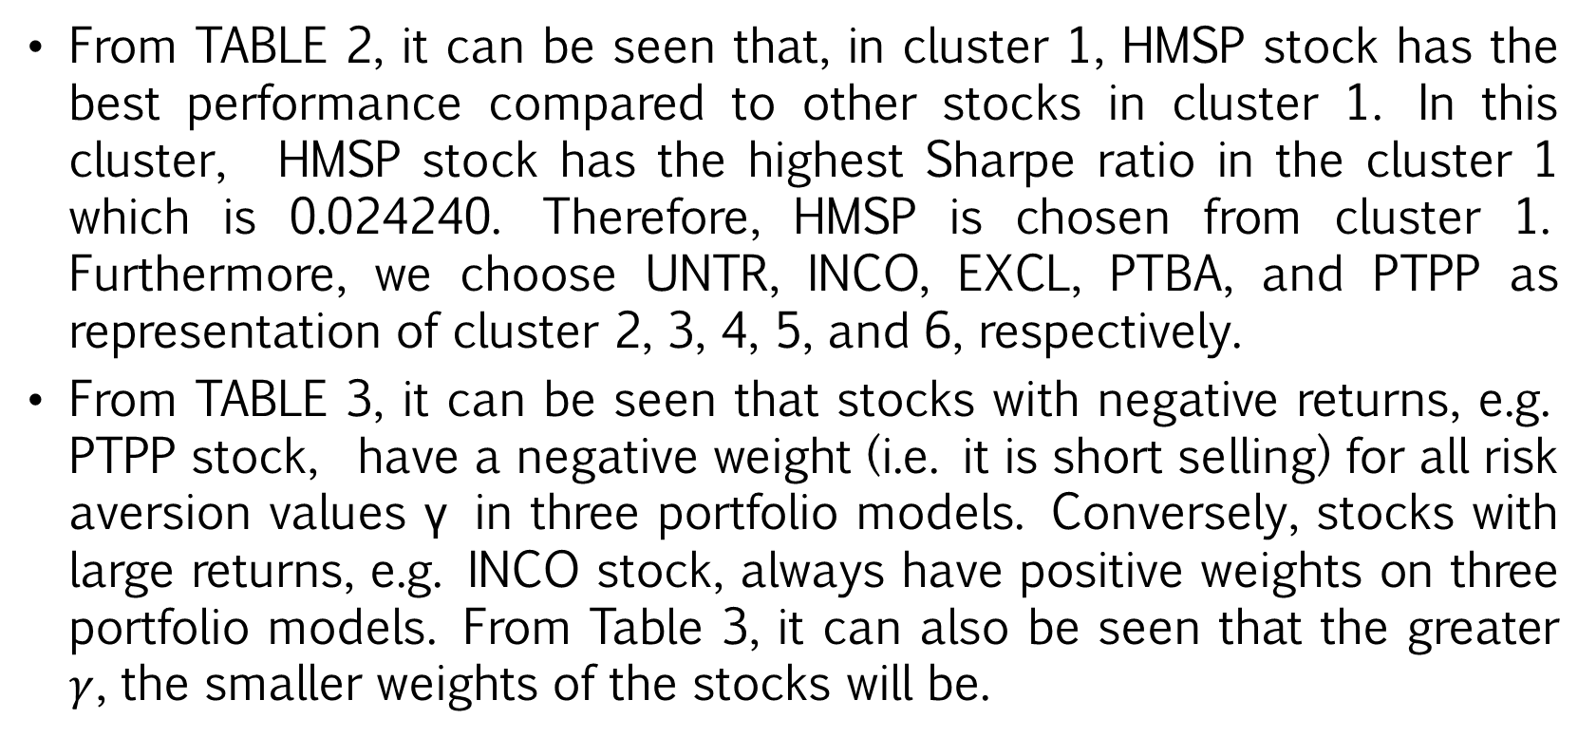
4. Discussion and Conclusion
4.1 Discussion
From TABLE 2, it can be seen that, in cluster 1, HMSP stock has the best performance compared to other stocks in cluster 1. In this cluster, HMSP stock has the highest Sharpe ratio in the cluster 1 which is 0.024240. Therefore, HMSP is chosen from cluster 1. Furthermore, we choose UNTR, INCO, EXCL, PTBA, and PTPP as representation of cluster 2, 3, 4, 5, and 6, respectively.
From TABLE 3, it can be seen that stocks with negative returns, e.g. PTPP stock, have a negative weight (i.e. it is short selling) for all risk aversion values γ in three portfolio models. Conversely, stocks with large returns, e.g. INCO stock, always have positive weights on three portfolio models. From Table 3, it can also be seen that the greater $γ$, the smaller weights of the stocks will be.

Slide 18
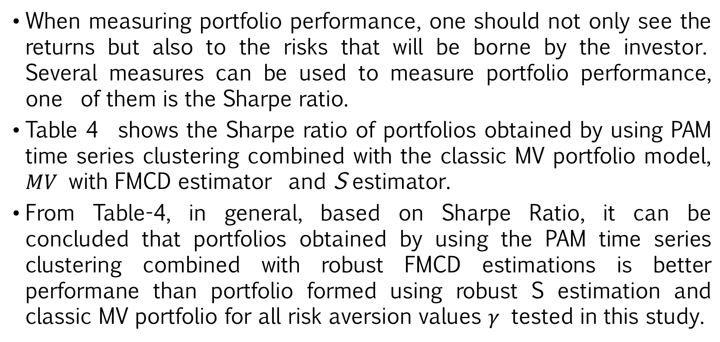
When measuring portfolio performance, one should not only see the returns but also to the risks that will be borne by the investor. Several measures can be used to measure portfolio performance, one of them is the Sharpe ratio.
Table 4 shows the Sharpe ratio of portfolios obtained by using PAM time series clustering combined with the classic MV portfolio model, $MV$ with FMCD estimator and S estimator.
From Table-4, in general, based on Sharpe Ratio, it can be concluded that portfolios obtained by using the PAM time series clustering combined with robust FMCD estimations is better performane than portfolio formed using robust S estimation and classic MV portfolio for all risk aversion values $γ$​ tested in this study.

Slide 19
4.2 Conclusions
This study shows how to integrate clustering techniques into portfolio management and building systems to get an efficient portfolio. This can reduce a lot of time in stocks selection because stocks of similar categories can be easily grouped into one cluster. The best performing stocks from each cluster are then chosen as representations of the cluster to built the portfolio. Empirical study showed that by using PAM time series clustering analysis, 45 stocks of the Indonesia Stock Exchange included in the LQ-45 index can be grouped into 6 clusters. Stocks as a representation of each cluster are then used to form a portfolio using the MV model with robust FMCD estimation, robust S estimation, and the classic MV model.
The results of this study show that portfolio performance obtained by using stocks representation of clusters with robust FMCD estimation is outperformed the other possible combination of the methods in our empirical study.

Slide 20
Acknowledgments
We acknowledge the financial support from Directorate General of Research Enhancement and Development, Ministry of Research Technology and Higher Education Republic of Indonesia via Doctoral Research Grant (Penelitian Disertasi Doktor, PDD) 2020.
The first author also acknowledges Indonesia Endowment Fund for Education (Lembaga Pengelola Dana Pendidikan, LPDP) Ministry of Finance of the Republic of Indonesia for the scholarship funds given for his Doctoral Program at the Mathematics Department of Gadjah Mada University.

Slide 21

THANK YOU

