Slide 1
A Comparison Forecasting Methods for Trend and Seasonal Indonesia Tourist Arrivals Time Series
Subanar (Universitas Gadjah Mada)
Winita Sulandari (Universitas Sebelas Maret)

Slide 2
Outline
Introduction
Brief overview of the methods
Experimental setup
Results, discussion, dan conlusions

Slide 3
Introduction
The accurate tourist demand forecasting is needed in the formulation of policies, accommodation, to transportation planning.
In Indonesia, the tourism sector has occupied the fourth position after oil and gas, coal, and palm oil as the country’s foreign exchange-earners since 2013.
In this study, we discuss the comparison single and hybrid forecasting methods for the monthly visitor arrivals in Indonesia.

Slide 4
Introduction
In general, the tourist arrivals time series data has trend and seasonal patterns.
Many studies have been carried out, involving conventional models such as Seasonal Autoregressive Integrated Moving Average (seasonal ARIMA or SARIMA) [1-4] and modern models such as Fuzzy Time Series (FTS) [5-7] and Singular Spectrum Analysis (SSA)[8].

Slide 5
Introduction
We implement the three single methods (SARIMA, FTS, and SSA) and compare them with other two hybrid approach methods, SARIMA-FTS and SSA-FTS.
We evaluate the methods by considering the one-step-ahead and multiple-step-ahead forecasting results measured by Root Mean Square Error (RMSE) and Mean Absolute Percentage Error (MAPE).

Slide 6

Brief overview of the methods
SARIMA
SARIMA model is represented as
and denoted as ARIMA(𝑝, 𝑑, 𝑞)(𝑃, 𝐷, 𝑄)^{𝑆}, where 𝑌𝑡 is the observation at time 𝑡, 𝑆 is the seasonal period. 𝜓_{𝑝}( 𝐵) and 𝜃_{𝑞}(𝐵) are the regular autoregressive and moving average component, while Φ_{𝑃}(𝐵^{𝑆}) are Ψ_{𝑄}(𝐵^{𝑆}) the seasonal autoregressive and moving average component.

Slide 7
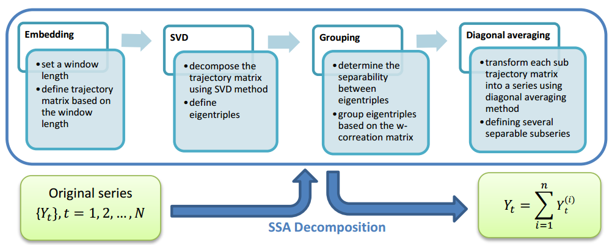
Brief overview of the methods
SSA decomposition

Slide 8
Brief overview of the methods
SSA-LRF
SSA-LRF means that the SSA forecasts are obtained based on the linear recurrence relationship algorithm [9]
Given a univariate time series of length N.
Y_{i} = a₁Y_{i-1} + a₂Y_{i-2} + … + a_{L-1}Y_{i-L+1}, for i = N+1, …, N+h
The coefficients of the LRF a₁, …, a_{L-1} are computed from a spectral decomposition of an L×K dimensional trajectory matrix in the SVD step.

Slide 9
Brief overview of the methods
Fuzzy Time Series
Fuzzy time series (FTS) works based on fuzzy logic relationships (FLRs), namely the relationship between the linguistic values of the data at time t-1 to the data at time t.
This kind of fuzzy time series is called the 1st order fuzzy time series, such that the relationship is represented by
F(t-1)=Ai → F(t) = Aj or Ai → Aj
As stated in [7,10–12], the performance of the FTS model is influenced by the determination of universe of discourse, length of intervals and fuzzy logical relationship.

Slide 10
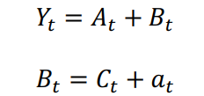
Brief overview of the methods
Hybrid Model
In general, this hybrid model can be represented as
where
we consider SARIMA and SSA to approximate the first component since these two methods are powerful in handling trend and seasonal time series.
For the second component, we choose first order weighted FTS following Lee’s method as it is successful in handling nonlinearity relationship in the hybrid approach for modeling trend and seasonal time series [13].

Slide 11
Experimental Setup
Data
The actual trend and seasonal time series data used in the empirical study was the monthly tourist arrivals in Indonesia from January 2016 to December 2019 (48 observations).
This series was divided into two parts. The first part consists of the 42 observations (January 2016 to June 2019) used as the training data and the rest is the testing data.

Slide 12
Experimental setup
Procedure
Modeling the training data by SARIMA, SSA, and Lee’s FTS methods
Obtaining the residuals calculated from SARIMA and SSA models
Modeling the residuals obtained in step 2 by first order Lee’s FTS.
Defining the forecast values for the 1-step-ahead and multiple-step-ahead by SARIMA, SSA, Lee’s FTS, Hybrid SARIMA-Lee’s FTS and Hybrid SSA-Lee’s FTS models
Calculating RMSE and MAPE for the training and the testing data for SARIMA, SSA, Lee’s FTS, Hybrid SARIMA-Lee’s FTS and Hybrid SSA-Lee’s FTS models
Making comparison based on RMSE and MAPE values both for training and testing data set.

Slide 13
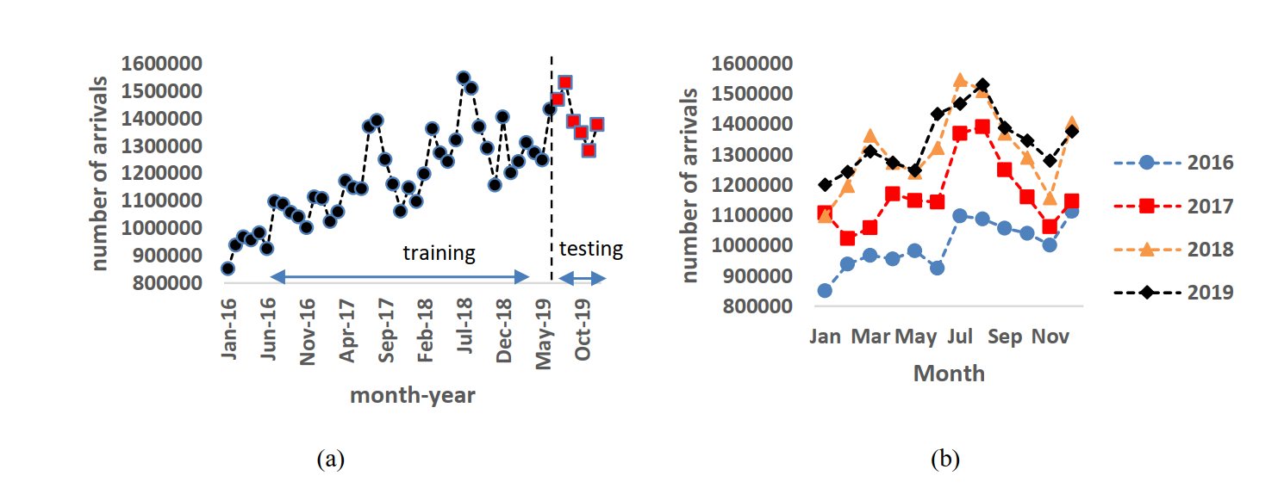
Result and discussion
Monthly arrivals in Indonesia (a) series plot from January 2016 to December 2019,
(b) comparison of four series, 2016 to 2019, each from January to December

Slide 14
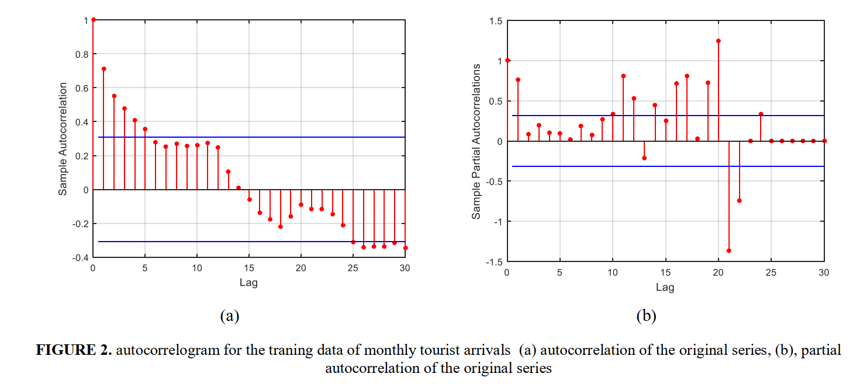
Result and discussion
SARIMA
By considering the Akaike’s Information Criteria (AIC) values, SARIMA(1,0,0)(0,1,1)₁₂ is the best appropriate model for the training data.
(a) Sample autocorrelation of monthly tourist arrivals (obtained from the original series)
(b) Sample partial autocorrelation of monthly tourist arrivals (obtained from the original series)

Slide 15
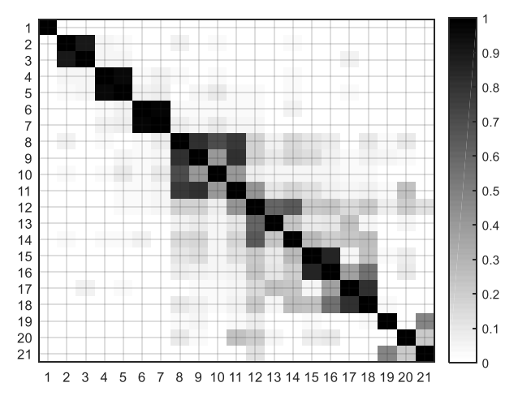
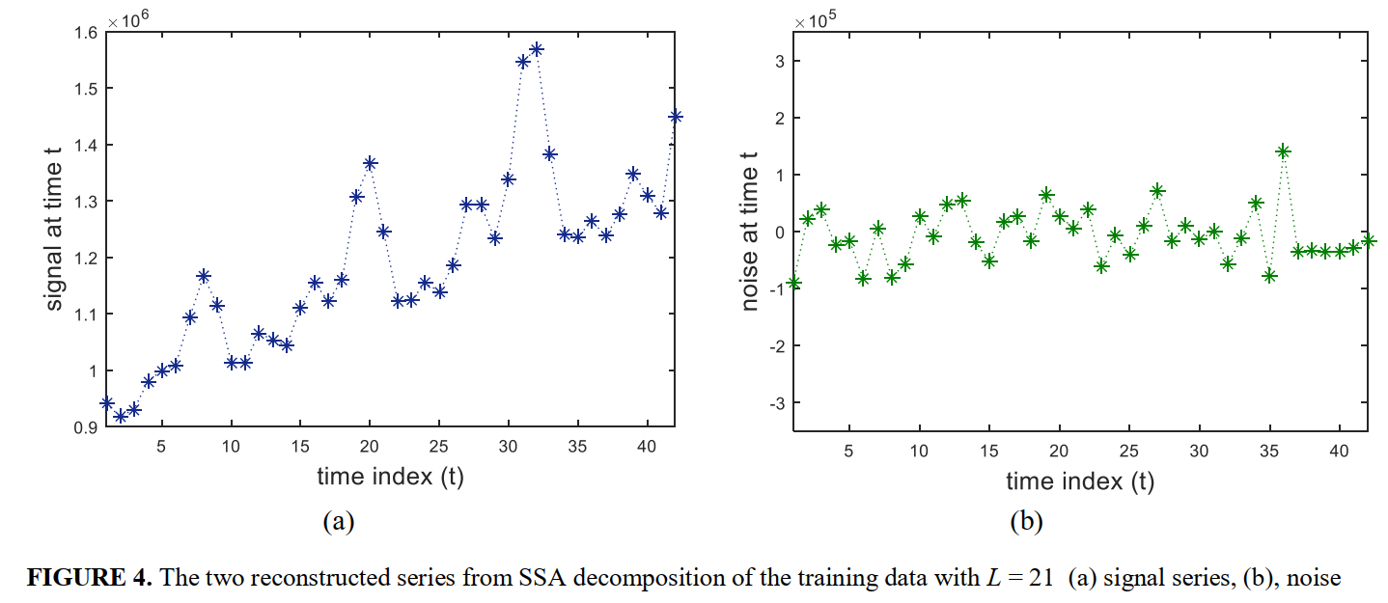
Result and discussion
SSA
We define the signal from eigentriple 1 to 7 and noise from the rest eigentriples.
w-correlation matrix, L = 21 (b) signal series (c) noise
SSA decomposition obtained from the training data

Slide 16
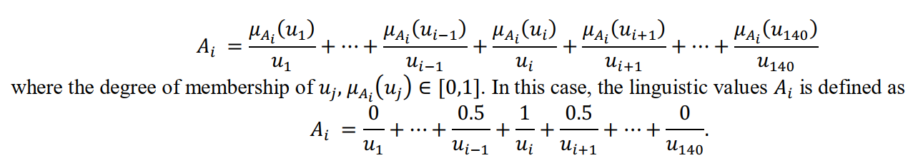
Result and discussion
FTS
The minimum and maximum values of the training data are 851 462 and 1 511 021, respectively.
The universe of discourse as ℧= [850 000, 1 550 000], length of interval is 5000 and the intervals are
𝑢𝑖= [850 000+(i-1)5000, 850 000 + 5000i] for i = 1, …, 140.
We define the fuzzy sets 𝐴1, 𝐴2, … , 𝐴140 on ℧ as follows

Slide 17
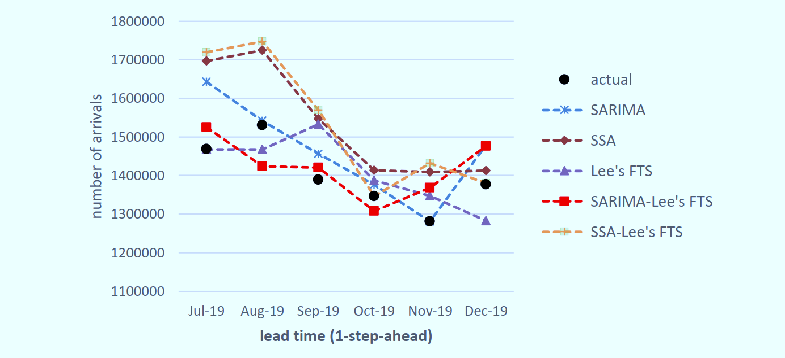
Result and discussion
Comparison of forecasting values
Forecast values for 1-step-ahead obtained from SARIMA, SSA, FTS, hybrid SARIMA-FTS, and SSA-FTS

Slide 18
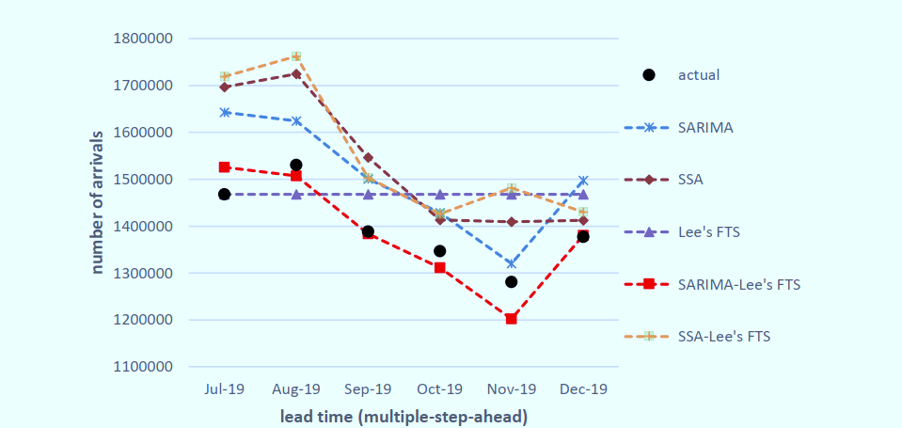
Result and discussion
Comparison of forecasting values
Forecast values for multiple-step-ahead obtained from SARIMA, SSA, FTS, hybrid SARIMA-FTS, and SSA-FTS

Slide 19
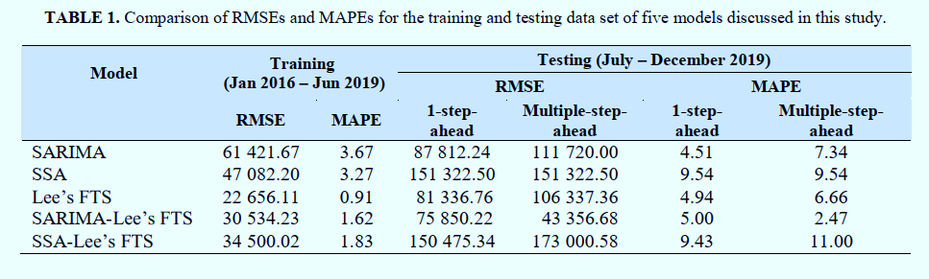
Result and discussion
Comparison of RMSEs and MAPEs
SARIMA-Fuzzy provides the highest accuracy for the case of forecasting tourist arrivals for July to December 2019 compared to the single SARIMA, SSA, Lee’s FTS, and SSA-Lee’s Fuzzy hybrid models.

Slide 20
Conclusion
Either SARIMA or FTS produces better forecasting values for 1-step-ahead compared to others, but not for multiple-step-ahead.
In this study, an improvement of accuracy forecasting performance was achieved by combining the SARIMA and Lee’s FTS method.
In the future research, Two Level Seasonal Autoregressive (TLSAR) and SARIMAX may be considered as the hybrid component to take into account some incidents, for example, the covid-19 pandemic, earthquakes, tsunamis, etc

Slide 21
References
[1] P. V. Severina, B. G. Marivel, P. B. Glynne, and B. J. Elvira, Multidiscip. Res. J. 8, 67–78 (2020) [2] A. Rusyana and M. Flancia, "SARIMA model for forecasting foreign tourists at the Kualanamu International Airport," in 2016 12th International Conference on Mathematics, Statistics, and Their Applications (ICMSA), IEEE conference proceeding (IEEE 2016) pp 153–158 [3] N. Borhan and Z. Arsad, "Forecasting international tourism demand from the US, Japan and South Korea to Malaysia: A SARIMA approach," AIP Conference Proceedings vol 1605 (American Institute of Physics 2014) pp 955–960 [4] J. G. Brida and N. Garrido, Int. J. Leis. Tour. Mark. 2, 176–190 (2011) [5] C. H. Aladag, E. Egrioglu, U. Yolcu, and V. R. Uslu, J. Intell. Fuzzy Syst. 26, 295–302 (2014) [6] M. H. Lee, M. E. Nor, Suhartono, H. J. Sadaei, N. H. A. Rahman, and N. A. B. Kamisan, Am. J. Appl. Sci. 9, 132–40 (2012) [7] M. H. Lee and Suhartono, "A novel weighted fuzzy time series model for forecasting seasonal data,“ Proceeding the 2nd International Conference on Mathematical Sciences, International Conference on Mathematical Sciences (Kuala Lumpur, Malaysia 2010) pp 332–40 [8] H. Hassani, A. Webster, E. S. Silva, and S. Heravi, Tour. Manag. 46 322–335 (2015
[9] N. Golyandina and A. Korobeynikov, Comput. Stat. Data Anal. 71, 934–54(2014)
[10] H-K. Yu, Phys. Stat. Mech. Its Appl. 349, 609–624 (2005) [11] C-H. Cheng, T-L. Chen, H. J. Teoh, and C. H. Chiang, Expert Syst. Appl. 34, 1126–1132 (2008) [12 ]P. Singh, Int. J. Mach. Learn. Cybern. 8, 397–420 (2017) [13] Suhartono and M. H. Lee, J Math Stat 7, 177–183 (2011)

Slide 22
Thank you

