Slide 1
Bi-response Spline Smoothing Estimator for Modelling the Percentage of Poor Population and Human Development Index in Papua Province
Dyah Putri Rahmawati, I Nyoman Budiantara, Dedy Dwi Prastyo and Made Ayu Dwi Octavanny Department of Statistics, Faculty of Science and Data Analytics, Institut Teknologi Sepuluh Nopember

Slide 2


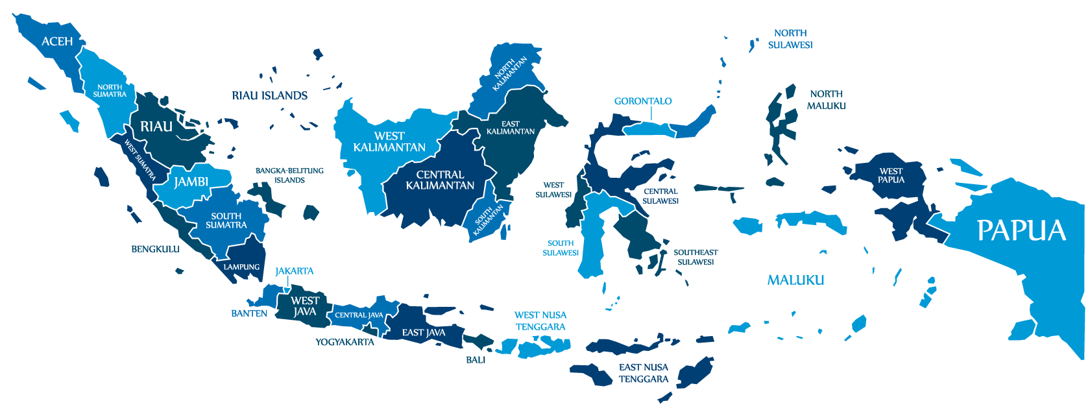



Introduction
Indicators
The goal of a country's development is to achieve prosperity for its people
Percentage of poor people (PPP)
Human Development Index (HDI).
Indonesia
Poverty is one of the problems that often occur in Indonesia
In 2019, Papua Province was a province with the highest PPP in Indonesia.
PPP in March 2019
Papua Province: 27.53%
Indonesia: 9.41%
(Statistics Indonesia,2020)
Besides, Papua Province was the province with the lowest HDI in Indonesia
HDI in 2019
Papua Province :60.84
Indonesia: 71.92.
(Statistics Indonesia,2020)
Therefore, Papua Province needs particular attention,
especially PPP and HDI.

Slide 3
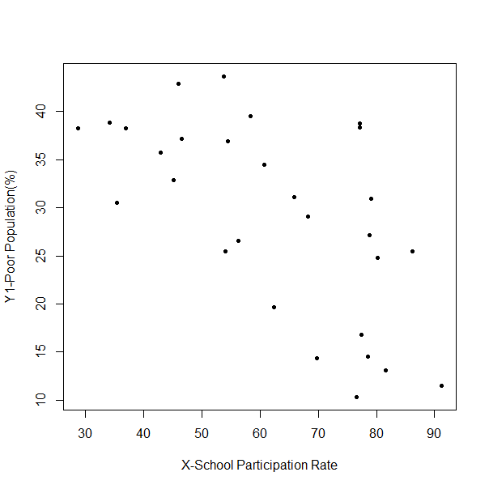
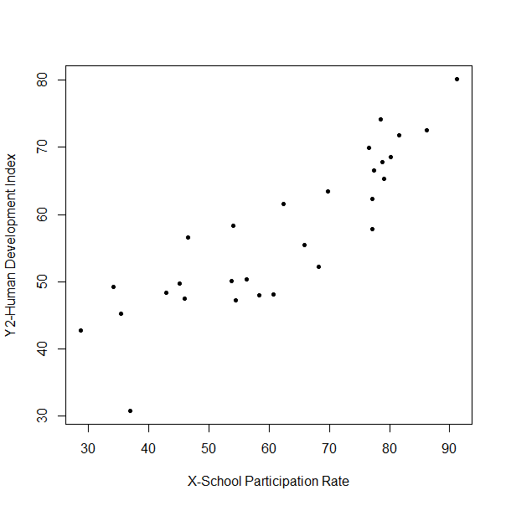
Introduction
Poverty and HDI has a negative correlation
(Akhmad et al,. 2018)
Due to the existence of a correlation between PPP and HDI, and there is variable that affect both like School Participant Rate (SPR) (Sachs, 2005 ; Gounder and Xing, 2012), the modelling of PPP and HDI can be done simultaneously using bi-response regression.
The patterns of PPP and HDI with SPR are unknown, so this case is suitable for modelling with nonparametric regression with Spline Smoothing Estimator.
Spline Smoothing estimator in the bi-response nonparametric regression is applied to model the PPP and HDI in Papua Province with SPR as a factor that is considered to influence both.

Slide 4
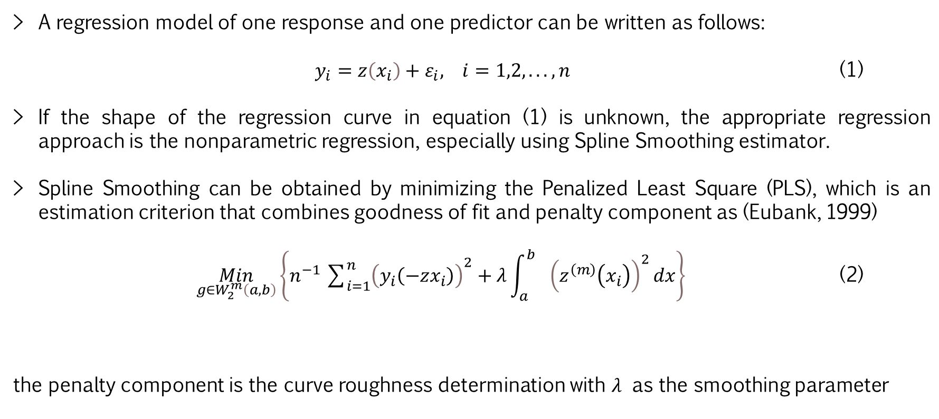
MATERIAL AND METHOD Nonparametric Regression with Spline Smoothing
A regression model of one response and one predictor can be written as follows:
$y_{i}=z\left(x_{i}\right)+ε_{i}, i=1,2,...,n$ (1)
If the shape of the regression curve in equation (1) is unknown, the appropriate regression approach is the nonparametric regression, especially using Spline Smoothing estimator.
Spline Smoothing can be obtained by minimizing the Penalized Least Square (PLS), which is an estimation criterion that combines goodness of fit and penalty component as (Eubank, 1999)
$\underset{g∈W_{2}^{m}\left(a,b\right)}{Min}\left\{n^{−1}{\sum_{i=1}^{n}{\left(\left.y_{i} ( −zx_{i}\right)\right)}}^{2}+λ\int_{a}^{b_{}}{{\left(\left.z^{\left(m\right)} ( x_{i}\right)\right)}^{2}dx}\right\}$ (2)
the penalty component is the curve roughness determination with $λ$ as the smoothing parameter
goodness of fit
penalty component

Slide 5
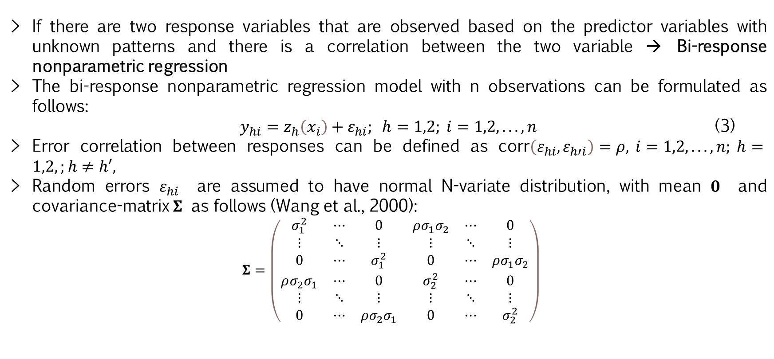
MATERIAL AND METHOD Bi-response nonparametric Regression
If there are two response variables that are observed based on the predictor variables with unknown patterns and there is a correlation between the two variable → Bi-response nonparametric regression
The bi-response nonparametric regression model with n observations can be formulated as follows:
$y_{hi}=z_{h}\left(x_{i}\right)+ε_{hi}; h=1,2; i=1,2,...,n$ (3)
Error correlation between responses can be defined as $\text{corr}\left(ε_{hi},ε_{h′i}\right)=ρ, i=1,2,...,n; h=1,2,;h≠h′,$
Random errors $ε_{hi}$ are assumed to have normal N-variate distribution, with mean $0$ and covariance-matrix $Σ$ as follows (Wang et al., 2000):
$$Σ=\left(\begin{matrix}σ_{1}^{2} & ⋯ & 0 & ρσ_{1}σ_{2} & ⋯ & 0 \\ ⋮ & ⋱ & ⋮ & ⋮ & ⋱ & ⋮ \\ 0 & ⋯ & σ_{1}^{2} & 0 & ⋯ & ρσ_{1}σ_{2} \\ ρσ_{2}σ_{1} & ⋯ & 0 & σ_{2}^{2} & ⋯ & 0 \\ ⋮ & ⋱ & ⋮ & ⋮ & ⋱ & ⋮ \\ 0 & ⋯ & ρσ_{2}σ_{1} & 0 & ⋯ & σ_{2}^{2}\end{matrix}\right)$$

Slide 6
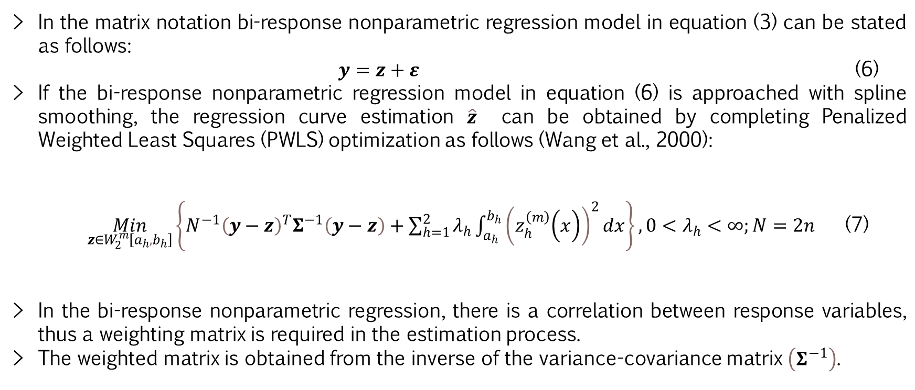
MATERIAL AND METHOD Penalized Weighted Least Square
In the matrix notation bi-response nonparametric regression model in equation (3) can be stated as follows:
$y=z+ε$ (6)
If the bi-response nonparametric regression model in equation (6) is approached with spline smoothing, the regression curve estimation $\hat{z}$ can be obtained by completing Penalized Weighted Least Squares (PWLS) optimization as follows (Wang et al., 2000):
$\underset{z∈W_{2}^{m}\left[a_{h}{,b}_{h}\right]}{Min}\left\{N^{−1}{\left(y−z\right)}^{T}Σ^{−1}\left(y−z\right)+\sum_{h=1}^{2}{λ_{h}\int_{a_{h}}^{b_{h}}{{\left(\left.z_{h}^{\left(m\right)} ( x\right)\right)}^{2}dx}}\right\},0<λ_{h}<∞;N=2n$ (7)
In the bi-response nonparametric regression, there is a correlation between response variables, thus a weighting matrix is required in the estimation process.
The weighted matrix is obtained from the inverse of the variance-covariance matrix $\left(Σ^{−1}\right)$.
weighted matrix
goodness of fit
penalty component

Slide 7
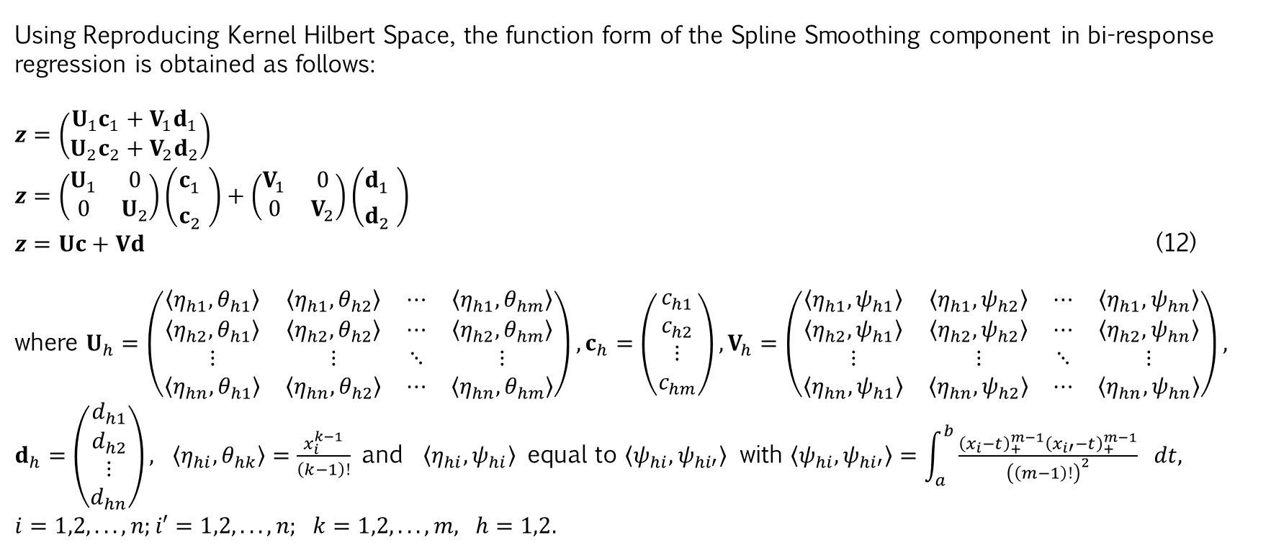
RESULTS AND DISCUSSION The Form Function of Bi-response Spline Smoothing
Using Reproducing Kernel Hilbert Space, the function form of the Spline Smoothing component in bi-response regression is obtained as follows:
$z=\left(\begin{matrix}U_{1}c_{1}+V_{1}d_{1} \\ U_{2}c_{2}+V_{2}d_{2}\end{matrix}\right)$
$z=\left(\begin{matrix}U_{1} & 0 \\ 0 & U_{2}\end{matrix}\right)\left(\begin{matrix}c_{1}^{} \\ c_{2}^{}\end{matrix}\right)+\left(\begin{matrix}V_{1} & 0 \\ 0 & V_{2}\end{matrix}\right)\left(\begin{matrix}d_{1}^{} \\ d_{2}^{}\end{matrix}\right)$
$z=Uc+Vd$ (12)
where $U_{h}=\left(\begin{matrix}〈η_{h1},θ_{h1}〉 & 〈η_{h1},θ_{h2}〉 & ⋯ & 〈η_{h1},θ_{hm}〉 \\ 〈η_{h2},θ_{h1}〉 & 〈η_{h2},θ_{h2}〉 & ⋯ & 〈η_{h2},θ_{hm}〉 \\ ⋮ & ⋮ & ⋱ & ⋮ \\ 〈η_{hn},θ_{h1}〉 & 〈η_{hn},θ_{h2}〉 & ⋯ & 〈η_{hn},θ_{hm}〉\end{matrix}\right),c_{h}=\left(\begin{matrix}c_{h1} \\ c_{h2} \\ ⋮ \\ c_{hm}\end{matrix}\right),V_{h}=\left(\begin{matrix}〈η_{h1},ψ_{h1}〉 & 〈η_{h1},ψ_{h2}〉 & ⋯ & 〈η_{h1},ψ_{hn}〉 \\ 〈η_{h2},ψ_{h1}〉 & 〈η_{h2},ψ_{h2}〉 & ⋯ & 〈η_{h2},ψ_{hn}〉 \\ ⋮ & ⋮ & ⋱ & ⋮ \\ 〈η_{hn},ψ_{h1}〉 & 〈η_{hn},ψ_{h2}〉 & ⋯ & 〈η_{hn},ψ_{hn}〉\end{matrix}\right), d_{h}=\left(\begin{matrix}d_{h1} \\ d_{h2} \\ ⋮ \\ d_{hn}\end{matrix}\right),$ $〈η_{hi},θ_{hk}〉=\frac{x_{i}^{k−1}}{\left(k−1\right)!}$ and $〈η_{hi},ψ_{hi}〉$ equal to $〈ψ_{hi},ψ_{hi′}〉$ with $〈ψ_{hi},ψ_{hi′}〉=\int_{a}^{b}{\frac{{\left(x_{i}−t\right)}_{+}^{m−1}{\left(x_{i′}−t\right)}_{+}^{m−1}}{{\left(\left(m−1\right)!\right)}^{2}}} dt,$
$i=1,2,...,n;i′=1,2,...,n; k=1,2,...,m, h=1,2.$

Slide 8
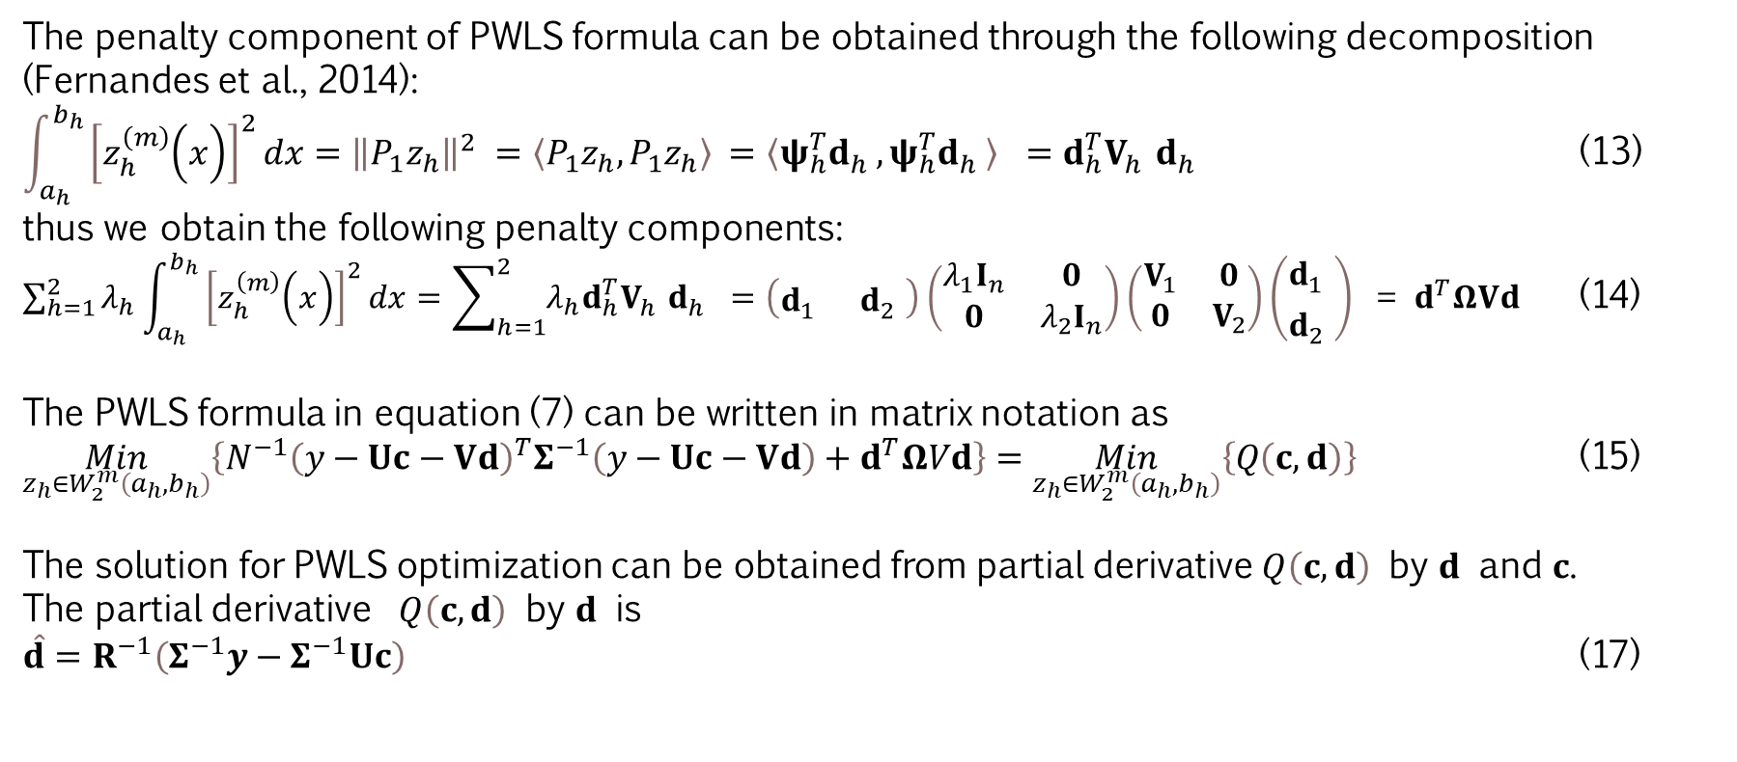
RESULTS AND DISCUSSION Estimation of Bi-response Spline Smoothing using PWLS
The penalty component of PWLS formula can be obtained through the following decomposition (Fernandes et al., 2014):
$\int_{a_{h}}^{b_{h}}{{\left[\left.z_{h}^{\left(m\right)} ( x\right)\right]}^{2}}dx={\left\|P_{1}z_{h}\right\|}^{2}$ $=〈P_{1}z_{h},P_{1}z_{h}〉$ $=〈ψ_{h}^{T}d_{h}^{},ψ_{h}^{T}d_{h}^{}〉 =d_{h}^{T}V_{h}^{}d_{h}^{}$ (13)
thus we obtain the following penalty components:
$\sum_{h=1}^{2}{λ_{h}\int_{a_{h}}^{b_{h}}{{\left[\left.z_{h}^{\left(m\right)} ( x\right)\right]}^{2}}}dx=\sum_{h=1}^{2}{λ_{h}d_{h}^{T}V_{h}^{}d_{h}^{}}$ $=\left(\begin{matrix}d_{1}^{} & d_{2}^{}\end{matrix}\right)\left(\begin{matrix}λ_{1}I_{n} & 0 \\ 0 & λ_{2}I_{n}\end{matrix}\right)\left(\begin{matrix}V_{1} & 0 \\ 0 & V_{2}\end{matrix}\right)\left(\begin{matrix}d_{1}^{} \\ d_{2}^{}\end{matrix}\right)\text{ = }d^{T}ΩVd$ (14)
The PWLS formula in equation (7) can be written in matrix notation as
$\underset{z_{h}∈W_{2}^{m}\left(a_{h},b_{h}\right)}{Min}\left\{N^{−1}{\left(y−Uc−Vd\right)}^{T}Σ^{−1}\left(y−Uc−Vd\right)+d^{T}ΩVd\right\}=\underset{z_{h}∈W_{2}^{m}\left(a_{h},b_{h}\right)}{Min}\left\{Q\left(c,d\right)\right\}$ (15)
The solution for PWLS optimization can be obtained from partial derivative $Q\left(c,d\right)$ by $d$ and $c$.
The partial derivative $Q\left(c,d\right)$ by $d$ is
$\hat{d}=R^{−1}\left(Σ^{−1}y−Σ^{−1}Uc\right)$ (17)

Slide 9
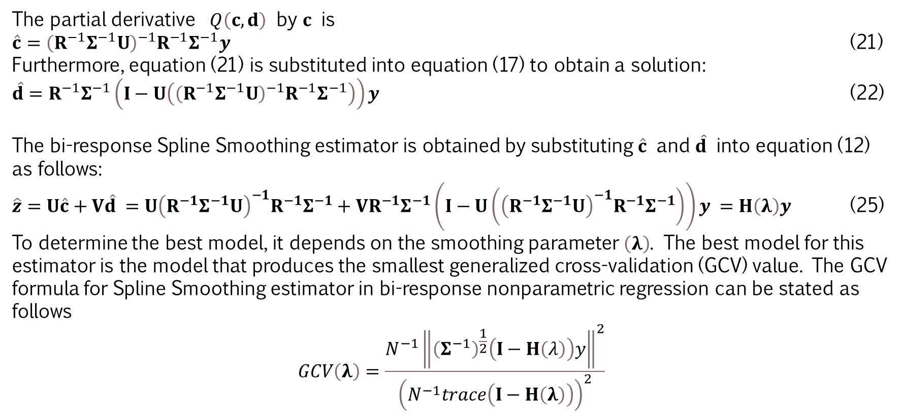
RESULTS AND DISCUSSION Estimation of Bi-response Spline Smoothing using PWLS
The partial derivative $Q\left(c,d\right)$ by $c$ is
$\hat{c}={\left(R^{−1}Σ^{−1}U\right)}^{−1}R^{−1}Σ^{−1}y$ (21)
Furthermore, equation (21) is substituted into equation (17) to obtain a solution:
$\hat{d}=R^{−1}Σ^{−1}\left(I−U\left({\left(R^{−1}Σ^{−1}U\right)}^{−1}R^{−1}Σ^{−1}\right)\right)y$ (22)
The bi-response Spline Smoothing estimator is obtained by substituting $\hat{c}$ and $\hat{d}$ into equation (12) as follows:
$\hat{z}=U\hat{c}+V\hat{d}$ $=U{\left(R^{−1}Σ^{−1}U\right)}^{−1}R^{−1}Σ^{−1}+VR^{−1}Σ^{−1}\left(I−U\left({\left(R^{−1}Σ^{−1}U\right)}^{−1}R^{−1}Σ^{−1}\right)\right)y$ $=H\left(λ\right)y$ (25)
To determine the best model, it depends on the smoothing parameter $\left(λ\right)$. The best model for this estimator is the model that produces the smallest generalized cross-validation (GCV) value. The GCV formula for Spline Smoothing estimator in bi-response nonparametric regression can be stated as follows
$$GCV\left(λ\right)=\frac{N^{−1}{\left\|{\left(Σ^{−1}\right)}^{\frac{1}{2}}\left(I−H\left(λ\right)\right)y\right\|}^{2}}{{\left(N^{−1}trace\left(I−H\left(λ\right)\right)\right)}^{2}}$$

Slide 10
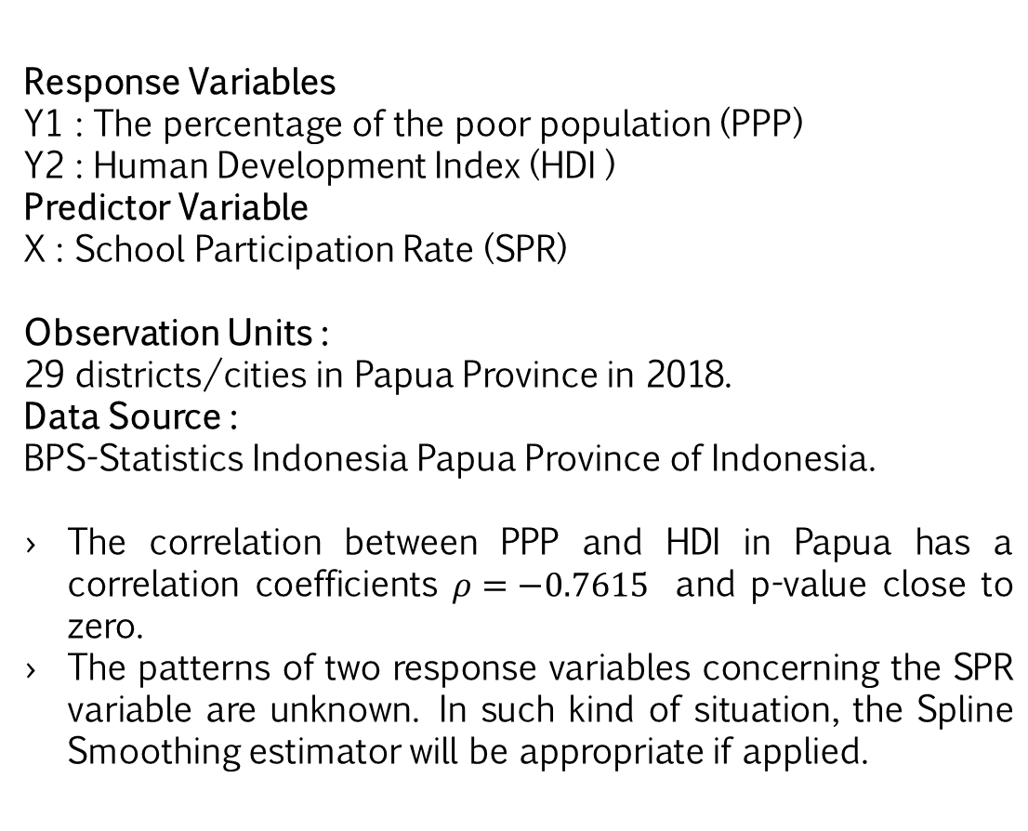
RESULTS AND DISCUSSION Modelling PPP and HDI in Papua Province
Response Variables
Y1 : The percentage of the poor population (PPP)
Y2 : Human Development Index (HDI )
Predictor Variable
X : School Participation Rate (SPR)
Observation Units :
29 districts/cities in Papua Province in 2018.
Data Source :
BPS-Statistics Indonesia Papua Province of Indonesia.
The correlation between PPP and HDI in Papua has a correlation coefficients $ρ=−0.7615$ and p-value close to zero.
The patterns of two response variables concerning the SPR variable are unknown. In such kind of situation, the Spline Smoothing estimator will be appropriate if applied.

Slide 11
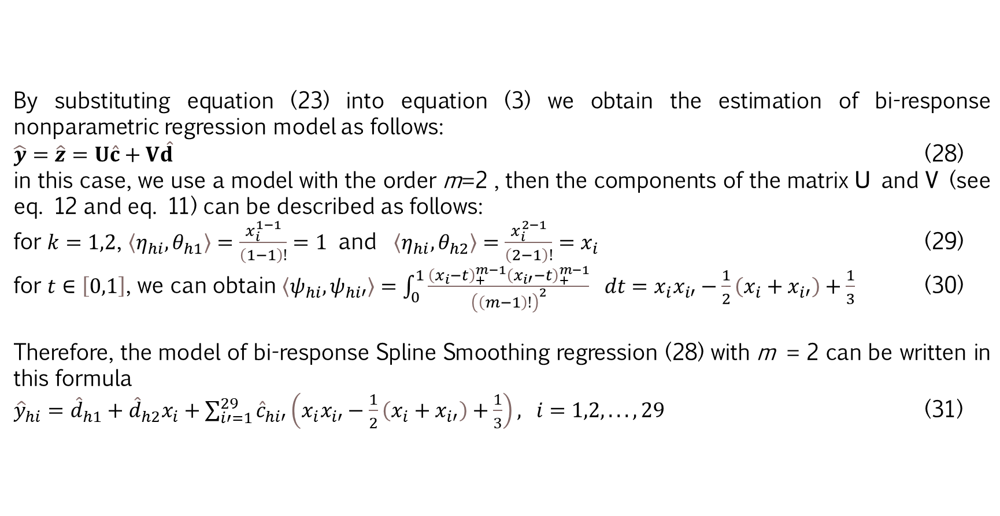
RESULTS AND DISCUSSION Modelling PPP and HDI in Papua Province
By substituting equation (23) into equation (3) we obtain the estimation of bi-response nonparametric regression model as follows:
$\hat{y}=\hat{z}=U\hat{c}+V\hat{d}$ (28)
in this case, we use a model with the order m=2 , then the components of the matrix U and V (see eq. 12 and eq. 11) can be described as follows:
for $k=1,2$, $〈η_{hi},θ_{h1}〉=\frac{x_{i}^{1−1}}{\left(1−1\right)!}=1$ and $〈η_{hi},θ_{h2}〉=\frac{x_{i}^{2−1}}{\left(2−1\right)!}=x_{i}$ (29)
for $t∈\left[0,1\right]$, we can obtain $〈ψ_{hi},ψ_{hi′}〉=\int_{0}^{1}{\frac{{\left(x_{i}−t\right)}_{+}^{m−1}{\left(x_{i′}−t\right)}_{+}^{m−1}}{{\left(\left(m−1\right)!\right)}^{2}}} dt=x_{i}x_{i′}−\frac{1}{2}\left(x_{i}+x_{i′}\right)+\frac{1}{3}$ (30)
Therefore, the model of bi-response Spline Smoothing regression (28) with m = 2 can be written in this formula
${\hat{y}}_{hi}={\hat{d}}_{h1}+{\hat{d}}_{h2}x_{i}+\sum_{i′=1}^{29}{{\hat{c}}_{hi′}}\left(x_{i}x_{i′}−\frac{1}{2}\left(x_{i}+x_{i′}\right)+\frac{1}{3}\right), i=1,2,...,29$ (31)

Slide 12
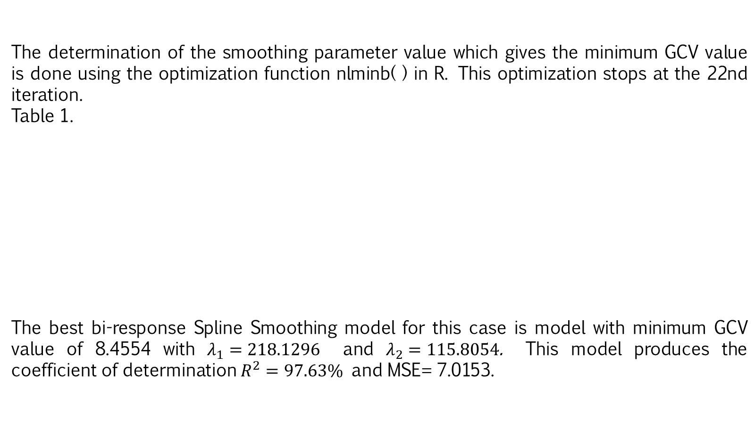
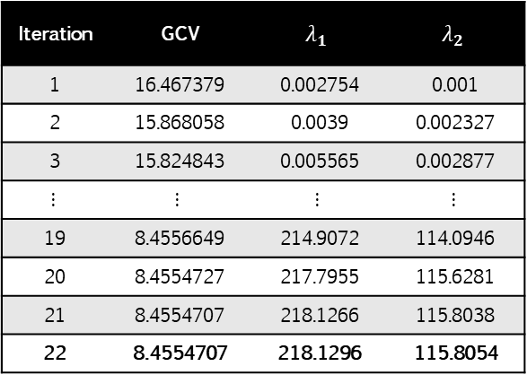
RESULTS AND DISCUSSION Modelling PPP and HDI in Papua Province
The determination of the smoothing parameter value which gives the minimum GCV value is done using the optimization function nlminb( ) in R. This optimization stops at the 22nd iteration.
Table 1.
The best bi-response Spline Smoothing model for this case is model with minimum GCV value of 8.4554 with $λ_{1}=\text{218.1296}$ and $λ_{2}=\text{115.8054}\text{.}$ This model produces the coefficient of determination $R^{2}=97.63\%$ and MSE= 7.0153.
Iteration | GCV | $$λ_{1}$$ | $$λ_{2}$$
1 | 16.467379 | 0.002754 | 0.001
2 | 15.868058 | 0.0039 | 0.002327
3 | 15.824843 | 0.005565 | 0.002877
$$⋮$$ | $$⋮$$ | $$⋮$$ | $$⋮$$
19 | 8.4556649 | 214.9072 | 114.0946
20 | 8.4554727 | 217.7955 | 115.6281
21 | 8.4554707 | 218.1266 | 115.8038
22 | 8.4554707 | 218.1296 | 115.8054

Slide 14
RESULTS AND DISCUSSION Modelling PPP and HDI in Papua Province
Figure 2 show that the estimated values of PPP and HDI are close to the actual value. These results indicate that this model is appropriate for modelling the PPP and HDI modelling in Papua Province.

Slide 15
RESULTS AND DISCUSSION Modelling PPP and HDI in Papua Province
The bi-response Spline Smoothing model from the PPP and HDI of the Papua province in 2018 was used to predict the PPP and HDI of the Papua province in 2019.
The prediction is done using the model in equation (31) by substituting parameter values in Table 2 and the SPR in 2019.
The MAPE value for PPP and HDI of the Papua Province in 2019 is 6.57% or the accuracy rate is 93.43%.
It means that the bi-response Spline Smoothing model obtained has a very good ability to predict PPP and HDI in Papua province.
FIGURE 3. Comparison of prediction value and actual value of PPP (a) and HDI (b) in 2019.

Slide 16
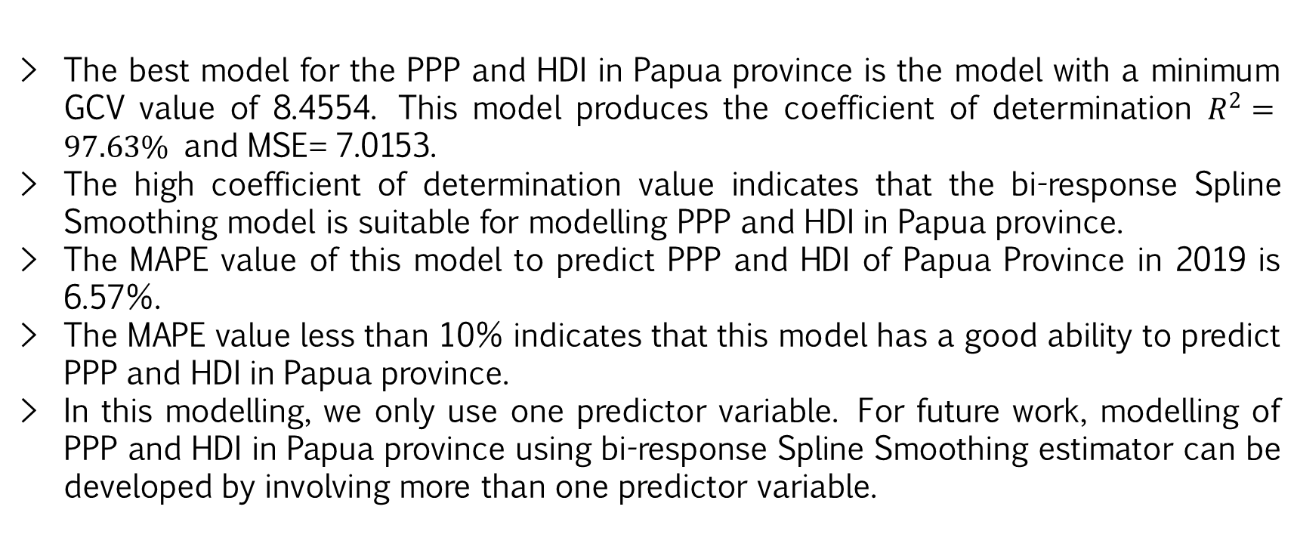
CONCLUSION
The best model for the PPP and HDI in Papua province is the model with a minimum GCV value of 8.4554. This model produces the coefficient of determination $R^{2}=97.63\%$ and MSE= 7.0153.
The high coefficient of determination value indicates that the bi-response Spline Smoothing model is suitable for modelling PPP and HDI in Papua province.
The MAPE value of this model to predict PPP and HDI of Papua Province in 2019 is 6.57%.
The MAPE value less than 10% indicates that this model has a good ability to predict PPP and HDI in Papua province.
In this modelling, we only use one predictor variable. For future work, modelling of PPP and HDI in Papua province using bi-response Spline Smoothing estimator can be developed by involving more than one predictor variable.

Slide 17
Thank You ☺

