Slide 1
Application of Linear and Nonlinear Seasonal Autoregressive Based Methods for Forecasting Grojogan Sewu Tourism Demand
W. Sulandari, S.Subanti, I. Slamet, Sugiyanto, E. Zukhronah, and I. Susanto

Slide 2
Outline
Introduction
Material and methods
Results and discussion
Conclusion
References

Slide 3
INTRODUCTION
Grojogan Sewu waterfall one of the tourist attractions in Karanganyar is located on the slopes of Mount Lawu, the protected forest, in Beiji, Tawangmangu.
Grojogan Sewu has become a source of income for the Karanganyar district.
Various infrastructure improvements and innovations have been made to make visitors comfortable and to make them willing to visit again.
Motivation
Problem statement
Aims and objectives
Significance of the study

Slide 4
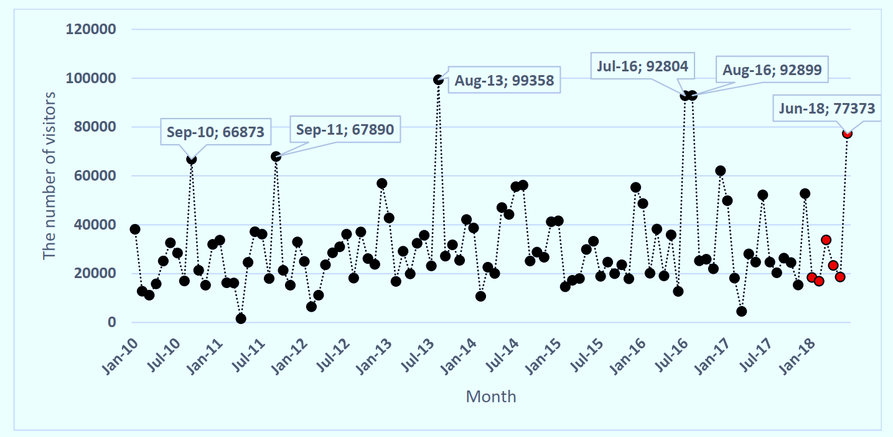
Introduction
Sometimes there is a decrease where the number of visitors should increase, and we need to know what causes it.
This study aims to analyze the monthly number of visitors in Grojogan Sewu and to find the most appropriate forecasting model to describe the pattern.
Motivation
Problem statement
Aims and objectives
Significance of the study

Slide 5
Introduction
The methods discussed in this study are SARIMA and NNAR, and compare them with the Two Level SARIMA (TLSARIMA) and Two Level Seasonal NNAR (TLSNNAR).
The advantages of these two level methods are being able to capture deterministic patterns in the data and accommodate external influences, such as holidays and ticket price, on the number of visitors.
Motivation
Problem statement
Aims and objectives
Significance of the study

Slide 6
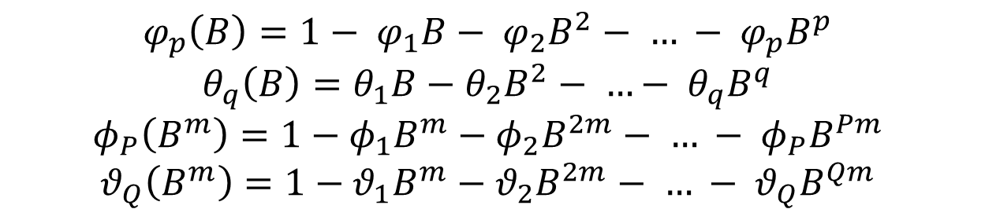
Material and Methods : SARIMA
where
The chosen model should pass the residual test and had smallest AICc (Akaike’s Information Criterion with a correction for small sample size) between other alternative models.
$$φ_{p}\left(B\right)φ_{P}\left(B^{m}\right){\left(1−B\right)}^{d}{\left(1−B^{m}\right)}^{D}Y_{t}=θ_{q}\left(B\right)θ_{Q}\left(B^{m}\right)a_{t}$$
$$φ_{p}\left(B\right)=1− φ_{1}B− φ_{2}B^{2}− … − φ_{p}B^{p}$$
$$θ_{q}\left(B\right)=θ_{1}B−θ_{2}B^{2}− …− θ_{q}B^{q}$$
$$φ_{P}\left(B^{m}\right)=1−φ_{1}B^{m}−φ_{2}B^{2m}− … − φ_{P}B^{Pm}$$
$$θ_{Q}\left(B^{m}\right)={1−θ}_{1}B^{m}−θ_{2}B^{2m}− … − θ_{Q}B^{Qm}$$

Slide 7
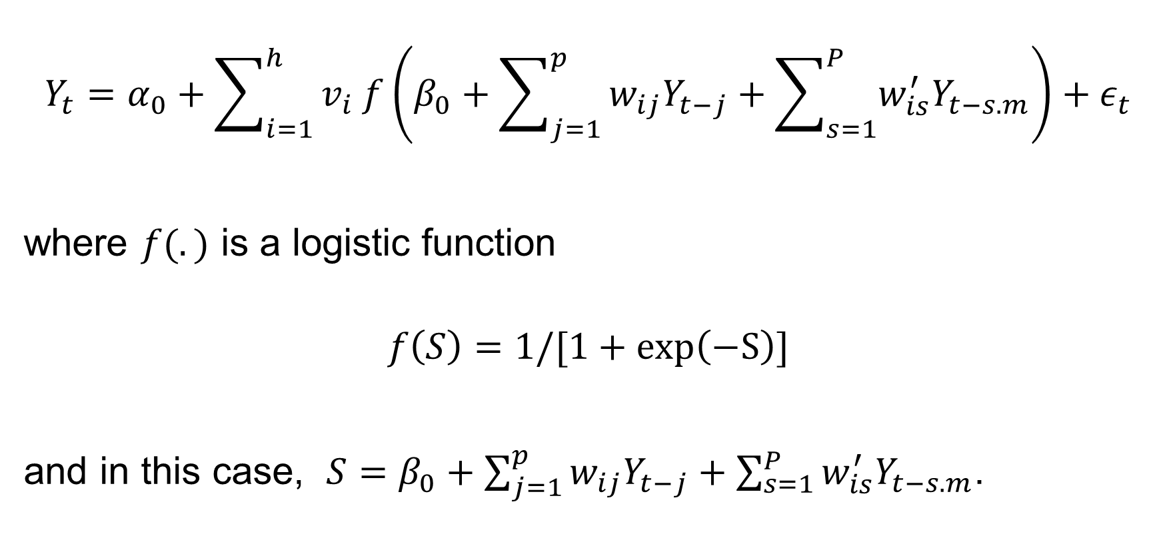
Material and Methods : NNAR
$$Y_{t}=α_{0}+\sum_{i=1}^{h}{v_{i} f\left(β_{0}+\sum_{j=1}^{p}{w_{ij}Y_{t−j}}+\sum_{s=1}^{P}{w_{is}^{′}Y_{t−s.m}}\right)}+ε_{t}$$
where $f(.)$ is a logistic function
$$f\left(S\right)=1/[1+\exp\left(−S\right)]$$
and in this case, $S=β_{0}+\sum_{j=1}^{p}{w_{ij}Y_{t−j}}+\sum_{s=1}^{P}{w_{is}^{′}Y_{t−s.m}}$.

Slide 8

Material and Methods : TLSARIMA
$$Y_{t}=L_{t}+N_{t}$$
where
$$L_{t}=\sum_{i=0}^{n_{p}}{a_{i}t^{i}}+\sum_{j=1}^{n_{h}}{b_{j}\sin{(2πjt/m)}+c_{j}\cos{(2πjt/m)}}+\sum_{k=1}^{n_{D}}{δ_{k}ξ_{k}}$$
and $N_{t}$ follows SARIMA model

Slide 9
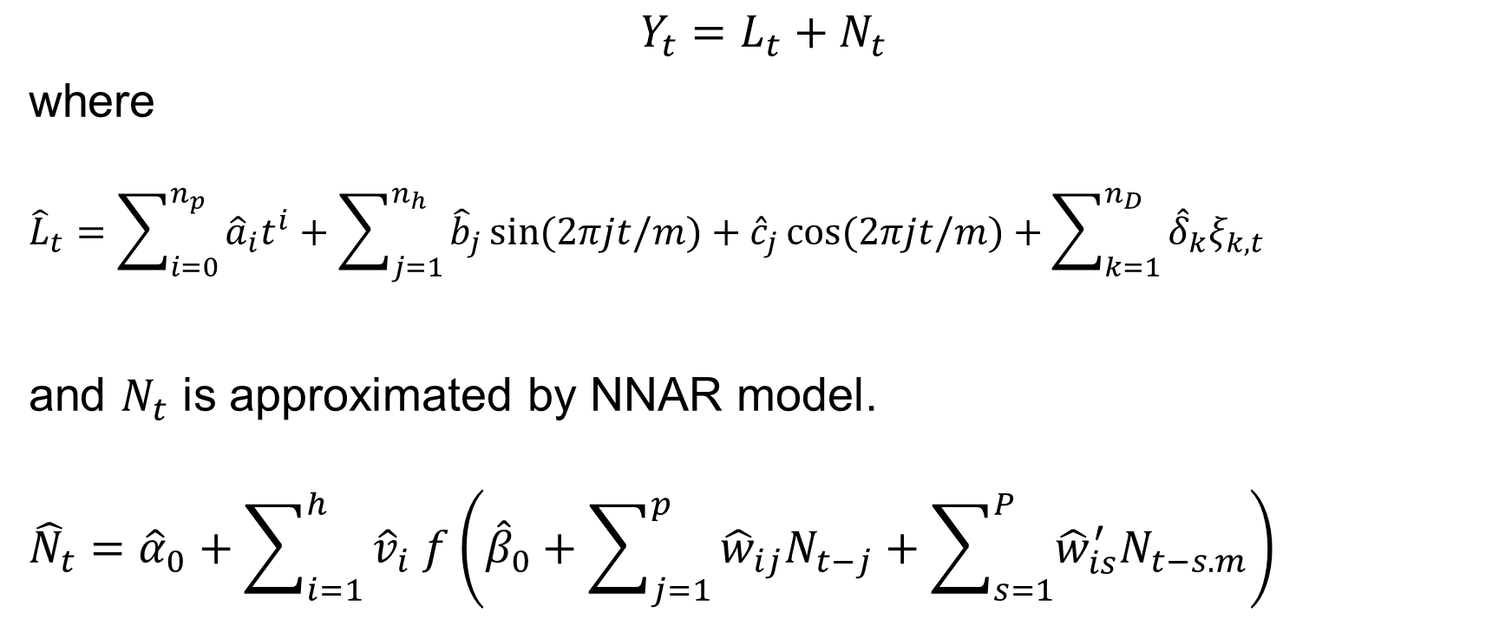
Material and Methods: TLSNNAR
$$Y_{t}=L_{t}+N_{t}$$
where
$${\hat{L}}_{t}=\sum_{i=0}^{n_{p}}{{\hat{a}}_{i}t^{i}}+\sum_{j=1}^{n_{h}}{{\hat{b}}_{j}\sin{(2πjt/m)}+{\hat{c}}_{j}\cos{(2πjt/m)}}+\sum_{k=1}^{n_{D}}{{\hat{δ}}_{k}ξ_{k,t}}$$
and $N_{t}$ is approximated by NNAR model.
$${\hat{N}}_{t}={\hat{α}}_{0}+\sum_{i=1}^{h}{{\hat{v}}_{i} f\left({\hat{β}}_{0}+\sum_{j=1}^{p}{{\hat{w}}_{ij}N_{t−j}}+\sum_{s=1}^{P}{{\hat{w}}_{is}^{′}N_{t−s.m}}\right)}$$

Slide 10


Measure Accuracy
$$RMSE=\sqrt{\frac{1}{n}\sum_{t}{{\left(Y_{t}−{\hat{Y}}_{t}\right)}^{2}}}$$
$MAE=\frac{1}{n}\sum_{t}{\left|Y_{t}−{\hat{Y}}_{t}\right|}$.
$$MAPE=\frac{1}{n}\sum_{t}{\left|100\left(Y_{t}−{\hat{Y}}_{t}\right)/Y_{t}\right|}.$$
$MASE=\frac{1}{n}\sum_{t}{\left|\frac{\left(Y_{t}−\hat{Y_{t}}\right)}{\frac{1}{T−m}\sum_{j=m+1}^{T}{|Y_{j}−Y_{j−m}|}}\right|}.$

Slide 11
Results and Discussion
Data : January 2010 to June 2018
No trend, but seasonal pattern
Increase in every Eid Al-Fitr?
Figure 1. Time series plot for number of tourist to Grojogan Sewu from January 2010 to June 2018

Slide 12
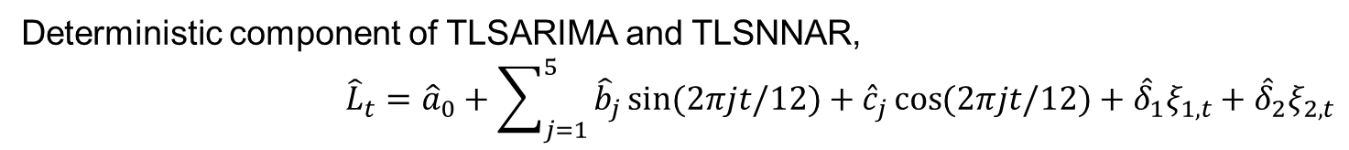
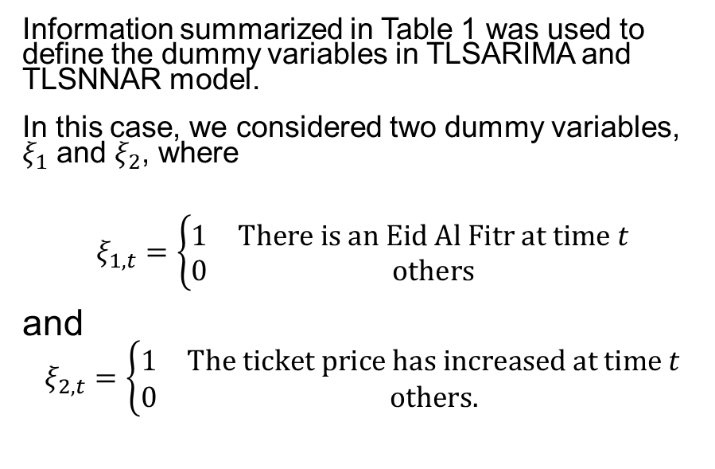
Results and Discussion
TABLE 1. Ticket price changes at Eid Al-Fitr
Year and Month of Eid Al-Fitr |  | The ticket price has increased more than 50%
2010 | September | No
2011 | September | No
2012 | August | Yes
2013 | August | No
2014 | July | Yes
2015 | July | Yes
2016 | July | No
2017 | June | Yes
2018 | June | No
Information summarized in Table 1 was used to define the dummy variables in TLSARIMA and TLSNNAR model.
In this case, we considered two dummy variables, $ξ_{1}$ and $ξ_{2}$, where
$$ξ_{1,t}=\left\{\begin{matrix}1 & There is an Eid Al Fitr at time t \\ 0 & others\end{matrix}\right.$$
and
$$ξ_{2,t}=\left\{\begin{matrix}1 & The ticket price has increased at time t \\ 0 & others.\end{matrix}\right.$$
Deterministic component of TLSARIMA and TLSNNAR,
$${\hat{L}}_{t}={\hat{a}}_{0}+\sum_{j=1}^{5}{{\hat{b}}_{j}\sin{(2πjt/12)}+{\hat{c}}_{j}\cos{(2πjt/12)}}+{\hat{δ}}_{1}ξ_{1,t}+{\hat{δ}}_{2}ξ_{2,t}$$

Slide 13
Results and Discussion
Based on the experimental results, we obtained
Single model :
SARIMA(0,0,0)(2,0,0)₁₂
NNAR(1,1,2)
Hybrid model:
TLSARIMA(0,1,1)(1,0,0) ₁₂
TLSNNAR(12,1,6)

Slide 14
Results and Discussion
Methods | Ljung-Box | Training data Testing data
 |  | RMSE | MAE | MAPE | MASE | RMSE | MAE | MAPE | MASE
SARIMA | 0.996 | 16 436.359 | 10 810.610 | 0.590 | 0.819 | 23 159.720 | 16 634.427 | 0.542 | 1.260
NNAR | 0.950 | 15 886.637 | 10 669.968 | 0.639 | 0.808 | 18 891.957 | 14 777.434 | 0.505 | 1.119
TLSARIMA | 0.800 | 10 246.037 | 7 225.632 | 0.367 | 0.547 | 12 738.135 | 10 243.720 | 0.474 | 0.776
TLSNNAR | 0.824 | 719.699 | 486.149 | 0.031 | 0.037 | 11 812.142 | 10 566.200 | 0.489 | 0.848
In fitting the training data, TLSNNAR is superior compared to the others while SARIMA is the inferior one.
In testing data, TLSARIMA is able to reduce the value of RMSE, MAE, MAPE, and MASE from those obtained by SARIMA for about 45%, 38%, 13%, and 38%, respectively. Meanwhile, TLSNNAR decreases the values of RMSE, MAE, MAPE, and MASE from those obtained from NNAR model for about 37%, 28%, 3%, and 28%, respectively.

Slide 15
Results and Discussion
TLSNNAR as the best fitted for the data is not the most accurate model for forecasting the testing data.
This result strengthens the statement of Makridakis et al (2020) that the over-parameterizing and over-fitting actually occurs as a result of minimizing the model fit errors.
The two-sided Diebold-Mariano test shows that there is no difference in accuracy between the forecast values ​​generated by TLSARIMA and TLSNNAR.

Slide 16
Conclusion
All methods discussed in this work can be implemented properly, though the SARIMA and NNAR did not accommodate the external variables, i.e., the effect of Eid Al-Fitr holiday and ticket price.
An important note that can be drawn from this study is that the involvement of deterministic functions with dummy variables in SARIMA and NNAR models provides more accurate out of sample forecasting results.
This conclusion is in line with Soares & Medeiros (2008), though the cases discussed are not the same.

Slide 17
References
N. Loganathan and Y. Ibrahim, South Asian J. Tour. Herit. 3 50–60 (2010)
Suhartono, J. Math. Stat. 7 20–27 (2011)
N. Borhan and Z. Arsad, Forecasting international tourism demand from the US, Japan and South Korea to Malaysia: A SARIMA approach, AIP Conference Proceedings 1605 (American Institute of Physics, 2014) pp 955–960
A. Rusyana and M. Flancia, SARIMA model for forecasting foreign tourists at the Kualanamu International Airport 2016, 12th International Conference on Mathematics, Statistics, and Their Applications (ICMSA) (IEEE, 2016) pp. 153–158
U. Konarasinghe, Forecasting foreign guest nights in hill country of Sri Lanka, Conference Proceedings of the SIBR-Thammasat Conference on Interdisciplinary business & economics research 7 (Bangkok, 2018) pp 018–066
R. Thoplan, Int. J. Stat. Appl. 4 217–223 (2014)
W.W.S. Wei, Time series analysis: Univariate and Multivariate Methods (Pearson Addison Wesley, NY, 2006)
G.E. Box, G.M. Jenkins, G.C. Reinsel, and G.M. Ljung, Time series analysis: forecasting and control (John Wiley & Sons, 2015)
J.D. Cryer and K-S. Chan, Time series analysis: with applications in R (Springer Science & Business Media, 2008)
R.J. Hyndman and Y. Khandakar, J. Stat. Softw. 27 1–23 (2008)
K.P. Burnham and D.R. Anderson, Model selection and multimodel inference: a practical information-theoretic approach (Springer Science & Business Media, 2003)
R. J. Hyndman, Prediction intervals for NNETAR models (2017). https://robjhyndman.com/hyndsight/nnetar-prediction-intervals/
R.J.Hyndman,nnetar Neural Network Time Series Forecasts. Rdocumentation
https://www.rdocumentation.org/packages/forecast/versions/8.12/topics/nnetar
14. L.J. Soares and M.C. Medeiros, Int. J. Forecast. 24 630–644 (2008)
15. W. Sulandari, Subanar, Suhartono, H. Utami, M.H. Lee, and P.C. Rodrigues, Bull. Electr. Eng. Inform. 9 2178–88 (2020)
16. R.J. Hyndman and A.B. Koehler, Int. J. Forecast. 22 679–688 (2006)
17. R.J. Hyndman and G. Athanasopoulos, Forecasting: Principles and Practice (OTexts, Melbourne, 2018)
18. J.E., Hanke, D. Wichern, and A.G. Reitsch, Business Forecasting (Pearson Prentice Hall, New Jersey, 2005)
19. S. Makridakis, R.J. Hyndman, and F. Petropoulos, Int. J. Forecast. 36 15-28 (2020)
20. F.X. Diebold, J. Bus. Econ. Stat. 33 1–1 (2015)
21. F X. Diebold and R.S. Mariano, J. Bus. Econ. Stat. 13 253–63 (1995)

Slide 18
Application of Linear and Nonlinear Seasonal Autoregressive Based Methods for Forecasting Grojogan Sewu Tourism Demand
W. Sulandari, S.Subanti, I. Slamet, Sugiyanto, E. Zukhronah, and I. Susanto

