Slide 1
The Impact of US-China Trade War in Forecasting the Gold Price using ARIMAX Model
Author :
Christopher Andreas
Ilma Amira Rahmayanti
Siti Maghfirotul Ulyah
Presented by :
Christopher Andreas

Slide 2
Outline
Introduction
Literature Riview
Material and Method
Result and Discussion
Conclusion

Slide 3
Introduction
The Gold
Extraordinary Appeal
Safe Haven
Used to Invest
Global Uncertainty
US-China Trade War
The development of an accurate forecasting model for gold price fluctuations plays an important role in future investments.

Slide 4
Related Work
Yang (2018)
The Prediction of Gold Price Using the ARIMA Model
Ling et al. (2019)
Application of ARIMAX Model to Forecast Weekly Cocoa Black Pod Disease Incidence
Ulyah et al. (2019)
Comparing the Performance of Seasonal ARIMAX Model and Nonparametric Regression Model in Predicting Claim Reserve of Education Insurance

Slide 5
Literature Review : ARIMA
The ARIMA model is a model obtained from a combination of the autoregressive process and the moving average process, which is accompanied by the differencing process^{[5][8]}.
ARIMA
Non-Seasonal ARIMA
Seasonal ARIMA

Slide 6
Literature Review : ARIMAX
In principle, the modification of the ARIMA model combined with the addition of other variables, in this case, the exogenous variable, is called the ARIMAX model^{[9]}.
ARIMA
ARIMAX
Exogenous Variable

Slide 7
Material and Methods
This study is based on a quantitative method that carries out an analysis of time series data.
Training Data
Testing Data
January 1994
December 2019
March 2018
December 2018

Slide 8
Material and Methods
Steps of analysis can be described as follows.
In this case, the significance level used is 5%.
Descriptive Statistical Analysis
Fitting Regression Linier Model
ARIMA Modeling
ARIMAX Modeling
Forecasting

Slide 9
Result and Discussion
The descriptive statistics of gold price data.
Total Count | 300
Mean | 774,4
Median | 604,4
StDev | 472,2
Minimum | 256,1
Maximum | 1772,1
Time series plots of gold price.

Slide 10
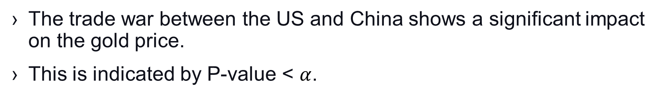
Result and Discussion
The trade war between the US and China shows a significant impact on the gold price.
This is indicated by P-value < $α$.
The results of the dummy variable regression of the gold price.
Series | Variable | Coefficient | P-value
Gold Price | Constant | 757.8 | 0.000
 | T | 499 | 0.001

Slide 11
Result and Discussion
The autocorrelation function plot and the partial autocorrelation function plot of residuals.
For this reason, a data transformation process is needed if the data is not stationary in variance and differencing processes if the data is not stationary in mean.

Slide 12
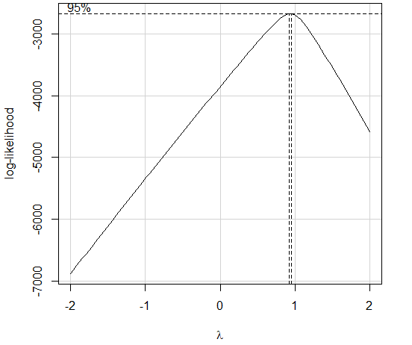
Result and Discussion
The results of Augmented Dickey-Fuller test of residuals.
Dickey - Fuller | Lag Order | P-value
-1.2433 | 6 | 0.8952
The results of Augmented Dickey-Fuller test of residuals after differencing.
Dickey - Fuller | Lag Order | P-value
-9.6341 | 6 | 0.01
Rounded value of Yeo – Johnson transformation.

Slide 13
Result and Discussion
The autocorrelation function plot and the partial autocorrelation function plot of residuals after differencing.

Slide 14
Result and Discussion
After being analyzed, only ARIMA (0,2,1) fulfilled the parameter significance test and parsimony principle with a small MSE value compared to other models.
The ARIMA (0,2,1) coefficients.
Variable | Coefficient | Std. Error | t-Statistic | P-value
MA(1) | 0.973 | 0.004 | 242.58 | 0.000

Slide 15
Result and Discussion
The autocorrelation function of residual of ARIMA (0,2,1) model and autocorrelation function of the squared residuals of ARIMA (0,2,1) model.
There is no cut off in the autocorrelation plot. It means the residual is white noise. However, the squared residual was not white noise.

Slide 16
Result and Discussion
Furthermore, in the residual diagnostics, it is found that the assumption of normality is not fulfilled by residuals.
This is caused by the existence of an outlier, namely the 291st data.
The QQ plot of residual of ARIMA (0,2,1).

Slide 17
Result and Discussion
By going through the process elaborated above, the final ARIMAX model is ARIMAX (0,2,1).
Mathematically, this model can be written as follows.
 | MAPE
Training Data | 2.609%
Testing Data | 9.671%
Forecasting results of the gold price with the ARIMAX (0,2,1) model.

Slide 18
Conclusion
The trade war between the US and China has a significant impact on gold price fluctuations.
By using the ARIMAX approach, it is found that the ARIMAX model (0,2,1) has high accuracy in prediction with the MAPE of training data is 2.6 percent and the MAPE of testing data is 9.6 percent.
Thus, it is hoped that the fluctuations in the price of gold that occurred during the trade war between the US and China can be predicted accurately so that future investment, especially gold investment, can be profitable.

Slide 19
References
M. K. Jain, Trade war effect: Gold may touch $1,390 level as outlook brightens. https://economictimes.indiatimes.com/markets/commodities/views/trade-war-effect-gold-may-touch-1390-level-as-outlook-brightens/articleshow/69694634.cms?from=mdr. (2019). Retrived July 20, 2020.
W. Kristjanpoller, and M. C. Minutolo, Gold price volatility: A forecasting approach using the Artificial Neural Network–GARCH model. Expert Systems with Applications, 42(20), 7245-7251. (2015).
X. Yang, The Prediction of Gold Price Using the ARIMA Model. Education and Humanities Research, 196, 273-276. (2018).
N. Tripathy, Forecasting the Gold Price with Auto Regressive Integrated Moving Average Model. International Journal of Economics and Financial Issues, 7(4), 324-329. (2017).
S. M. Ulyah, “Forecasting index and stock returns by considering the effect of Indonesia prepresidential election 2019 using ARIMAX and VARX approaches”, in Journal of Physics: Conference Series, IOP Publishing 1277(1) (IOP Publishing, 2019), pp. 012053.

Slide 20
References
A. S. C. Ling, G. Darmesah, K. P. Chong, and C. M . Ho, Application of ARIMAX Model to Forecast Weekly Cocoa Black Pod Disease Incidence. Mathematics and Statistics, 7(4A):29-40. (2019).
S. M. Ulyah, M. F. F. Mardianto, and Sediono, “Comparing the Performance of Seasonal ARIMAX Model and Nonparametric Regression Model in Predicting Claim Reserve of Education Insurance”, in Journal of Physics: Conference Series, IOP Publishing 1397(1) (IOP Publishing, 2019), pp. 012074.
W. W. S. Wei, Time Series Analysis : Univariate and Multivariate Methods 2nd Edition. (Pearson Education, United States of America, 2006)
J. D. Cryer, and K. S. Chan, Time Series Analysis with Application in R 2nd Edition. (Springer, New York, 2008)
M. H. Lee, Suhartono, and N. A. Hamzah, Calender Variation Model based on ARIMAX for Forecasting Sales Data with Ramadhan Effect. Proceedings of the Regional Conference on Statistical Science, 349-361. (2010).
J. S. Armstrong, Significance Tests Harm Progress in Forecasting. International Journal of Forecasting, 23, 321–327. (2007).

Slide 21
Thank You
Any Question ?
christopher.andreas-2018@fst.unair.ac.id

