Slide 1
Does US-China Trade War Affect The Brent Crude Oil Price? An ARIMAX Forecasting Approach
Ilma Amira Rahmayanti
Christopher Andreas
Siti Maghfirotul Ulyah (Corresponding Author)

Slide 2
DISCUSSION
What is the US-China trade war?
What is Brent crude oil?
What is ARIMAX?
How does the US-China trade war affect the Brent crude oil price?
How is the ARIMAX equation form for the Brent crude oil price if considering the impacts of the US-China trade war?
Conclusion

Slide 3
What is us-china trade war?

Slide 4
HOW DID IT START?
The term of US-China trade war began to be recognized since March 22, 2018, when Donald Trump (the President of the United States) imposed a tax on Chinese goods entering the United States. The rules on import taxes are covered by Section 301 of the Trade Act of 1974. However, in response, the Chinese Government also imposed taxes on imported goods originating from the United States. This trade war has caused many changes, especially in the economic sector.

Slide 5
WHAT IS brent crude oil?

Slide 6
DEFINITION
Brent crude oil is the crude oil produced from the North Sea. It is considered as “sweet oil” because it contains less than 1 percent of sulfur. Brent crude oil is also thinner than other extraction oils, so it is more attractive to petroleum product producers.
The Organization of Petroleum Exporting Countries (OPEC) uses Brent crude oil price as a benchmark for the international oil price, so this price is somewhat sensitive to geopolitical tensions including the US-China trade war/trade tension.

Slide 7
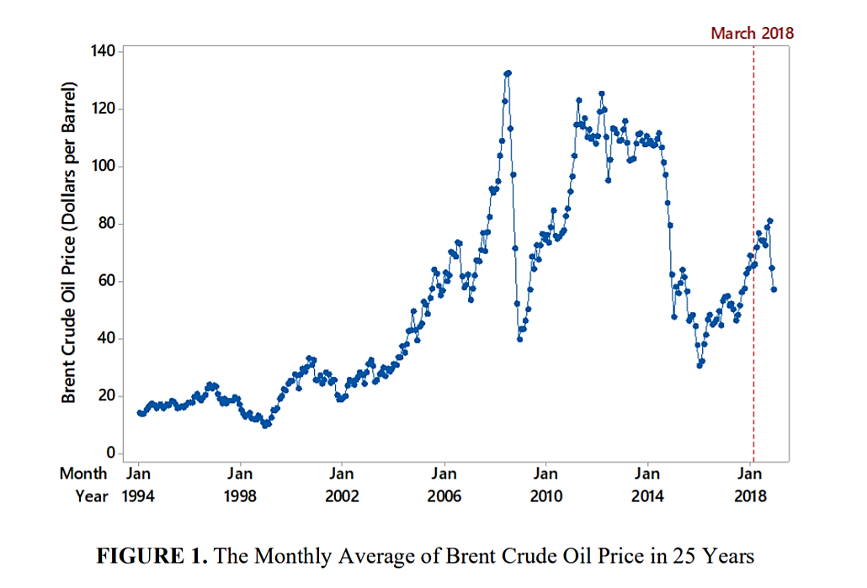

Slide 8
What is ARIMAX?

Slide 9
ARIMA
ARIMA is a forecasting technique that uses time series data effects. Modelling using ARIMA has stationary data requirements, both in mean and variance. Data that are not stationary in variance can be transformed using the Box-Cox transformation. Meanwhile, differencing can be done for data that are not stationary in the mean.
ARIMA model is the combination of AR and MA models that have differencing orders. A model with the undifferenced data is called ARMA.

Slide 10
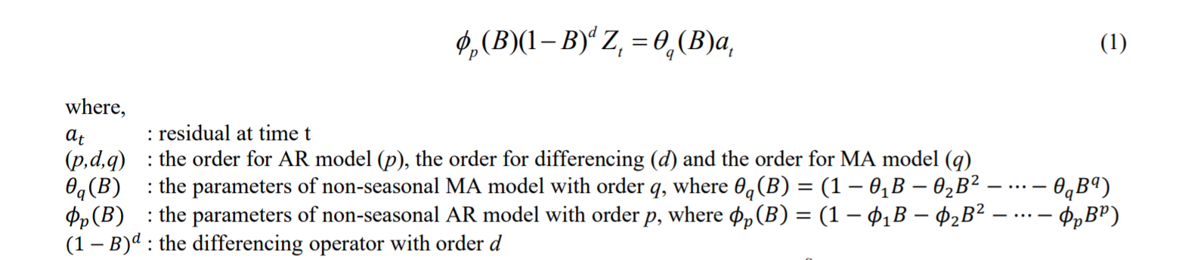
NON-SEASONAL ARIMA

Slide 11
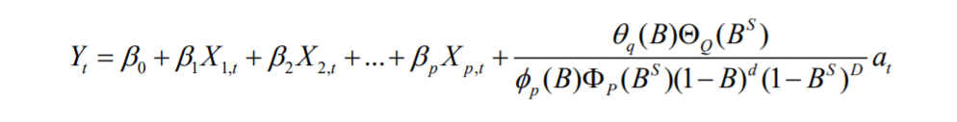
ARIMAX
ARIMAX model is a modification of the ARIMA model which has additional variables, namely exogenous variables. In this study, the exogenous variable used is the dummy variable for the US-China trade war.

Slide 12
ARIMAX STEPS
Divide data into in-sample and out-sample
Fit a linear regression model with dummy variable as a predictor variable and the in sample data as a response variable
Conduct an ARIMA modelling with the regression residuals if they do not meet the assumption of white noise
Conduct a Box-Cox transformation if the regression residuals are non-stationary toward variance
Conduct a differencing if the regression residuals are non-stationary toward mean

Slide 13
ARIMAX STEPS
Identify the orders of ARIMA model
Select the best model of ARIMA
Estimate the parameters of chosen ARIMA model
Use the ARIMAX equation to make forecasts
Compare the forecast results with out-sample data

Slide 14
HOW DOES US-CHINA TRADE WAR AFFECT THE BRENT CRUDE OIL PRICE?

Slide 15
Variable | Coefficient | P-value
Constant | 52.55659 | 0.0000
Trade War | 19.27641 | 0.0747
The regression model shows that the trade war has a significant effect on the Brent crude oil price using a 10 percent significance level.

Slide 16
HOW is the ARIMAX EQUATION FORM for THE BRENT CRUDE OIL PRICE IF considering THE impacts OF the US-CHINA TRADE WAR?

Slide 17
THE STEPS
1
Regression equation: ${\hat{Y}}_{t}=$52.5569+19.27641$X_{t}$
Regression equation: 𝑌 ̂_𝑡=52.5569+19.27641𝑋_𝑡
2
Regression residuals aren’t stationary toward variance and mean
3
Possible ARIMA = ARIMA(1,1,0) and ARIMA(0,1,1)
X (Trade war) is significant with positive effect
Regression residuals aren’t white noise, so it is modelled with ARIMA
Rounded value of the Box-Cox transformation = 0.5
Order of differencing = 1
Best ARIMA = ARIMA(1,1,0)
ARIMAX model = ARIMAX(1,1,0)

Slide 18
ARIMAX EQUATION

Slide 19
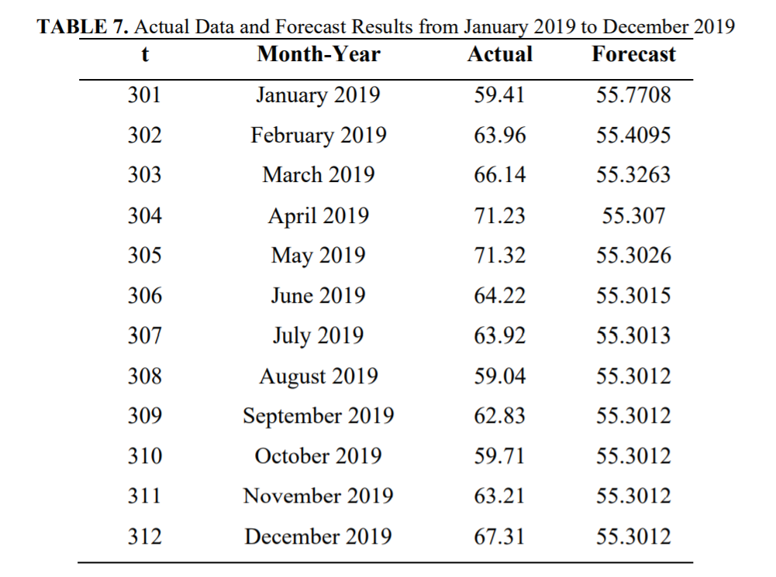
COMPARISON WITH OUT-SAMPLE DATA
MAPE value = 13.6733%

Slide 20
CONCLUSION

Slide 21
CONCLUSION
The trade war variable can be announced as a significant variable below the 10 percent significance level, so it concluded that US-China trade war has a significant effect on the Brent crude oil price. The best model for the Brent crude oil price is ARIMAX(1,1,0) with a MAPE value of 13.6733%.
Further work from this study can be done by considering the heteroscedasticity detected in the data.

Slide 22
THANKS YOU FOR YOUR ATTENTION

