Slide 1
An Approach of Vector Autoregressive with Exogenous Input in Forecasting the Effect of US-China Trade War on Gold and Oil Prices
Siti Maghfirotul Ulyah, Christopher Andreas, Ilma Amira Rahmayanti
Department of Mathematics, Universitas Airlangga

Slide 2
Content
Introduction
Method
Result and Discussion
Conclusion

Slide 3
Introduction

Slide 4
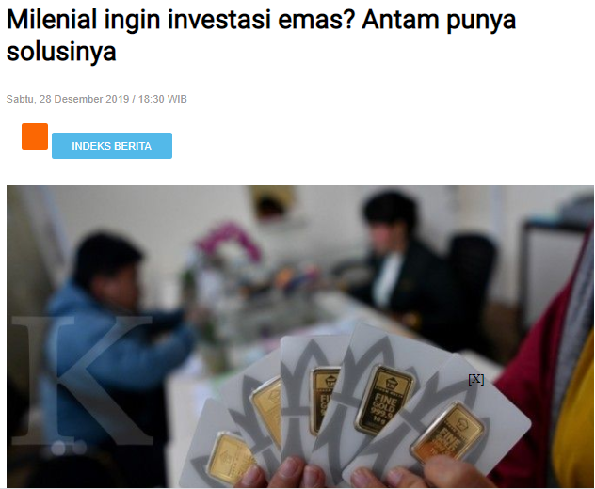
Motivation
Gold investment began to be popular among groups, especially millennial generation.

Slide 5
Motivation
According to VP Marketing & Sales Aneka Tambang (ANTAM), Iwan Dahlan, the price of gold is predicted to rise in 2020.
The increase can be dramatic as long as the trade war between America and China continues

Slide 6
Objective
To obtain the forecasting model that accommodate the effect of US-China trade war
To obtain the forecasts of gold price and oil price considering the US-China Trade War as the exogenous variable using vector autoregressive with exogenous input (VARX).

Slide 7
Previous Works
Forecasting uses traditional mathematical models such as Autoregressive Integrated Moving Average (ARIMA) and linear regression.
Kriechbaumer et al. [7] used the improved wavelet-ARIMA model to predict metal prices.
Prediction using multi-factor support vector regressions
Nazemi et al. [8] predict the recovery rate of corporate bonds.
Forecasting uses hybrid model
Kristjanpoller & Minutolo [5] predicted the volatility of gold prices using the Artificial Neural Network – GARCH model. Then in 2018, Kristjanpoller and Minutolo [9] proposed a hybrid (hybrid) model that integrates GARCH, artificial neural networks, technical analysis, and principal component analysis.
All of these studies use a univariate model without regard to factors that cause gold price fluctuations.

Slide 8
The Trade War between United States and China
The US-China trade war is an ongoing conflict in economy between China and the United States.
This war is caused by the policy created by President Donald Trump in 2018 to set tariffs and other trade barriers on China.
The trade war is predicted to have negative impact of the economies of both the US and China, even other countries

Slide 9
Material and Method

Slide 10
Data Sources and Research Variables
Secondary data from Index Mundi (www.indexmundi.com) and Thomson Reuters website.
Monthly data for 26 years (312 months) starting from January 1994 to December 2019 that consisted of Gold price and Europe Brent spot price.
We defined the data from January 1994 - December 2018 as training data and the rest (one year in 2019) as testing data.
This study considered a dummy variable of Trade War between United States (US) and China that started on March 2018.
In this month, Donald Trump, the president of US created a new tariff policy in order to encourage consumers in buying American products by making imported goods’ price much higher.
The dummy variable of trade war is expressed below,

Slide 11
Steps of Analysis
(1) checking the stationary of the data both in variance and mean.
(2) selecting the order of the model based on minimum AIC,
(3) estimating the parameter of the chosen model using least square method,
(4) having residual diagnostic checking including white noise and multivariate normality assumptions,
(5) calculating in-sample accuracy criteria using some information criteria,
(6) forecasting the data for 2019,
(7) computing the goodness of fit criteria of the model (MAPE).

Slide 12
RESULT AND DISCUSSION

Slide 14
Title and Content Layout with Chart

Slide 15
Two Content Layout with Table
Class | Group A | Group B
Class 1 | 82 | 95
Class 2 | 76 | 88
Class 3 | 84 | 90
First bullet point here
Second bullet point here
Third bullet point here

Slide 16
Two Content Layout with SmartArt
A
Task 1
Task 2
B
Task 1
Task 2
C
Task 1
Task 2
First bullet point here
Second bullet point here
Third bullet point here

Slide 17
Add a Slide Title - 2

Slide 18
Add a Slide Title - 3

Slide 20
Add a Slide Title - 4

Slide 21
Add a Slide Title - 5

