Slide 1
Prediction Concentration of PM2.5 in Surabaya Using Ordinary Kriging Method
Presenter : Derbi Wulan Fitri
Corresponding Author : Nur Chamidah

Slide 2
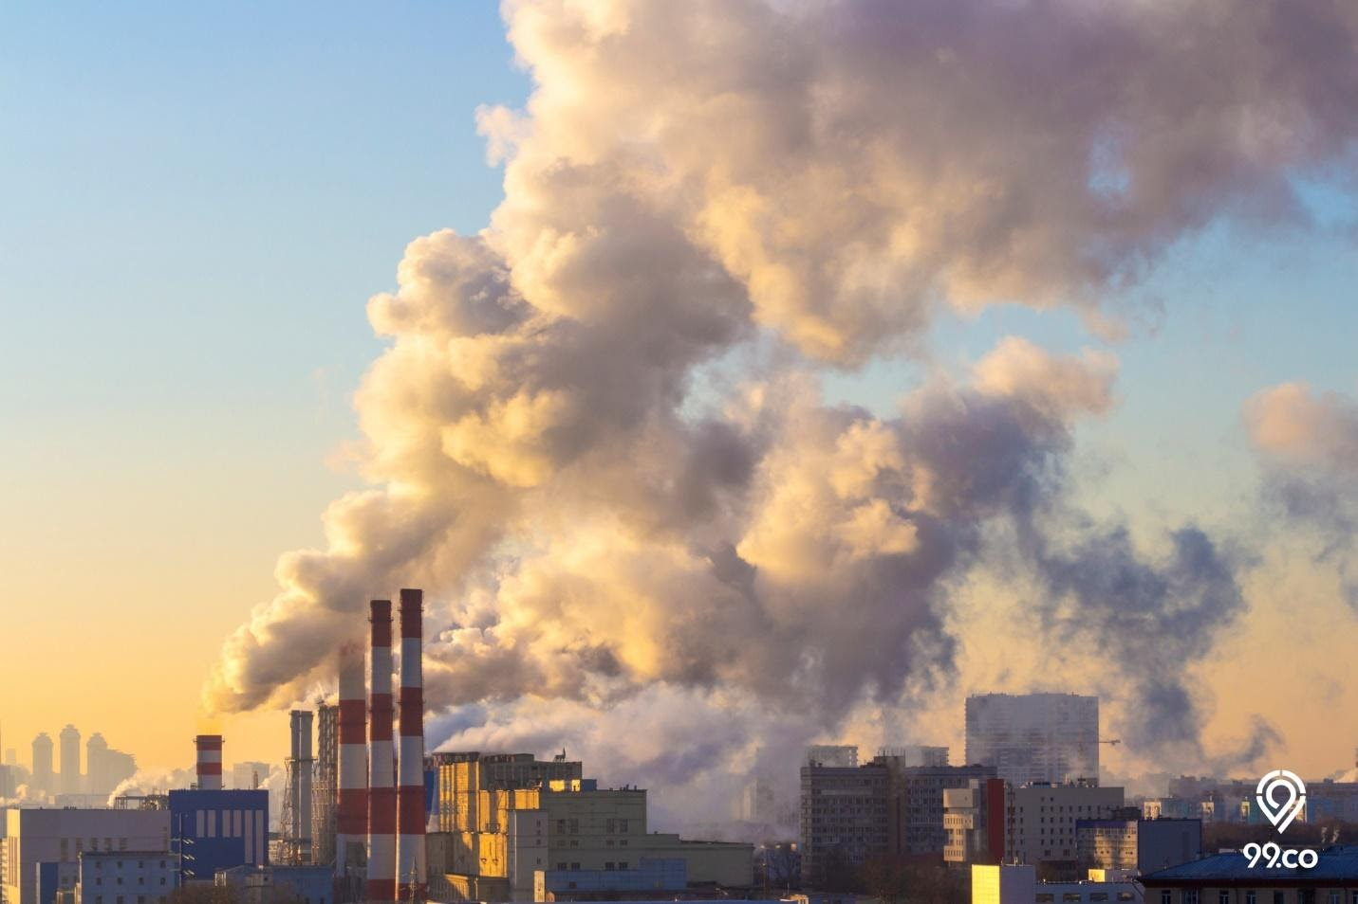
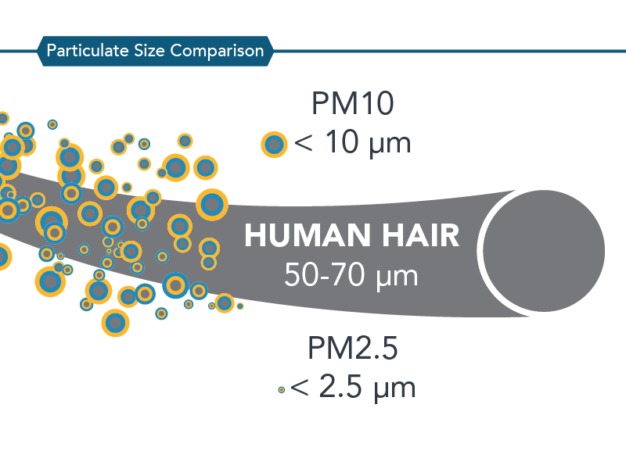

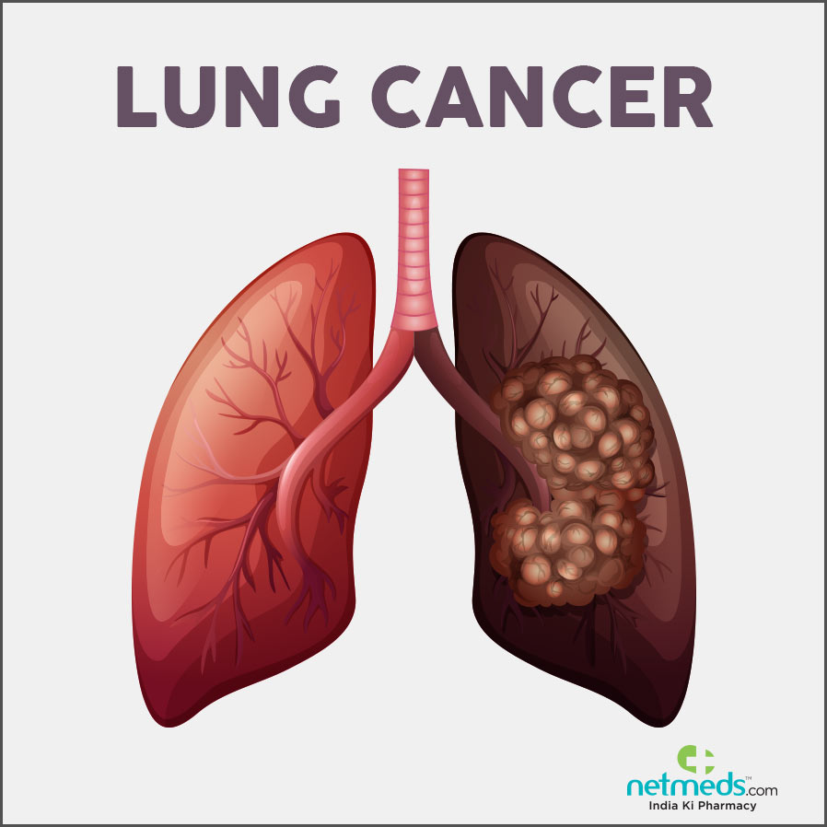
INTRODUCTION
Air Pollution is a very common problem in big cities in Indonesia, one of which is Surabaya, which is the second largest city in Indonesia
There are many indicators of air pollution, one of which is PM2.5.
This pollutant has a size of less than 2.5 microns which can penetrate the lungs blocking and entering the blood system which can lead to the risk of developing cardiovascular disease, breathing to lung cancer

Slide 3
INTRODUCTION
In general, the concentration of air pollution in each region has a different level.
In this case the researchers used the ordinary kriging method

Slide 4
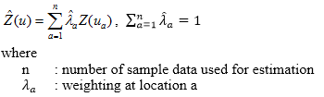
METHODS
Ordinary Kriging
In this method, it is assumed that the mean of the population is unknown, and the spatial data does not contain trends. In addition to not containing trends, the data used also does not contain outliers.

Slide 5
THE DATA
Data obtained from the AirVisual
Data obtained from data from 8 monitoring stations in Surabaya, in KLHK Tandes, ITS Campus, Gunung Anyar, Pacar Keling, Kertajaya, Gubeng Airlangga, and Benowo.

Slide 6
RESULT AND DISCUSSION
FIGURE 1. Scatter Plot of Longitude and Concentration PM2.5 in Surabaya
FIGURE 2. Scatter Plot of Latitude and Concentration PM2.5 in Surabaya

Slide 7
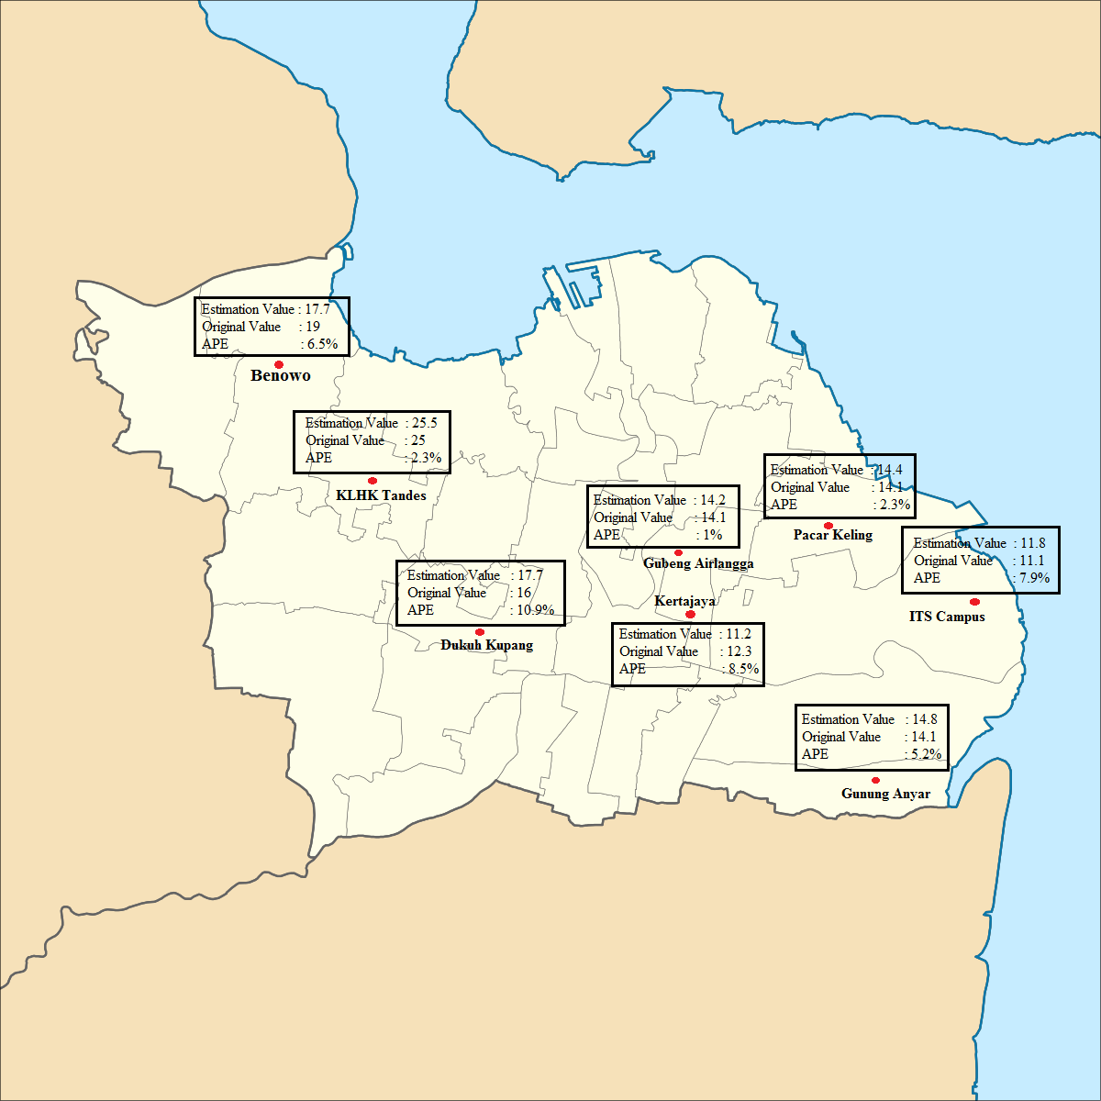
RESULT AND DISCUSSION
The lowest APE is at Pacar Keling , with 1%
The highest APE value is in the Kupang estimate of 10,9 %
MAPE : 5.6%

Slide 8
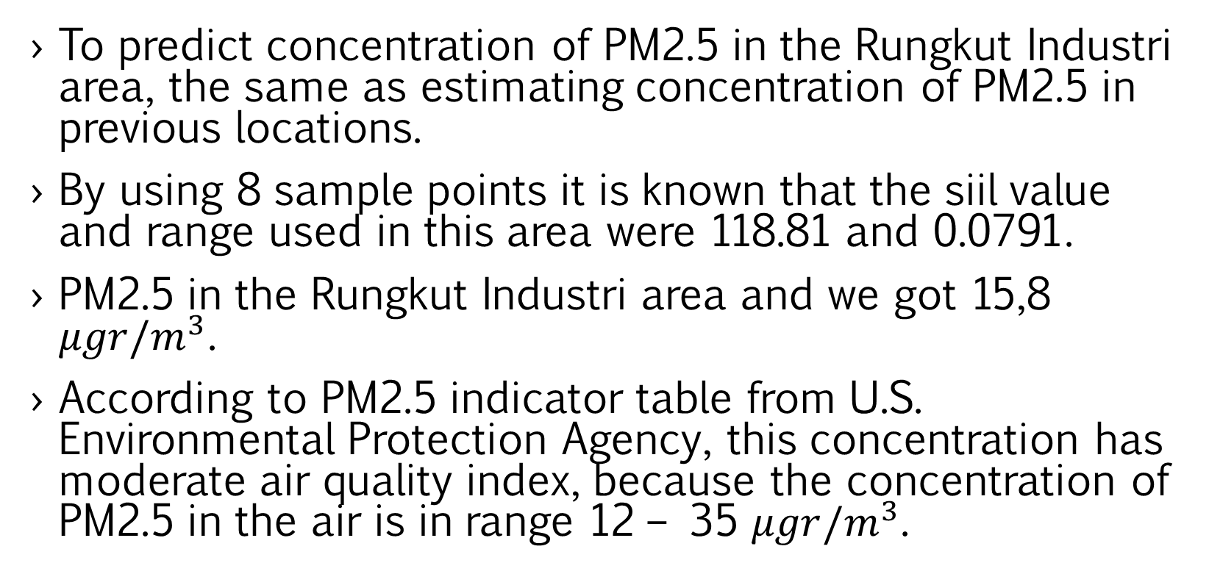
RESULT AND DISCUSSION
To predict concentration of PM2.5 in the Rungkut Industri area, the same as estimating concentration of PM2.5 in previous locations.
By using 8 sample points it is known that the siil value and range used in this area were 118.81 and 0.0791.
PM2.5 in the Rungkut Industri area and we got 15,8 $μgr/m^{3}$.
According to PM2.5 indicator table from U.S. Environmental Protection Agency, this concentration has moderate air quality index, because the concentration of PM2.5 in the air is in range 12 – 35 $μgr/m^{3}$.

Slide 9
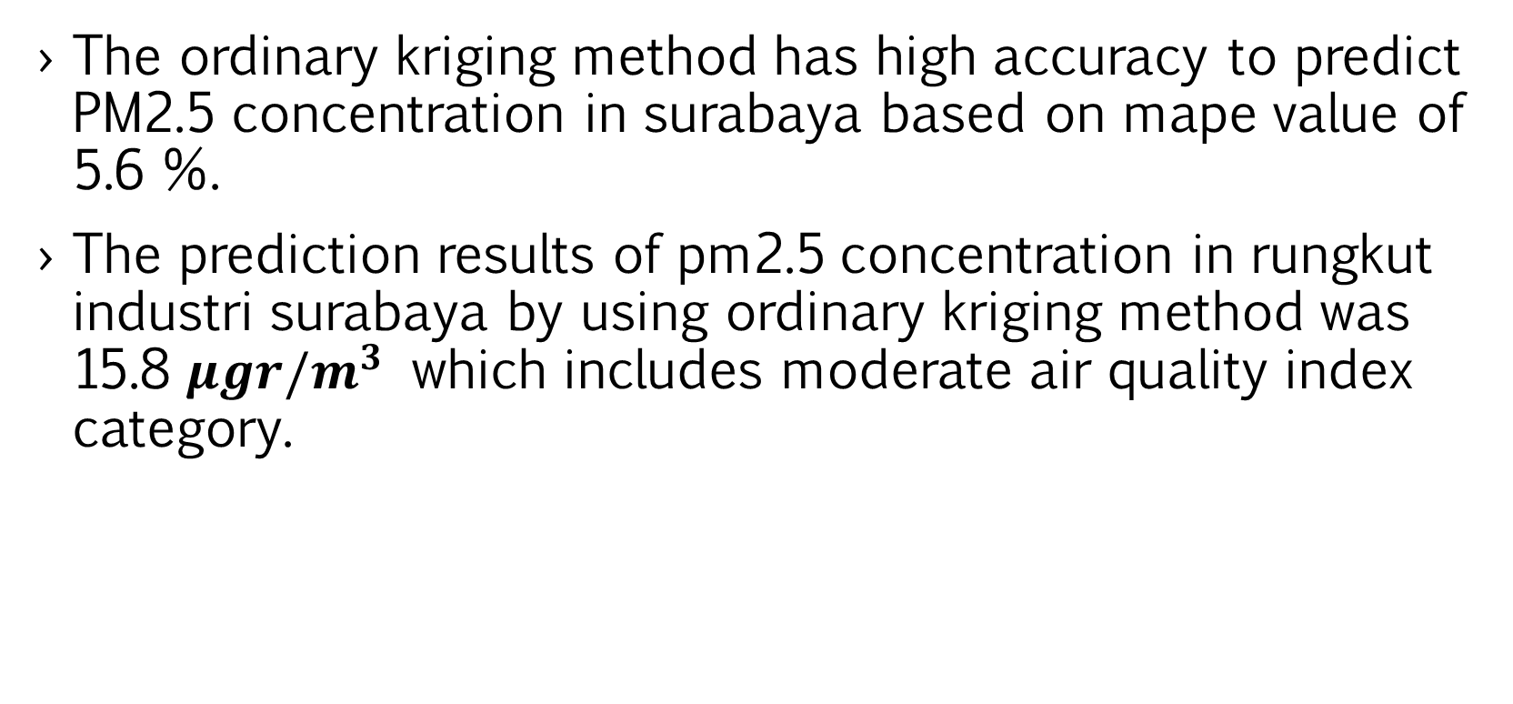
CONCLUSION
The ordinary kriging method has high accuracy to predict PM2.5 concentration in surabaya based on mape value of 5.6 %.
The prediction results of pm2.5 concentration in rungkut industri surabaya by using ordinary kriging method was 15.8 $μgr/m^{3}$ which includes moderate air quality index category.

