Slide 1
Fourier Series Estimator for Predicting International Market Price of White Sugar
Presenter: Research team:
Selvira Dwi Febriana Nur Chamidah
Reynaldy Aries Ariyanto
Reiza Sahawaly

Slide 2

White Sugar
Sugar is one of the major commodity in the world. By the early 21th century, industry and the world sugar trade is expected to experience a fairly fundamental changes to the long-term impact.
The success of Hong Kong Ministerial Meeting in Hong Kong on December 13-18, 2005 at the framework of the Doha Development Round to agree on the elimination of agricultural subsidies in 2013, is one of the factors that affect the world’s sugar industry.
Sugar industry policy reform plan in 2007 in Western Europe and America as two major players, is expected to reduce the world’s sugar production, thus pushing up the price of sugar in the future. Therefore, it will lead to scarcity of sugar and price of sugar in International market rise.
To anticipate that problem, government must make regulation to maintain price of sugar. Therefore, government need to predict price of sugar in International to make regulation for the country.

Slide 3
White sugar prices data are published every month ⟶ time series data
Previous researches (using Fuzzy):
Chen (1996)
MAPE: 8.58%
Singh (2008)
MAPE: 8.62%
Huargh (2001)
MAPE: 8.01%
White sugar prices data are fluctuating month to month ⟶ nonparametric regression
“Nonparametric regression can be used for a data that have unknown pattern” Prahutama, 2013
Regression
Parametric
Nonparametric

Slide 4
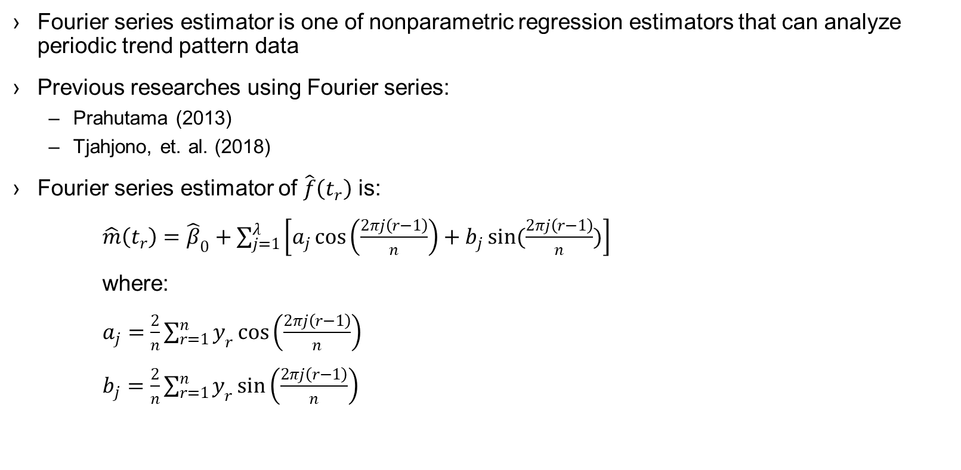
Fourier Series Estimator
Fourier series estimator is one of nonparametric regression estimators that can analyze periodic trend pattern data
Previous researches using Fourier series:
Prahutama (2013)
Tjahjono, et. al. (2018)
Fourier series estimator of $\hat{f}\left(t_{r}\right)$ is:
$\hat{m}\left(t_{r}\right)={\hat{β}}_{0}+\sum_{j=1}^{λ}{\left[a_{j}\cos\left(\frac{2πj\left(r−1\right)}{n}\right)+b_{j}\sin{(\frac{2πj\left(r−1\right)}{n})}\right]}$
where:
$a_{j}=\frac{2}{n}\sum_{r=1}^{n}{y_{r}}\cos\left(\frac{2πj\left(r−1\right)}{n}\right)$
$b_{j}=\frac{2}{n}\sum_{r=1}^{n}{y_{r}}\sin\left(\frac{2πj\left(r−1\right)}{n}\right)$

Slide 5

Mean Absolute Percentage Error (MAPE)
MAPE is used in this research for determining accuracy of prediction
$MAPE= \frac{\sum_{i=1}^{N}{\left|{\left(y_{i}−{\hat{y}}_{i}\right)}/{y_{i}}\right| \left(100\%\right)}}{N}$
MAPE (%) | Interpretation
<10 | High accurate prediction
10-20 | Good prediction
20-50 | Reasonable
>50 | Inaccurate

Slide 6
Data Sources
The data used in this research is secondary data, i.e. data on international white sugar prices in January 2014 to September 2018 were obtained from sites https://www.isosugar.org/prices.php. Data of in-sample used is the price of sugar in the international market in January 2014 to February 2018. Data out-sample used is the price of sugar in the international market in March 2018 to September 2018.

Slide 7
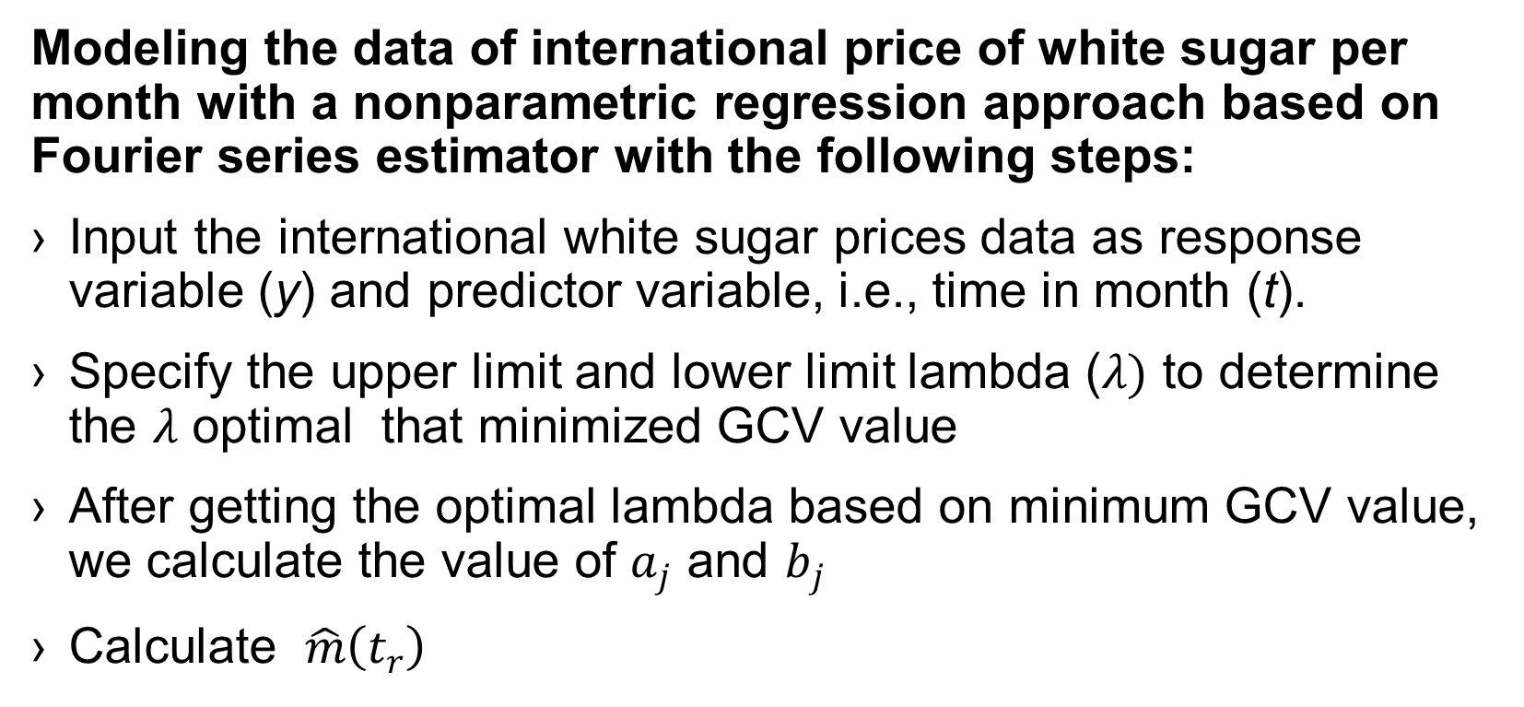
Steps of Analysis
Modeling the data of international price of white sugar per month with a nonparametric regression approach based on Fourier series estimator with the following steps:
Input the international white sugar prices data as response variable (y) and predictor variable, i.e., time in month (t).
Specify the upper limit and lower limit lambda ($λ)$ to determine the $λ$ optimal that minimized GCV value
After getting the optimal lambda based on minimum GCV value, we calculate the value of $a_{j}$ and $b_{j}$
Calculate $\hat{m}\left(t_{r}\right)$

Slide 8
Analyzing and interpreting the results obtained from the data modeling of international price of white sugar per month with a nonparametric regression approach based estimator Fourier series, the stages are:
Make observation plots and estimated
After obtaining the model, described by the estimation equation obtained.
Predicting data for 6 months ahead by using Fourier series estimator and measuring the accuracy of prediction by using RMSE value and MAPE values for in-sample and out-sample data.

Slide 9
Results and Discussion
Scatterplot Data of Sugar Prices in International Market in January 2014 to February 2018

Slide 10
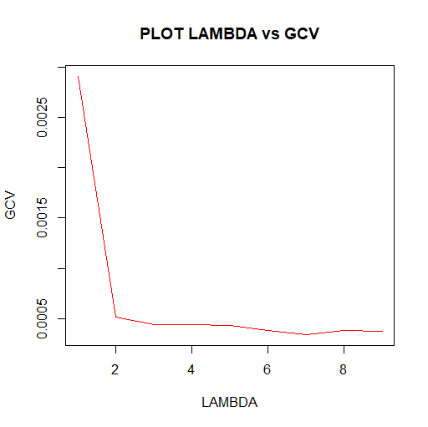
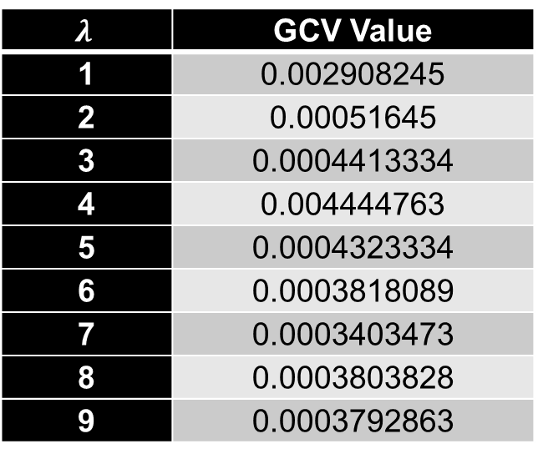

The number of Fourier coefficients ($λ$) is the controller of the balance between the smooth functioning of the data. To determine the number of Fourier coefficients we can use the method of generalized cross validation (GCV). The table below illustrates the value of GCV with initial lambda 1 and end lambda 9 using the R program.
The minimum GCV value is on the 7th 𝜆 which is 0.0003403473
Therefore, the optimal 𝜆 is 7.
$$λ$$ | GCV Value
1 | 0.002908245
2 | 0.00051645
3 | 0.0004413334
4 | 0.004444763
5 | 0.0004323334
6 | 0.0003818089
7 | 0.0003403473
8 | 0.0003803828
9 | 0.0003792863

Slide 11
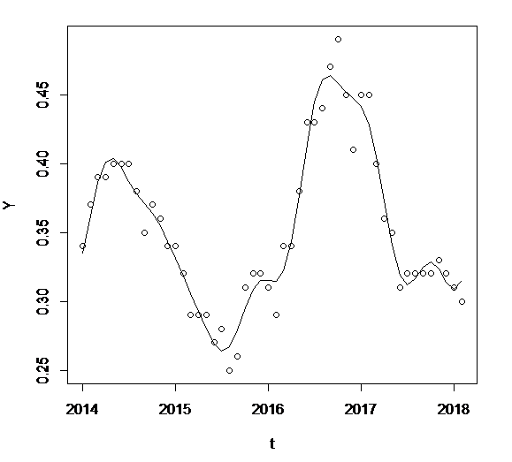
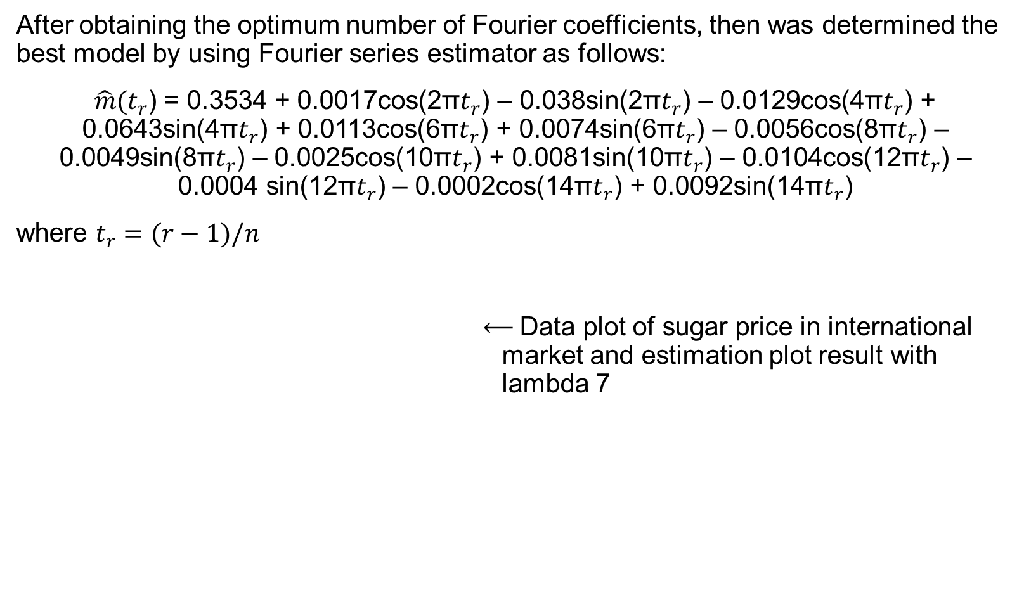
After obtaining the optimum number of Fourier coefficients, then was determined the best model by using Fourier series estimator as follows:
$\hat{m}(t_{r}$) = 0.3534 + 0.0017cos(2π$t_{r}$) – 0.038sin(2π$t_{r}$) – 0.0129cos(4π$t_{r}$) + 0.0643sin(4π$t_{r}$) + 0.0113cos(6π$t_{r}$) + 0.0074sin(6π$t_{r}$) – 0.0056cos(8π$t_{r}$) – 0.0049sin(8π$t_{r}$) – 0.0025cos(10π$t_{r}$) + 0.0081sin(10π$t_{r}$) – 0.0104cos(12π$t_{r}$) – 0.0004 sin(12π$t_{r}$) – 0.0002cos(14π$t_{r}$) + 0.0092sin(14π$t_{r}$)
where $t_{r}=(r−1)/n$
⟵ Data plot of sugar price in international market and estimation plot result with lambda 7

Slide 12
Month | Actual Price (US$/kg) | Prediction Price | Absolute Percentage Error (APE)
March 2018 | 0.28 | 0.315558 | 0.126993
April 2018 | 0.27 | 0.315818 | 0.169696
May 2018 | 0.27 | 0.316073 | 0.170641
June 2018 | 0.28 | 0.316323 | 0.129725
July 2018 | 0.26 | 0.316568 | 0.217569
August 2018 | 0.24 | 0.316807 | 0.320029
After obtaining the estimated model of the price of sugar in the international market by using the Fourier series estimator, we predict the price of sugar in the international market for the 6 months ahead

Slide 13
RMSE and MAPE values
 | RMSE | MAPE
In-sample | 0.015989 | 3.71%
Out-sample | 0.051486 | 18.9%
Overall data | 0.0226337 | 5.34%

Slide 14
Conclusion
Based on the optimal number of Fourier coefficient (𝜆=7), we obtained the estimation model that can be used for predicting the sugar price in international market and its MAPE value was 5.34% which is less than 10%. So, we can conclude that Fourier series estimator is good for predicting the white sugar price in international market.

Slide 15
Reference
W.R. Susila, and A. Supriono. Keseimbangan Baru Pasar Gula Dunia: Peluang Kejayaan Industri Gula Indonesia, IDEALS Working Paper, No. 1-2006, Institute for Development Economics of Agriculture and Rural Areas, Bogor. (2006)
Chen, S.M. (1996). Fuzzy set and System, 81, 311
Singh, S.R. (2008). Fuzzy set and System, 79, 539
Huargh, K. (2001). Fuzzy set and System, 123, 369
T. Adiwati, and N. Chamidah. IOP Conf. Series: Materials Science and Engineering 546 052003(2019)
A. Massaid, M. Hanif, D. Febrianti and N. Chamidah. IOP Conf. Series: Materials Science and Engineering 546 052044 (2019).
N. I. Oktavitri, E P Kuncoro, H. Purnobasuki and N. Chamidah. Eco. Env. & Cons. 25 (April Suppl. Issue), S96-S100 (2019).
N. Chamidah, B. Lestari, and T. Saifudin. International Journal of Innovation, Creativity and Change 5 (3). 1200-1216 (2019).
A. Islamiyati, Fatmawati, and N. Chamidah. Songklanakarin J. Sci. Technol. 42 (4), 897-909. (2020)
N. Chamidah and T. Saifudin. Applied Mathematical Sciences, 7 (37-40), 1839-1847(2013)
B. Lestari, Fatmawati, I. N. Budiantara, and N. Chamidah. Journal of Physics: Conference Series 1097 012091. (2018).
B. Lestari, Fatmawati, I. N. Budiantara, and Chamidah, N. Journal of Physics: Conference Series 1397 012064. (2019).
N. Chamidah, and M. Rifada, AIP Conference Proceedings 1718 110001(2016)
N. Chamidah, E. Tjahjono, E., A. R. Fadilah, and B. Lestari. Journal of Physics: Conference Series, 1097 012092(2018)
Nidhomuddin, N. Chamidah, and A. Kurniawan IOP Conf. Series: Materials Science and Engineering 546 052047(2019)
N. Chamidah, and B. Lestari, Journal of Physics: Conference Series, 1397 012072 (2019).
A. Tohari, N. Chamidah, and Fatmawati. Annals of Biology 36 (2) : 215-219(2020).
A. Prahutama, (2013). Model Regresi Nonparametrik Dengan Pendekatan Deret Fourier Pada Kasus Tingkat Pengangguran Terbuka Di Jawa Timur. Prosiding Seminar Nasional Statistika Universitas Diponegoro 2013, 69-76
E. Tjahjono, M. F. F Mardianto, and N. Chamidah. 103(8), 1251-1263(2018).
J. J. M., Moreno, A. P., Pol, A. S Abad, and B. C. Blasco, Psicothema 25(4), 500-506(2013).
N. Chamidah. Analisis Regresi Nonparametrik Menggunakan Program R. Surabaya: Universitas Airlangga (2018).
H. Wu, and J.T. Zhang. Nonparametric Regression Methods for Longitudinal Data Analysis, A John-Wiley and Sons Inc. Publication, New Jersey. (2006).
S. Makridakis, et al. The Accuracy of Extrapolative (Time Series Methods): Results of a Forecasting Competition. Journal of Forecasting 1(2), 11-153 (1982).

Slide 16
THANK YOU

