Slide 1
Classification Using Nonparametric Logistic Regression for Predicting Working Status
Wahyu Wibowo, Rahmi Amelia, Fanny Ayu Octavia, & Regina Niken W.

Slide 2
Introduction
Classification
Predict the categorical target feature
Fittest model
Logistic Regression
Classical & prominent method

Slide 3
Nonparametric model → Continuous predictor variables
Improving Classification Accuracy
Logistic Regression
Relaxes assumption between response & predictor variables
More flexible to capture any form of relationship

Slide 4
Nonparametric Logistic Regression Model
Binary Logistic Regression Model
VS
Classification Accuracy ?

Slide 5
Materials and Methods
Nonparametric regression assumes that the functional form between response and predictor is unknown.
The key performance of nonparametric regression is its flexibility to model the response and predictor variables.
The nonparametric regression model:
y is continuous target feature, x is input feature, f(x) is unknown function and is assumed smooth

Slide 6
The estimator of f(x) can be obtained by minimizing:
: smoothing parameter
Logistic Regression: to model the relationship between categorical target with one or more input variables either metric or non-metric.
If the response variable y consists of 2 categories, “success” (y=1) or “failed” (y=0), and x is the predictor variables, then logistic regression model is:

Slide 7
Nonparametric Logistic Regression is developed by combining logistic and nonparametric model:
Smooth function obtained by minimizing penalized log-likelihood:

Slide 8
Goodness of Classifier
Actual Group |  | Predicted Group
 |  | 1 | 0
Y | 1 | True Positive (n₁₁) | False Positive (n₁₀)
 | 0 | False Negative (n₀₁) | True Negative (n₀₀)
1. Accuracy
2. The area under Receiving Operating Characteristic (ROC) curve.

Slide 9
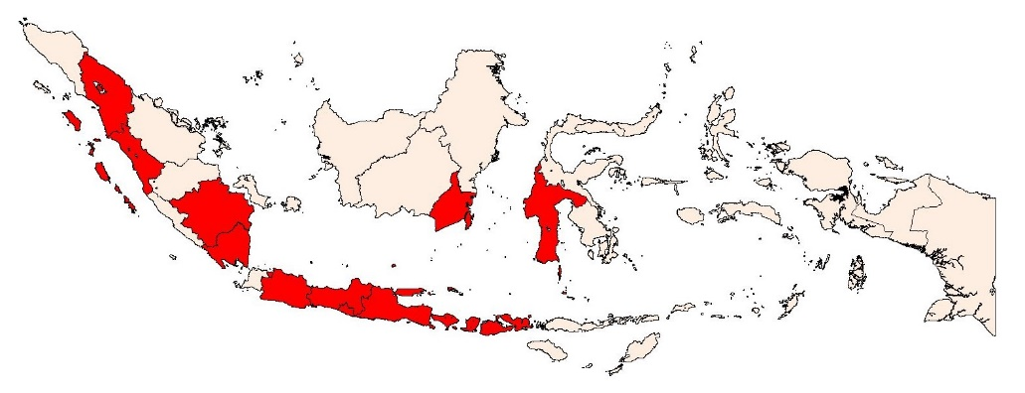
Data
Secondary data from Indonesian Family Life Survey (IFLS) phase 5 in 13 provinces in Indonesia.

Slide 10
Research Variables
Indicator | Description | Scale
Working Status of Housewife (Y) | 0: Not-working | Nominal
 | 1: Working
Highest Education (X₁) | 0 : No School | Ordinal
 | 1 : Elementary School
 | 2 : Junior High School
 | 3 : Senior High School
 | 4 : Higher Education
Age (X₂) | - | Ratio
Household Expenditure (X₃) | - | Ratio

Slide 11
Result
 | Age |  | Expenditure
Status | Mean | SD | Mean | SD
Not Working | 41 | 15 | 1,505,000 | 2,916,286
Working | 42 | 12 | 1,885,000 | 4,242,965

Slide 12
Logistic Regression Model
Actual Group |  | Training Prediction |  | Testing Prediction
 |  | 0 | 1 | 0 | 1
Y | 0 | 50 | 1,378 | 13 | 359
 | 1 | 27 | 2,089 | 2 | 513

Slide 14
Nonparametric Logistic Regression
Actual Group |  | Training Prediction |  | Testing Prediction
 |  | 0 | 1 | 0 | 1
Y | 0 | 526 | 902 | 141 | 231
 | 1 | 394 | 1722 | 80 | 435

Slide 17
Conclusion
Incorporating nonparametric model to the binary logistic regression model can improve the classification accuracy
Accuracy and area under curve of nonparametric logistic regression is higher than those of binary logistic regression.

