Slide 1
Multi-predictor Local Polynomial Regression for Predicting The Acidity Level of Avomango (Gadung Klonal 21)
Millatul Ulya
Nur Chamidah
Study Program of Mathematics and Natural Science
Faculty of Science and Technology
Airlangga University
Indonesia

Slide 2
INTRODUCTION
The acidity level is one of the fruit quality. The ripe the fruit, the less acidic the fruit is.
It can be measured using analysis of pH→ Destructive analysis
NIR spectroscopy method → Non-destructive analysis to determine pH
NIR spectroscopy produced spectra data → multi-predictor, used to predict pH
Prediction Model using Regression Approach

Slide 3
INTRODUCTION
Nonparametric Regression
Kernel PLSR (Nicolai et al., 2007)
Parametric Regression
PLSR (Rungpichayapichet et al., 2016)
Multiple LR (Jha et al., 2014)
Simple LR (Watanawan et al., 2014)
pH Prediction model has the value of R² 0,69-0,70 (Jha et al., 2012)
Nicolai et al. (2007) used nonparametric regression to predict the fruit quality and maturity
Multi-predictor Local Polynomial Regression

Slide 4
INTRODUCTION
The aims of this research:
Predict the pH value of avomango using Multi-predictor Local Polynomial Regression (MLPR)
Compare the MLPR model performance with Multiple Polynomial Regression (MPR) approach to determine the pH value

Slide 5
Materials and Method

Slide 6
Materials and Method
Materials
100 avomangos were used as samples, harvested by researcher from Mr. Sugik’s garden (Pasuruan). 80 samples as in-sample data and another as out-sample data
Data Collection
Samples were tested using NIR spectroscopy with wavelengths between 900 - 1650 nm (reflectan mode) at the Photonics Engineering Laboratory, Department of Engineering Physics, ITS. In addition, pH was tested using pHmeter at the UTM Laboratory
Data processing
The spectra data (112 variables) were reduced (into 2 variables) using Principal Component Analysis/PCA. The results are used as variable predictors. Meanwhile, pH value was used as the response variable.

Slide 7
Developing Prediction Model
Multi-predictor local polynomial regression (mlpr)
with
Multiple polynomial regression
The Goodness of Fit

Slide 8
The Research Stages
1. Input the pH value as the response variable and 2 predictor variables
2. Scatter Plot X Vs Y
3. Determine optimal bandwidth values ​​(h_{j}) at first and second polynomial degrees. Bandwidth (h) is a smoothing parameter that controls the smoothness of the curve. The selection of optimum bandwidth is based on the bandwidth that has the minimum Cross-Validation (CV) value.
4. Fit the pH model in in-sample data using MLPR. Plot The actual pH value and predicted pH value and calculate MSE and MAPE values ​​in in-sample data
5. Predict the pH value on the out-sample data based on the optimal bandwidth (h_{j}) value. Calculate MSE and MAPE values in out-sample data and overall data
6. Do points 4 – 5 using the MPR approach. compare MSE and MAPE values between MLPR and MPR approach.
Data analysis was performed using Open Source Software - R

Slide 9
Results and Discussions

Slide 10
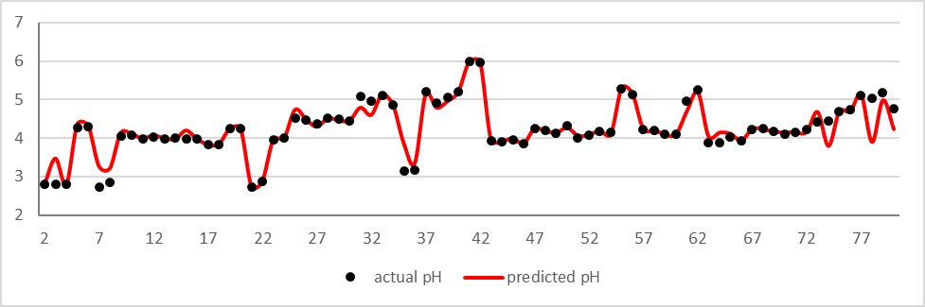
Multi-predictor local polynomial regression (Mlpr)
X1 = second order local polynomial, h opt = 0.1
X2 = First order local polynomial, h opt = 0.09

Slide 11
MLPR
For examples in the 6th data, where x₀₁ =-12.442 and x₀₂ = -3.708 produces the estimated values of β₀₁, β₁₁, β₂₁, and β₁₂ were 4.3209, 5.8922, -3.7712 and 1.0174, respectively. So that, the estimated equation was:
where
and
If the value of x₅₁ = -12.442 and x₅₂ = -3.708, then equation (15) became:
The actual pH value is 4.29, so the MAPE is 0.72%

Slide 12
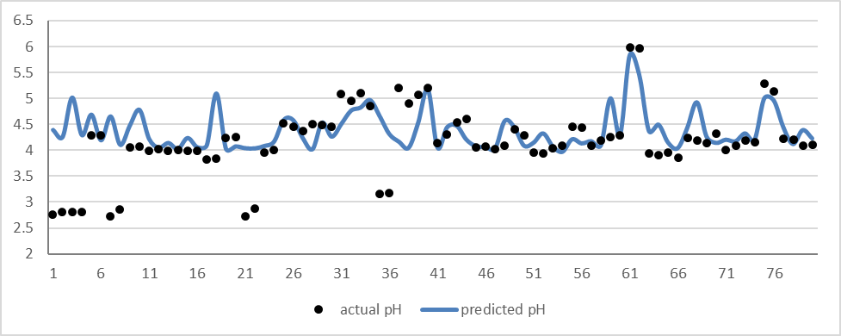
Multiple polynomial regression (Mpr)
X1 = second order; X2 = First order

Slide 13
MPR
For examples in the 6th data, where x₀₁ =-12.442 and x₀₂ = -3.708. Then, the equation became:
The actual pH value is 4.29, so the MAPE So, the MAPE of this point is 2.028%

Slide 14
MLPR and MPR
Table 1. The performance of prediction model
Data | MLPR (nonparametric regression) |  | MPR (parametric regression)
 | MSE | MAPE (%) | MSE | MAPE (%)
In-sample | 0.054 | 2.90 | 0.191 | 7.63
Out-sample | 2.695 | 19.57 | 1.004 | 23.42
Overall | 0.582 | 6.23 | 0.354 | 10.79
The MSE and MAPE value of MLPR is less than MPR approach.
The MAPE value of MLPR is 6.23% less than 10%, so it is categorized as high accurate prediction (Moreno et al. 2013)
The MLPR approach has better performance than MPR approach in predicting pH value of avomango

Slide 15
conclusion
The model prediction of TSS value of avomango using MLPR approach categorized as high accurate prediction with MAPE value is 6.23%.
The performance of MLPR (nonparametric regression) approach is better than MPR (parametric regression) approach in predicting The pH value of avomango

Slide 16
Thank You

