Slide 1

Range of Motion Measurement of Articulatio cubiti Based on Hough Transformation

Slide 2
Author
Mastri Cahyaningtyas Pediyanti
Riries Rulaningtyas
Akif Rahmatillah
Katherine
Biomedical Engineering, Physics Department, Faculty of Science and Technology, Universitas Airlangga, Surabaya, Indonesia

Slide 3
Introduction

Slide 4

Range of Motion (ROM)
Measurement of the ability of joints movement
ROM
Parameters in physical rehabilitation
Classify the severity of injury or disease
Measure the rehabilitation effectivity
Design an exoskeleton

Slide 5
Range of Motion (ROM)
Measurement of the ability of joints movement
ROM
Parameters in physical rehabilitation
Blood circulation
Joints
Neurological
Ligaments

Slide 6
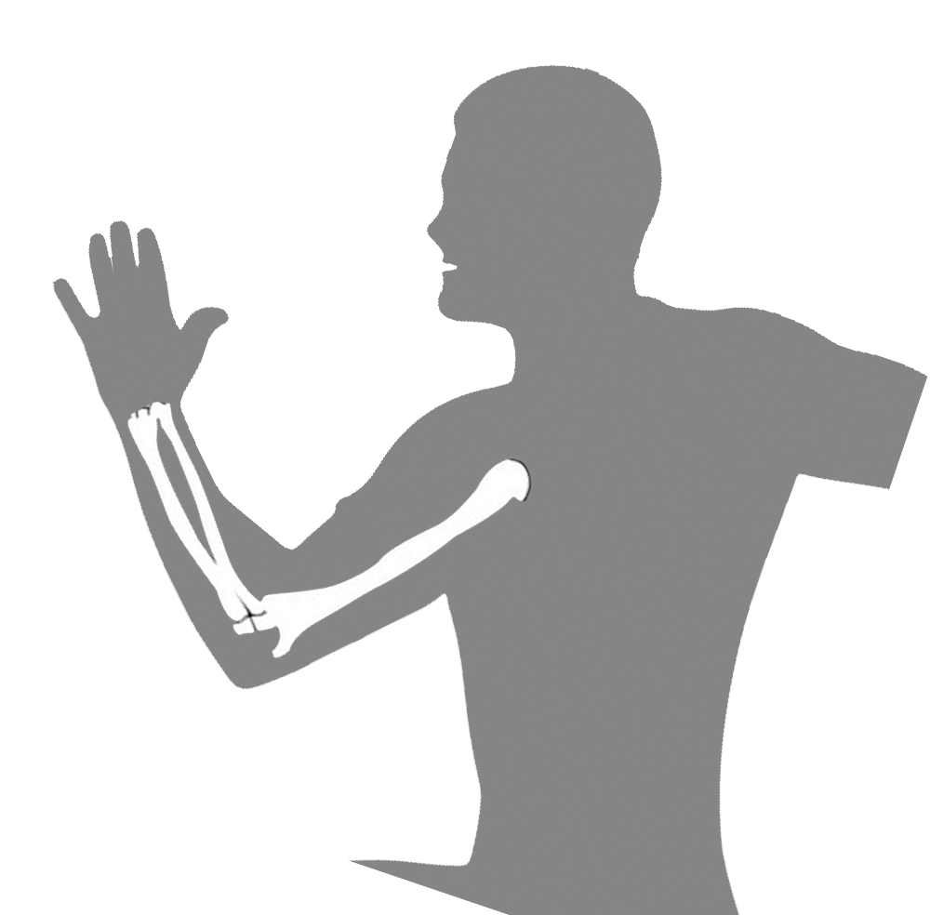
ARTICULATIO CUBITI
ELBOW
MOST OFTEN INJURED
Humerus
BONES
Radius
Ulna
Biceps brachii
Flexion movements
MUSCLES
Brachial & brachioradial
Triceps brachii
Extenxion movements

Slide 7
ARTICULATIO CUBITI
ELBOW
MOST OFTEN INJURED
Trauma
Repetitive movements
Flexion
Supination
Rehabilitation Effectiveness
ROM
Extension
Pronation

Slide 8
ARTICULATIO CUBITI
ELBOW
MOST OFTEN INJURED
Trauma
Repetitive movements
ROM
Accurate
Precise
NO Misdiagnosis

Slide 9
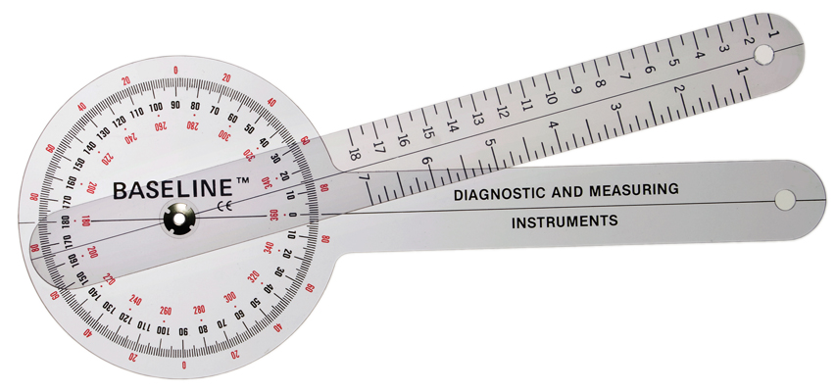
ROM MEASUREMENT
Still requires a human intervention
Goniometer
Requires high clinical experience from a therapist or doctor.
Cannot be used for ROM measurement in certain joints

Slide 10
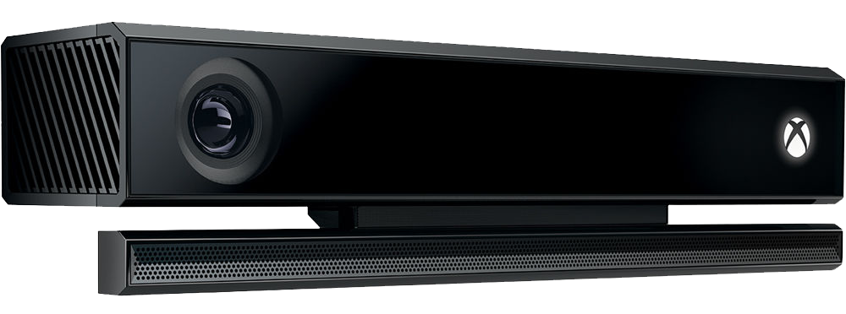
KINECT SENSORS
Vertical viewing angle of 430
Horizontal viewing angle of 570
Distance: 1.2 m to 4 m
Depth range: 400mm to 800mm

Slide 11











HOUGH TRANSFORM
$$y$$
A
an image processing technique that aims to recognize lines, circles, and even unusual shapes automatically
$$ρ=xcosθ+ysinθ$$
$$ρ$$
$$θ$$
C
The line ρ = xcosθ + ysinθ in the image space corresponds to ρ0,θ0 in the Hough space, and vice versa.
$$0$$
$$x$$
$$y$$
The point (x0, y0) in the image space corresponds to the sine curve in the Hough space.
$$ρ$$
N points on the line in the image space correspond to n curves in the Hough space
$$0$$
$$θ$$
$$x$$

Slide 12
System Design

Slide 13
Flow Diagram
Image Segmentation Using Thresholding Method
10 variations ​​
with intervals of 4º to 120º.
ROM values
Image Morphology Operations Using Thinning Method
140 cm
220 cm
Skeletal Tracking Detection Using Hough Transform
Distance
300 cm
Python programming
ROM Measurement

Slide 14
Result

Slide 15
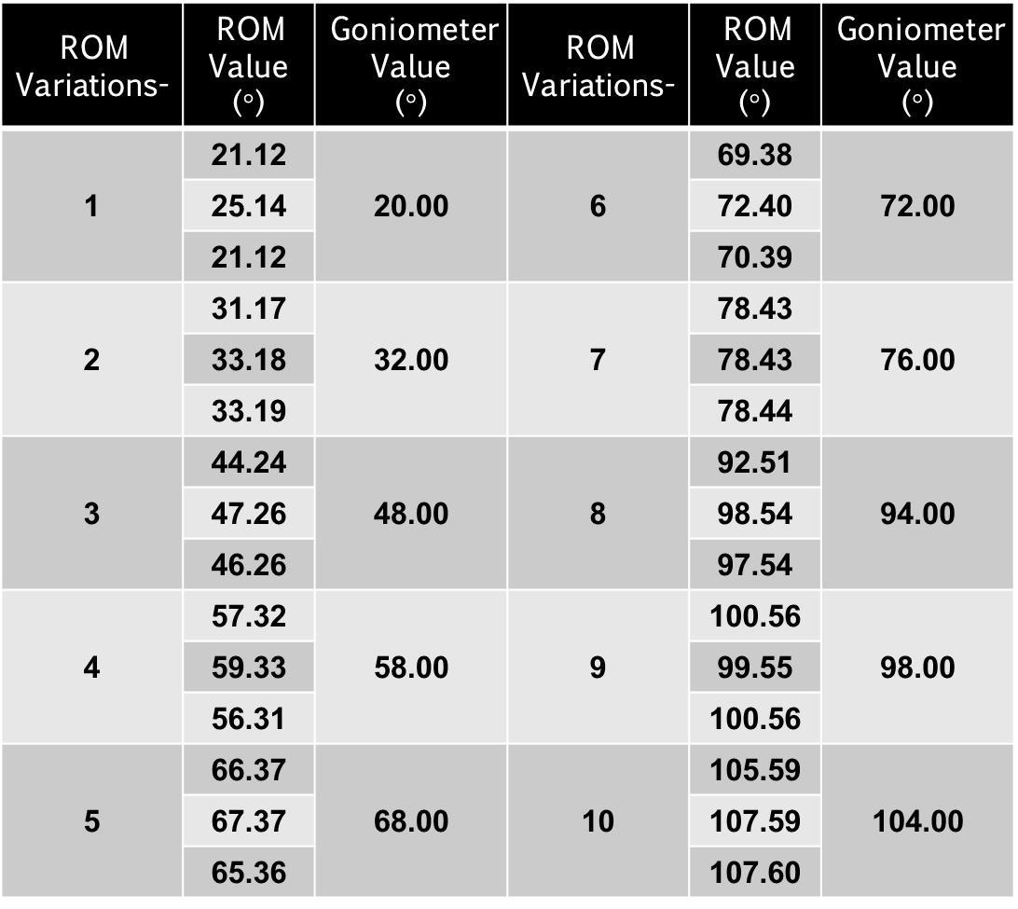
ROM Measurement
ROM Variations- | ROM Value ($°$) | Goniometer Value ($°$) | ROM Variations- | ROM Value ($°$) | Goniometer Value ($°$)
1 | 21.12 | 20.00 | 6 | 69.38 | 72.00
 | 25.14 |  |  | 72.40
 | 21.12 |  |  | 70.39
2 | 31.17 | 32.00 | 7 | 78.43 | 76.00
 | 33.18 |  |  | 78.43
 | 33.19 |  |  | 78.44
3 | 44.24 | 48.00 | 8 | 92.51 | 94.00
 | 47.26 |  |  | 98.54
 | 46.26 |  |  | 97.54
4 | 57.32 | 58.00 | 9 | 100.56 | 98.00
 | 59.33 |  |  | 99.55
 | 56.31 |  |  | 100.56
5 | 66.37 | 68.00 | 10 | 105.59 | 104.00
 | 67.37 |  |  | 107.59
 | 65.36 |  |  | 107.60
First distance
Second
distance
Third distance

Slide 16
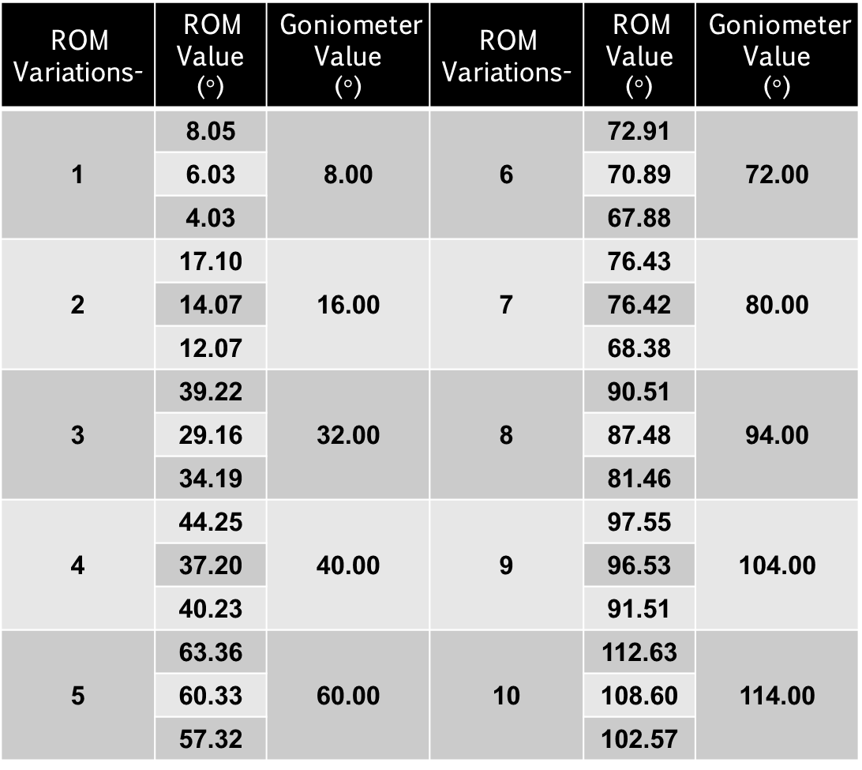
ROM Measurement
ROM Variations- | ROM Value ($°$) | Goniometer Value ($°$) | ROM Variations- | ROM Value ($°$) | Goniometer Value ($°$)
1 | 8.05 | 8.00 | 6 | 72.91 | 72.00
 | 6.03 |  |  | 70.89
 | 4.03 |  |  | 67.88
2 | 17.10 | 16.00 | 7 | 76.43 | 80.00
 | 14.07 |  |  | 76.42
 | 12.07 |  |  | 68.38
3 | 39.22 | 32.00 | 8 | 90.51 | 94.00
 | 29.16 |  |  | 87.48
 | 34.19 |  |  | 81.46
4 | 44.25 | 40.00 | 9 | 97.55 | 104.00
 | 37.20 |  |  | 96.53
 | 40.23 |  |  | 91.51
5 | 63.36 | 60.00 | 10 | 112.63 | 114.00
 | 60.33 |  |  | 108.60
 | 57.32 |  |  | 102.57
First distance
Second
distance
Third distance

Slide 17
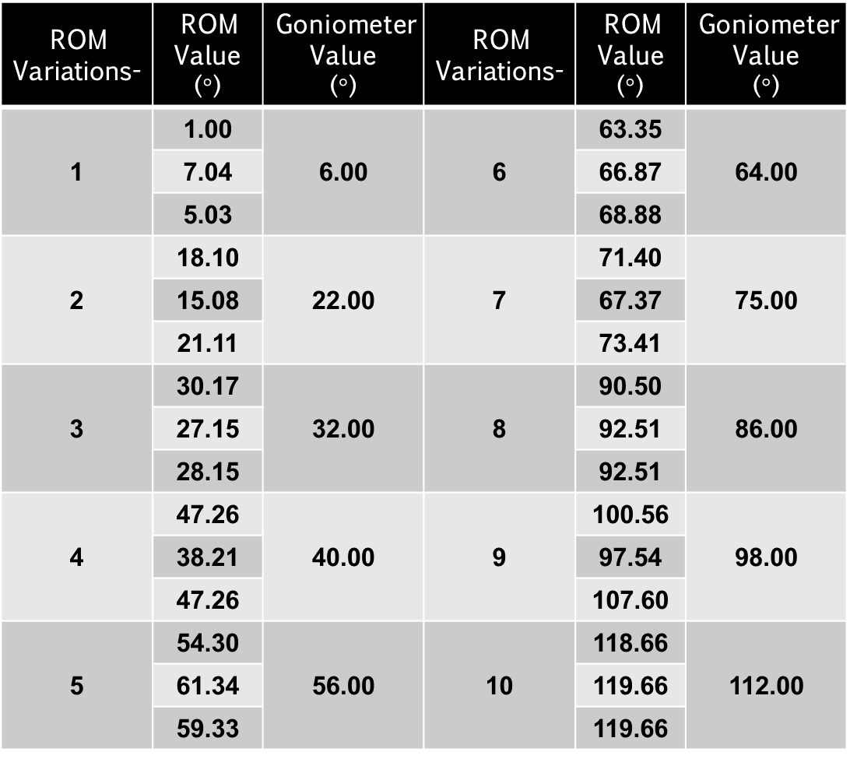
ROM Measurement
ROM Variations- | ROM Value ($°$) | Goniometer Value ($°$) | ROM Variations- | ROM Value ($°$) | Goniometer Value ($°$)
1 | 1.00 | 6.00 | 6 | 63.35 | 64.00
 | 7.04 |  |  | 66.87
 | 5.03 |  |  | 68.88
2 | 18.10 | 22.00 | 7 | 71.40 | 75.00
 | 15.08 |  |  | 67.37
 | 21.11 |  |  | 73.41
3 | 30.17 | 32.00 | 8 | 90.50 | 86.00
 | 27.15 |  |  | 92.51
 | 28.15 |  |  | 92.51
4 | 47.26 | 40.00 | 9 | 100.56 | 98.00
 | 38.21 |  |  | 97.54
 | 47.26 |  |  | 107.60
5 | 54.30 | 56.00 | 10 | 118.66 | 112.00
 | 61.34 |  |  | 119.66
 | 59.33 |  |  | 119.66
First distance
Second
distance
Third distance

Slide 18
LINEARITY
(Linear Regression)
First distance
Second
distance
Third distance

Slide 19
LINEARITY
(Linear Regression)
First distance
Second
distance
Third distance

Slide 20
LINEARITY
(Linear Regression)
First distance
Second
distance
Third distance

Slide 21
LINEARITY
(Linear Regression)
First distance
99.59%
Second
distance
Distance
linearity and correlation
99.46%
Third distance
99.27%

Slide 22
SENSITIVITY
First distance
97.38%
Second
distance
Distance
Sensitivity
92.28%
Third distance
91.68%

Slide 23
ACCURACY
PRECISION
GOOD
ACCURACY
GOOD
PRECISION

Slide 24
CONCLUTIONS
ROM measurement performance on Articulatio cubiti based on Hough Transformation
Distance | Linearity | Sensitivity | Accuracy | Precision
First-140 cm | 99.59% | 97.38% | 96.64% | 1.65%
Second-220 cm | 99.46% | 92.28% | 92.51% | 5.92%
Third-300 cm | 99.27% | 91.68% | 90.25% | 7.28%
BEST

Slide 25
CONCLUTIONS
ROM measurement using Hough transformation method based on Hough Transformation
Distance
Linearity
Sensitivity
Accuracy
Precision

Slide 26
THANK YOU

