Slide 1
Leveraging Data Analytics and Machine Learning to Predict Data Scientists Salaries
Tammi Hawa
1000311655

Slide 2
Exploratory Analysis
The location of respondents, level of education, as well as job title were all investigated because these seemed like the obvious reasons why salaries would vary.
FOUND: Most of the respondents were from the United State or India, had attained either a master’s or bachelors degree, and worked under the title of data scientist, software engineer, or data analyst (with a large number of respondents also being students).
Additionally, a correlation matrix was constructed to determine which features had a strong correlation to yearly compensation.
FOUND: age, years of experience, years writing code to analyze data, years use machine learning methods, and living in the USA, all had a noticeable positive correlation with yearly compensation ( >=0.2)

Slide 3
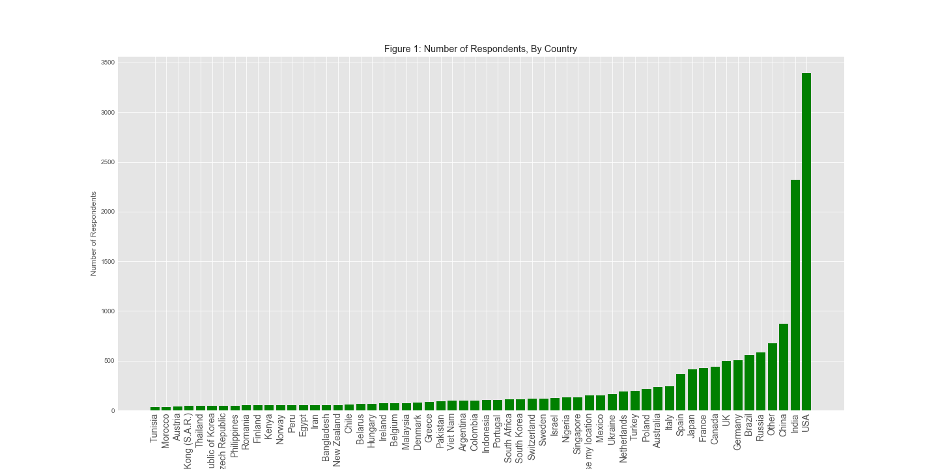
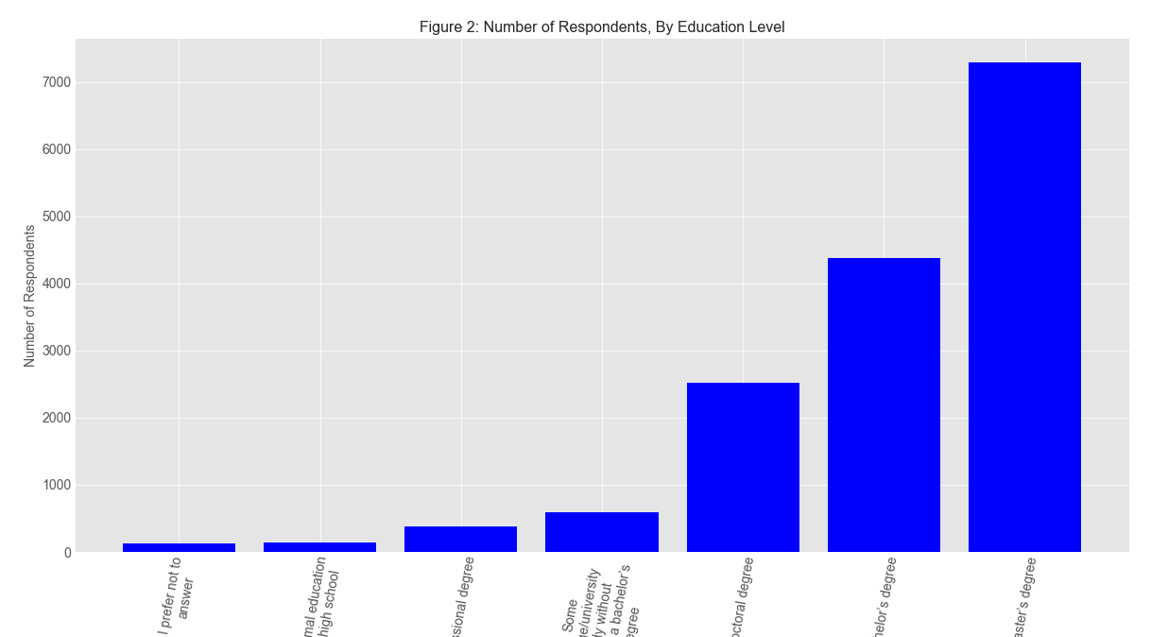
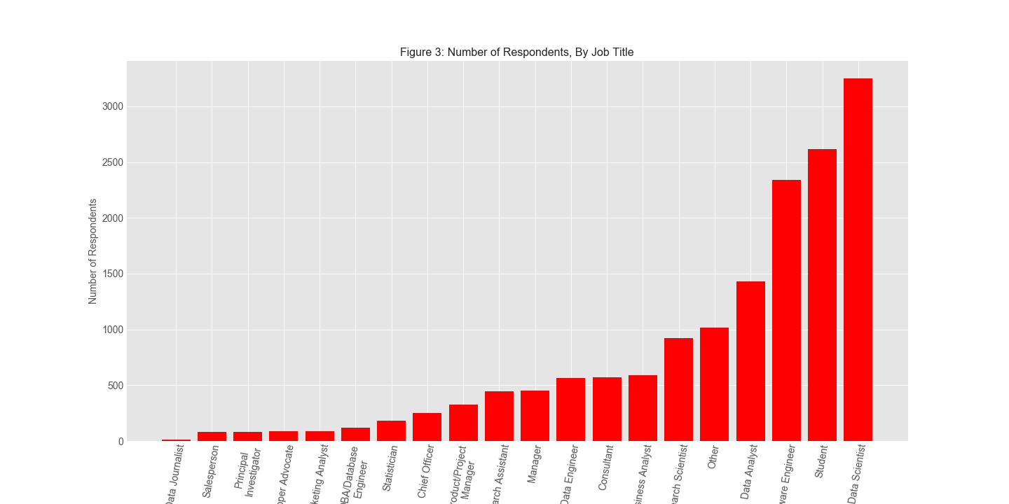
Exploratory Analysis - Graphs

Slide 4
Model Feature Importance
One-hot encoding was used to handle categorical features
Lasso Regression was used to determine which features in the models were significant. Coefficients with a value of 0 were discarded from the model.
Highly positive coefficients (represent a positive correlation with yearly income):
country_United States of America (58,351)
country_Switzerland (55,551)
Highly negative coefficients ( represent a negative correlation with yearly income)
Data_vis_library_Altair (-30,921)
language_Julia (-21,893)
Coefficients with value 0 (does not affect yearly income, removed)
country_Italy, data_type_Numerical Data, education_Master’s degree, industry_Marketing/CRM, language_R, major_A business discipline, Data_scientist?_Probably_yes

Slide 5
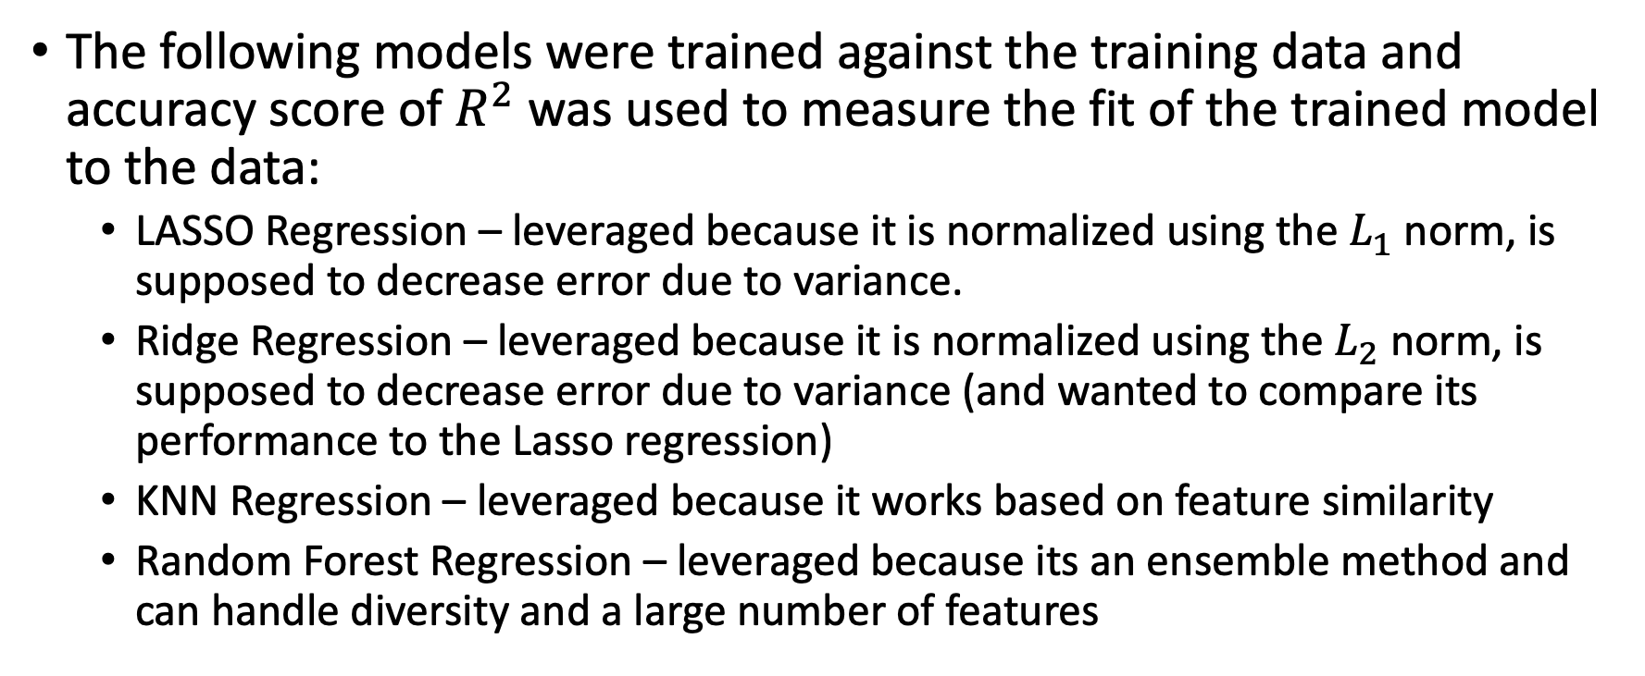
Models Used
The following models were trained against the training data and accuracy score of $R^{2}$was used to measure the fit of the trained model to the data:
LASSO Regression – leveraged because it is normalized using the $L_{1}$norm, is supposed to decrease error due to variance.
Ridge Regression – leveraged because it is normalized using the $L_{2}$norm, is supposed to decrease error due to variance (and wanted to compare its performance to the Lasso regression)
KNN Regression – leveraged because it works based on feature similarity
Random Forest Regression – leveraged because its an ensemble method and can handle diversity and a large number of features

Slide 6
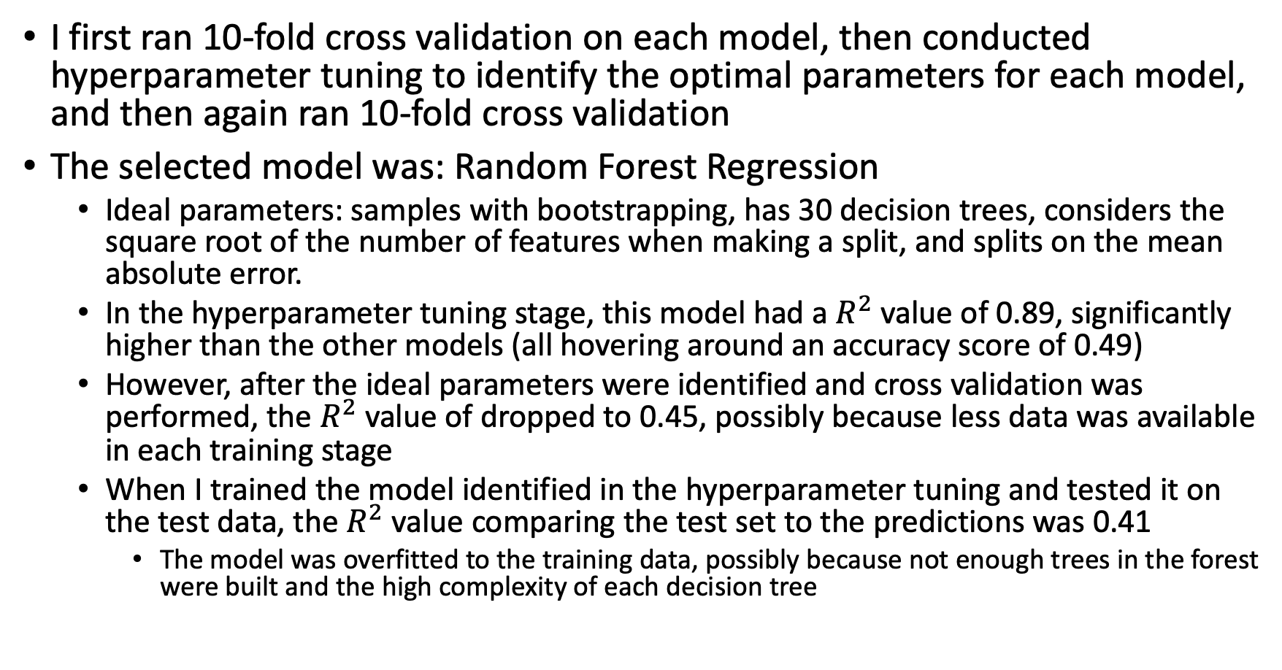
Model Results
I first ran 10-fold cross validation on each model, then conducted hyperparameter tuning to identify the optimal parameters for each model, and then again ran 10-fold cross validation
The selected model was: Random Forest Regression
Ideal parameters: samples with bootstrapping, has 30 decision trees, considers the square root of the number of features when making a split, and splits on the mean absolute error.
In the hyperparameter tuning stage, this model had a $R^{2}$value of 0.89, significantly higher than the other models (all hovering around an accuracy score of 0.49)
However, after the ideal parameters were identified and cross validation was performed, the $R^{2}$value of dropped to 0.45, possibly because less data was available in each training stage
When I trained the model identified in the hyperparameter tuning and tested it on the test data, the $R^{2}$ value comparing the test set to the predictions was 0.41
The model was overfitted to the training data, possibly because not enough trees in the forest were built and the high complexity of each decision tree

