Slide 1
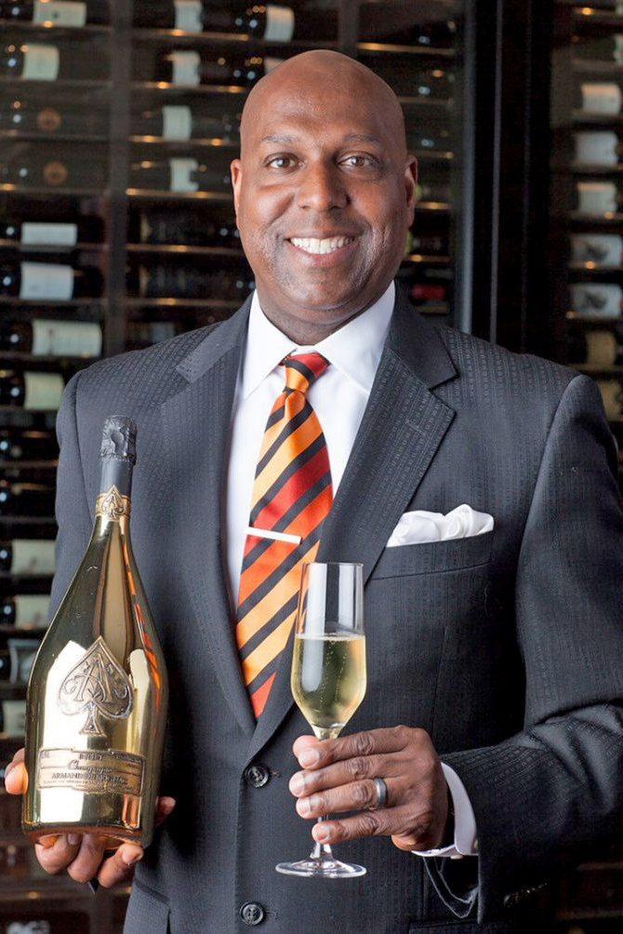
William Lewis
OWNER WINERY TUSTIN
William owns a restaurant with 3 locations, a menu of 650 wines (that change weekly) and a cellar that holds 7,500 bottles (at the main location, other locations are similar). They constantly need to select new wines for their menu. If a reliable model says x bottle costs them almost as much as people would expect to pay for it William probably does not want to add that wine to the menu. If the model suggests that a wine is under priced based on expectations, then they would want to promote it because they can sell glasses for a bigger markup than wines that are priced at or near expected price.

Slide 2
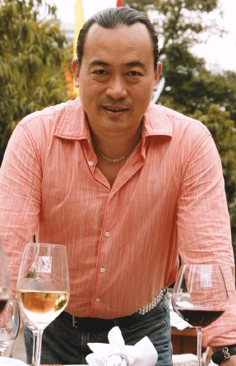
Michael Ma
WINE SPECULATOR, CHINA
Michael buys wine in large amounts as a commodity banking on the growing demand in China as a guaranteed path to high returns. If a reliable model predicts that a wine should cost $30 a bottle but is listed at $10 Michael might buy 10,000 bottles because when introduced into a new market prices can be set more in-line with the model's projections.
All other things being equal he likely would not invest in bottles that cost more than a model says they should cost.

