Slide 1
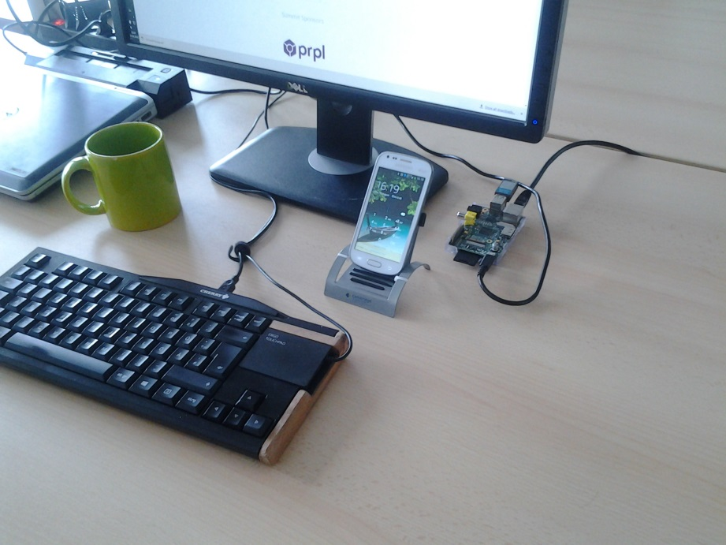
Emulate a Bluetooth Keyboard on a Raspberry Pi
Every keyboard can be a bluetooth keyboard
rdubois440@gmail.com
https://github.com/rdubois440/btkbdemu

Slide 2
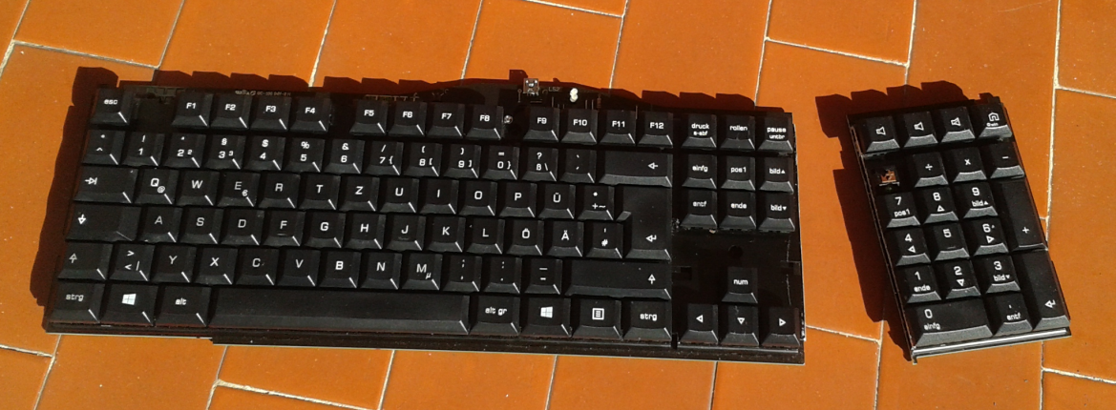
What is it good for
When I sit at my desk, I want to use my comfortable keyboard for everything I have to type
A single keyboard on my desk (and no mouse)
Easily switch from main computer to phone, to tablet…(Unlimited number)
Very convenient when the phone is charging

Slide 3

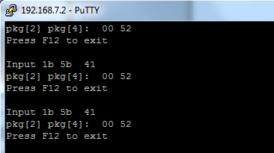
Equipment
Raspberry Pi connected to the network
Power Supply
SD Memory Card
Bluetooth Dongle
How to Use it?
telnet or ssh to the Raspberry PI
(One time pairing)
Run the program btkbdemu
Type …
F12 to terminate

Slide 4
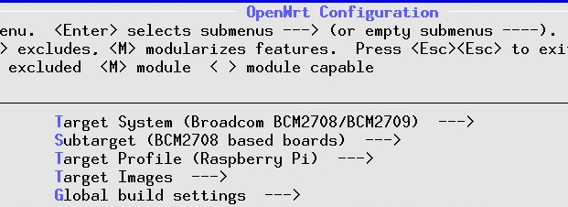
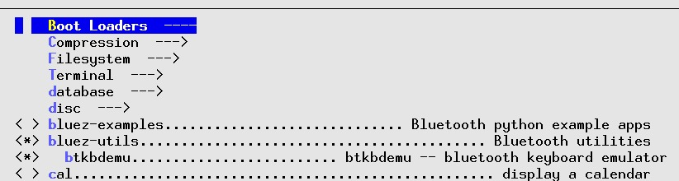
OpenWrt Configuration
Use Default OpenWrt for Raspberry Pi
Configure Bluetooth and dependencies
Create and enable the module btkbdemu

Slide 5
btkbdemu Program
Runs as a console program
Configured to emulate a bluetooth keyboard
Reads keystrokes from stdin, translates and passes to the bluetooth interface

Slide 6
Future Improvements
Some keyboard keys are captured by the desktop, and not available in btkbdemu (capture the keyboard and mouse like the virtual machines do)
Handle the mouse
Show the screen on the Desktop… Or just use VNC, but this is a different project
Beaglebone Black support on OpenWrt

Slide 7
Pairing
Start 2 windows on Raspi – First window create the sdp record with /root/rene/btkbdemu –s
- Second window – Check the sdp record sdptool browse local Browsing FF:FF:FF:00:00:00 ... Service Name: Collin's Fake Bluetooth Keyboard Service Description: http://www.mulliner.org/bluetooth
From the phone, scan for bt devices. Raspi should appear as a keyboard ! not a computer
On Raspi, start the pairing with bluez-simple-agent hci0 FC:19:10:FE:DE:9F RequestPinCode (/org/bluez/599/hci0/dev_FC_19_10_FE_DE_9F) Enter PIN Code:
Start the pairing form the device. Device will provide a pin. Enter the pin in the Raspi. Pairing process should succeed !
Enter PIN Code: 337080 Release New device (/org/bluez/599/hci0/dev_FC_19_10_FE_DE_9F)
Done !

Slide 8
More Information
https://github.com/rdubois440/btkbdemu
Credits
http://www.mulliner.org/bluetooth/xkbdbthid.php
http://www.linuxuser.co.uk/tutorials/emulate-a-bluetooth-keyboard-with-the-raspberry-pi
https://delog.wordpress.com/2014/10/29/bluetooth-on-raspberry-pi-with-buildroot/
https://hacks.pmf.io/2015/06/24/the-beaglebone-black-as-a-smart-kvm/

