Slide 1

Introduction to JavaScript
Full stack Skills Bootcamp

Slide 2
What is JavaScript?
Lesson Overview:
In this lesson, we will be introduced to:
JavaScript installation
The Browser Console
Variables and concatenation
Expressions and Conditions
Functions and Arguments

Slide 3
Introduction to JavaScript
What is JavaScript?
JavaScript is a programming language that allows you to create interactive and dynamic content on web pages.
It’s used for handling user interactions, manipulating content, and building complex applications.
Why Learn JavaScript?
JavaScript is essential for front-end web development.
Works alongside HTML and CSS.

Slide 4
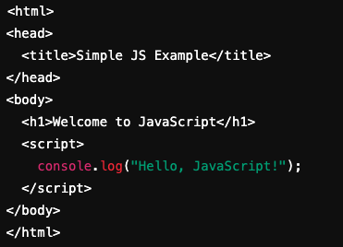
Including JavaScript in a Web Page
Where to Place JavaScript Inside <script> tags in the HTML file. You can also link to an external .js file using the <script src="..."></script> tag.
Example:

Slide 5

Variables and Data Types
What is a Variable? A way to store and manage data in JavaScript. Variables can be declared using var, let, or const.
Data Types in JavaScript: Number: Represents numeric values (e.g., 10, 3.14). String: Represents text enclosed in quotes (e.g., "Hello", 'World’). Boolean: Represents true/false values (e.g., true, false).

Slide 6

Console and Console.log
What is the Console? A tool in web browsers for debugging and testing JavaScript code.
Using console.log() Outputs information to the browser console for debugging. Use it to display variable values, results, or messages during development.
How to Access the Console: Right-click on the webpage → Inspect → Console tab (in browsers like Chrome or Firefox).

Slide 7

Basic Concatenation
String Concatenation:
Combining two or more strings using the + operator.
Example: demo…

Slide 8
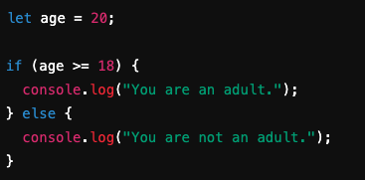
Expressions and Conditions
Expressions:
Any valid unit of code that resolves to a value.
Examples: 5 + 3, name === "Alice"
Comparison Operators:
>, <, ==, ===, !=, etc.
Conditions with if/else:
Use conditions to execute code based on different situations.

Slide 9
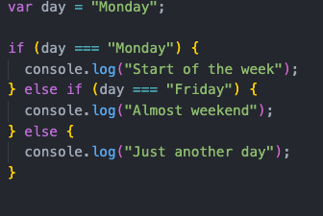
Handling Multiple Conditions with if/else
Multiple Conditions:
You can use multiple if/else if statements to handle different cases.
Example:
If the first condition is met, the first block runs.
If not, the code checks the next else if.
If no conditions are true, the else block runs by default. Demo…

Slide 10
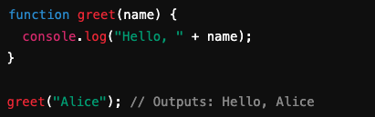
Simple Functions
What is a Function? A block of code designed to perform a specific task.
Defining and Calling a Function: A function is defined using the function keyword, followed by a name, parameters, and code block.

Slide 11
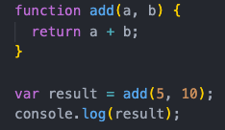
Passing Arguments to Functions
What are Arguments? Inputs passed into a function when calling it.
Function Parameters: A function can take one or more parameters to operate on.

Slide 12
Passing Arguments to Functions
What are returns? A function can optionally return a value Demo…

Slide 13
Conclusion
The Console: Allows us to see output from the JavaScript routine
Variables: Store data in memory
Expressions and conditions: Can be used to test and determine the program flow
Functions Can be used to break down functionality in to smaller reusable routines
1. JavaScript Variables (MDN Web Docs): https://developer.mozilla.org/en-US/docs/Web/JavaScript/Guide/Grammar_and_types#declarations
2. JavaScript Concatenation (w3schools): https://www.w3schools.com/js/js_string_methods.asp
3. JavaScript Expressions and Conditions: https://javascript.info/ifelse
4. JavaScript Functions (MDN Web Docs): https://developer.mozilla.org/en-US/docs/Web/JavaScript/Guide/Functions

Slide 14
Questions?

