Slide 1

Using React Context
Full stack Skills Bootcamp

Slide 2
Simplifying State Management in React
Lesson Overview:
In this lesson, we will be introduced to:
What is React Context
Real World examples
Context Providers
Context Consumers

Slide 3
Introduction to React Context
What is React Context? A mechanism for sharing values across the component tree without passing props manually at every level.
Core Features:
Provides a global state that can be accessed by any component.
Reduces prop drilling.
Introduced in React 16.3 and improved over time.

Slide 4


Installation
React Context is built into React no additional library is required. 1: Import createContext
2: Create a Context object

Slide 5
What Problem Does React Context Solve?
The Problem:
Prop drilling makes passing data cumbersome and error-prone, especially with deeply nested components.
The Solution:
React Context allows data to be available anywhere in the component tree without manual prop passing.

Slide 6
Real-World Use Cases
Theme Management: Dynamically switch between light and dark themes.
User Authentication: Share user details and authentication status across the app.
Language Translation: Provide localized strings globally.
State Sharing: Share app-wide settings or data, like cart items in an e-commerce app.

Slide 7


Creating Providers
What is a Provider? A component that supplies the Context value to its children.
Steps to Create a Provider:
Create Context: Wrap components with MyContext.Provider

Slide 8
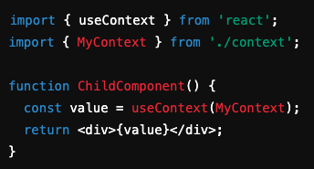
Using Providers
Access the provided value using hooks:
Benefits:
Cleaner syntax with useContext.
Avoids manually subscribing to updates.

Slide 9
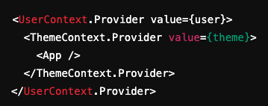

Use of Multiple Contexts/Providers
Why Use Multiple Contexts?
Separate concerns, e.g., UserContext for user info and ThemeContext for themes.
Implementation Example: Access values separately in components:

Slide 10

Creating and Using Consumers
What is a Consumer? A component that subscribes to a Context and receives its value.
Example with a Consumer:
When to Use Consumers Over useContext:
When working with class components.

Slide 11
Conclusion
React Context simplifies state management.
Avoids prop drilling for better readability.
Scales well with multiple contexts for modular state handling.

Slide 12
Next Steps
Experiment with custom hooks for context.
Combine with state libraries like Redux or Zustand for larger apps.

Slide 13
Questions?

