Slide 1

Rendering and Deployment with React
Full stack Skills Bootcamp

Slide 2
APIs, Conditional Rendering, Layouts, and Deployment
Lesson Overview:
In this lesson, we will be introduced to:
Using 3rd party APIs with React
Conditional Rendering
App Layouts
Deployment with render.com

Slide 3
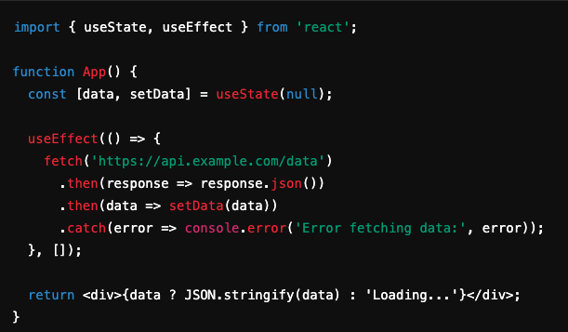
Using 3rd Party APIs in React with fetch
What is fetch? A JavaScript function for making HTTP requests to APIs.
useEffect used to fetch data after the component mounts.
Data is stored in state and displayed in the component. Demo…

Slide 4


Conditional Rendering in React
What is Conditional Rendering? A technique to render elements or components based on certain conditions.
Common Patterns: Ternary Operator: Logical AND (&&):

Slide 5
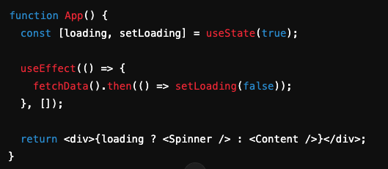
Conditional Rendering in React
Render loading spinner until data is loaded: demo…

Slide 6
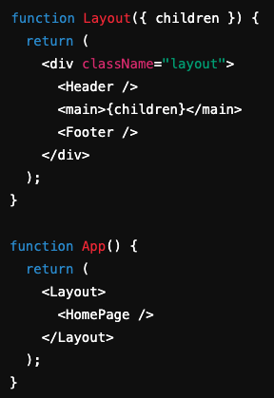
App Layouts Using props.children
What is props.children? A special prop in React that allows components to render their children elements.
Creating a Layout Component: Define a reusable layout that wraps content passed as children.
Use Cases:
Wrapping multiple pages with a consistent header/footer structure.
Creating reusable components that serve as "wrappers" for various sections of the app. Demo…

Slide 7

Deployment Using Render.com
Why render.com? Render.com is a platform that simplifies deploying web applications, including React apps.
Provides automatic deployment, scaling, and HTTPS out of the box.

Slide 8
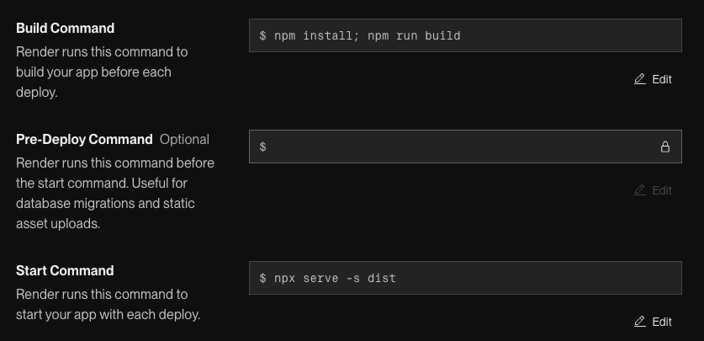
Deployment Using Render.com
Steps to Deploy a React App:Step 1: Set up your React app and push it to a Git repository (GitHub or GitLab).
Step 2: Sign up on Render.com and create a new web service.
Step 3: Connect your repository and configure the build settings:
Build Command: npm install && npm run build
Start Command: serve -s build (assuming you’re using serve to serve the static files)
Step 4: Deploy and monitor the logs to confirm successful deployment.

Slide 9
Conclusion
Using APIs:Fetch and display data from third-party APIs with fetch and useEffect.
Conditional Rendering:Techniques to render components based on conditions, enhancing user experience.
Layouts with props.children:Efficiently structure apps by passing child components into layout wrappers.
Deployment:Render.com simplifies deploying and managing React apps in production.

Slide 10
Questions?

