Slide 1

Using React Router
Full stack Skills Bootcamp

Slide 2
Mastering Navigation in React Applications
Lesson Overview:
In this lesson, we will be introduced to:
What is React Router
Installation
Passing URL parameters
Using Query String paramaters

Slide 3
What is React Router?
Why Use It? Facilitates seamless navigation between views or components.
Maintains application state across navigation.
Enables deep linking and client-side routing.

Slide 4
What is React Router?
Core Features: Declarative routing.
Nested and dynamic routes.
Code-splitting for performance.

Slide 5

Installation
Open your project directory in the terminal. Run the command: Import React Router components in your application

Slide 6
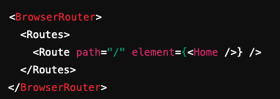
Types of Routing
Uses the HTML5 history API.

Slide 7
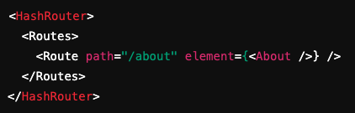
Types of Routing
HashRouter
Uses URL hash for routing.

Slide 8
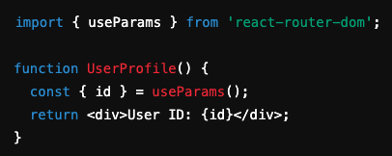
Passing URL Parameters
Dynamic paths to pass parameters:
Access parameters using useParams hook:

Slide 9
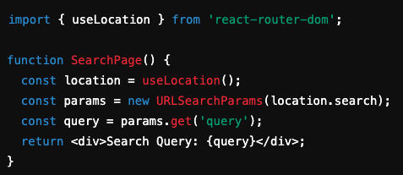
Using Query String Parameters
Query strings allow passing optional parameters in the URL. Example: http://example.com/search?query=react
Access query parameters using useLocation and URLSearchParams:

Slide 10
Conclusion
Key Takeaways:
React Router simplifies client-side routing.
Supports dynamic routing with URL and query string parameters.
Enhances user experience with declarative, efficient navigation.

Slide 11
Conclusion
Next Steps:
Experiment with nested routes.
Explore route protection using useNavigate.
Combine with state management libraries like Redux.

Slide 12
Questions?

