Slide 1

React Style and State
Full stack Skills Bootcamp

Slide 2
Understanding Styling, Assets, and State in React
Lesson Overview:
In this lesson, we will be introduced to:
Methods of applying style in React
Using images and other assets
React Hooks, useEffect and useState

Slide 3
Different Ways of Applying Style in React
Inline Styles: Defined directly in JSX elements as an object.
Pros: Quick for small, dynamic styles.
Cons: Difficult to manage for larger, complex styles.

Slide 4

Different Ways of Applying Style in React
CSS Stylesheets: Traditional CSS files imported into the component.
Pros: Familiar and simple to maintain.
Cons: Styles are globally scoped by default.

Slide 5

Different Ways of Applying Style in React
CSS Modules: CSS files that are locally scoped to components (e.g., App.module.css).
Pros: Avoids global scope conflicts.
Cons: Requires additional setup and syntax.

Slide 6

Different Ways of Applying Style in React
Styled Components: Styled-components library for writing CSS-in-JS.
Pros: Dynamic and component-scoped styling.
Cons: Increases bundle size and adds complexity. Demo…

Slide 7


Importing Images and Assets
Importing Images: Import images directly in JavaScript
Using public Folder: Place assets in the public folder and reference them
When to Use Which:
src Imports: Best for component-specific images.
public Folder: Use for images needed globally across the app.
Adding Other Assets: Fonts, icons, and external resources can be imported similarly or linked in index.html.
Demo…

Slide 8
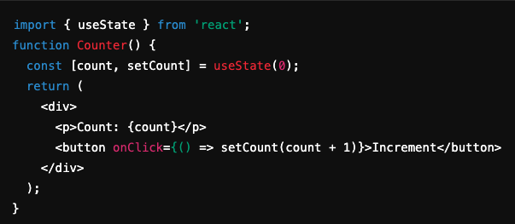
React Hooks: useState
What is useState? A React Hook for adding state to functional components.
Using useState: useState returns a state variable and a function to update it. Allows reactivity, updating the UI when state changes.

Slide 9
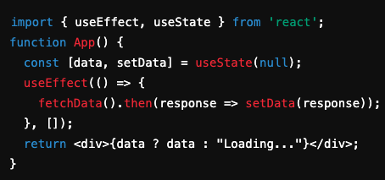
React Hooks: useEffect
What is useEffect? A hook for performing side effects in functional components, such as fetching data, setting up subscriptions, or manually updating the DOM.
Using useEffect: The second argument, [], is a dependency array. When empty, the effect runs only once after the initial render. Effects can be re-run when dependencies in the array change.

Slide 10
Conclusion
Styling Options:
Inline, CSS Stylesheets, CSS Modules, Styled Components.
Assets:
How to import images and assets, and when to use src vs. public folder.
State and Side Effects:
useState for managing component state.
useEffect for side effects and data fetching.

Slide 11
Questions?

