Slide 1

Step8Up Knowledge Base Support and Development
Full stack Skills Bootcamp

Slide 2
Online Knowledge Base Platform
Lesson Overview:
In this lesson, we will be introduced to:
Introduction to the Challenge
Key Learnings
Project Requirements
Team Structure
Acceptance Criteria

Slide 3
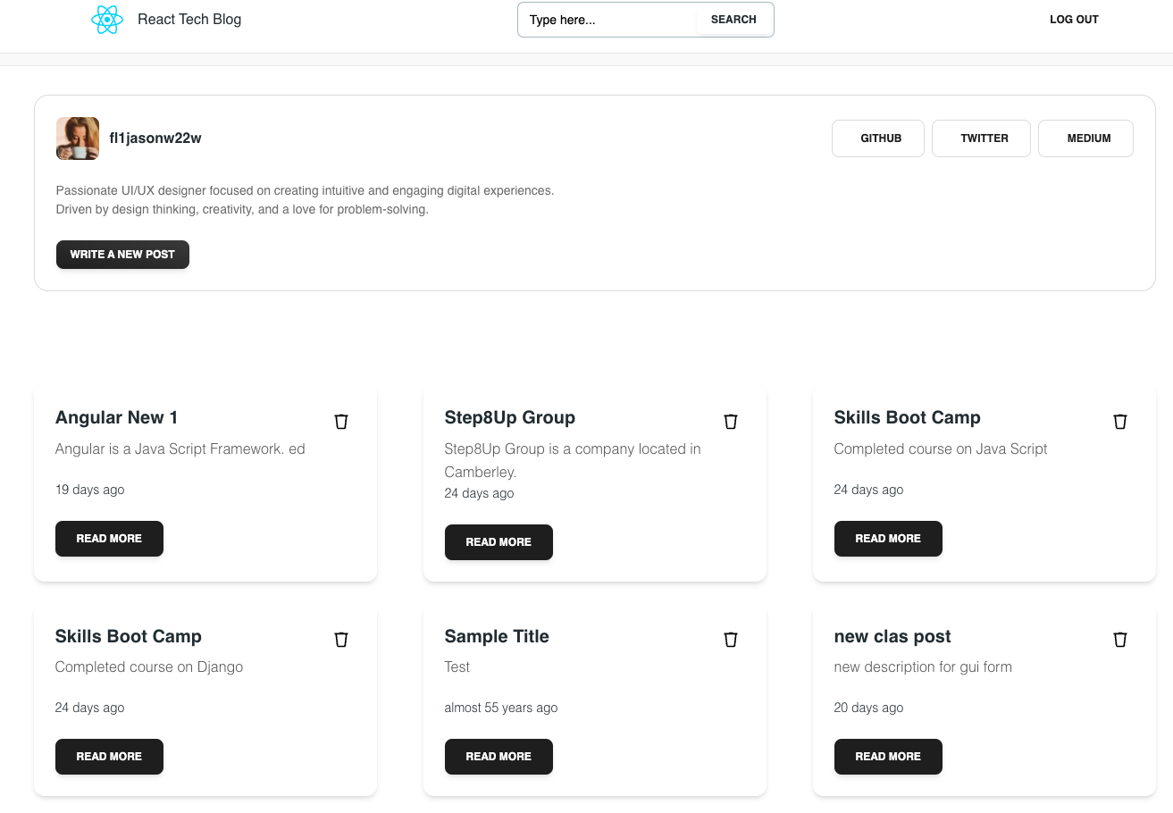
Introduction to the Challenge
Purpose: A platform for managing and sharing technical articles securely.
Frontend: Built using React (Vite framework) for a dynamic user experience.
Backend: Powered by Django, offering a secure and scalable API for data handling.
Goal: Enhance functionality and fix issues to create a robust knowledge-sharing tool.

Slide 4

Installation
Clone the Repository

Slide 5

Setting up: Front end
Navigate to frontend folder. Install dependencies and start the Vite development server:
Copy code

Slide 6
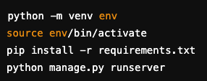
Setting up: BACK end
Navigate to backend folder.
Create a Python virtual environment, install dependencies, run migrations and start the Django server:

Slide 7
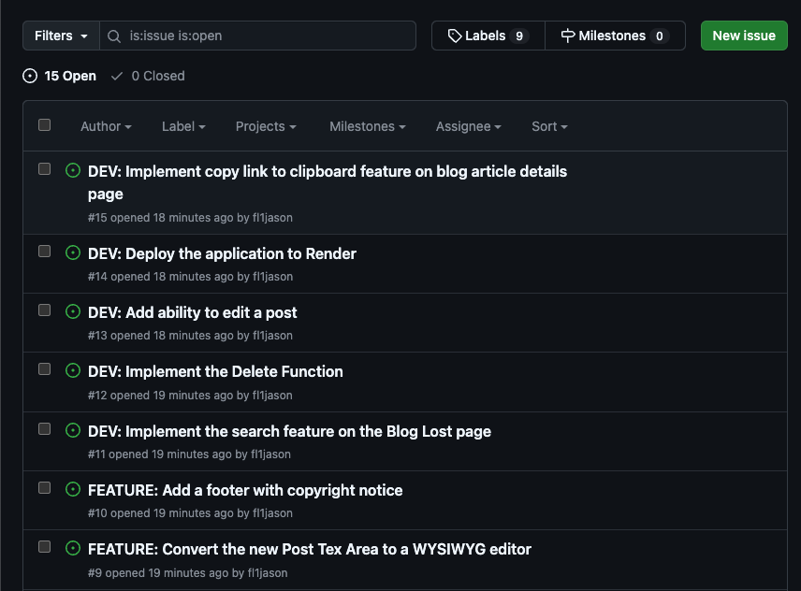
What Are GitHub Issues?
Definition: GitHub Issues are tools for tracking tasks, enhancements, and bugs in a project repository.
Features:
Assign issues to team members.
Add labels for categorization (e.g., bug, feature request, enhancement).
Include detailed descriptions, screenshots, or steps to reproduce.
Use Case: In Step8Up, GitHub Issues define tasks like fixing bugs, adding features, or improving the platform.

Slide 8
GitHub Pull Requests (PRs)
Definition: Pull Requests are a way to propose changes to the main codebase.
Workflow:
Create a branch for your work.
Commit changes and push to your fork or branch.
Open a Pull Request to merge changes into the main branch.
Collaborators review, discuss, and approve your PR.
Benefits:
Facilitates collaboration.
Tracks changes with detailed commit history.
Ensures code quality through reviews.

Slide 9
Current Developments vs. Bug Fixes and Feature Requests
Current Developments: Focus on enhancing the core functionality of the Step8Up Knowledge Base.
Bug Fixes: Resolve reported issues that hinder the application from functioning as expected.
Feature Requests: Add new capabilities to the platform, such as:
Improved user authentication.
Enhanced article tagging system.

Slide 10
Updating Progress Using GitHub Issues
Workflow:
Assign Yourself: Select an open issue and assign it to yourself.
Communicate Progress: Use comments to provide updates or ask for clarification.
Close the Issue: After completing the task and merging the related Pull Request, mark the issue as resolved.
Keep the Team Updated: Ensure transparency by tagging team members and summarizing changes in the issue thread.

Slide 11
Team Structure
Team Size: 3 members
Time Limit: 3 hours
Presentation: Showcase your app to the group, explaining your process and contributions.

Slide 12

Let’s Build Together!
Collaborate: Work as a team to enhance and support the Step8Up Knowledge Base.
Communicate: Use GitHub Issues and Pull Requests to streamline the development process.
Contribute: Learn and grow as you tackle real-world project challenges.
Let’s make Step8Up the go-to platform for technical knowledge sharing! 🎉

Slide 13
Questions?

