Slide 1

API CRUD and React
Full stack Skills Bootcamp

Slide 2
CRUD API Operations with React
Lesson Overview:
In this lesson, we will be introduced to:
Basics of CRUD operations.
Understanding REST APIs.
Tools like Postman and Swagger.
Implementing API calls in a React application.

Slide 3
What is CRUD?
Definition: CRUD stands for:Create
Read
Update
Delete
Purpose: CRUD represents the fundamental operations for interacting with data in applications.

Slide 4
What is a REST API?
Definition: REST (Representational State Transfer) is an architecture for building APIs that interact over HTTP.
Key Features:
Stateless: No session tracking.
Resource-oriented: Access data using endpoints.
Supports multiple formats: JSON, XML, etc.
Example:
Endpoint: GET /users retrieves a list of users.

Slide 5
Testing REST API Operations with Postman
What is Postman?: A tool for testing and interacting with APIs.
Common Operations:
POST: Add new data to the server.
GET: Fetch data from an API.
PUT: Modify existing data.
DELETE: Remove data from the server.

Slide 6
Testing REST API Operations with Postman
Steps to Test:
Add an endpoint.
Provide required data (if any).
Choose the HTTP method.
Click "Send" and check the response.

Slide 7
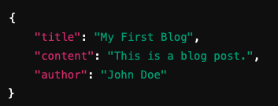
Creating JSON within a Postman Request
Why JSON?:
It is lightweight, human-readable, and widely used in APIs.
Example of JSON for a POST request:

Slide 8

Creating JSON within a Postman Request
How to Add JSON in Postman:Choose the POST method.
Go to the Body tab.
Select raw and choose JSON as the format.
Enter your JSON data.

Slide 9
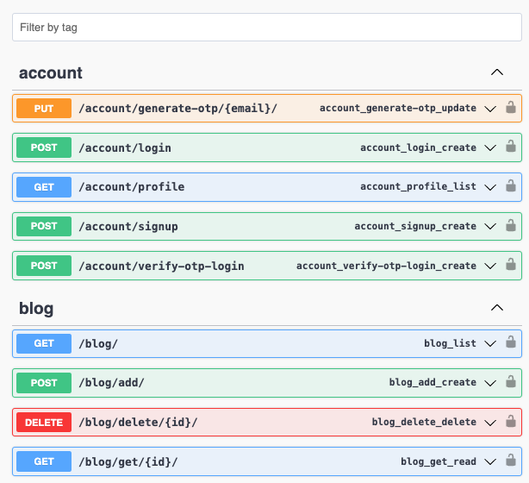
Using Swagger to Examine REST Endpoints
What is Swagger?: An API documentation tool that provides:Interactive UI to explore and test endpoints.
Descriptions of endpoints and their expected inputs/outputs.
Steps to Use Swagger: Open Swagger documentation (e.g., http://127.0.0.1:8000/).
Look for available endpoints (e.g., GET /users).
Test endpoints directly within Swagger’s interface.

Slide 10
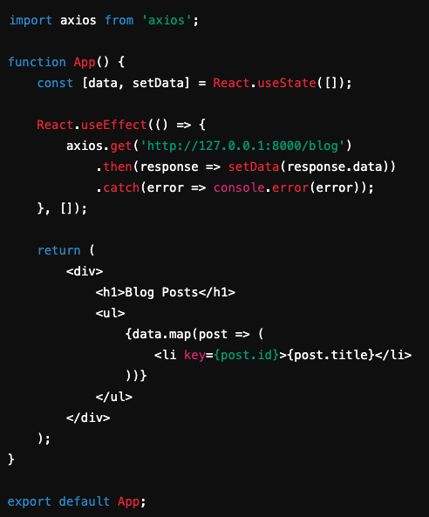
Implementing REST API Calls in React
Tools: Use axios or the Fetch API for HTTP requests.
Example: Fetching data from an API in React:

Slide 11
Conclusion
Key Takeaways: CRUD operations are fundamental to API interactions.
REST APIs and tools like Postman and Swagger simplify development and testing.
React seamlessly integrates API calls for dynamic applications.
Next Steps: Implement these concepts in your own projects!

Slide 12
Questions?

