Slide 1
Little Darcy Drop Tables
Do his titles ever make sense?

Slide 2
The Plan
Write,
Hack,
Protect,
Discuss!

Slide 3


Write
from StachOverflow
Who has written JavaScript?
It comes out all messy – I want my JS to be fancy!
What can we use?
copied and pasted

Slide 4
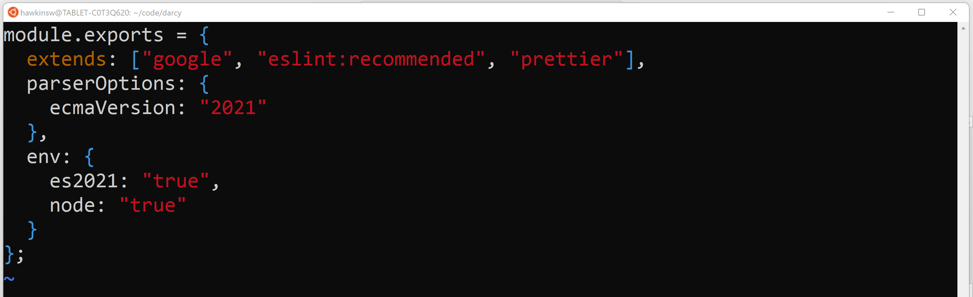
ESLint e.g.

Slide 5
Darcy
Our tool will let us …
Add configuration rules
Generate the configuration
Reset all the rules

Slide 6





Architecture
Server by Creative Mania from NounProject.com
Computer by Midev from NounProject.com

Slide 7
Databases and SQL
Relational databases are manipulated/queried using SQL, the structured query language.
darcy
eslint
Database
Tables
key: string
value: string

Slide 8

Darcy Database Dramatization
insert into eslint (key, value) values(
‘extends’,
‘[“google”, “eslint:recommended”]’;
eslint
key
value
extends
[“google”…

Slide 9
Darcy Database Dramatization
select * from eslint;
eslint
key
value
extends
[“google”…
camelCase
{“prope…

Slide 10
Darcy Database Dramatization
delete from eslint;
eslint
key
value
extends
[“google”…
camelCase
{“prope…

Slide 11
Databases and SQL
Comments are anything after --
Statements are separated by ;

Slide 12
You’re Looking Live …
$ sqlite3 darcy.db
client program
database storage

Slide 13
Express
url
A “router”
url
function h() {
…
}
function i() {
…
}

Slide 14
Enough With The Slides

Slide 15

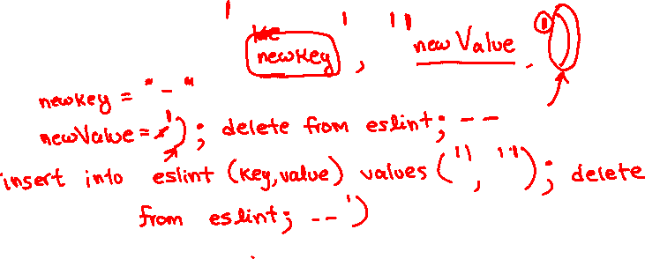
Let’s Make Some Problems

Slide 16

What Did We Learn?

