Slide 1
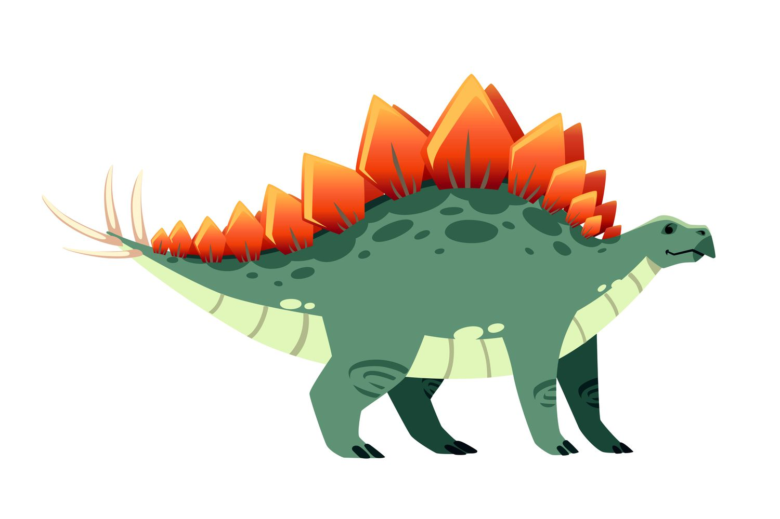
Stenago, The Stenography Stegosaurus
Hidden in plain sight!

Slide 2

Wait, what?!
We are going to hide one image inside another!
And then we are going to pull the hidden image back out!
But, why??

Slide 3
Roy G. Biv
We represent every color as a combination of three (additive) primary colors!

Slide 4
Can You Tell The Difference?

Slide 5
A Grayscale Image
What if we don’t need color?
HI!
Pixel??
Each pixel is either black or white!

Slide 6
Can You Tell The Difference?
Red: 180, Green: 57, 102
Red: 181, Green: 57, 102
Even values of Red represent Black pixels in the hidden image!
Odd values of Red represent White pixels in the hidden image!

Slide 7
Let’s Do It!
Code available:
https://github.com/hawkinsw/stenosaurus

