Slide 1
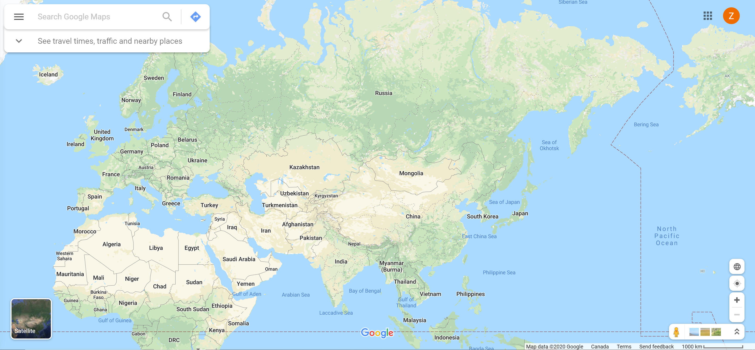
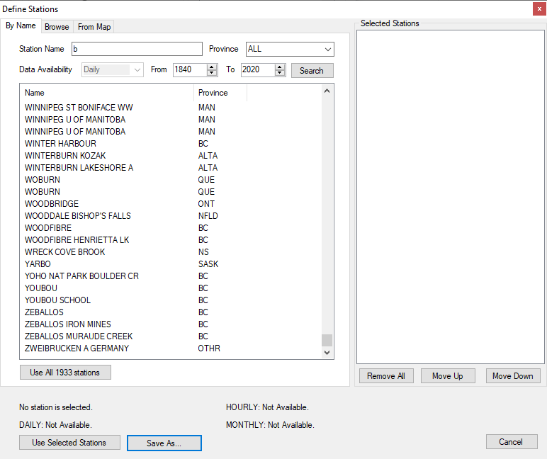
Logo
Search by station name, country name, province name
Upload
Draw
Sign in
Station Name
Country Name
Province Name
8
City Name
1990
to
Availability
Hourly
2000
Data Source
Environment Canada
Search
6
2
5

Slide 2
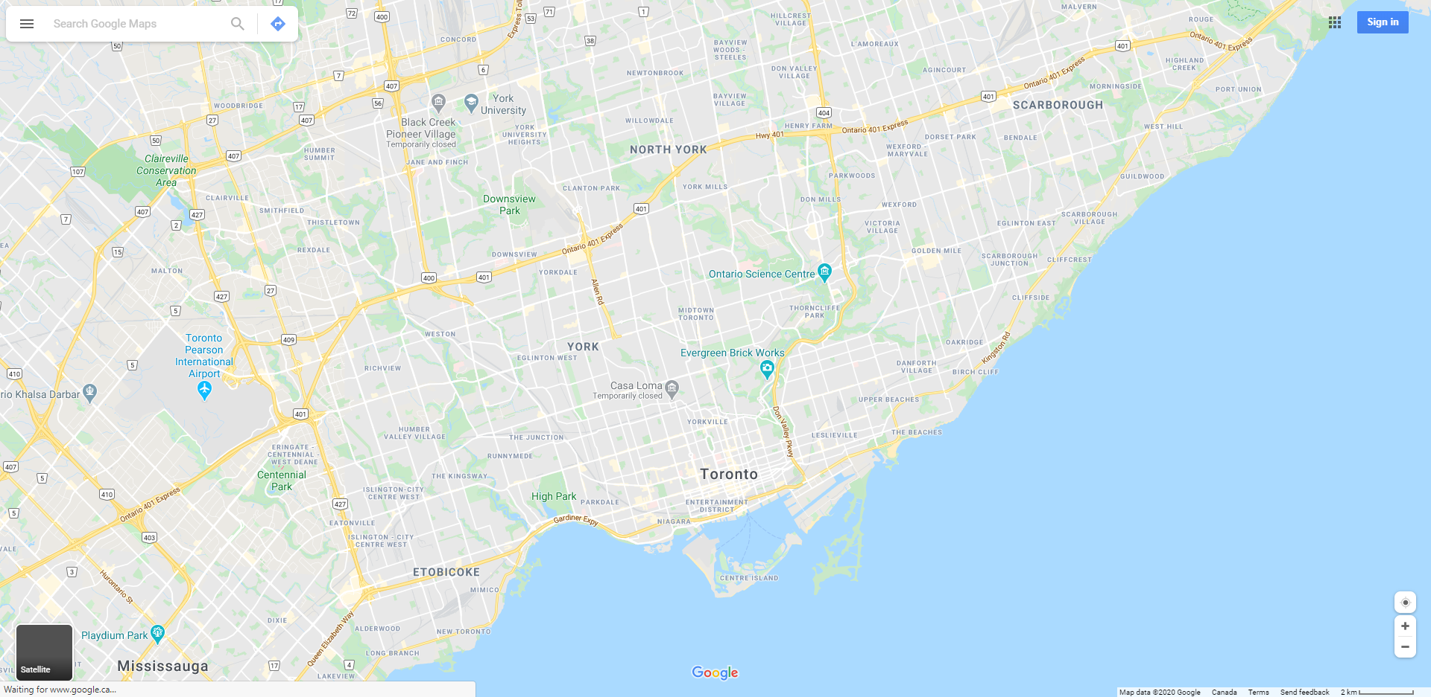


Logo
Toronto
Upload
Draw
Sign in
Stations
Download
Name | Avg Annual Volume | Gap
Toronto 1 | 800 | Y
Toronto 2 | 700 | Y
Toronto 3 | 750 | N
Toronto 4 | 700 | Y
Toronto 5 | 600 | N
Toronto 6 | 650 | Y
2
Add to list
Toronto 1
boundary
Elevation: 100 m
Hourly : Not available
Daily : 2008 to 2020, has gap
Monthly : 2008 to 2020, has gap
Save both boundary and results to a list. Need login
Save
2
Use different icon for the one with gaps
5
Chart
Statistics (min, max, total, etc.)

Slide 3
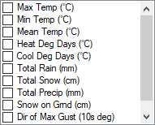
Logo
Toronto
Upload
Draw
Sign in
Stations
Download
Interval
Hourly
Range
1) Keep; 2) Fill with nearby stations with user defined search range and # of stations
Gap
Keep
2
Model
SWAT
Toronto 1
Format
dbf
boundary
Elevation: 100 m
Values
Hourly : Not available
Daily : 2008 to 2020, has gap
Monthly : 2008 to 2020, has gap
2
Emails:
**@gmail.com
Use different icon for the one with gaps
5
Start Download
Chart
Statistics (min, max, total, etc.)

Slide 4

Logo
Toronto
Upload
Draw
Michael Yu
Stations
Download
My profile
After signing
My list
Interval
Hourly
My downloads
Range
Download preference
Gap
Keep
2
Sign out
Model
SWAT
Format
dbf
Values
2
Emails:
**@gmail.com
5
Start Download
Chart
Statistics (min, max, total, etc.)

Slide 5
Logo
Toronto
Upload
Draw
Michael Yu
Stations
Download
My List
My downloads
Interval
Hourly
Name | # of Stations
List 1 | 10
List 2 | 20
Toronto 3 | 5
Range
open
Gap
Keep
2
Model
SWAT
open
Format
dbf
open
Values
Show all stations on map
2
Emails:
**@gmail.com
5
Start Download
Chart
Statistics (min, max, total, etc.)

Slide 6

Logo
Toronto
Upload
Draw
Michael Yu
Stations
Download
My List
My downloads
Interval
Hourly
List | Date
List 1 | May 2, 2020
List 2 | May 2, 2020
Unsaved | May 2, 2020
Range
Gap
Keep
2
Model
SWAT
Format
dbf
Values
Download Preference
Pop-up to specify preference including gap, model and format
2
Emails:
**@gmail.com
5
Start Download
Chart
Statistics (min, max, total, etc.)

