Slide 1
Species Distribution Models Using MaxEnt
Bats of The Pacific Northwest

Slide 2
Data Acquisition and Preparation
Environmental Covariates

Slide 3
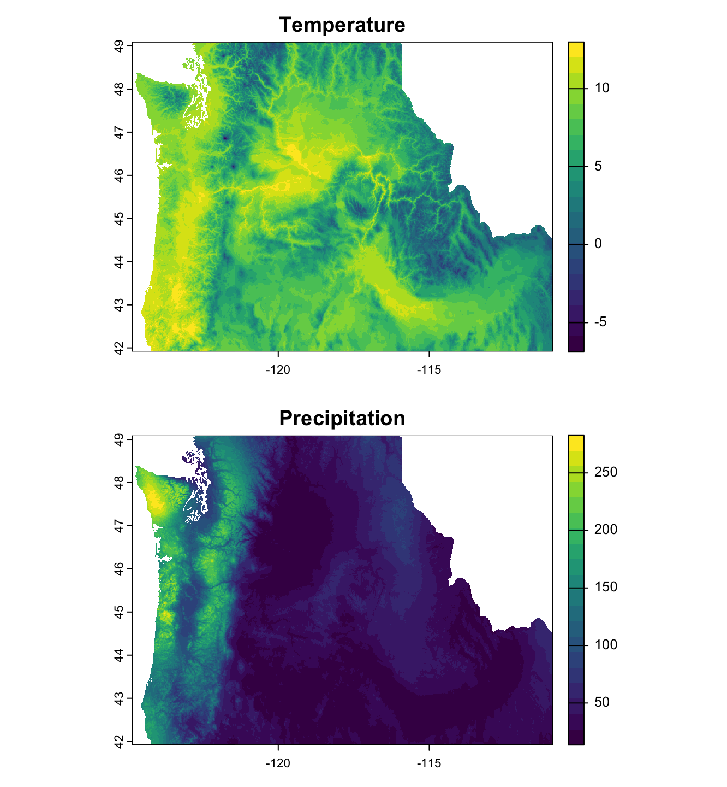
Temperature & Precipitation
Source: WorldClim Version 2
Original Data: Temperature and Precipitation averaged monthly from 1970 – 2000
Additional Transformations: Averaged again to get average annual temperature and precipitation
R Package: geodata

Slide 4
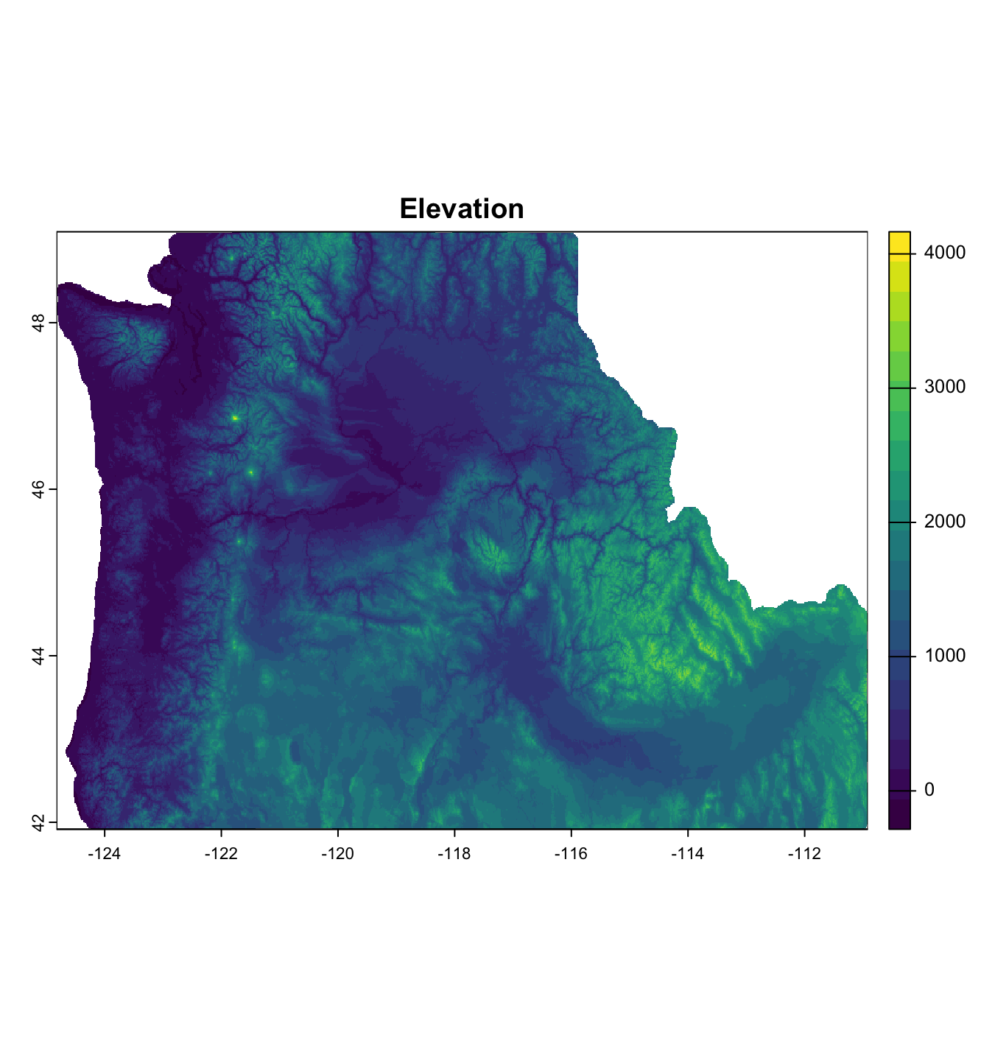
Elevation
Source: USGS
Original Data: Temperature and Precipitation averaged monthly from 1970 – 2000
Additional Transformations: Averaged again to get average annual temperature and precipitation
R Package: geodata

Slide 5
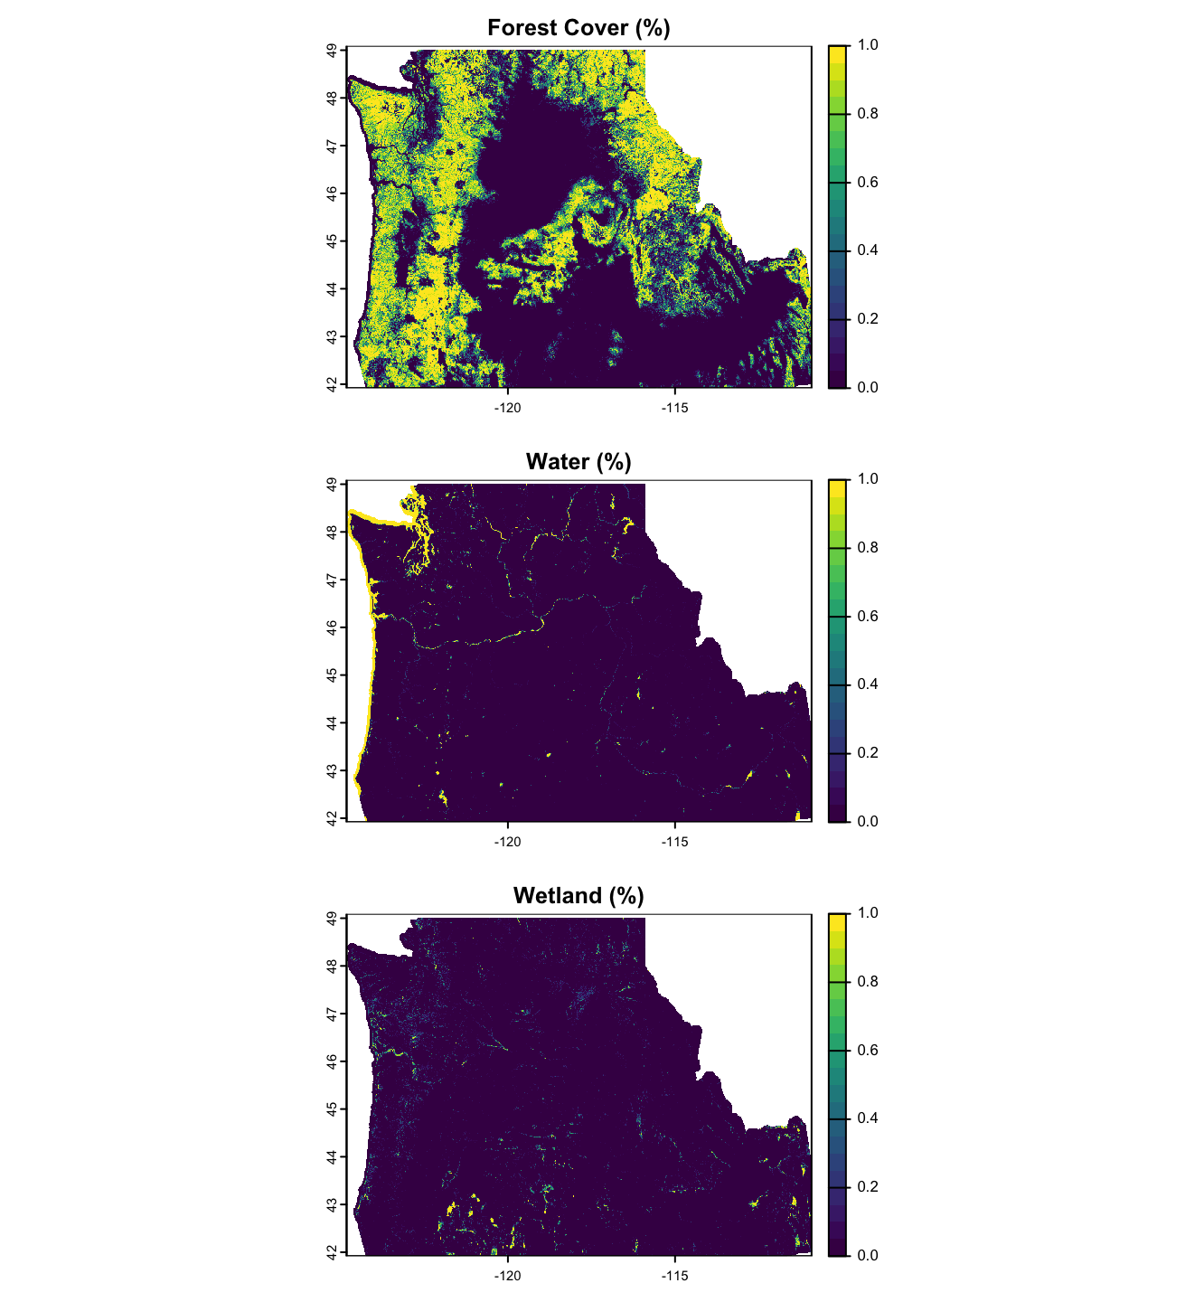
National Land Cover (NLCD)
Source: USGS
Original Data: Temperature and Precipitation averaged monthly from 1970 – 2000
Additional Transformations: Averaged again to get average annual temperature and precipitation
R Package: geodata

Slide 6
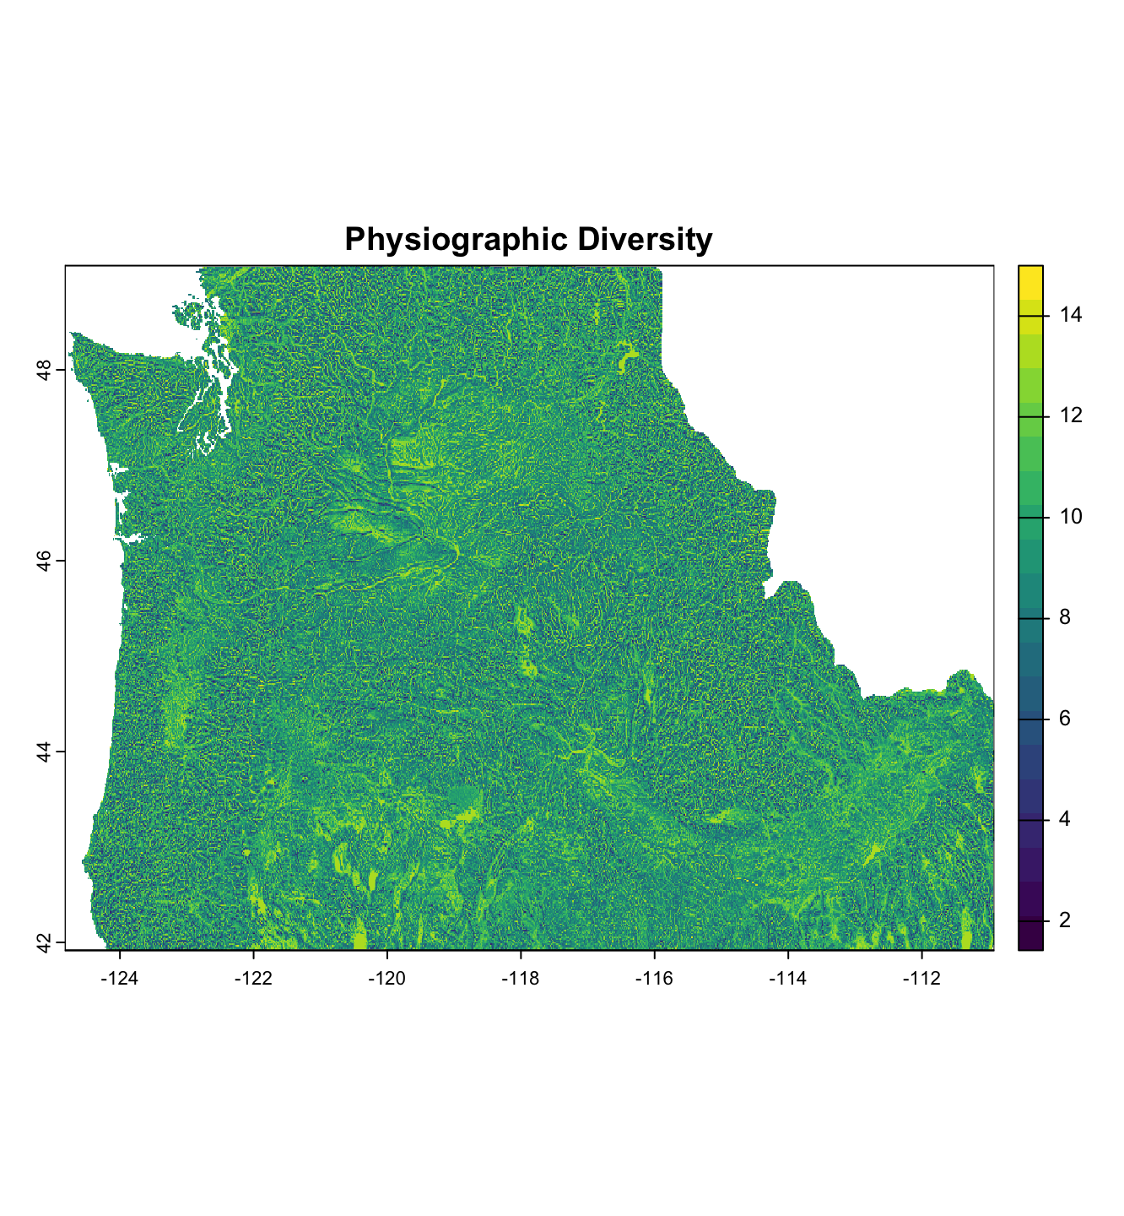
Physiographic Diversity
Source: USGS
Original Data: Temperature and Precipitation averaged monthly from 1970 – 2000
Additional Transformations: Averaged again to get average annual temperature and precipitation
R Package: geodata

Slide 7
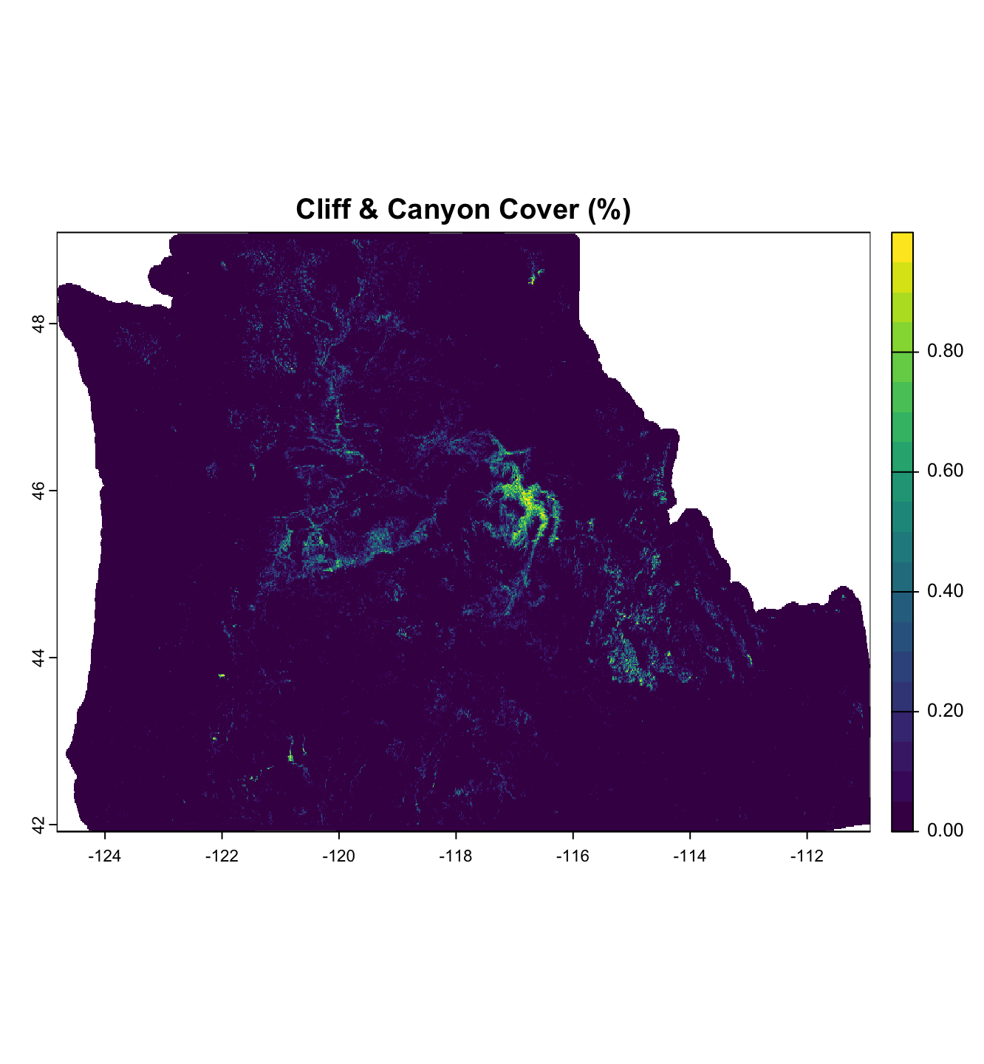
Landfire
Source: USGS
Original Data: Temperature and Precipitation averaged monthly from 1970 – 2000
Additional Transformations: Averaged again to get average annual temperature and precipitation
R Package: geodata

Slide 8
Data Acquisition and Preparation
Species Occurrence Records

Slide 9
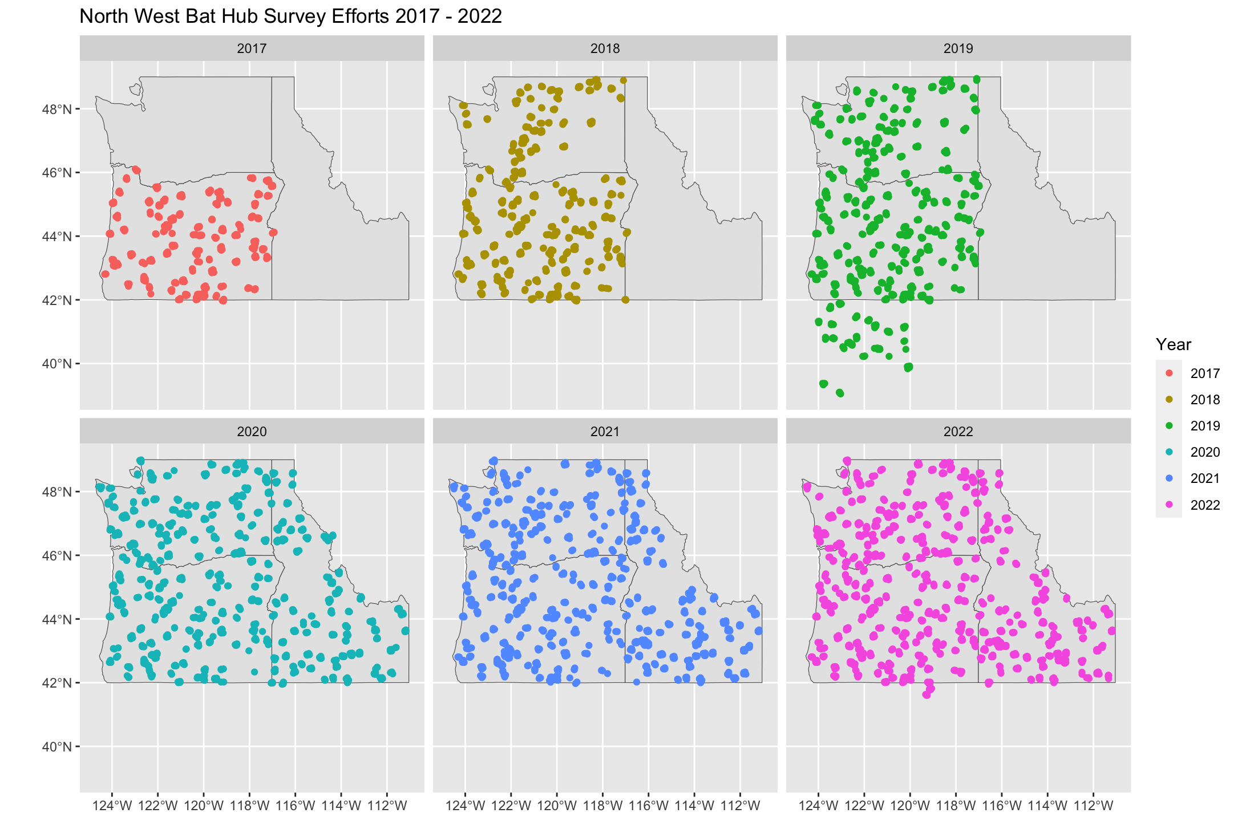
Species Occurrence
Source: PNW_BatHub_Database.accdb
Step 1: Any species with > 0 calls in one recording night is an occurance
Step 2: Within 1 year, if a species occurs at one site at one night, it is an occurance
R Package: geodata

