Slide 1
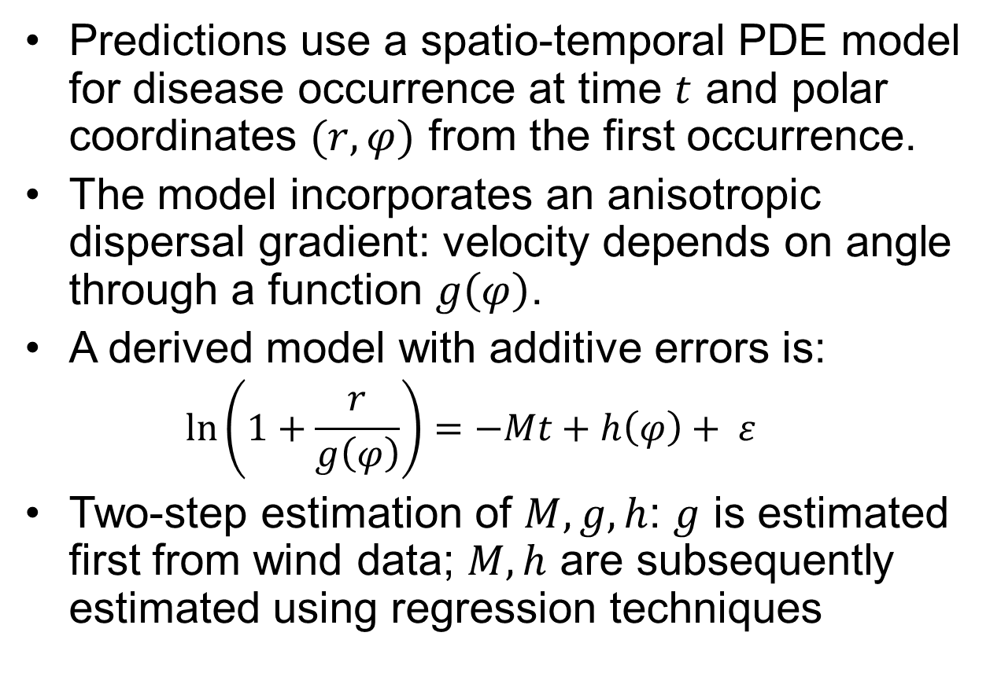
Predicting epidemic front
Predictions use a spatio-temporal PDE model for disease occurrence at time $t$ and polar coordinates $(r, φ)$ from the first occurrence.
The model incorporates an anisotropic dispersal gradient: velocity depends on angle through a function $g\left(φ\right)$.
A derived model with additive errors is:
$$\ln\left(1+\frac{r}{g\left(φ\right)}\right)=−Mt+h\left(φ\right)+ ε$$
Two-step estimation of $M, g, h$: $g$ is estimated first from wind data; $M, h$ are subsequently estimated using regression techniques
Notes:
h(\phi) is the integration constant; in the PDE formulation, derivative of disease level wrt r depends on angle, but derivative wrt t does not, and no model is explicitly formed for derivative wrt \phi;

Slide 2
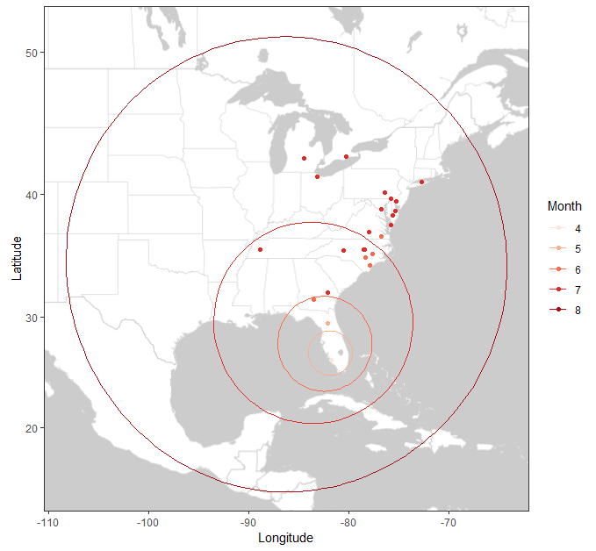
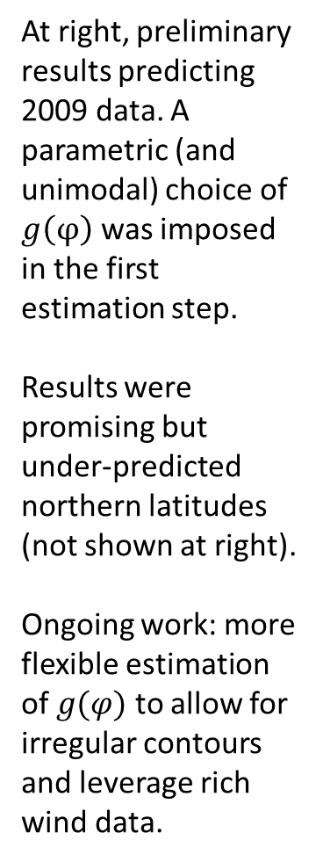
Predicting epidemic front
At right, preliminary results predicting 2009 data. A parametric (and unimodal) choice of $g\left(φ\right)$ was imposed in the first estimation step.
Results were promising but under-predicted northern latitudes (not shown at right).
Ongoing work: more flexible estimation of $g(φ)$ to allow for irregular contours and leverage rich wind data.
Notes:
Points are observed occurrences in 2009, colored according to month; circles are predicted distances from the source each month from April through August

Slide 3



Acknowledgements
Supervisors
Dr. Alun Lloyd
Dr. Peter Ojiambo
Dr. Ross Meentemeyer
Dr. Kevin Gross
Colleagues
Katie Neufeld
Biomathematics
Dr. Ojiambo lab
NSF grant
Collaborators
Dr. David Gent
Dr. Sharmodeep Bhattacharyya
Trevor Dean Ruiz

