Slide 1
Understand haxejs-angular app
How to write app in OOP(Haxe) and Dependency Injection Way(Angular)?

Slide 2
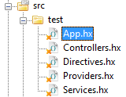
Package to be angularjs module name
1) They all belong to “test” module
2) Module dependencies will be managed automatically

Slide 3
Group components into different classes(files) by type
Total 11 types of components:
Controller
Directive
Service
Config
Run
Constant
Value
Filter
Provider
Animation
Factory

Slide 4

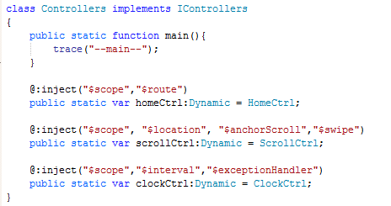
Each type class(file) should
1) Implement an interface, like IControllers
2) Has a public static main function
3) Remember to import ng.Angular even your code does not use any of it

Slide 5
Every component should use
@:inject meta to inject dependencies (it can be empty)
Static Dynamic variable name to be the name of your component
$scope component is of NgScope type ($->Ng)

Slide 6
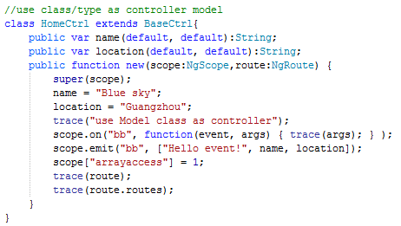
Component can be a class
Like service, controller, provider

Slide 7
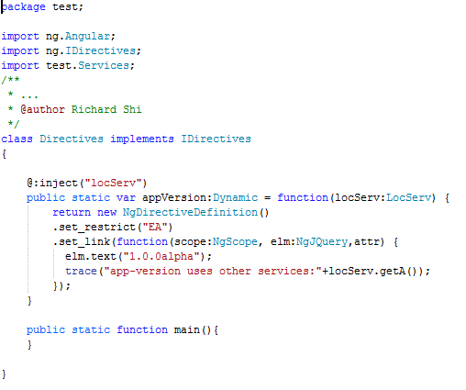
Component can be a function
Like config, run, directive

Slide 8

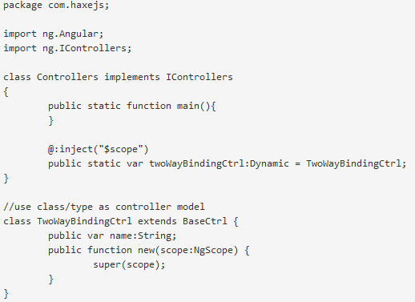
Controller component should extend BaseCtrl class
Call super() in new function
Camel class name to be the object name inside html code

Slide 9
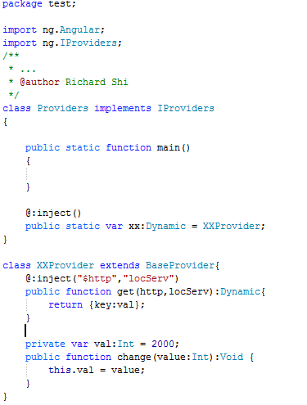
Provider component should extend BaseProvider with get function
Invoke service by “xx” name to access what get function returns
Config service by “xxProvider” name to call setting functions like “change”

