Slide 1
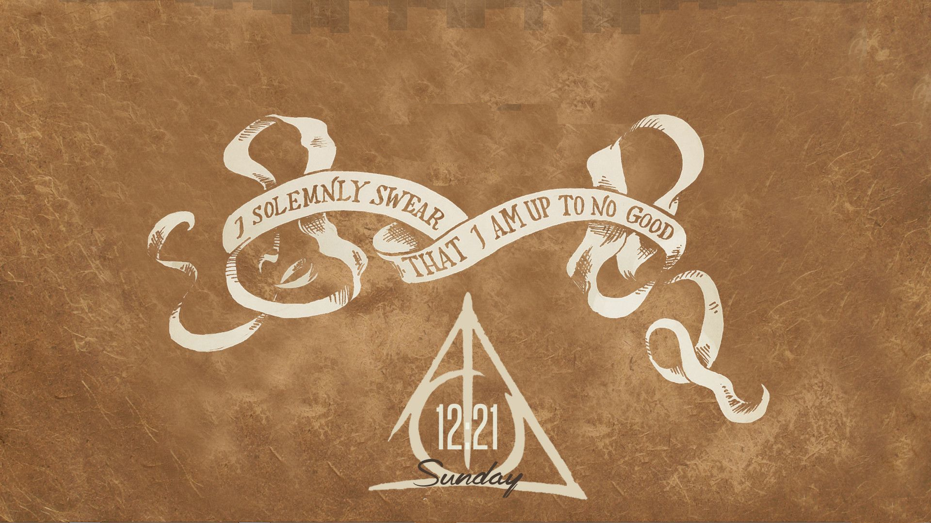

Slide 2
The
Marauders’
Chess
By the Marauders :
Athava Shrawge
Rahul Aggarwal

Slide 3
Object of the Game
The Marauders’ Chess is a strategic game in which two opponents play against each other using their 4 characters.
The objective is to kill the opponent's king. To this end, a player's pieces are used to attack and capture the opponent's pieces, while supporting each other.
In addition to that, the players can earn points by killing the other pieces of opponents.

Slide 4
Setup at the Start
All the players are trapped in dungeons(main board), which consists of 6 square rooms. Each square room is a 5x5 maze with some walls blocking the movement of pieces through them.
Each player begins the game with 6 pieces: one king, one rook, two knights and two bishops.
The White player starts from the left side and The black player from the right.

Slide 5
Movements of the pieces
All the pieces have traditional chess moves.
As the pieces are trapped in a maze, the giant walls block the direct movement of King, Rook, Bishop through them.
However, a Knight can jump over “one wall” in a move.

Slide 6
Mazes in Motion!
Thanks to the creators of the Marauders’ maze! Each room is equipped with a complex wheels and gears mechanism allowing it to rotate.
The rooms can be rotated clockwise 90º( for white) or anti-clockwise(for black). The Rotation Gear which triggers this movement is represented by a colored button.
Escaping the mazes is made easy with this rotation of the rooms.

Slide 7
During the game, each player must try to kill the pieces of the opponent.
To initiate a move, select the piece and then select the destination cell. The piece can be moved only if it is its valid movement and no other piece or wall is blocking its way.
To Rotate a Room, just click on the respective Rotate gear button on the screen.
Each player is given 20min, and if player's time is exausted , the payer looses

Slide 8
How does it End?
You may leave the dungeon in different scenarios :
The opponent is defeated if his King is killed => The game ends and you escape the Labyrinth.this is intense game and not like chess, so it doesn't have check , checkmate and stalemate, you have to kill the king to win
A player runs out of his time => His forces are down and the other player can escape the Labyrinth without any fear.
if any player gives up, and resigns.
Each of the player gets points according to his performance in the game.
But!!! Do not rest here…..
There are many more deepest Dungeons you need to escape by defeating your enemy forces.

Slide 9
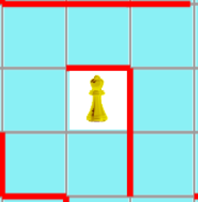
Special Rules
RESTRICTION IN ROATING ROOMS:
The rooms can be rotated only clockwise 90º .
If any room is rotated, each players can't rotated any room till 1 move .
MOVEMENT OF THE BISHOP:
The bishop cannot cross a cornered wall as shown in move A.
The bishop can however cross a single wall from the edge as shown in move B , but not move C.
B
A
C

Slide 10
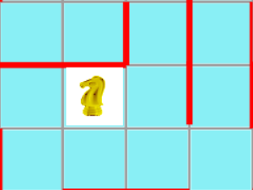
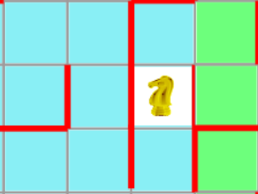
MOVEMENT OF THE KNIGHT:
The knight move must be first 2 forward moves and then 1 side move only but not 1 forward and 2 sideways as in move C.
During this movement if it comes across only one wall as in move A, it is a valid move.
If the it comes across more than 1 wall as in move B, it is invalid.
A
B
C
MOVEMENT OF THE ROOK:
It can't jump wall ahead of it.
MOVEMENT OF THE KING:
When king moves straight, it follows rules of rook
And when king moves diagonally, it follows rules of Bishop

Slide 11
POINTS
The player gets points for each kill he makes. The value of each piece is as follows:
Knight - 50 points
Rook - 35 points
Bishop - 35 points
and extra points which are
[( minutes drained of oponent)*10]
if you win ,50 pts

Slide 12
End of the Event
In order to escape from Marauders Game, you need to escape the dungeons defeating your enemies who will be decided by the Marauders(The Creators)
The scores in each game are tracked by the Marauders.

