Slide 1
MLPC_2025_Task4_Chanllenge
Team Laborer
Ali Doğukan Seven, Karel Štícha, Yisong Tang, Dmitrii Troitskii

Slide 2
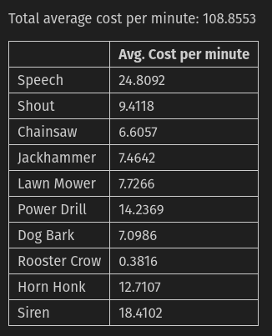
Evaluation Setup
• Stratified, file-level split: 70 % train / 15 % val / 15 % test: more date on training (Reduced base cost by 4%)
• Split by filename to avoid any temporal or label leakage
• Official metric = total cost per minute (segment level) — outweighs plain accuracy
• Naive majority-class baseline: 101.09 cost/min; top costly classes = Speech, Siren, Power Drill, Dog Bark (show table)

Slide 3
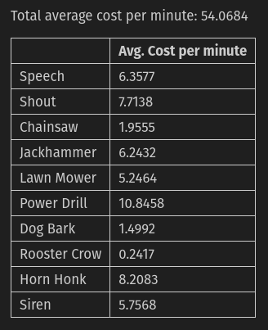
Build a Simple SED system
• 120 ms frame embeddings → group 10 frames (1.2 s) and take the max probability
• Start with global threshold 0.5; later replace with per-class values
• No smoothing / median filtering applied
• Logistic-regression baseline (C = 1): 54.07 cost/min — already far below naive baseline

Slide 4
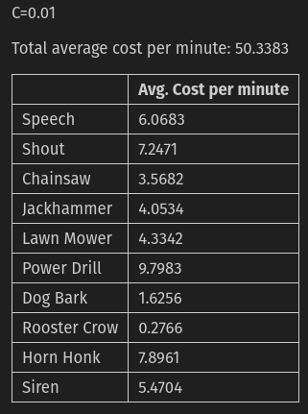
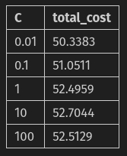
Improvement Strategy #1 Hyper-parameter Tuning (Grid Search on C)
• Hypothesis: smaller C (stronger regularisation) curbs over-fitting
• Searched C ∈ {0.01, 0.1, 1, 10, 100}
• Best C = 0.01 → 50.34 cost/min (-6.8 % vs 54.07)

Slide 5
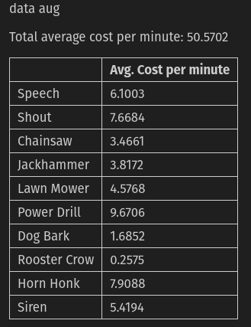
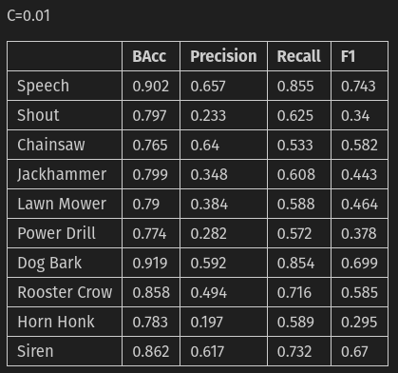
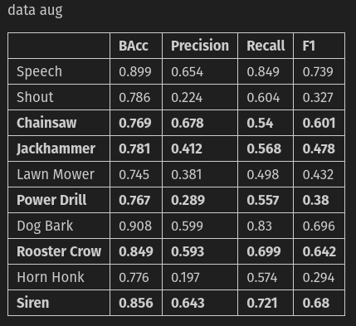
Improvement Strategy #2 Gaussian-Noise Data Augmentation
• Add Gaussian noise σ = 0.02 to each frame; triple the training samples
• Retrained under best-C = 0.01 setting
• Result: 50.57 cost/min — slight increase, no benefit
• For some classes the F1 score increases (highlighted)

Slide 6
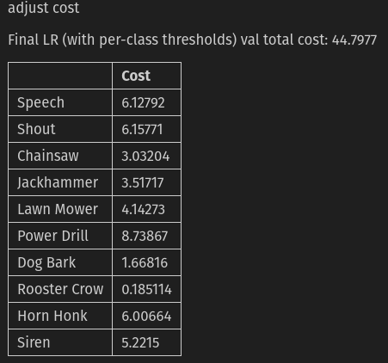
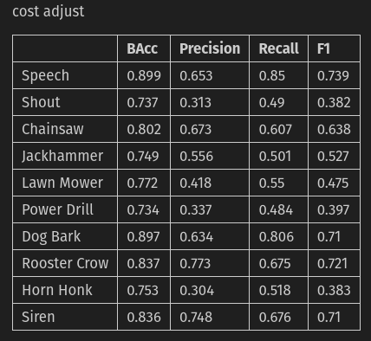
Improvement Strategy #3 Per-Class Threshold Tuning
• Grid-search thresholds 0.10 – 0.90 (step 0.05) per class
• Chosen thresholds minimise validation cost per label
• Total cost drops to 44.80 cost/min (-17.2 % vs baseline)

Slide 7
Real-World Application Thinking
• Deployed model achieves 44.80 cost/min vs 54.07 baseline
• Use adaptive thresholds to cope with changing acoustics
• Design for incremental learning: plug-in new classes without full retrain; schedule periodic updates
• Cost-centred optimisation already realises >17 % operational savings

Slide 8
Team Laborer
Thank You

