Slide 1
MLPC_2025_Task3_Experiments
Team Laborer
Ali Doğukan Seven, Karel Štícha, Yisong Tang, Dmitrii Troitskii

Slide 2
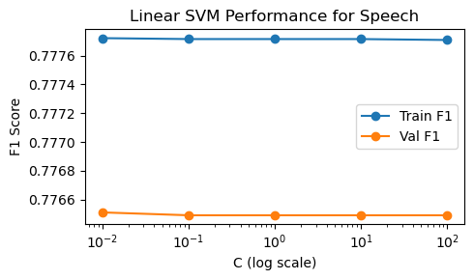
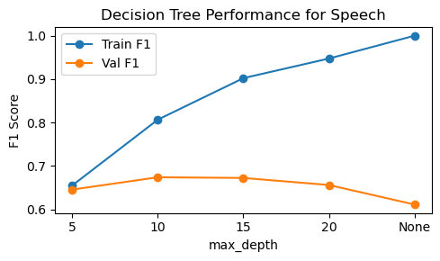
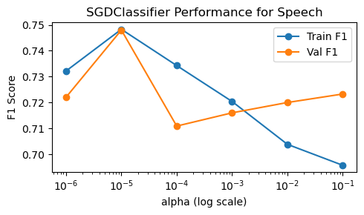
Model selection – Train 6 features on “speech” class
Linear SVM
Hyperparameter: do not have much impact on performance, we select C=1
Performance: F1 remain almost constant (Train ≈ 0.7787, Val ≈ 0.7747)
Over- vs. Under-fitting: over-fitting maybe
Training time: all around 45s
Decision Tree
Hyperparameter: Best max_depth=10
Performance: best F1 ≈ 0.674 (Train ≈ 0.807)
Over- vs. Under-fitting: when Depth > 10: over-fitting. When Depth <10: under-fitting
Training time: increase from 223s to 2279s as the max_depth increase
Logistic Regression (SGD)
Hyperparameter: Best α=1e-5
Performance: Train F1 ≈ 0.7483 and Val F1 ≈ 0.7480
Over- vs. Under-fitting: α >1e-5: under-fitting; α <1e-5: over-fitting.
Training time：α=1e-4, almost 30 times to α=1e-5. (22.8s)
α=1e-2,α=1e-1. training time ok.

Slide 3
Comparison of the Three Classifiers
Model | Best Hyperparameter | Validation F1 | Training Speed
Linear SVM | C=1 | 0.775 | ~44 second per class
Logistic Regression(SGD) | α = 1e⁻⁵ | 0.748 | 5-90 seconds per class
Decision Tree | max_depth = 10 | 0.674 | 438 seconds per class
Linear SVM achieves the highest Macro-F1 on the validation set with no over-fitting, making it the best choice.
SGDClassifier is a close second, with very fast training—good for situations requiring frequent retraining.
Decision Tree performs worst, is slow to train, and is sensitive to depth (easily under- or over-fits).

Slide 4
Final Model Performance
Using the selected Linear SVM (C=1) trained on all 58 classes with the six features (mfcc, embeddings, contrast, flatness, bandwidth, melspectrogram), we evaluated on the held-out test set:
Overall Macro-F1: 0.5381
Per-class metrics: Precision, Recall, and F1 for each of the 58 classes were computed (see previous table).
This final Macro-F1 reflects the average performance across all classes, balancing the model’s ability to detect both frequent and rare sound events.

Slide 5
Team Laborer
Thank You

