Slide 1
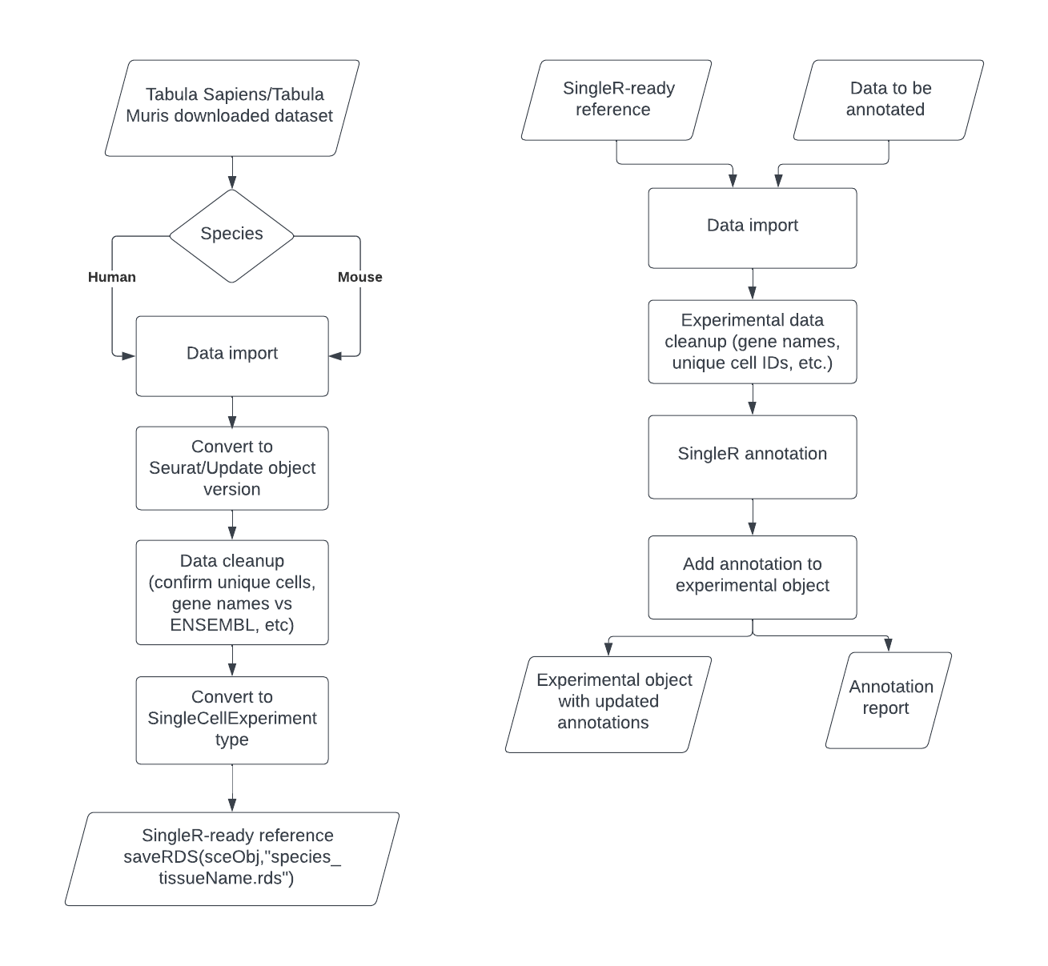
Potential arguments:
Species (sanity check, data compatibility check): Check for GAPDH (human) or Gapdh (mouse)
TS/TM reference file(s)/tissue type(s)
Internal (scRNAseq package) or external experimental data
Metadata column label
Output in HTML

