Slide 1
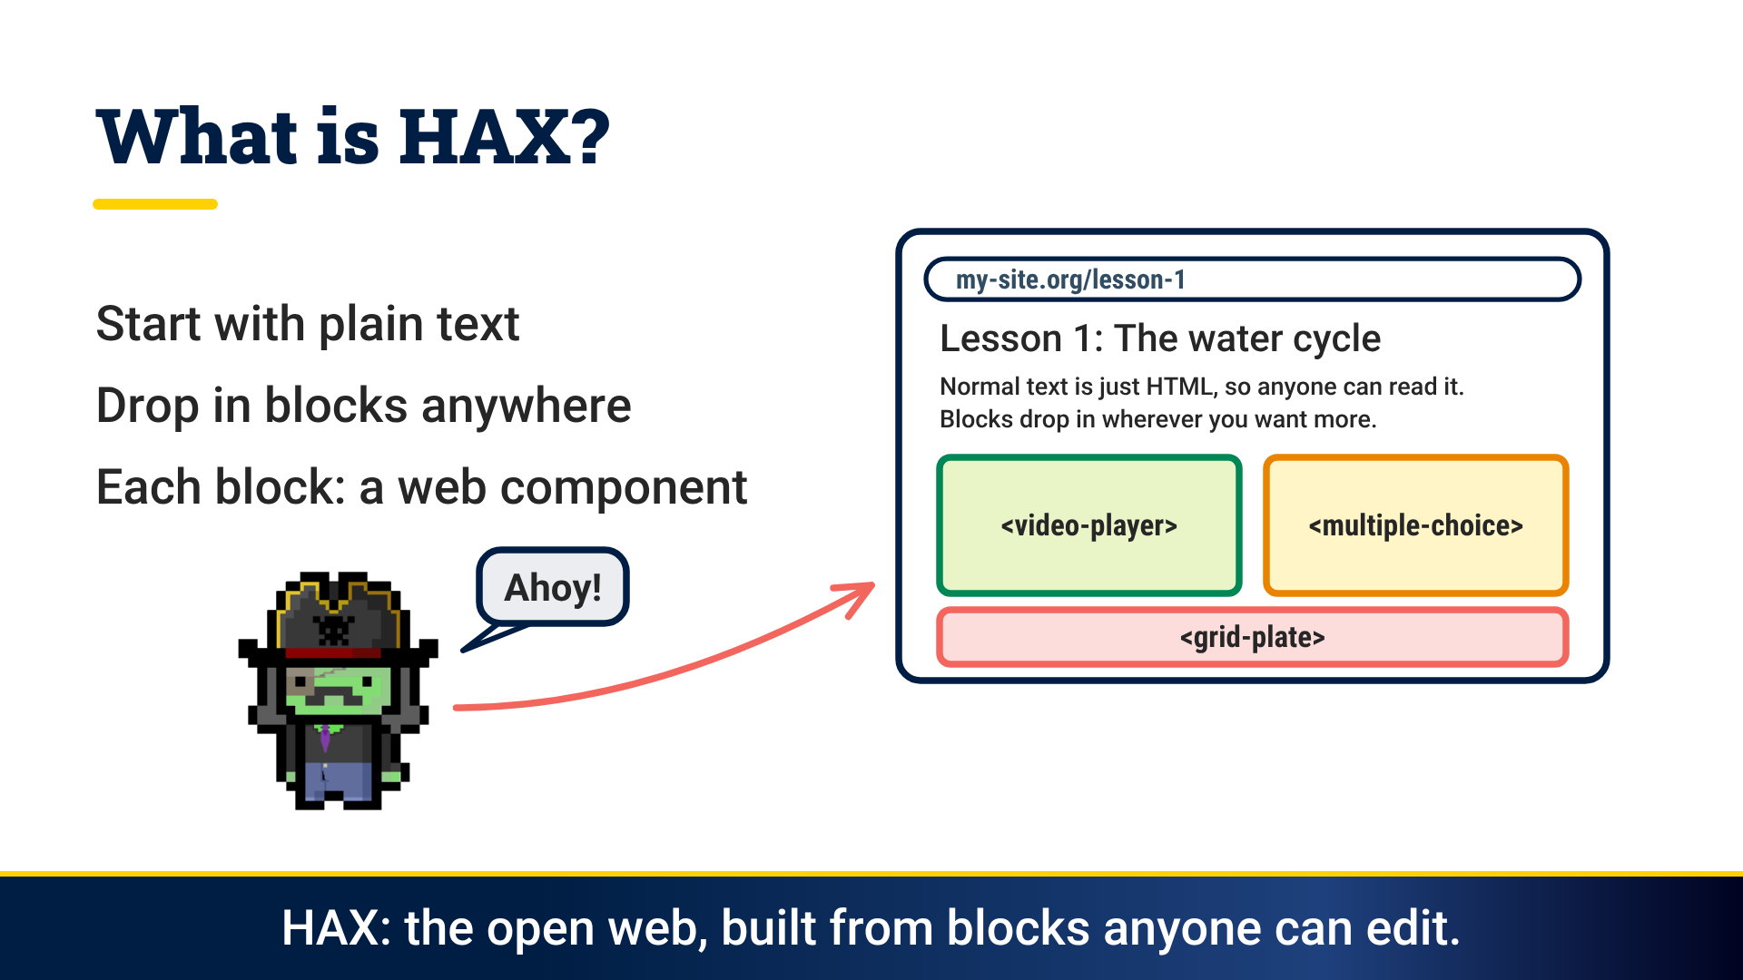
Notes:
Play the video (about a minute). The following slides are the end frame of each scene, for talking through at your own pace.
HAX is the open web, built from plain text and blocks that anyone can edit. Each block is a web component.
Same blocks, same editor, which reads each component's schema. Run it as a single site, multisite or multi-tenant, or publish plain static files.
The magic script loads each element once. Later pages only fetch what is new, so every follow-up request is faster.
Seven community pillars hold it up for students, designers, educators, developers and AI agents: accessible, extensible, free and open, efficient, platform agnostic, remixable and sustainable.
So what will you launch? A docs site, a portfolio, a website, a blog, a course. Everyone gets a rocket, and our pillars are your engines of change!

Slide 2
Notes:
HAX is the open web, built from plain text and blocks that anyone can edit. Each block is a web component.

Slide 3
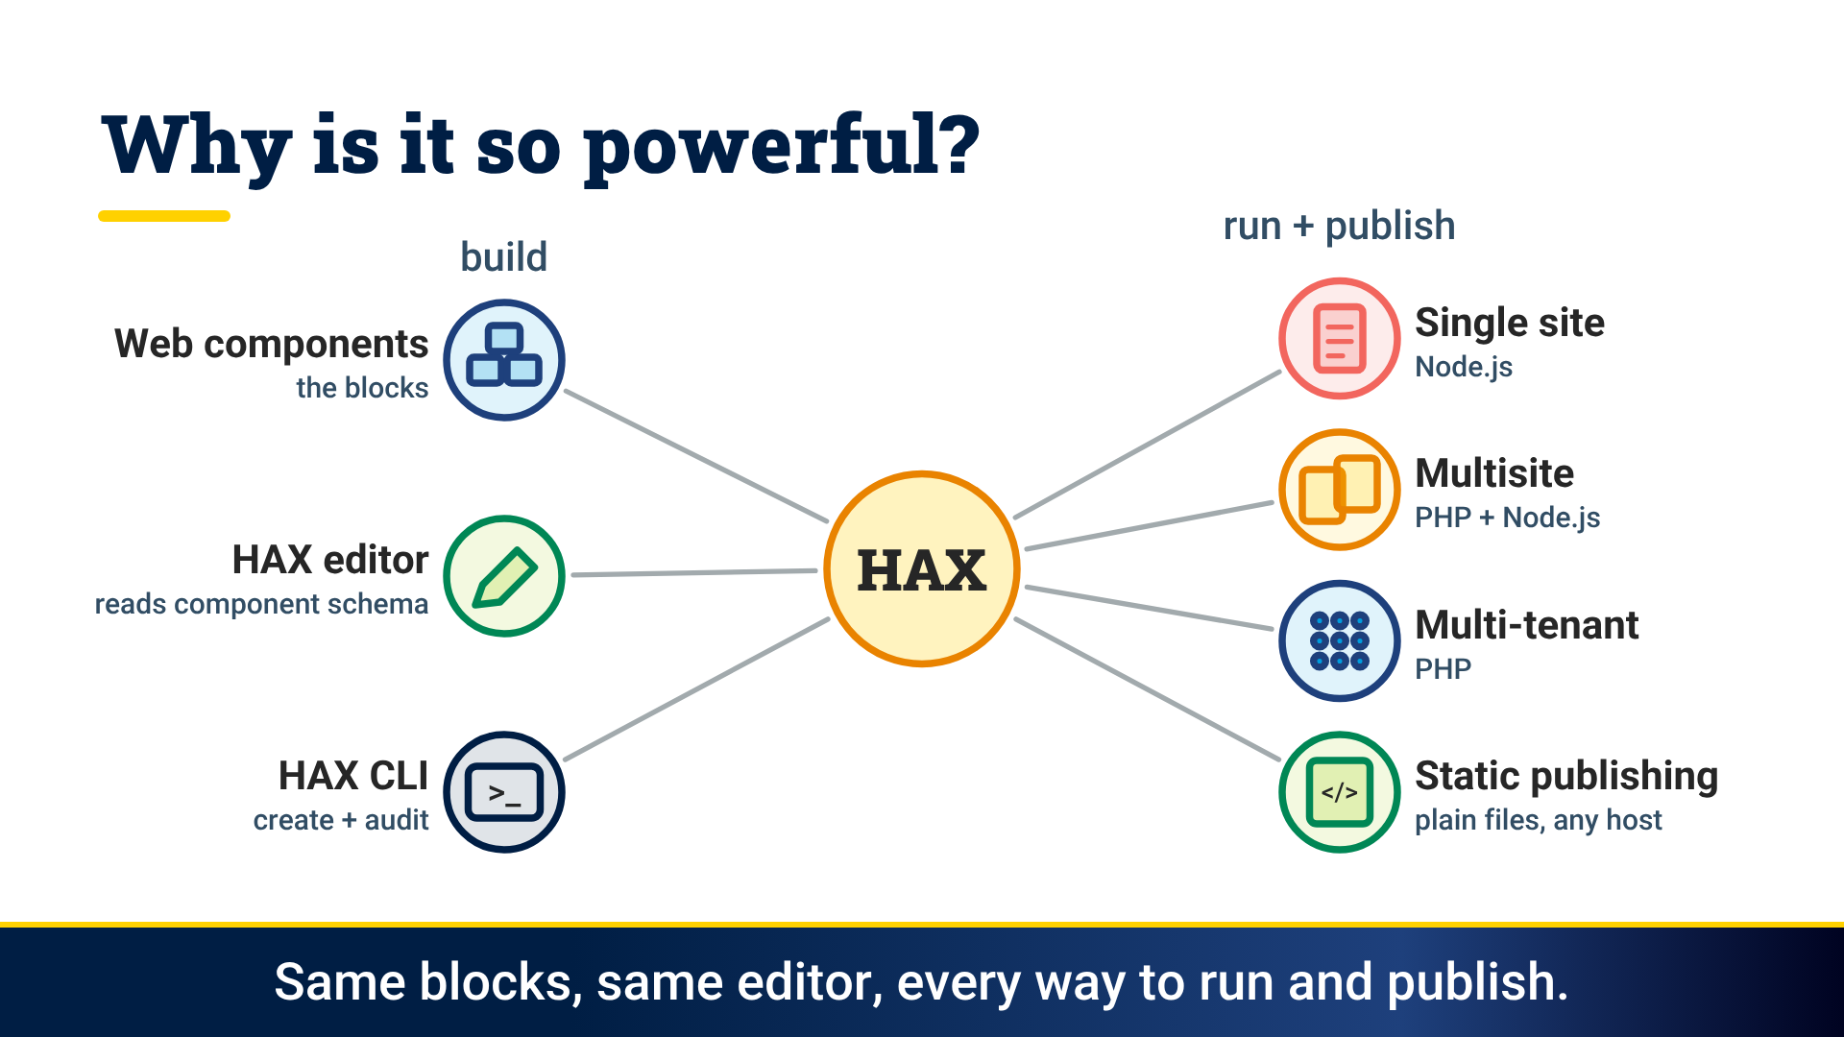
Notes:
Same blocks, same editor, which reads each component's schema. Run it as a single site, multisite or multi-tenant, or publish plain static files.

Slide 4
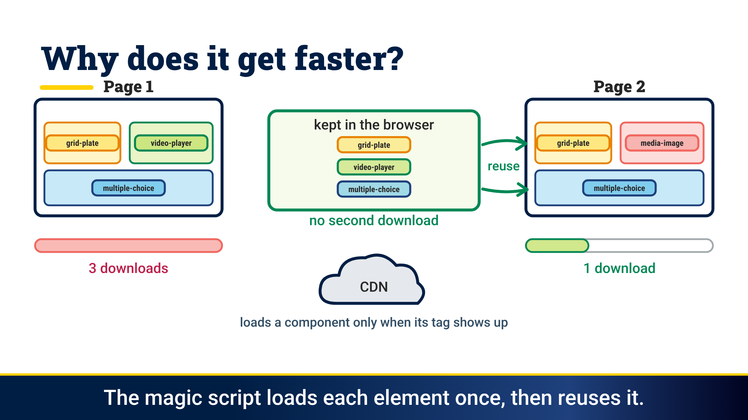
Notes:
The magic script loads each element once. Later pages only fetch what is new, so every follow-up request is faster.

Slide 5
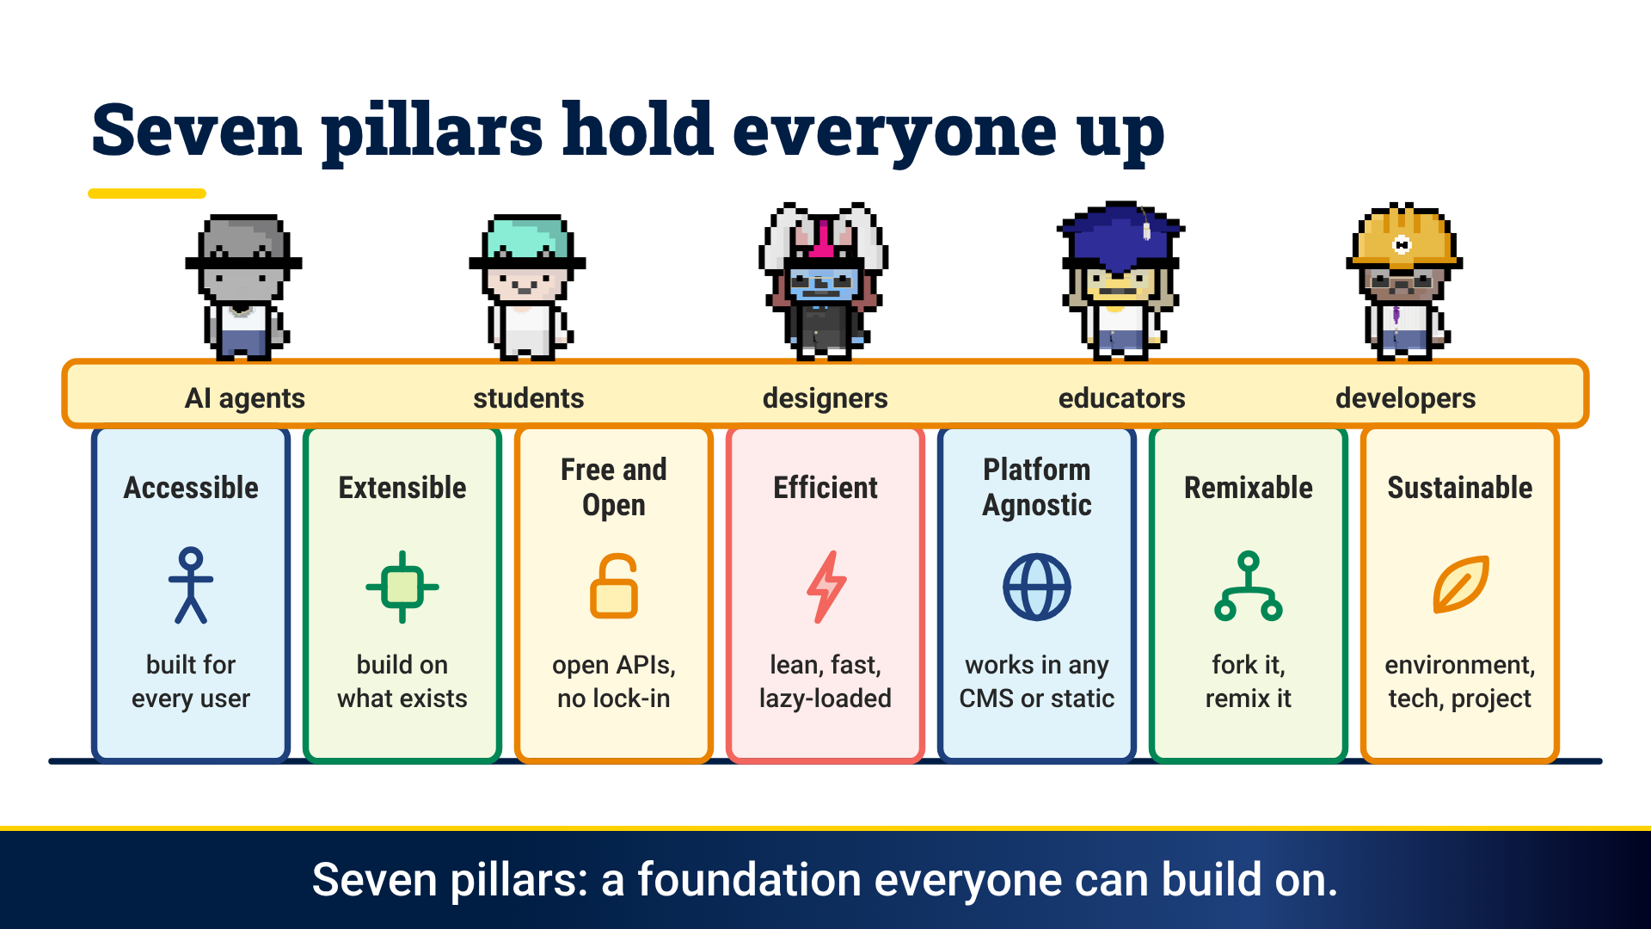
Notes:
Seven community pillars hold it up for students, designers, educators, developers and AI agents: accessible, extensible, free and open, efficient, platform agnostic, remixable and sustainable.

Slide 6

Notes:
So what will you launch? A docs site, a portfolio, a website, a blog, a course. Everyone gets a rocket, and our pillars are your engines of change!

