Slide 1
Do VLMs Have Human-Like Vision, or Just Pattern Matching?
Motivation • Background • Hypothesis
THE COGNITIVE PHENOMENON
• Human object recognition involves two dissociable processing stages (Riddoch & Humphreys, 1987):
◦ Apperceptive stage — the brain performs global form completion, assembling a coherent percept from raw visual input before any meaning is accessed
◦ Associative stage — the completed percept is matched to stored semantic knowledge to yield recognition
• These stages can break independently (visual agnosia). Apperceptive patients cannot form percepts from degraded input; associative patients form percepts but cannot access meaning.
• Mooney (two-tone) images isolate the apperceptive stage — objects are invisible until the visual system commits to a global form hypothesis. Language cannot help before the percept forms.
• Degraded line drawings allow bottom-up feature matching without requiring global completion — the apperceptive stage is partially bypassed.
WHY TEST THIS ON VLMs?
• Marjieh et al. (2023): adding visual input to GPT-4 does not improve perceptual similarity judgments — suggesting VLM vision may not add genuine perceptual grounding beyond language.
• If VLMs process vision through language-mediated feature matching (skipping the apperceptive stage), Mooney images should specifically expose that gap.
• This tests Marjieh's null result at the algorithmic level (Marr Level 2) — asking which processing stage breaks, not just measuring representational geometry.
HYPOTHESIS
VLMs will show higher accuracy on degraded line drawings than on Mooney images, reflecting a selective deficit at the apperceptive (global form completion) stage. If confirmed: VLM vision is texture/feature-based rather than genuinely perceptual — a behavioral-level mechanism for Marjieh et al.'s finding that visual input does not add perceptual structure beyond what language already encodes.
Haya Bugshan • Mohammad Essa • CPSY 1950: Deep Learning in Brains, Minds & Machines • Brown University • Spring 2026

Slide 2
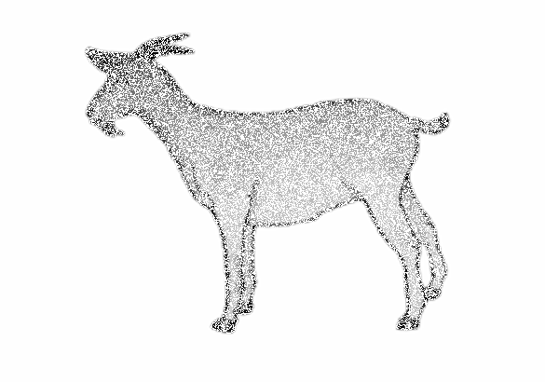
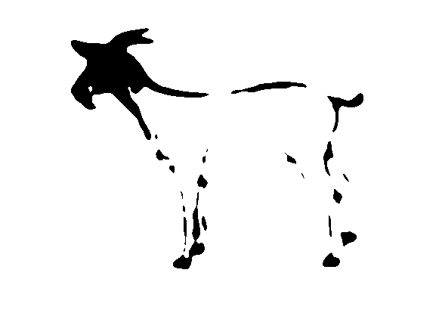
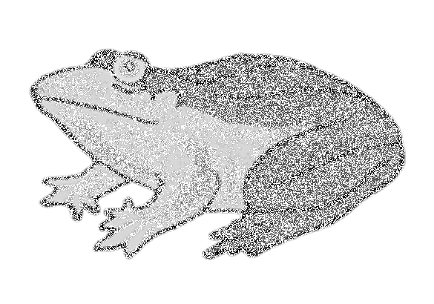
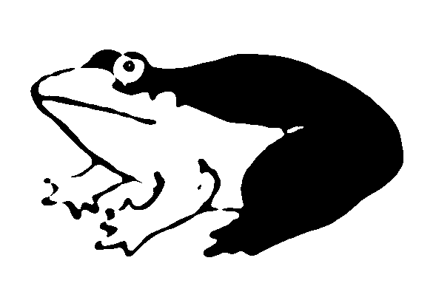
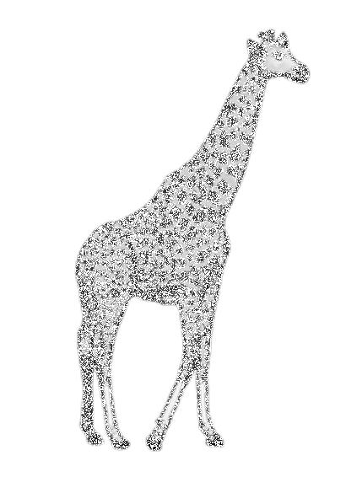
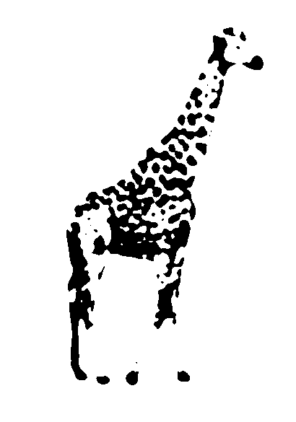
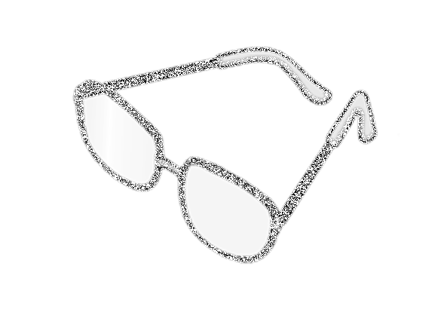
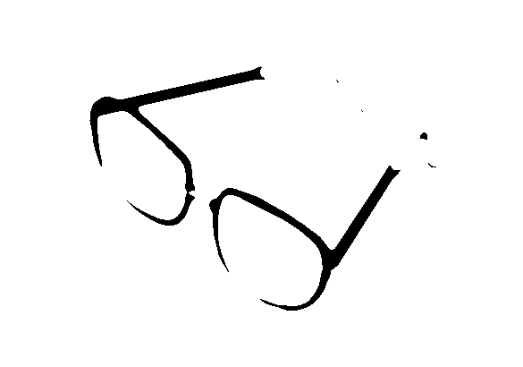
Methods
Task design • Stimuli • Models • Prompting • Confound control
STIMULI (161 matched pairs)
• Base set: Snodgrass & Vanderwart (1980) standardized line drawings — 161 common objects (Rossion & Pourtois, 2004 version)
• Degraded condition: 50% of dark line pixels randomly removed (NumPy random seed = 42). Partial features preserved; bottom-up matching possible.
• Mooney condition: Gaussian blur (σ = 3) applied, then binary threshold at pixel value 128 → pure black/white blobs. No legible edges or parts; global form completion required.
• Each object appears in both conditions — perfectly matched pairs eliminate object-level confounds.
STIMULUS EXAMPLES (degraded left, mooney right per pair)
goat
frog
giraffe
glasses
MODELS & PROMPTING
• Models: gemini-3-flash-preview (open-weight, current results); claude-sonnet-4-5 & gemini-2.5-pro (frontier, pending after April 5)
• System prompt: "Respond with only the name of the object you see — a single word or short noun phrase. Do not describe the image."
• User prompt: "What object is in this image?" — identical across all conditions and models (no chain-of-thought, reasoning_effort=None)
• Scoring: correct if true object label appears as a case-insensitive substring of the model response
CONFOUND CONTROL
• Same 161 objects in both conditions — eliminates object-level confounds between Mooney and degraded
• Identical prompt wording and structure across all models — eliminates autoregressive framing artifacts
• Fixed random seed (42) for pixel removal — degradation is reproducible across runs
• No chain-of-thought used — consistent prompting strategy prevents CoT-related distribution shift
• Limitation acknowledged: human baseline from Snodgrass & Corwin (1988) uses a different fragmentation paradigm — not directly comparable; treated as approximate
Haya Bugshan • Mohammad Essa • CPSY 1950: Deep Learning in Brains, Minds & Machines • Brown University • Spring 2026

Slide 3
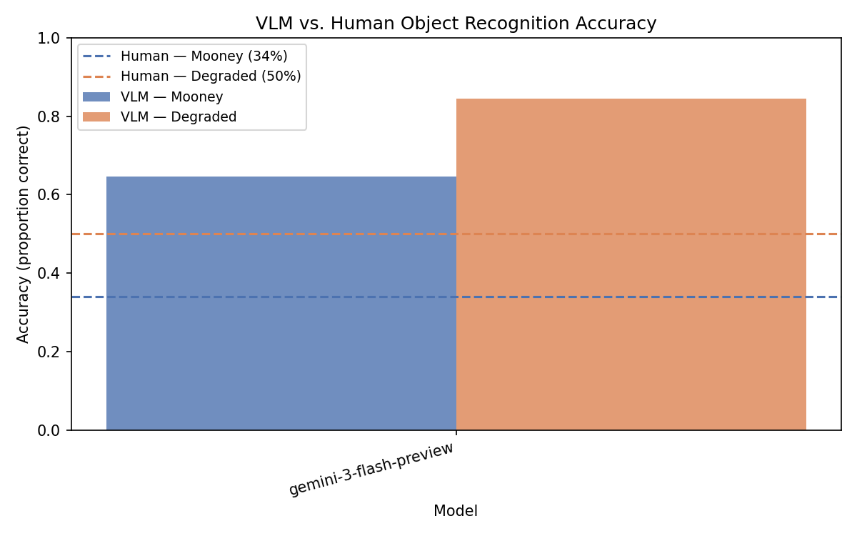
Results
gemini-3-flash-preview • 161 objects • Mooney vs. Degraded
ACCURACY BY CONDITION — VLM vs. Human Benchmark
Figure 1. Proportion correct for gemini-3-flash-preview on Mooney (blue) vs. degraded (orange) conditions. Dashed lines = approximate human benchmarks from Snodgrass & Corwin (1988): ~34% Mooney, ~50% degraded. Human baselines reflect a different fragmentation paradigm — treat as approximate.
KEY FINDINGS
• gemini-3-flash-preview: 65% correct on Mooney images, 85% correct on degraded drawings
• Expected dissociation present: degraded > Mooney — same direction as humans
• 20 pt VLM gap (degraded vs. Mooney) mirrors ~16 pt human dissociation — same processing bottleneck
• VLM Mooney accuracy exceeds human benchmark (~34%) — likely because line-drawing Mooneys are less ambiguous than photograph-based stimuli; see limitations
SUMMARY TABLE
Condition
VLM Accuracy
Human Baseline
Direction
Degraded drawings
85%
~35–63%
VLM > Human
Mooney images
65%
~34%
VLM > Human
Dissociation Δ
20 pts
~16 pts
Same direction ✓
Haya Bugshan • Mohammad Essa • CPSY 1950: Deep Learning in Brains, Minds & Machines • Brown University • Spring 2026

Slide 4
Open Questions & Conclusions
Interpretation • Marr's Levels • Limitations • Next Steps
WHAT THE RESULTS TELL US
• Dissociation (degraded > Mooney) is present in the predicted direction — consistent with VLMs finding global form completion harder than feature-based matching
• VLM vision appears predominantly texture/feature-based: succeeds when parts are physically present, struggles when global synthesis is required first
• Directionally consistent with Marjieh et al. — if VLMs skip the apperceptive stage, Mooney images should specifically expose that gap, and they do
CONNECTION TO COURSE THEMES (MARR'S LEVELS)
Level 1 Computational
Level 2 ★ Algorithmic
Level 3 Implementation
What is vision for? Object recognition from images.
Which stage fails? Apperceptive vs. associative. ← THIS PAPER
Neural responses in IT / V4 cortex. (Brain-Score, Yamins)
LIMITATIONS
• Mooney stimuli from line drawings, not photographs — reduces blob ambiguity; likely underestimates task difficulty for outline-based objects (glasses, tools)
• Human baseline (Snodgrass & Corwin, 1988) uses a different fragmentation paradigm — approximate, not directly comparable
• Only one model tested so far; frontier model comparison (claude-sonnet-4-5, gemini-2.5-pro) pending
• Substring scoring may overcount correct responses for verbose or hedging outputs
NEXT STEPS
• Add frontier models (claude-sonnet-4-5, gemini-2.5-pro) for model-to-model comparison
• Replace line-drawing Mooneys with MoonBase photograph-based stimuli (Tuerlinckx et al.) for a stronger manipulation
• Post-disambiguation condition: show model the original image first, then the Mooney — does recognition recover? (Mirrors Hegdé et al., 2007)
• Analyze token logprobs: is model uncertainty higher on Mooney than degraded?
CONCLUSIONS
Haya Bugshan • Mohammad Essa • CPSY 1950: Deep Learning in Brains, Minds & Machines • Brown University • Spring 2026
gemini-3-flash-preview shows the predicted dissociation: degraded > Mooney. This is consistent with VLMs lacking genuine apperceptive completion — the pre-linguistic form assembly step that must precede semantic access in human vision. Our results provide a behavioral-level account of Marjieh et al.'s null result: if the apperceptive stage is absent, more visual input simply adds more of the same shallow features language already encodes.

