Slide 1
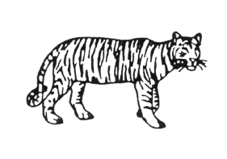
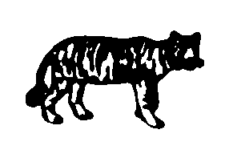
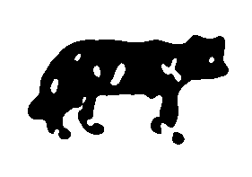
Do VLMs Use Feedforward or Feedback Visual Processing?
Hayabusa Bugshan · CPSY 1950 · Brown University · Spring 2026
Hypothesis
VLMs will perform well on degraded line drawings (local features survive) but fail on Mooney images (global completion required) — mirroring their feedforward-only architecture.
The Phenomenon
Why Test VLMs?
Humans use top-down feedback: when local
features are sparse, the brain predicts and
completes global form from stored models.
Mooney images (pure B/W blobs) require
gestalt completion — humans fail at first,
then suddenly 'see' it. Once seen, cannot
be un-seen.
VLMs process images in a single feedforward
pass — no iterative top-down feedback
during inference.
If recognition requires top-down completion,
VLMs should fail on Mooneys even when
they succeed on degraded drawings of the
same objects.
Course Connection — Marr's Levels of Analysis
Computational level: Same goal — identify the object.
Algorithmic level: Humans use hierarchical inference with top-down feedback.
VLMs use feedforward feature matching in one forward pass.
Consistent with Marjieh et al. (2024): visual input adds no perceptual structure
beyond what language priors already capture.
Original
Mooney (σ=2.0)
Hard Mooney (σ=4.0)
Tiger: Original → Standard Mooney (both wrong: 'wolf'/'pig') → Hard Mooney (both wrong: 'cow'/'cow')
1 / 4

Slide 2
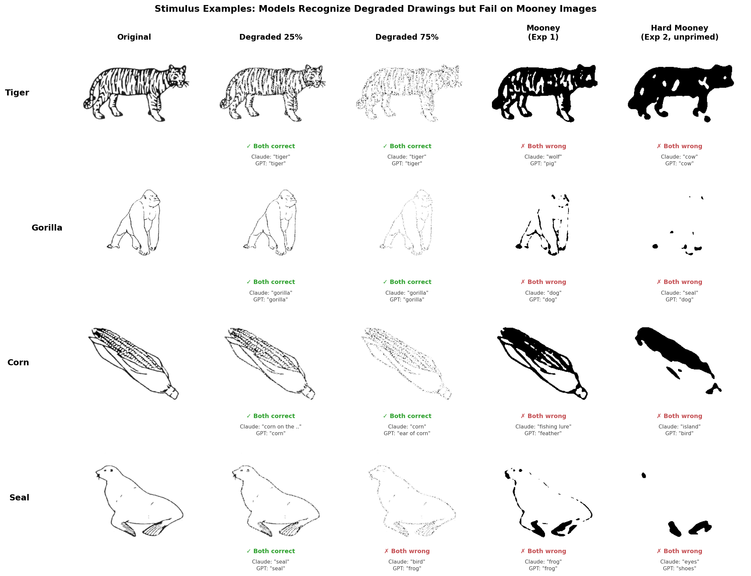
Methods
Figure 0. Stimulus examples. Green = both models correct. Red = both models wrong.
Design
Stimuli: 260 Snodgrass & Vanderwart (1980) canonical B&W line drawings
Models: claude-sonnet-4-5 (Anthropic) · gpt-5.4 (OpenAI) via Brown CCV LiteLLM
Trials: 4,160 total · Checkpointed after every trial
Exp 1 — 6 conditions: Degraded 25/50/75/90% · Standard Mooney (σ=2.0) · Inverted Mooney
Exp 2 — 2 conditions: Hard Mooney unprimed (σ=4.0) · Hard Mooney primed (degraded_25 first)
Prompt: "Respond with only the name of the object — a single word or short noun phrase."
Scoring: Exact match + synonym dictionary (12 entries) + hallucination guard (>8 words → wrong)
Confound Controls
Contamination: Inverted Mooney (B/W flipped) — small drop rules out training data memorization
Language priors: Identical prompt across all conditions and both models
Reproducibility: Fixed random seed (42) · Full code on GitHub
Human baselines: Snodgrass & Corwin (1988) · Moore & Cavanagh (1998)
2 / 4

Slide 3
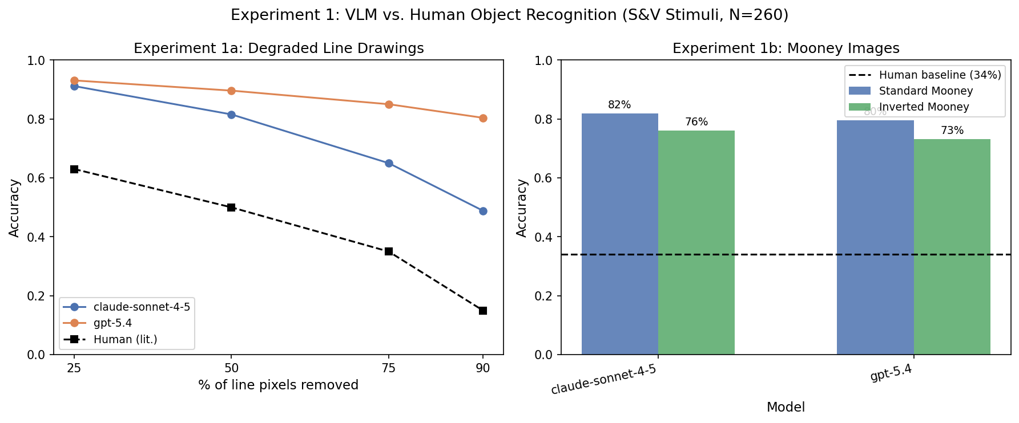
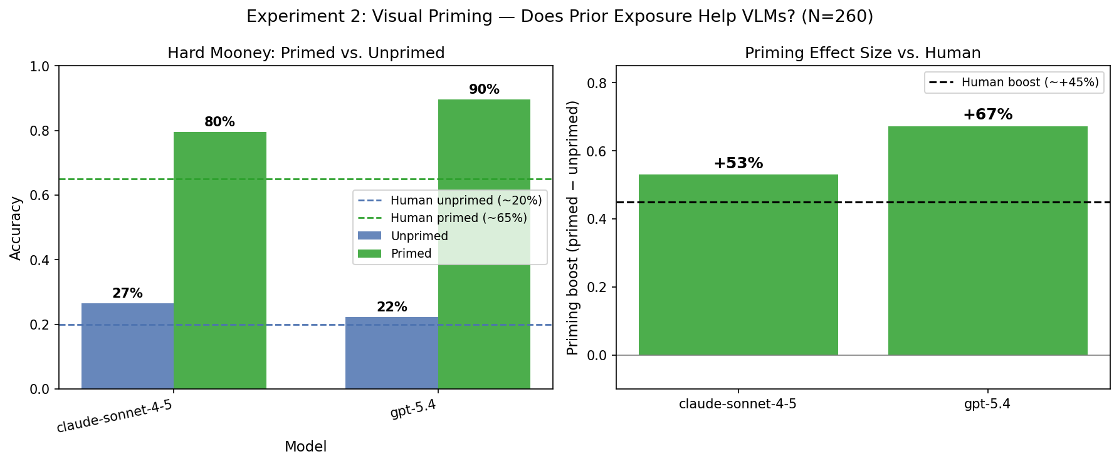
Results
Exp 1 Mooney: Claude 82% · GPT 80% · Human 34% | Exp 2 Unprimed: Claude 27% · GPT 22% · Human ~20% | Priming boost: Claude +53% · GPT +67% · Human ~+45%
Figure 1. Experiment 1: Accuracy across all conditions vs. human baselines (Snodgrass & Corwin, 1988).
Figure 2. Experiment 2: Primed vs. unprimed hard Mooney and priming boost vs. human expectation (Moore & Cavanagh, 1998).
3 / 4

Slide 4
Open Questions & Conclusions
Finding 1 — Feedforward shortcut
VLMs exceed humans on degraded drawings at every level. At 90% degradation, GPT scores 80% vs. ~15% human. Feedforward feature matching does not require global form completion.
Finding 2 — Mooney difficulty is stimulus-dependent
Standard Mooney: ~80% vs. 34% human — S&V silhouettes survive thresholding. Hard Mooney (σ=4.0) drops unprimed to human levels: 27% (Claude) / 22% (GPT).
Finding 3 — Priming ≠ perceptual memory
Both models show +53–67% priming boost — larger than humans' ~+45%. But both images are in one forward pass: in-context co-matching, not top-down perceptual memory.
Marr's Levels — Prediction vs. Understanding
Same computational goal. Different algorithm. Aggregate accuracy can look identical while
mechanisms are fundamentally different.
Consistent with Marjieh et al. (2024): VLMs predict labels without perceptual understanding.
Limitations
What We'd Do Next
· Priming within one API call — not true memory
· S&V silhouettes reduce Mooney difficulty
· Human baselines: different degradation method
· Separate-call priming (true memory test)
· Face Mooneys (non-diagnostic silhouettes)
· Explain Claude vs. GPT gap at 90% degradation
4 / 4

Slide 5
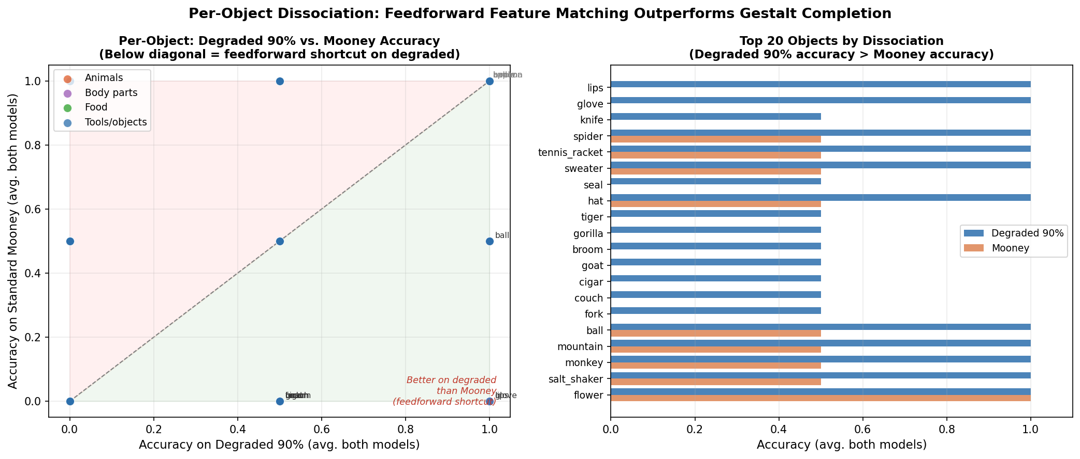
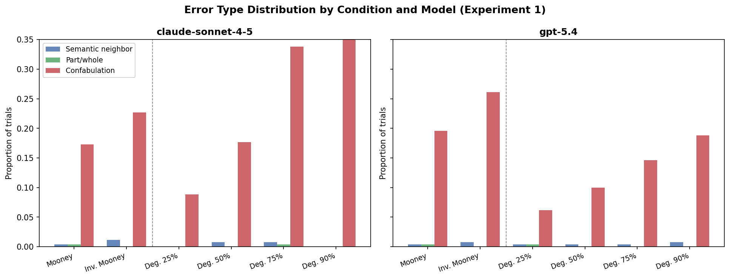
Appendix — Supplementary Analysis
Figure 4. Per-object dissociation: degraded 90% vs. Mooney accuracy (N=260, avg. both models).
Figure 3. Error type distribution. Confabulation dominates — unrelated objects, not semantic neighbors.
Appendix

Slide 6
Speaker Script — Slide 1: Motivation
~45 seconds · Use as a guide — do not read verbatim
We're testing whether VLMs process images the way humans do — specifically whether they use top-down feedback or pure feedforward feature matching.
The Mooney image is our key tool. Humans can't identify it at first — until the visual system completes the global form. VLMs don't have that feedback loop.
Hypothesis: VLMs will do fine on degraded drawings where local features survive, but fail on Mooneys where global completion is required.
This connects to Marr's levels — same computational goal, potentially very different algorithm.
⚡ Point at the tiger: 'Both models got this wrong — one said wolf, one said pig.'

Slide 7
Speaker Script — Slide 2: Methods
~45 seconds · Use as a guide — do not read verbatim
260 Snodgrass and Vanderwart line drawings — the canonical stimulus set from the human agnosia literature, enabling direct comparison to published norms.
Experiment 1: six conditions — four degradation levels, standard Mooney, inverted Mooney as contamination control.
Experiment 2: harder Mooneys with stronger blur, tested with and without a priming image first.
Both models got identical prompts — controls for language priors. 4,160 total trials, saved after every one.
⚡ Emphasize: identical prompt for all conditions is the key confound control.

Slide 8
Speaker Script — Slide 3: Results
~45 seconds · Use as a guide — do not read verbatim
First — both models beat humans on degraded drawings at every level. Consistent with feedforward feature matching.
Second — standard Mooney ~80% vs. 34% human. S&V silhouettes survive thresholding. No global completion needed for banana, tiger, airplane.
Third — harder blur drops unprimed to human levels: 27% and 22%. Priming jumps accuracy over 80% — bigger boost than humans get.
⚡ Point at Fig 1 first, then Fig 2. Stress: unprimed drops to human level = shortcut eliminated.

Slide 9
Speaker Script — Slide 4: Conclusions
~45 seconds · Use as a guide — do not read verbatim
One: feedforward feature matching explains VLM performance — surviving pixels are enough, no global form needed.
Two: hard Mooneys fix the difficulty issue — unprimed drops to human levels. Standard Mooneys were too easy due to distinctive S&V silhouettes.
Three: the priming boost looks human-like but comes from a different mechanism — both images are in one forward pass, not separate viewings.
Marr's levels in action: same output, different algorithm. VLMs predict the label without building a perceptual representation.
⚡ Be ready for: 'Is priming really different from what humans do?'

Slide 10
Speaker Script — Slide Appendix
~45 seconds · Use as a guide — do not read verbatim
Only reference if asked during Q&A.
Figure 4: each dot is one of 260 objects. Points below the diagonal scored higher on degraded 90% than Mooney — the feedforward shortcut at item level.
Figure 3: nearly all errors are confabulation — completely unrelated objects, not semantic neighbors. Perceptual failure, not semantic retrieval failure.
⚡ Use if asked: 'Can you show individual objects?' or 'What kinds of errors?'

