Slide 1
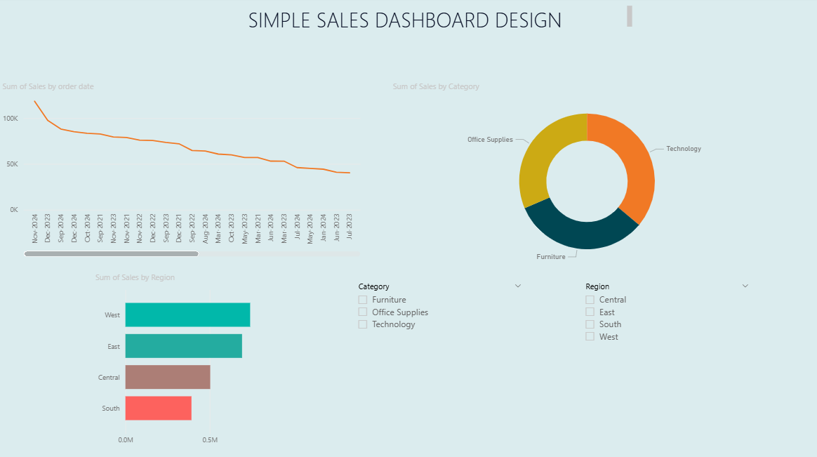
Simple Sales Performance Dashboard – Superstore Dataset
Insert Dashboard Screenshot Here
Key Insights:
1. The East region recorded the highest total sales
2. Technology emerged as the top-selling category.
3. November marked the peak sales month, indicating a holiday sales surge.
4. Sales across all categories showed a positive upward trend over the year.
Tool Used: Power BI | Dataset: online_retail.csv | Created by: Haya Hussain

